Slide 1
Question 223.20.7
I have two positive charges, they will
Attract each other
Repel each other
explode

Slide 2
Question 223.20.8
I have a positive and a negative charge they will
Attract each other
Repel each other
explode

Slide 3
Question 223.20.8.1
How many types of charge are there
1
2
3
4
5
6

Slide 4
Question 223.20.8.2
Some objects seem to be electrically neutral. How is this possible?
They are made of neutrons that don’t have electrical charge
They have the same number of positive charges and negative charges
They have had all the charge removed from them

Slide 5
Question 223.20.8.3
If we looked at the total amount of charge in the universe, how does it change over time?
We are slowly gaining more positive charge
We are slowly gaining more negative charge
The total amount of charge isn’t changing

Slide 6
Question 223.20.8.4
In physics, what word do we use to describe a quantity that doesn’t change?
Conserved
Equated
Equitated
Statified

Slide 8
Electrons
+
Electron
Nucleus with protons and neutrons
Particles not drawn to scale

Slide 9
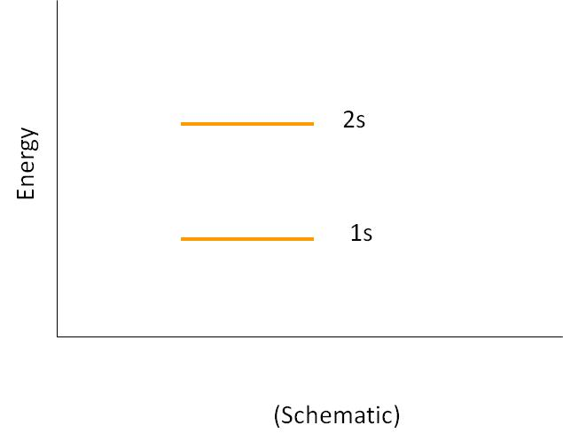
Energy Levels in Atoms
2s
Energy
1s
(Schematic)

Slide 10
Question
If I bring two atoms together and force them to get close, what happens to their electron energy levels?
They stay the same, why would they change?
The split so the 1s and 2s levels are different energies for the two atoms
The combine so the two atoms have half the electrons
They explode

Slide 11
Bringing Two Atoms Together
2s
Energy
1s
Distance, r
(Schematic)

Slide 12
Bringing 5 Atoms Together
2s
Energy
1s
Distance, r
(Schematic)

Slide 13
Many Atoms Together (A Solid)
2s
Energy
1s
Distance, r
(Schematic)

Slide 14
Many Atoms Together (A Solid)
2s
Energy
1s
r_{o}
Distance, r
(Schematic)

Slide 15
Question
What is an energy band?
Guns and Roses
It is a group of closely spaced allowed states for the electrons in a material to occupy.
It is the group of frequencies that make up a laser beam

Slide 16
Energy Bands, Detail
Sodium example
Blue represents energy bands occupied by the sodium electrons when the atoms are in their ground states
Gold represents energy bands that are empty
White represents energy gaps
Electrons can have any energy within the allowed bands
Electrons cannot have energies in the gaps
3p
3s
2p
2s
1s

Slide 17
Energy Level Definitions
The valence band is the highest filled band
The conduction band is the next higher empty band
The energy gap has an energy, E_{g}, equal to the difference in energy between the top of the valence band and the bottom of the conduction band

Slide 18
Question 223.20.11
What is a conductor
A person that tells you where to go on a train
Something that keeps you warm
Something that has fixed charge (charge that can’t move)
Something that has charge that is free to move from atom to atom within the whole sample.

Slide 19
Conductors
When a voltage is applied to a conductor, the electrons accelerate and gain energy
In quantum terms, electron energies increase if there are a high number of unoccupied energy levels for the electron to jump to
For example, it takes very little energy for electrons to jump from the partially filled to one of the nearby empty states

Slide 20
Question 223.20.10
What is an insulator
Something that absorbs sunlight
Something that keeps you warm
Something that has fixed charge (charge that can’t move)
An evil device invented by Dr. Doofenshmirtz.

Slide 21
Insulators
The valence band is completely full of electrons
A large band gap separates the valence and conduction bands
A large amount of energy is needed for an electron to be able to jump from the valence to the conduction band
The minimum required energy is E_{g}
Conduction Band
Energy Gap, E_{g}
Valance Band

Slide 22
Semiconductors
A semiconductor has a small energy gap
Thermally excited electrons have enough energy to cross the band gap
The resistivity of semiconductors decreases with increases in temperature
The white area in the valence band represents holes
Conduction Band
Energy Gap, E_{g}
Valance Band

Slide 23
Question 223.20.6
Which of the following can add or remove charge from an object
Frictional forces
Gravitational forces
Momentum transfer
ElecTrochargeTM Solution

Slide 24
Insulator Conductor

Slide 25
Question 223.20.12
Suppose you have a conductor in electrostatic equilibrium, but further suppose we add extra charge to this conductor. Where will the excess charge be?
Uniformly distributed throughout the conductor volume
Mostly near the center of the conductor volume
It depends on the conductor
On the conductor surface

Slide 26
-
-

Slide 27
Question 223.20.13
What does it mean to be grounded?
To have your arguments based on fact
To be less imaginative
To have your freedom restricted for a period of time
To be wired to the Earth

Slide 28
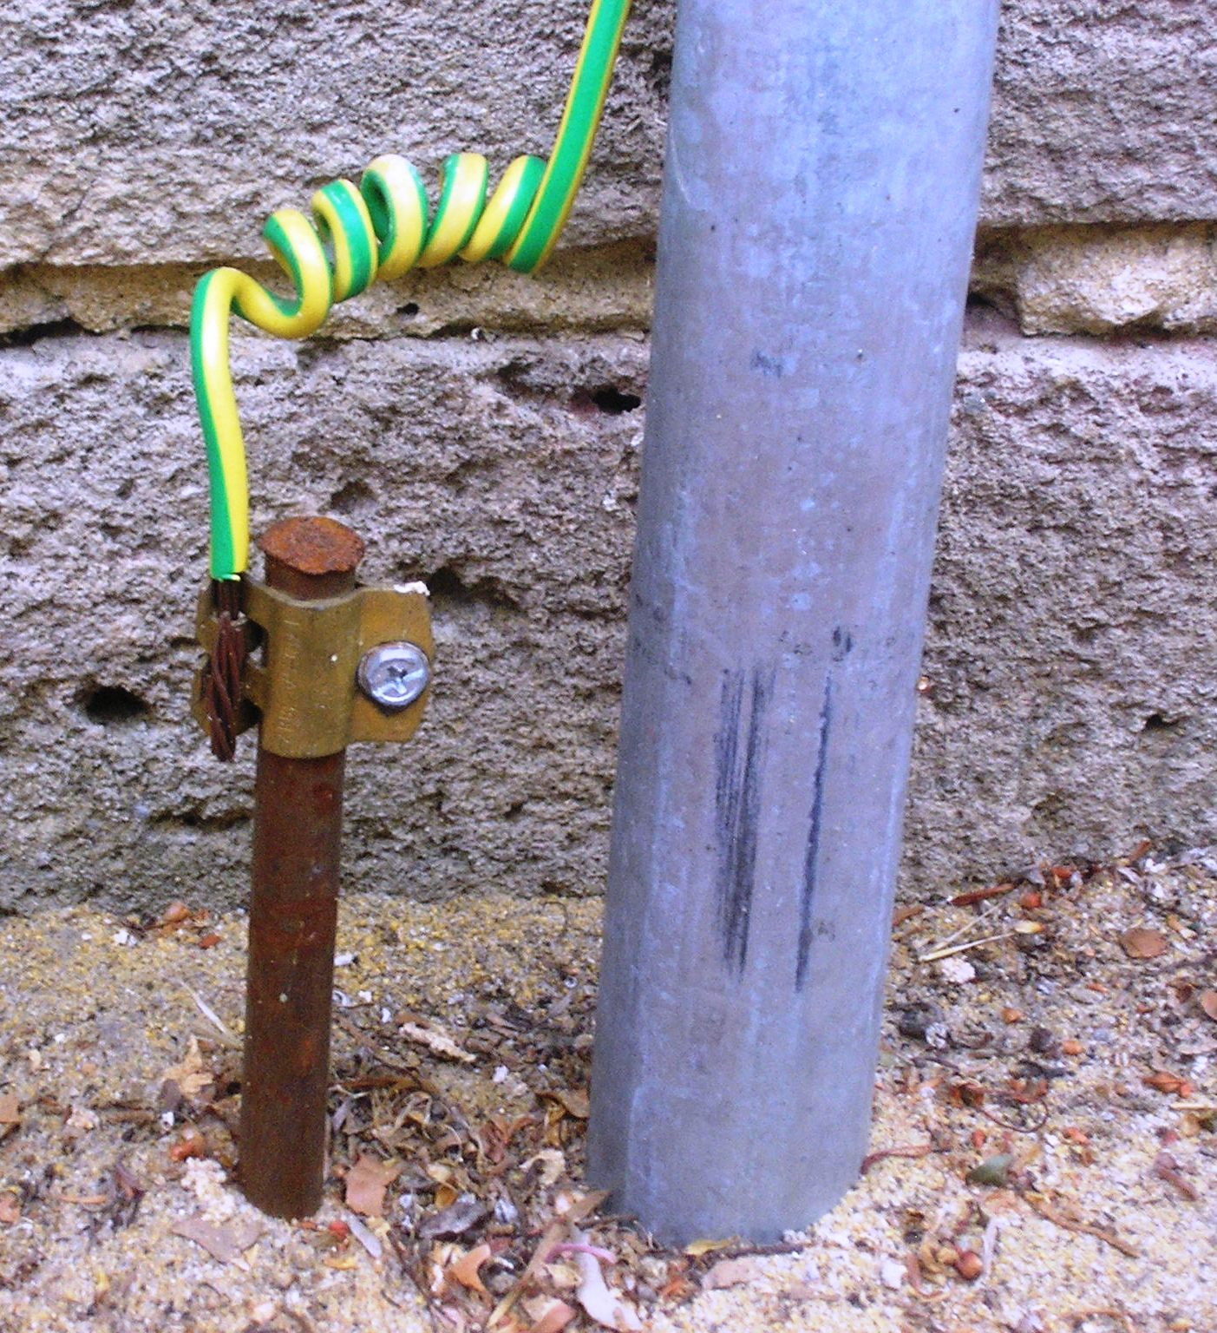
https://commons.wikimedia.org/wiki/File:HomeEarthRodAustralia1.jpg

Slide 29
TurboBlowTM
^{Blow Dryer}
The third wire in electrical devices is connect to the ground

Slide 30
Question 223.20.14
What is an electric dipole?
A charged conducting cylinder
Two charged conducting cylinders
Two dissimilar charges that are somehow bound together
A charged rod

Slide 31
+
-
+
-
-
-
-
-
-
+
-
-
-
-
-
-
-
-
-
+
-
-
-
-
-
-
+
-
+
-
-
-
-
-
+
-
+
-
+
-
+
+
-
-
+
-
+
-

Slide 32
-
-
-
-
-
-
-
-
-
-
-
+
+
-
-
-
-
-
-
-
-
-
-
-
-
-
Nucleus
+
+
-
-

Slide 33
Question 223.20.9
The force between charged objects
Has no effect at distances larger than a meter
Has no effect at distances larger than a kilometer
Has no effect at distances larger than a light year
Is long ranged, but is stronger near the charge

Slide 34
Center of Negative Charge
-
-
Center of Positive Charge
+
+ + +
+
-
-

Slide 35
Center of Negative Charge
Center of Positive Charge

Slide 36
Question
Are water molecules electric dipoles?
Yes
No
Maybe
What is a dipole again?

Slide 37
Center of Negative Charge
Center of Positive Charge

Slide 38
Question 223.20.15
Which charge diagram shows a conductor in electrostatic equilibrium?
+
+
+
+ + + +
+
+ + + + + +
+
+ + + + + + +
+
+
+ + + + + + + +
+
+ + + + + + +
+
+
+ + + + + +
+
+ + + +
+
A
B

Slide 40
+
+
-
-
+
-
+
-
+
-
+
+
-
-
+
+
-
-
+
-
+
-
+
-

Slide 41
+ + + +
- - - -
+ + + + + +
- - - - - -
+ + + + + + +
- - - - - - -
+ + + + + + + +
- - - - - - - -
+ + + + + + +
- - - - - - -
+ + + + + +
- - - - - -
+ + + +
- - - -

Slide 42
Comparison to Gravity

