Slide 1
Question 223.21.1
If I have two masses, m₁ and m₂. Will they attract each other?
Yes
No
Maybe

Slide 2
Question 223.21.2
If I have two masses, m₁ and m₂ and I increase the mass of m₂. The force of attraction will …
Increase
Decrease
Stay the same

Slide 3
Question 223.21.3
If I have two masses, m₁ and m₂ and I increase the mass of m₁. The force of attraction will …
Increase
Decrease
Stay the same

Slide 4
Question 223.21.3.5
If I have two masses, m₁ and m₂ and I increase the mass of m₂. The force of attraction will …
Increase
Decrease
Stay the same

Slide 5
Question 223.21.4
If I have two masses, m₁ and m₂ and I increase the distance r₁₂ between the two masses . The force of attraction will …
Increase
Decrease
Stay the same

Slide 6
Question 223.21.5
If I have two masses, m₁ and m₂ and I increase the distance r₁₂ between the two masses . The force of attraction will …
Increase
Decrease
Stay the same

Slide 7
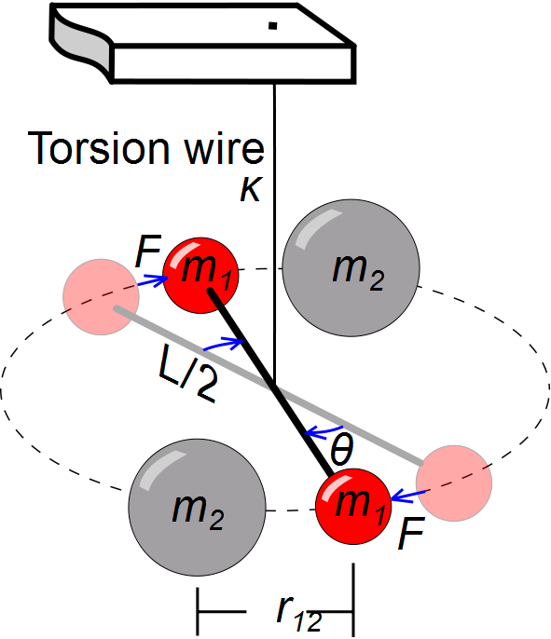

Slide 8
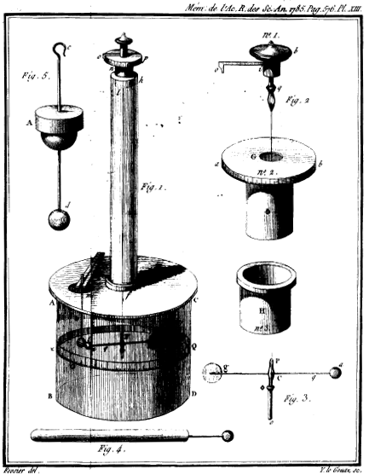

Slide 9
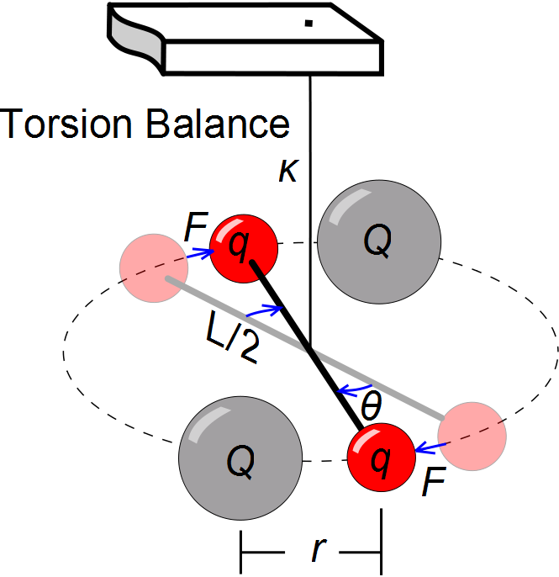

Slide 10
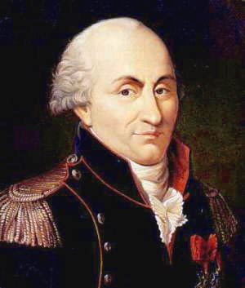
Charles Coulomb
1736 – 1806
Studied electrostatics and magnetism

Slide 12
Calculate the magnitude of the electric force between the proton and electron in a hydrogen atom.
Compare to their gravitational attraction.

Slide 13
Coulomb Force
q₂
+
F₂₁
F₁₂
r
-
q₁

Slide 14
Coulomb Force
q₂
F₂₁
+
r
+
q₁
F₁₂

Slide 15
Coulomb Force
q₂
F₂₁
-
r
-
q₁
F₁₂

Slide 16
Characteristics of Particles
Electron
Charge -1.60 x 10⁻¹⁹ C
Mass 9.11 x 10⁻³¹ Kg
Proton
Charge +1.60 x 10⁻¹⁹ C
Mass 1.67 x 10⁻²⁷ Kg

Slide 17
Question 223.21.6.1
Does the blue rock interfere with or “screen off” the gravitational force on the satellite due to the red rock?
Yes
No
maybe

Slide 18
Question 223.21.6
Does the blue charge interfere with or “screen off” the force on q due to the red charge?
Yes
No
maybe
+ + + +
+ + + + + +
+ + + + + + +
+
+ + + + + + + +
q
+ + + + + + +
+ + + + + +
+ + + +

Slide 19
Analogy with Gravity
F_{SR}
F_{RS}
Earth
Rexburg Rock

Slide 20
Analogy with Gravity
F_{SR}
F_{RS}
Rexburg Rock
China Rock

Slide 21
Analogy with Gravity
+
q_{m}
+ + + +
+ + + + + +
+ + + + + + +
+ + + + + + + +
+ + + + + + +
+ + + + + +
+ + + +

Slide 23
Question 223.21.7 Coulomb’s Law I
What is the magnitude of the force F₂?
a) 1.0 N
b) 1.5 N
c) 2.0 N
d) 3.0 N
e) 6.0 N
F₁ = 3N
F₂ = ?
Q
Q

Slide 24
Question 223.21.7 Coulomb’s Law I
What is the magnitude of the force F₂?
a) 1.0 N
b) 1.5 N
c) 2.0 N
d) 3.0 N
e) 6.0 N
F₁ = 3N
F₂ = ?
Q
Q
The force F₂ must have the same magnitude as F₁. This is due to the fact that the form of Coulomb’s Law is totally symmetric with respect to the two charges involved. The force of one on the other of a pair is the same as the reverse. Note that this sounds suspiciously like Newton’s 3rd Law!!

Slide 25
Question 223.21.8 Coulomb’s Law II
F₁ = 3N
F₂ = ?
Q
Q
a) 3/4 N
b) 3.0 N
c) 12 N
d) 16 N
e) 48 N
If we increase one charge to 4Q, what is the magnitude of F₁?
F₁ = ?
F₂ = ?
4Q
Q

Slide 26
Question 223.21.8 Coulomb’s Law II
a) 3/4 N
b) 3.0 N
c) 12 N
d) 16 N
e) 48 N
F₁ = 3N
F₂ = ?
Q
Q
If we increase one charge to 4Q, what is the magnitude of F₁?
F₁ = ?
F₂ = ?
4Q
Q
Originally we had:
F₁ = k(Q)(Q)/r² = 3 N
Now we have:
F₁ = k(4Q)(Q)/r²
which is 4 times bigger than before.
Follow-up: Now what is the magnitude of F₂?

Slide 27
Question 223.21.9 Coulomb’s Law III
The force between two charges separated by a distance d is F. If the charges are pulled apart to a distance 3d, what is the force on each charge?
a) 9 F
b) 3 F
c) F
d) 1/3 F
e) 1/9 F
F
F
Q
Q
d
?
?
Q
Q
3d

Slide 28
Question 223.21.9 Coulomb’s Law III
a) 9 F
b) 3 F
c) F
d) 1/3 F
e) 1/9 F
The force between two charges separated by a distance d is F. If the charges are pulled apart to a distance 3d, what is the force on each charge?
Originally we had:
F_{before} = k(Q)(Q)/d² = F
Now we have:
F_{after} = k(Q)(Q)/(3d)² = 1/9 F
F
F
Q
Q
d
?
?
Q
Q
3d
Follow-up: What is the force if the original distance is halved?

Slide 29
Question 223.21.10 Electric Force I
Two balls with charges +Q and +4Q are fixed at a separation distance of 3R. Is it possible to place another charged ball Q₀ on the line between the two charges such that the net force on Q₀ will be zero?
a) yes, but only if Q₀ is positive
b) yes, but only if Q₀ is negative
c) yes, independent of the sign (or value) of Q₀
d) no, the net force can never be zero
+Q
+4Q
3R

Slide 30
Question 223.21.10 Electric Force I
Two balls with charges +Q and +4Q are fixed at a separation distance of 3R. Is it possible to place another charged ball Q₀ on the line between the two charges such that the net force on Q₀ will be zero?
a) yes, but only if Q₀ is positive
b) yes, but only if Q₀ is negative
c) yes, independent of the sign (or value) of Q₀
d) no, the net force can never be zero
A positive charge would be repelled by both charges, so a point where these two repulsive forces cancel can be found. A negative charge would be attracted by both, and the same argument holds.
+Q
+4Q
3R

Slide 31
Question 223.21.11 Electric Force II
Two balls with charges +Q and +4Q are separated by 3R. Where should you place another charged ball Q₀ on the line between the two charges such that the net force on Q₀ will be zero?
+Q
+4Q
1
2
3
4
5
R
2R
3R

Slide 32
Question 223.21.11 Electric Force II
Two balls with charges +Q and +4Q are separated by 3R. Where should you place another charged ball Q₀ on the line between the two charges such that the net force on Q₀ will be zero?
+Q
+4Q
1
2
3
4
5
R
2R
3R
The force on Q₀ due to +Q is: F = k(Q₀)(Q)/R²
The force on Q₀ due to +4Q is: F = k(Q₀)(4Q)/(2R)²
Since +4Q is 4 times bigger than +Q, then Q₀ needs to be farther from +4Q. In fact, Q₀ must be twice as far from +4Q, since the distance is squared in Coulomb’s Law.

Slide 33
ConcepTest 16.4c Electric Force III
Two balls with charges +Q and –4Q are fixed at a separation distance of 3R. Is it possible to place another charged ball Q₀ anywhere on the line such that the net force on Q₀ will be zero?
a) yes, but only if Q₀ is positive
b) yes, but only if Q₀ is negative
c) yes, independent of the sign (or value) of Q₀
d) no, the net force can never be zero
+Q
– 4Q
3R

Slide 34
ConcepTest 16.4c Electric Force III
Two balls with charges +Q and –4Q are fixed at a separation distance of 3R. Is it possible to place another charged ball Q₀ anywhere on the line such that the net force on Q₀ will be zero?
a) yes, but only if Q₀ is positive
b) yes, but only if Q₀ is negative
c) yes, independent of the sign (or value) of Q₀
d) no, the net force can never be zero
A charge (positive or negative) can be placed to the left of the +Q charge, such that the repulsive force from the +Q charge cancels the attractive force from –4Q.
+Q
– 4Q
3R
Follow-up: What happens if one charge is +Q and the other is –Q?

Slide 35
ConcepTest 16.5a Proton and Electron I
A proton and an electron are held apart a distance of 1 m and then released. As they approach each other, what happens to the force between them?
a) it gets bigger
b) it gets smaller
c) it stays the same
p
e

Slide 36
ConcepTest 16.5a Proton and Electron I
A proton and an electron are held apart a distance of 1 m and then released. As they approach each other, what happens to the force between them?
a) it gets bigger
b) it gets smaller
c) it stays the same
By Coulomb’s Law, the force between the two charges is inversely proportional to the distance squared. So, the closer they get to each other, the bigger the electric force between them gets!
p
e
Follow-up: Which particle feels the larger force at any one moment?

Slide 37
ConcepTest 16.5b Proton and Electron II
A proton and an electron are held apart a distance of 1 m and then released. Which particle has the larger acceleration at any one moment?
a) proton
b) electron
c) both the same
p
e

Slide 38
ConcepTest 16.5b Proton and Electron II
A proton and an electron are held apart a distance of 1 m and then released. Which particle has the larger acceleration at any one moment?
a) proton
b) electron
c) both the same
p
e
The two particles feel the same force. Since F = ma, the particle with the smaller mass will have the larger acceleration. This would be the electron.

Slide 39
ConcepTest 16.5c Proton and Electron III
A proton and an electron are held apart a distance of 1 m and then let go. Where would they meet?
a) in the middle
b) closer to the electron’s side
c) closer to the proton’s side
p
e

Slide 40
ConcepTest 16.5c Proton and Electron III
A proton and an electron are held apart a distance of 1 m and then let go. Where would they meet?
a) in the middle
b) closer to the electron’s side
c) closer to the proton’s side
By Newton’s 3rd Law, the electron and proton feel the same force. But, since F = ma, and since the proton’s mass is much greater, the proton’s acceleration will be much smaller!
Thus, they will meet closer to the proton’s original position.
p
e
Follow-up: Which particle will be moving faster when they meet?

Slide 41
Question 223.21.12 Forces in 2D
1
2
3
Which of the arrows best represents the direction of the net force on charge +Q due to the other two charges?
4
d
+2Q
+Q
5
d
+4Q
Notes:
[CORRECT 5 ANSWER]

Slide 42
Question 223.21.12 Forces in 2D
1
2
3
Which of the arrows best represents the direction of the net force on charge +Q due to the other two charges?
4
d
+2Q
+Q
5
d
+4Q
The charge +2Q repels +Q towards the right. The charge +4Q repels +Q upwards, but with a stronger force. Therefore, the net force is up and to the right, but mostly up.
+2Q
Follow-up: What happens if the yellow charge would be +3Q?
+4Q

Slide 43
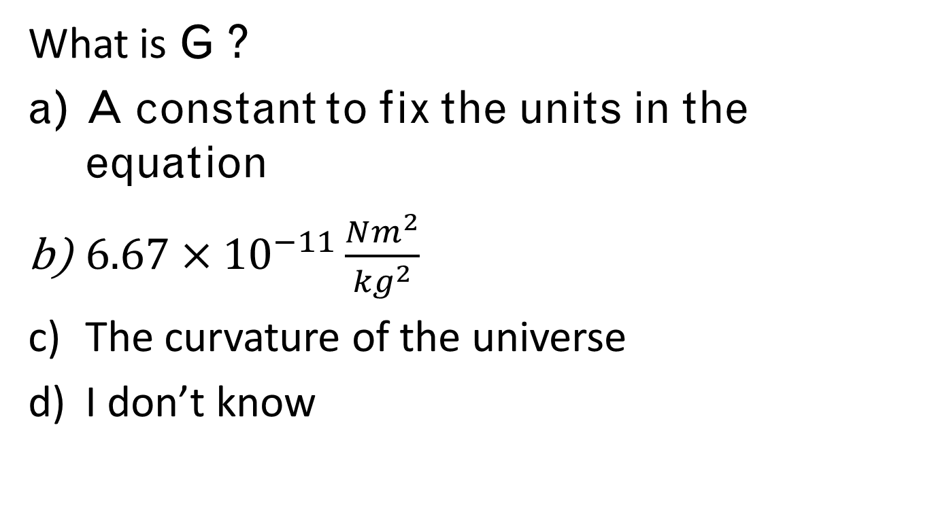
Question
What is G ?
A constant to fix the units in the equation
$6.67×{10}^{−11}\frac{Nm^{2}}{{kg}^{2}}$
The curvature of the universe
I don’t know

Slide 44
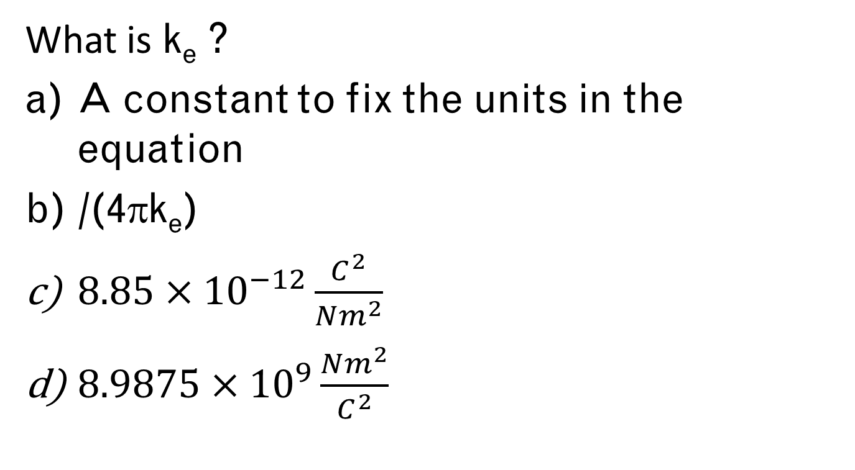
Question
What is k_{e} ?
A constant to fix the units in the equation
/(4πk_{e})
$8.85×{10}^{−12}\frac{C^{2}}{Nm^{2}}$
$8.9875×{10}^{9}\frac{Nm^{2}}{C^{2}}$

Slide 45
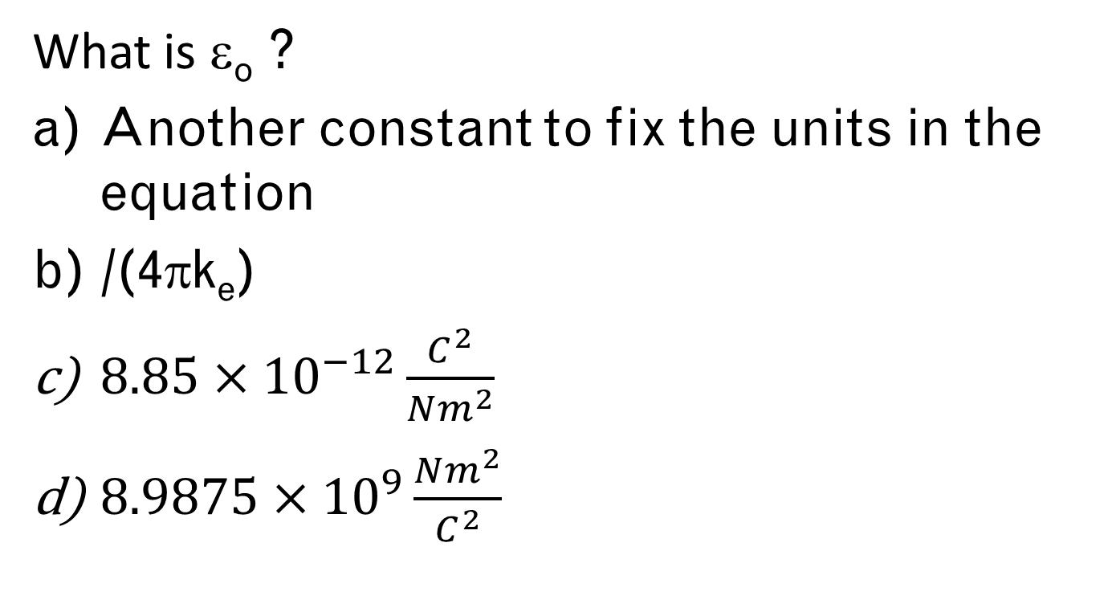
Question
What is ε_{o} ?
Another constant to fix the units in the equation
/(4πk_{e})
$8.85×{10}^{−12}\frac{C^{2}}{Nm^{2}}$
$8.9875×{10}^{9}\frac{Nm^{2}}{C^{2}}$

Slide 46
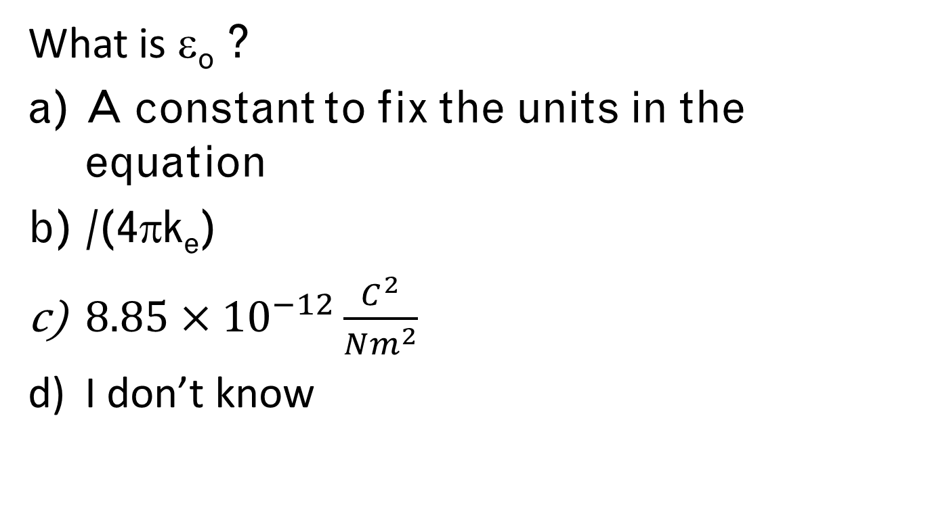
Question
What is ε_{o} ?
A constant to fix the units in the equation
/(4πk_{e})
$8.85×{10}^{−12}\frac{C^{2}}{Nm^{2}}$
I don’t know

Slide 47
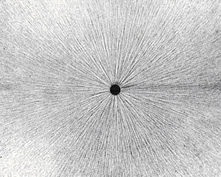
Field Lines
http://stargazers.gsfc.nasa.gov/images/geospace_images/electricity/elec_field_lines.jpg

Slide 48
Field Lines
http://stargazers.gsfc.nasa.gov/images/geospace_images/electricity/elec_field_lines.jpg

Slide 50
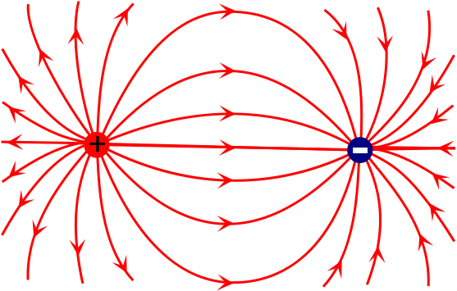
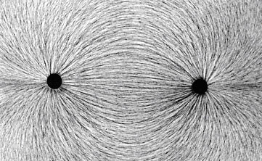
Field Lines
http://stargazers.gsfc.nasa.gov/images/geospace_images/electricity/elec_field_lines2.jpg

Slide 51
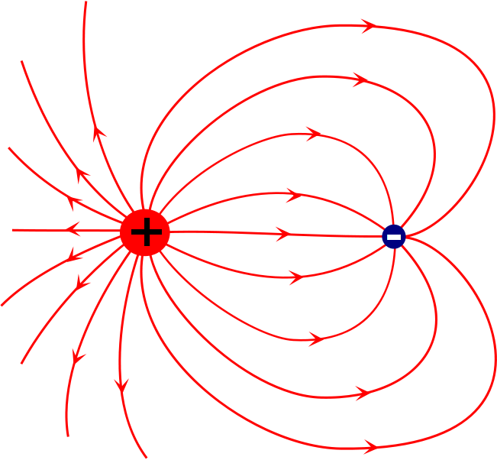

Slide 52
Question 223.21.13 Electric Field
You are sitting a certain distance from a point charge, and you measure an electric field of E₀. If the charge is doubled and your distance from the charge is also doubled, what is the electric field strength now?
(a) 4 E₀
(b) 2 E₀
(c) E₀
(d) 1/2 E₀
(e) 1/4 E₀

Slide 53
Question 223.21.13 Electric Field
You are sitting a certain distance from a point charge, and you measure an electric field of E₀. If the charge is doubled and your distance from the charge is also doubled, what is the electric field strength now?
(a) 4 E₀
(b) 2 E₀
(c) E₀
(d) 1/2 E₀
(e) 1/4 E₀
Remember that the electric field is: E = kQ/r². Doubling the charge puts a factor of 2 in the numerator, but doubling the distance puts a factor of 4 in the denominator, because it is distance squared!! Overall, that gives us a factor of 1/2.
Follow-up: If your distance is doubled, what must you do to the charge to maintain the same E field at your new position?

Slide 54
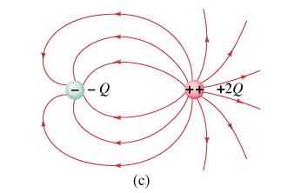
Question 223.21.14 Electric Field Lines I
a)
b)
c)
d)
e) no way to tell
What are the signs of the charges whose electric fields are shown at below?

Slide 55
Question 223.21.14 Electric Field Lines I
a)
b)
c)
d)
e) no way to tell
What are the signs of the charges whose electric fields are shown at right?
Electric field lines originate on positive charges and terminate on negative charges.

Slide 56
Question 223.21.15 Electric Field Lines II
a)
b)
c) Both the same
Which of the charges has the greater magnitude?

Slide 57
Question 223.21.15 Electric Field Lines II
a)
b)
c) Both the same
Which of the charges has the greater magnitude?
The field lines are denser around the red charge, so the red one has the greater magnitude.

