Slide 1
Question 223.28.1
The excess charge on a conductor in equilibrium is located
At the surface
Uniformly throughout the conductor
At the center
Conductors can’t have excess charge

Slide 2
+
-
-
-
-
-
-
-
-
-
-
-
-
+
+
-
+
+
-
-
-
-
-
-
-
-
+
-
-
-
+
+
-
-
-
-
-
-
+
+
-
+
-
-
-
-
-
+
+
+
+
+
+
+
+
-
-
+

Slide 3
-
-

Slide 4
Question 223.28.4
Field lines leave a conductor that is in electrostatic equilibrium
At 30 degree angles
At 90 degree angles
Parallel to the surface
Tangent to the surface

Slide 5
Question
I put a conductor in an electric field as shown. What will happen to the free charge?
It will move to the right
It will move to the left
It will stay where it was before the field was turned on.
Conductor
E

Slide 6
Conductor
E

Slide 7
Conductor
E
F=qE
-

Slide 8
Conductor
E
-

Slide 9
Question 223.28.3
The excess charge on a conductor in equilibrium is located
Uniformly throughout the metal object
Near the surface of the object
Exactly at the surface of the object
Slightly beyond the surface of the object
With a charge gradient that goes from zero at the center to a maximum at the surface.

Slide 10
Question 223.28.2
The field inside a conductor in electrostatic equilibrium is
Zero
Maximum at the surface, and minimum at the center of the conductor
A constant value
infinite

Slide 11
-
-
-
-
-
-
-
-
-
-
-
-
-
-
-
-
-
-
-
-
-
-
-
-
-
-
-
-
-
-
-
-
-
-
-
-
-

Slide 12
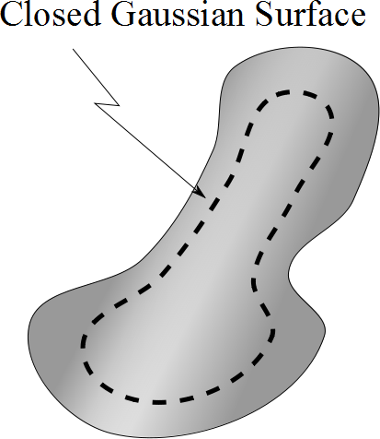

Slide 13
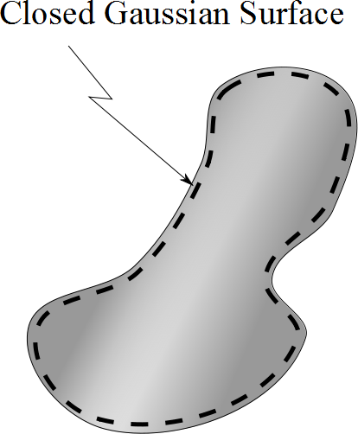

Slide 14
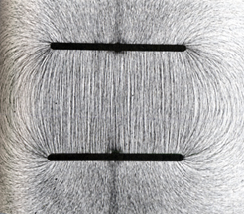

Slide 15
-
-
-
-
-
-
-
-
-
-
-
-
-
-
-
-
-
-
-
-
-
-
-
-
-
-
-
-
-
-
-
-
-
-
-
-
-

Slide 16
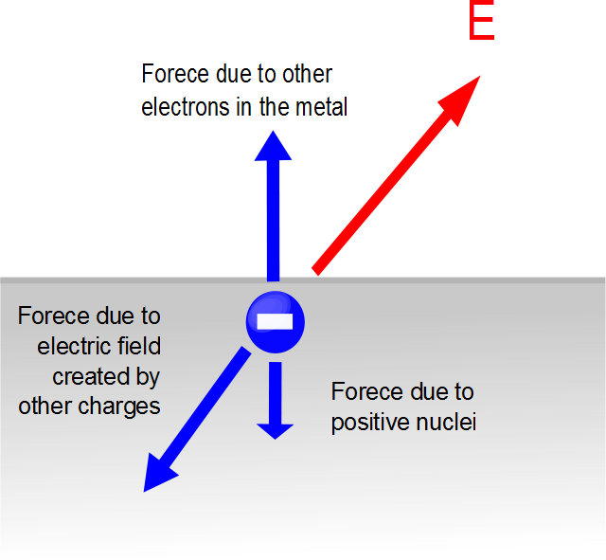

Slide 17
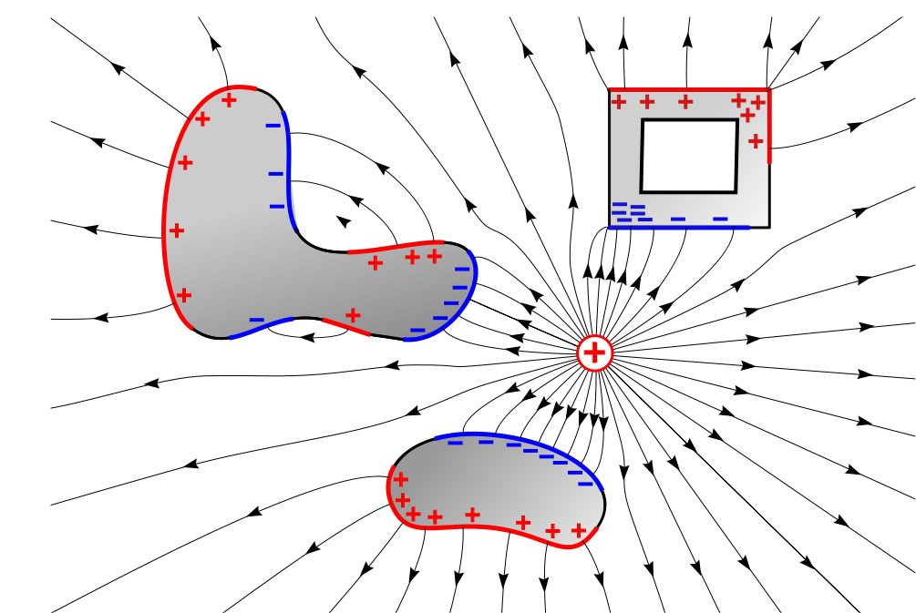

Slide 18
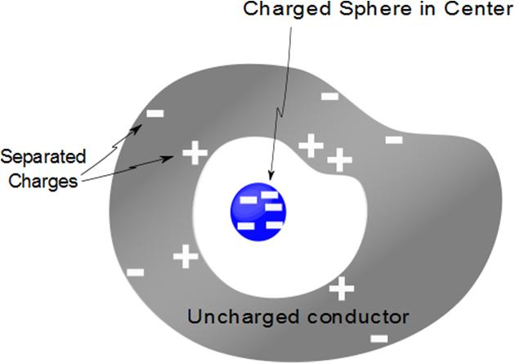
Question
We have a uncharged conductor with a charged sphere inside a cavity deep in the conductor. Could you tell from the outside if there was a charge inside or not?
Yes
No
Maybe

Slide 20
-
-
-
-
-
-
-
-
-
-
-
-
-
-
-
-
-
-
-
-
-
-
-
-
-
-
-
-
-
-
-
-
-
-
-
-
-

Slide 21
Question 223.28.5
In PH 121 we did many projectile motion problems in which we imagined throwing balls off of buildings. Remembering these problems, look at the picture below. At which point is the potential energy of the ball equal to zero?
B
A
C
D

Slide 22
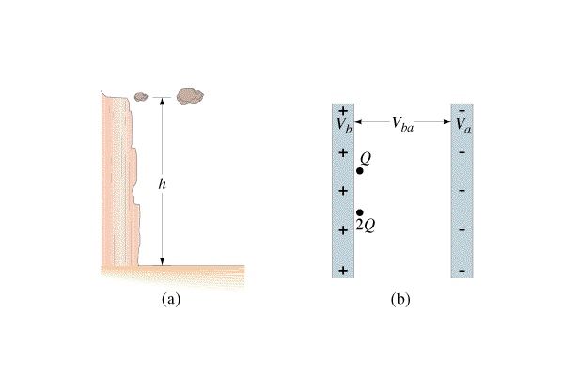
Question 223.28.6
A proton and an electron are in a constant electric field created by oppositely charged plates. You release the proton from the positive side and the electron from the negative side. Which feels the larger electric force?
1) proton
2) electron
3) both feel the same force
4) neither – there is no force
5) they feel the same magnitude force but opposite direction
electron
electron
-
+
proton
proton

Slide 23
Question 223.28.6
A proton and an electron are in a constant electric field created by oppositely charged plates. You release the proton from the positive side and the electron from the negative side. Which feels the larger electric force?
1) proton
2) electron
3) both feel the same force
4) neither – there is no force
5) they feel the same magnitude force but opposite direction
Since F = qE and the proton and electron have the same charge in magnitude, they both experience the same force. However, the forces point in opposite directions because the proton and electron are oppositely charged.
electron
electron
-
+
proton
proton

Slide 24
Question 223.28.7
A proton and an electron are in a constant electric field created by oppositely charged plates. You release the proton from the positive side and the electron from the negative side. Which has the larger acceleration?
1) proton
2) electron
3) both feel the same acceleration
4) neither – there is no acceleration
5) they feel the same magnitude acceleration but opposite direction
electron
electron
-
+
proton
proton

Slide 25
Question 223.28.7
A proton and an electron are in a constant electric field created by oppositely charged plates. You release the proton from the positive side and the electron from the negative side. Which has the larger acceleration?
1) proton
2) electron
3) both feel the same acceleration
4) neither – there is no acceleration
5) they feel the same magnitude acceleration but opposite direction
Since F = ma and the electron is much less massive than the proton, then the electron experiences the larger acceleration.
electron
electron
-
+
proton
proton

Slide 26
Question 223.28.8
A proton and an electron are in a constant electric field created by oppositely charged plates. You release the proton from the positive side and the electron from the negative side. When it strikes the opposite plate, which one has more KE?
1) proton
2) electron
3) both acquire the same KE
4) neither – there is no change of KE
5) they both acquire the same KE but with opposite signs
electron
electron
-
+
proton
proton

Slide 27
Question 223.28.8
A proton and an electron are in a constant electric field created by oppositely charged plates. You release the proton from the positive side and the electron from the negative side. When it strikes the opposite plate, which one has more KE?
1) proton
2) electron
3) both acquire the same KE
4) neither – there is no change of KE
5) they both acquire the same KE but with opposite signs
Since PE = qV and the proton and electron have the same charge in magnitude, they both have the same electric potential energy initially. Because energy is conserved, they both must have the same kinetic energy after they reach the opposite plate.
electron
electron
-
+
proton
proton

Slide 28
Gravity Analogy
+ + + + + + +
q
d
d
⁻ ⁻ ⁻ ⁻ ⁻ ⁻

Slide 29
+ + + + + + + + + + + + + + + + + + + + + + + + + +
High Potential Energy
+ + + + + + + + + + + + + + + + + + + + + + + + + +
A
+
d
E
B
- - - - - - - - - - - - - - - - - - - - - - - - - - - - - -
- - - - - - - - - - - - - - - - - - - - - - - - - - - - - -
Low Potential Energy

Slide 30
High Potential Energy
Low Potential Energy
E
+ + + + + + + + + + + + + + + + + + + + + + + + + +
+ + + + + + + + + + + + + + + + + + + + + + + + + +
+
A
B
- - - - - - - - - - - - - - - - - - - - - - - - - - - - - -
- - - - - - - - - - - - - - - - - - - - - - - - - - - - - -
d

Slide 31


Question
What is the amount of work done on the charge in moving a positive charge a distance Δy in a uniform field of strength E?
qE Δy
-qE Δy
qΔV
-qΔV
5
+ + + + + + + + + + + + + + + + + + + + + + + + + +
High Potential Energy
+ + + + + + + + + + + + + + + + + + + + + + + + + +
A
+
$$y=0$$
d
$$Δ\vec{y}$$
E
B
- - - - - - - - - - - - - - - - - - - - - - - - - - - - - -
Low Potential Energy
- - - - - - - - - - - - - - - - - - - - - - - - - - - - - -

Slide 32
Question
What is the change in electrical potential in moving a positive charge a distance Δy in a uniform field of strength E?
qE Δy
-qE Δy
qΔV
-qΔV
5
+ + + + + + + + + + + + + + + + + + + + + + + + + +
High Potential Energy
+ + + + + + + + + + + + + + + + + + + + + + + + + +
A
+
$$y=0$$
d
$$Δ\vec{y}$$
E
B
- - - - - - - - - - - - - - - - - - - - - - - - - - - - - -
Low Potential Energy
- - - - - - - - - - - - - - - - - - - - - - - - - - - - - -

Slide 33
Question
What is the amount of work done in moving a negative charge a distance Δy in a uniform field of strength E?
qE Δy
-qE Δy
qΔV
-qΔV
5
+ + + + + + + + + + + + + + + + + + + + + + + + + +
High Potential Energy
+ + + + + + + + + + + + + + + + + + + + + + + + + +
A
-
$$y=0$$
d
$$Δ\vec{y}$$
E
B
- - - - - - - - - - - - - - - - - - - - - - - - - - - - - -
Low Potential Energy
- - - - - - - - - - - - - - - - - - - - - - - - - - - - - -

