Slide 1
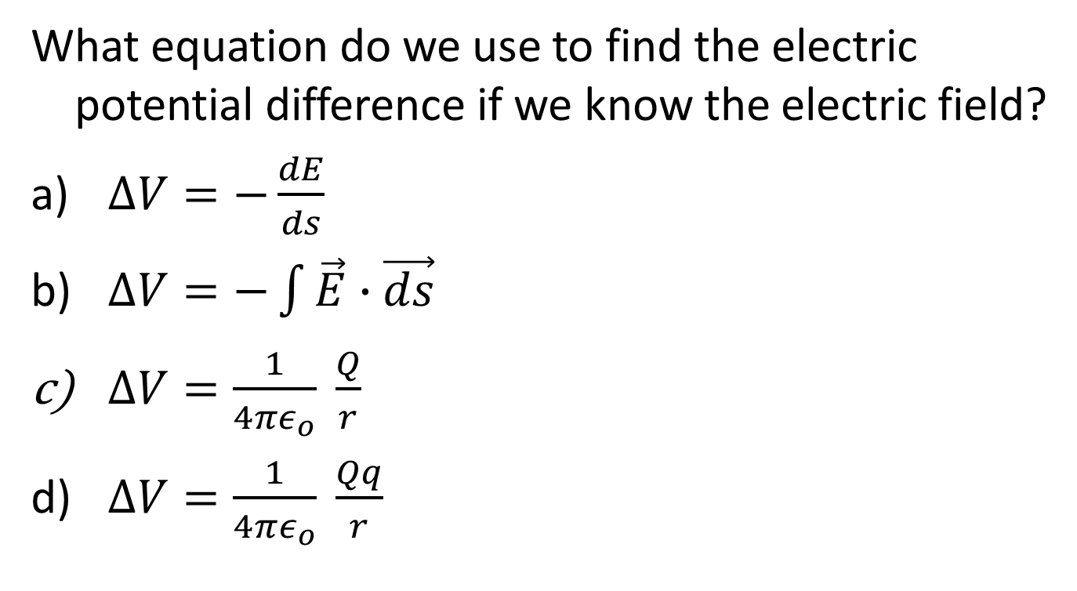
Question 223.32.2
What equation do we use to find the electric potential difference if we know the electric field?
$∆V=−\frac{dE}{ds}$
$∆V=−\int{\vec{E}∙\vec{ds}}$
$∆V=\frac{1}{4πε_{o}} \frac{Q}{r}$
$∆V=\frac{1}{4πε_{o}} \frac{Qq}{r}$

Slide 2
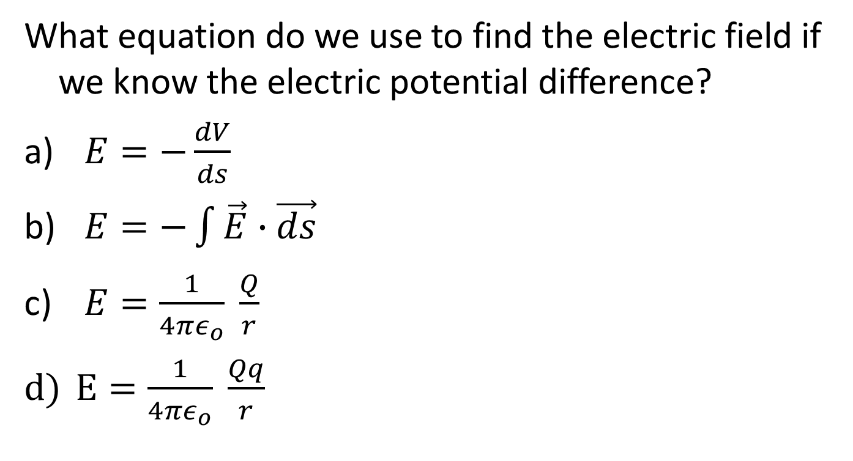
Question 223.32.2
What equation do we use to find the electric field if we know the electric potential difference?
$E=−\frac{dV}{ds}$
$E=−\int{\vec{E}∙\vec{ds}}$
$E=\frac{1}{4πε_{o}} \frac{Q}{r}$
$E=\frac{1}{4πε_{o}} \frac{Qq}{r}$

Slide 3
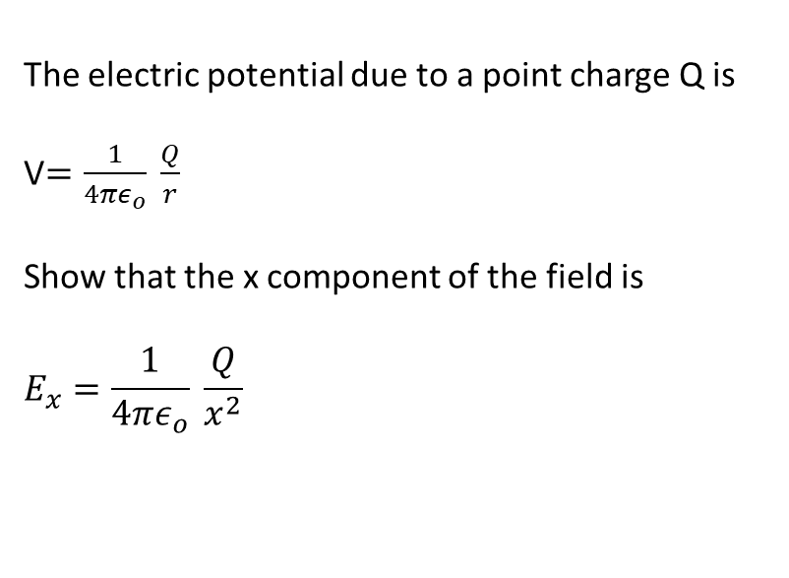
The electric potential due to a point charge Q is
V$=\frac{1}{4πε_{o}} \frac{Q}{r}$
Show that the x component of the field is
$$E_{x}=\frac{1}{4πε_{o}} \frac{Q}{x^{2}}$$
y
x

Slide 4
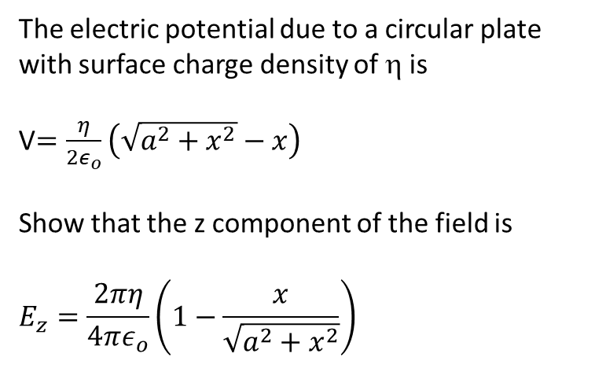
The electric potential due to a circular plate with surface charge density of η is
V$=\frac{η}{2ε_{o}}\left(\sqrt{a^{2}+x^{2}}−x\right)$
Show that the z component of the field is
$$E_{z}=\frac{2πη}{4πε_{o}}\left(1−\frac{x}{\sqrt{a^{2}+x^{2}}}\right)$$
x

Slide 5
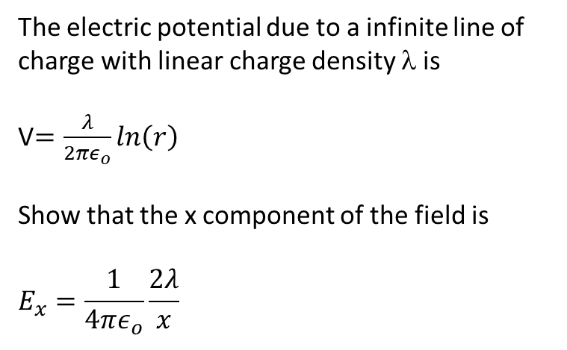
The electric potential due to a infinite line of charge with linear charge density λ is
V$=\frac{λ}{2πε_{o}}ln\left(r\right)$
Show that the x component of the field is
$$E_{x}=\frac{1}{4πε_{o}}\frac{2λ}{x}$$
x

Slide 6
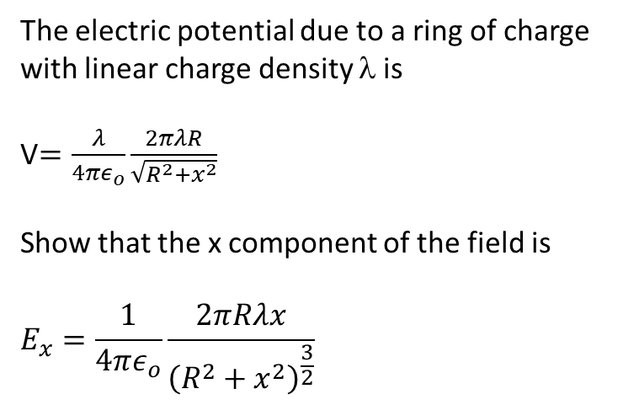
The electric potential due to a ring of charge with linear charge density λ is
V$=\frac{λ}{4πε_{o}}\frac{2πλR}{\sqrt{R^{2}+x^{2}}}$
Show that the x component of the field is
$$E_{x}=\frac{1}{4πε_{o}}\frac{2πRλx}{{\left(R^{2}+x^{2}\right)}^{\frac{3}{2}}}$$
x

Slide 7
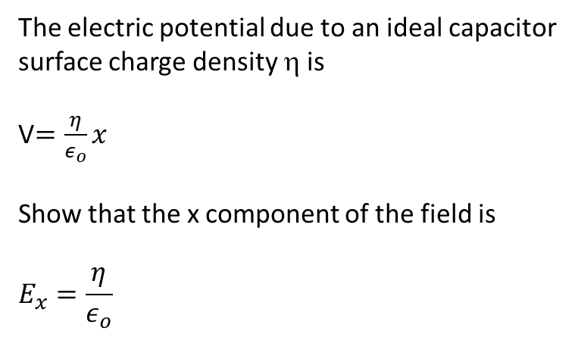
The electric potential due to an ideal capacitor surface charge density η is
V$=\frac{η}{ε_{o}}x$
Show that the x component of the field is
$$E_{x}=\frac{η}{ε_{o}}$$
x

Slide 8

Question 223.33.1
What is
called?
Divergence of a vector
The curl of a vector
The equi-potential
The gradient operator
$$∇f=\left(\frac{df}{dx}\hat{ı}+\frac{df}{dy}\hat{j}+\frac{df}{dz}\hat{k}\right)$$

Slide 9
Question 223.33.2
What does
tell us?
It gives the direction that f decreases fastest and the magnitude of the change in f is in that direction.
It tells us how curved the change in a vector field will be.
It gives us a measure of the spreading of the directions and magnitude of a vector field.
It shows us that all scalar functions have linear derivatives.

Slide 11
High Potential
Low Potential
E
- - - - - - - - - - - - - - - - - - - - - - - - - - - - - -
- - - - - - - - - - - - - - - - - - - - - - - - - - - - - -
+ + + + + + + + + + + + + + + + + + + + + + + + + +
+ + + + + + + + + + + + + + + + + + + + + + + + + +
Equipotential Lines

Slide 12
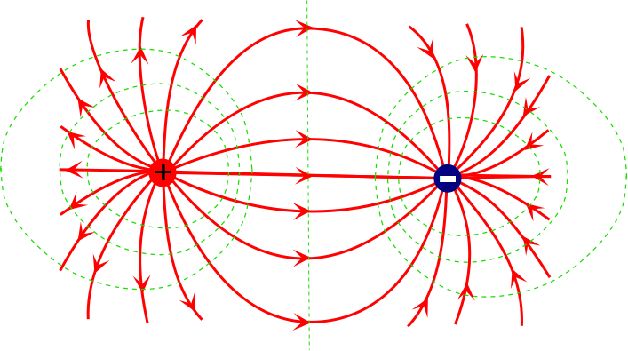

Slide 13
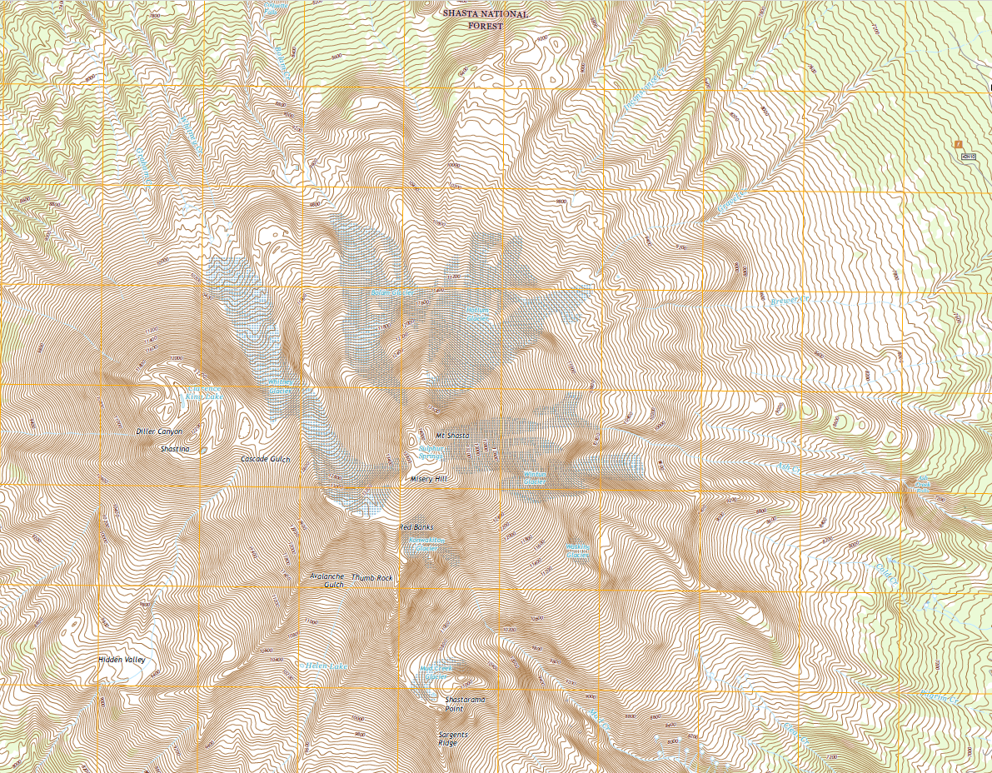
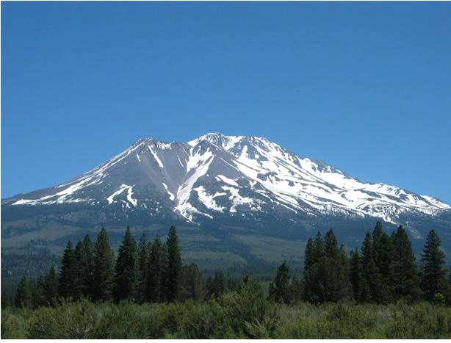
[Map courtesy USGS, Picture is in the Public Domain.]

Slide 14
Question 223.33.3
What is the field inside a conductor in electrostatic equilibrium?
0 V/m
infinite
100 V/m
1.602x10⁻¹⁹ V/m

Slide 15
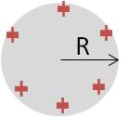
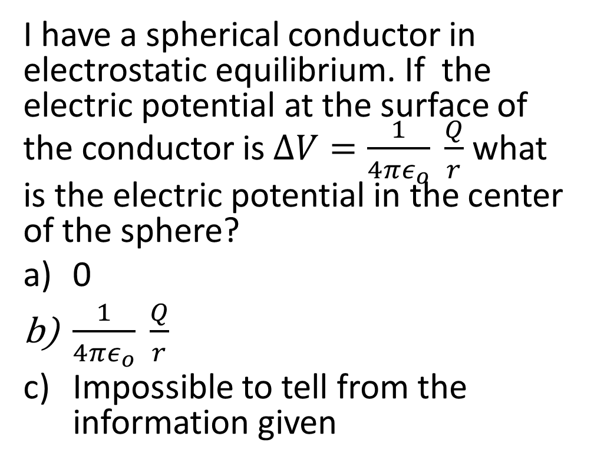
Question
I have a spherical conductor in electrostatic equilibrium. If the electric potential at the surface of the conductor is $∆V=\frac{1}{4πε_{o}} \frac{Q}{r}$ what is the electric potential in the center of the sphere?
0
$\frac{1}{4πε_{o}} \frac{Q}{r}$
Impossible to tell from the information given

Slide 16
Electric Potential for a Charged Conductor
Static Condition
The electric potential is constant inside the conductor.
The surface of the conductor is at the same electric potential (same as inside).
-
-
-
-
-
-
-
-
-
-
-
-
-
-
-
-
-
-
-
-
-
-
-
-
-
-
-
-
-
-
-
-
-
-
-
-
-

Slide 18
R

Slide 19
Question
The two shapes below are each part of a different conductor that is in electrostatic equilibrium. Each conductor has the same amount of additional charge added to it. Which point, A or B, would experience the strongest electric field?
A
B

Slide 20
R

Slide 21
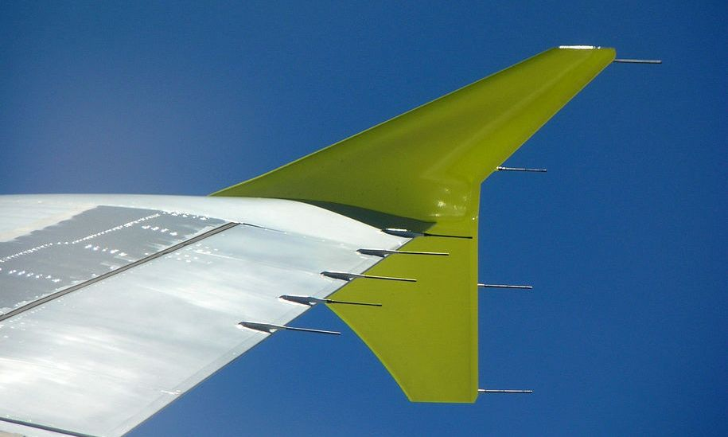

Slide 22

https://www.youtube.com/watch?v=dVMnTS5FqS8

Slide 23
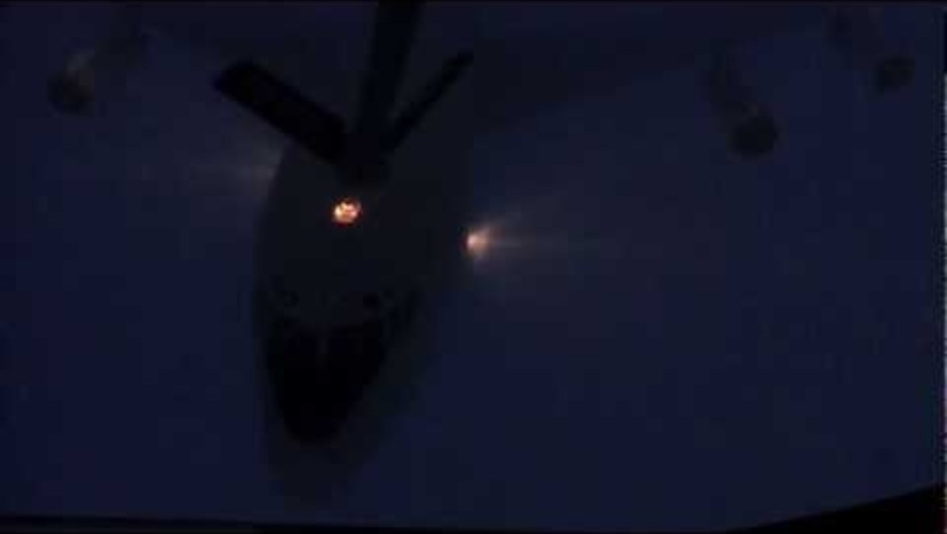

Slide 24
A
B

