Slide 1
36

Slide 2
Question 223.36.1
You pull a box. The box stops moving every time you stop pulling. Why?
Frictional forces oppose the motion
The natural state of objects is at rest so it returns to it’s natural state
The box must be leaking glue or some sticky substance

Slide 3
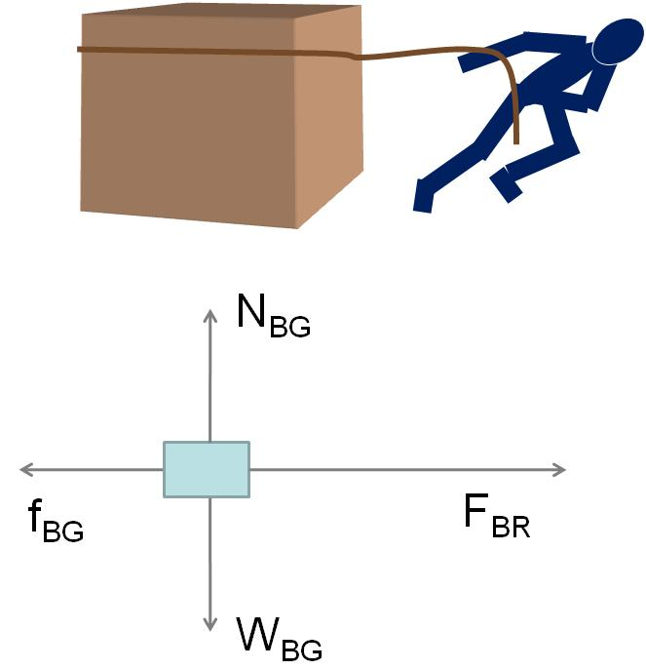

Slide 4
Question 223.36.2
What causes electric current?
Electric Fields
Electric potentials
Gravitational fields
batteries

Slide 5
High Potential
Low Potential
E
+ + + + + + + + + + + + + + + + + + + + + + + + + +
+ + + + + + + + + + + + + + + + + + + + + + + + + +
+
A
B
- - - - - - - - - - - - - - - - - - - - - - - - - - - - - -
- - - - - - - - - - - - - - - - - - - - - - - - - - - - - -
d

Slide 6
High Potential
Low Potential
E
Conductor
+ + + + + + + + + + + + + + + + + + + + + + + + + +
+ + + + + + + + + + + + + + + + + + + + + + + + + +
+
A
B
- - - - - - - - - - - - - - - - - - - - - - - - - - - - - -
- - - - - - - - - - - - - - - - - - - - - - - - - - - - - -
d

Slide 7
Question 223.36.3
We put a conductor inside a capacitor. The free charge will travel which path shape?
Parabola
Straight line
Circular
Zig zag
The electron won’t move
High Potential
Low Potential
E
Conductor
+ + + + + + + + + + + +
- - - - - - - - - - - - - - - - -
- - - - - - - - - - - - - - - - - - - - - - - - - - - - - -
d

Slide 8
Question
We put a conductor inside a capacitor. The free charge won’t travel a straight line path. Why not?
Friction forces
Magnetic forces
Collisions
Gravitation
Magic
High Potential
Low Potential
E
Conductor
+ + + + + + + + + + + +
- - - - - - - - - - - - - - - - -
- - - - - - - - - - - - - - - - - - - - - - - - - - - - - -
d

Slide 9
High Potential
Low Potential
Parabolic electron Path Segments
E
- - - - - - - - - - - - - - - - - - - - - - - - - - - - - -
- - - - - - - - - - - - - - - - - - - - - - - - - - - - - -
+ + + + + + + + + + + + + + + + + + + + + + + + + +
+ + + + + + + + + + + + + + + + + + + + + + + + + +
Conductor

Slide 10
Question 223.36.4
What is the average kinetic energy of electrons in a conductor in equilibrium?
0
(3/2)kT
(3/2)RT
900m/s
For those who have taken Thermo

Slide 11
Question 223.36.5
Which of the following are key in beginning an electric current?
Chemical processes
Non uniform charge distributions
Frictional forces
General relativity

Slide 12
High Potential
Low Potential
E
Conductor
+
- - - - - - - - - - - - - - - - - - - - - - - - - - - - - -
- - - - - - - - - - - - - - - - - - - - - - - - - - - - - -
+ + + + + + + + + + + + + + + + + + + + + + + + + +
+ + + + + + + + + + + + + + + + + + + + + + + + + +
d

Slide 13
Question
Charge moves from the positive side of the capacitor to the negative side. The charge would like to move as far away from like charge as it can. Where would the charge like to be on the conducting wire?
In the middle of the wire
On the surface of the wire
Uniformly spread in the wire.
E
-
-
-
-
-
-
-
-
-
+ + + + + + + + + + +
- - - - - - - - - - - - -
+
+
+
+
-
-
-
-
+
+
-
-
+
+
+
+
-
-
-
-
+
-
-
+
+
+
-
-
-
-
+
+
-
1
2
3
4

Slide 14
Question
Is there free charge at point P in the wire?
Yes
No
Maybe
E
-
-
-
-
-
-
-
-
-
+ + + + + + + + + + +
- - - - - - - - - - - - -
+
+
+
+
P
-
-
-
-
+
+
-
-
+
+
+
+
-
-
-
-
+
-
-
+
+
+
-
-
-
-
+
+
-
1
2
3
4

Slide 15
Question
If there is a charge at point P, will it feel a force?
Yes
No
Maybe
x
+
+
+
+
+
+
θ
E
+
+
z
+
R
+
P
+
+
+
+
y

Slide 16
x
+
+
+
+
+
+
E
θ
+
+
z
+
R
+
P
+
+
y
+
+

Slide 17
Question
Looking at rings or charge 1, 2, 3, and 5, is there a net force on the free charge at point P in the wire?
Yes
No
Maybe
E
-
-
-
-
-
-
-
-
-
+ + + + + + + + + + +
- - - - - - - - - - - - -
+
+
+
+
P
-
-
-
-
+
+
-
-
+
+
+
+
-
-
-
-
+
-
-
+
+
+
-
-
-
-
+
+
-
1
2
3
4

Slide 18
Question
Looking at rings or charge 1, 2, 3, and 5, what direction is the net force on the free charge at point P in the wire?
right
Left
No force
E
-
-
-
-
-
-
-
-
-
+ + + + + + + + + + +
- - - - - - - - - - - - -
+
+
+
+
P
-
-
-
-
+
+
-
-
+
+
+
+
-
-
-
-
+
-
-
+
+
+
-
-
-
-
+
+
-
1
2
3
4

Slide 19
-
-
-
-
-
-
-
-
-
E
- - - - - - - - - - - - -
+ + + + + + + + + + +
+
+
+
+
-
-
-
-
+
+
-
-
E₁
-
+
+
+
+
-
-
-
-
+
+
-
-
+
+
+
+
-
-
-
-
1
2
3
4

Slide 20
-
-
-
-
-
-
-
-
-
E
- - - - - - - - - - - - -
+ + + + + + + + + + +
+
+
+
+
-
-
-
-
+
+
E₂
E₃
-
-
E₁
-
+
+
+
+
-
-
-
-
+
+
E₄
-
-
E₂
E₃
+
+
+
+
-
-
-
-
1
2
3
4

Slide 21
-
-
-
-
-
-
-
-
-
E
- - - - - - - - - - - - -
+ + + + + + + + + + +
+
+
+
+
-
-
-
-
+
+
E_{net}
E_{net}
E_{net}
-
-
-
+
+
+
+
-
-
-
-
+
+
-
-
+
+
+
+
-
-
-
-
1
2
3
4

Slide 22
Question
Looking at rings or charge 1, 2, 3, and 5, the net force on the free charge is to the left. Which way does the current go?
Left
Right
Is this a trick question?
E
-
-
-
-
-
-
-
-
-
+ + + + + + + + + + +
- - - - - - - - - - - - -
+
+
+
+
P
-
-
-
-
+
+
-
-
+
+
+
+
-
-
-
-
+
-
-
+
+
+
-
-
-
-
+
+
-
1
2
3
4

Slide 23
Case 1: Negative charges flow to the right
Result: Left side is more positive than before, Right side is more negative than before
Case 2: Negative charges flow to the right
+
+
+
+
Result: Left side is more positive than before, Right side is more negative than before

Slide 24
Question 223.36.6
Which of the following is the unit for current flow in the SI system?
V/m
J/m²
dB
C/s

Slide 25
Question 223.36.7
The current in a wire is traveling to the right. Which way are the electrons going?
To the right
To the right of course, what are you talking about?
To the left
At right angles to the current flow.

Slide 26
Current Flow Direction
Electron Flow Direction

Slide 27
Question 223.36.8
What would you call the quantity current/area?
Surface charge density
Current density
voltage
current
unfortunate

Slide 28
Question 223.36.9
Can we create charge?
Yes
No
Maybe

Slide 31
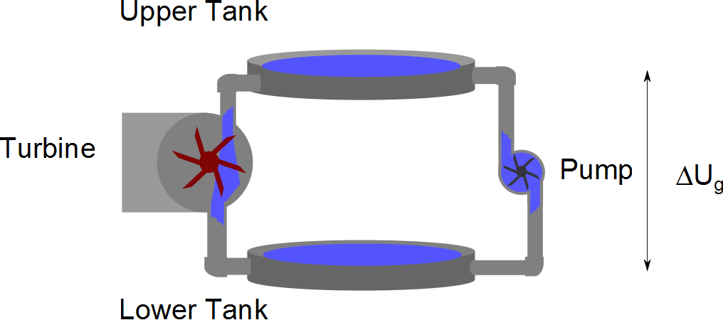
Question 223.36.10
What is being “lost” as the water goes through the turbine.
Water
Electricity
Potential Energy
oil

Slide 32
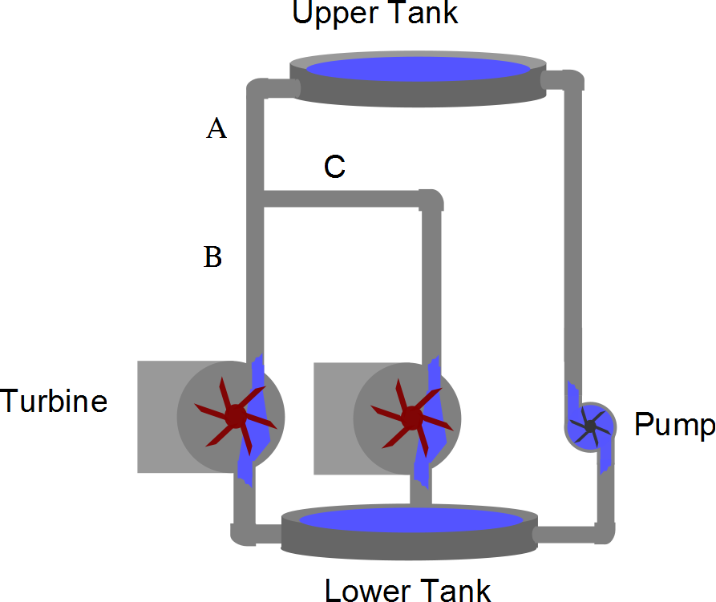
Question 223.36.11
Suppose we constructed the pipe system shown.
What can you say about the flow rate at points A, B and C?
A=B+C
A<B<C
A=B<C
C>A>B

Slide 33
Question 223.36.12
Suppose we constructed the wire system shown.
What can you say about the current at points A, B and C?
A=B+C
A<B<C
A=B<C
C>A>B

Slide 34
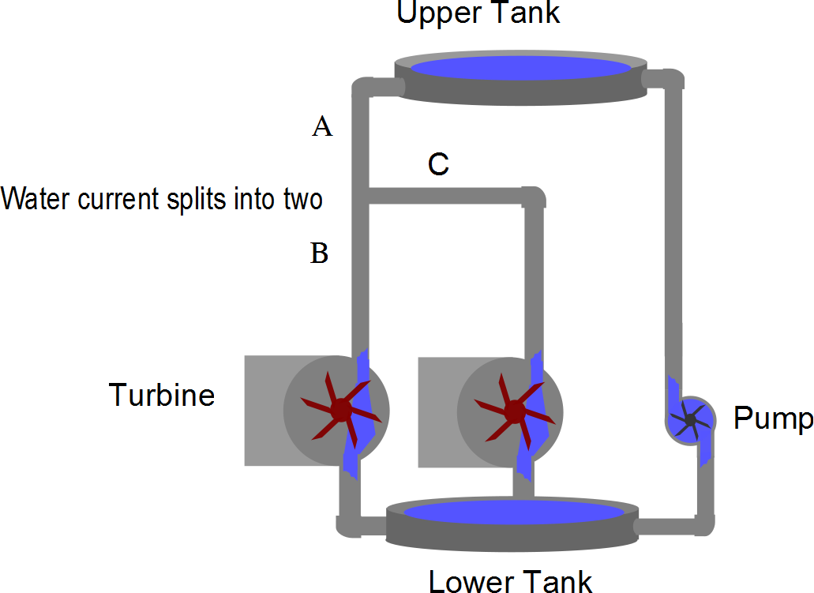
Water current splits into two

Slide 35
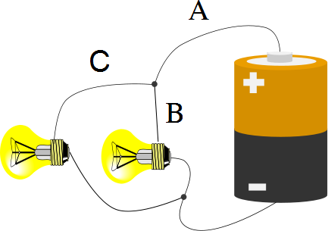

Slide 36


Question 233.36.13
Consider the circuit shown. The light produced in a bulb is proportional to the current flow in the bulb. Which bulb will be brighter?
The top one
The bottom one
Neither will be brighter

Slide 37
Question 233.36.14
Consider the circuit shown. The light produced in a bulb is proportional to the current flow in the bulb. How much charge is used up in making the first bulb glow?
All the charge in the current
Half the charge in the current
None of the charge is used up

Slide 38
Question 233.36.15
Consider the circuit shown. The light produced in a bulb is proportional to the current flow in the bulb. Which bulb will be brighter?
Bulb A
Bulb B
Bulb C
All will be equally bright
A
B
C

Slide 39
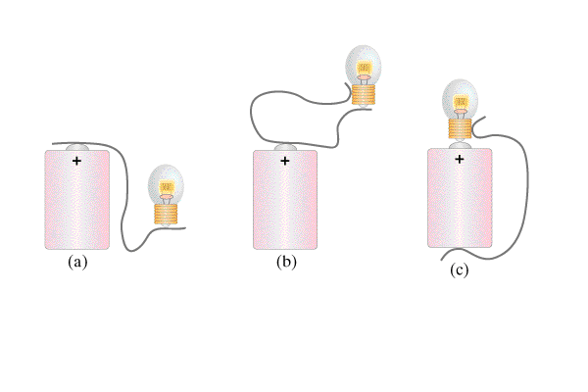
ConcepTest 18.1 Connect the Battery
Which is the correct way to light the lightbulb with the battery?
4) all are correct
5) none are correct
1)
2)
3)

Slide 40
ConcepTest 18.1 Connect the Battery
Which is the correct way to light the lightbulb with the battery?
4) all are correct
5) none are correct
1)
2)
3)
Current can only flow if there is a continuous connection from the negative terminal through the bulb to the positive terminal. This is only the case for Fig. (3).

