Slide 1
38

Slide 2
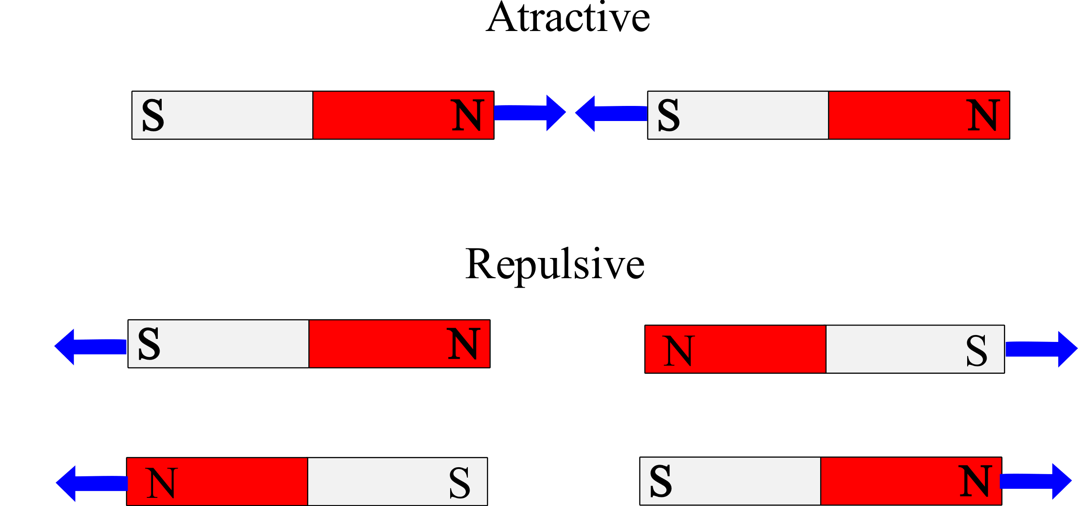

Slide 3
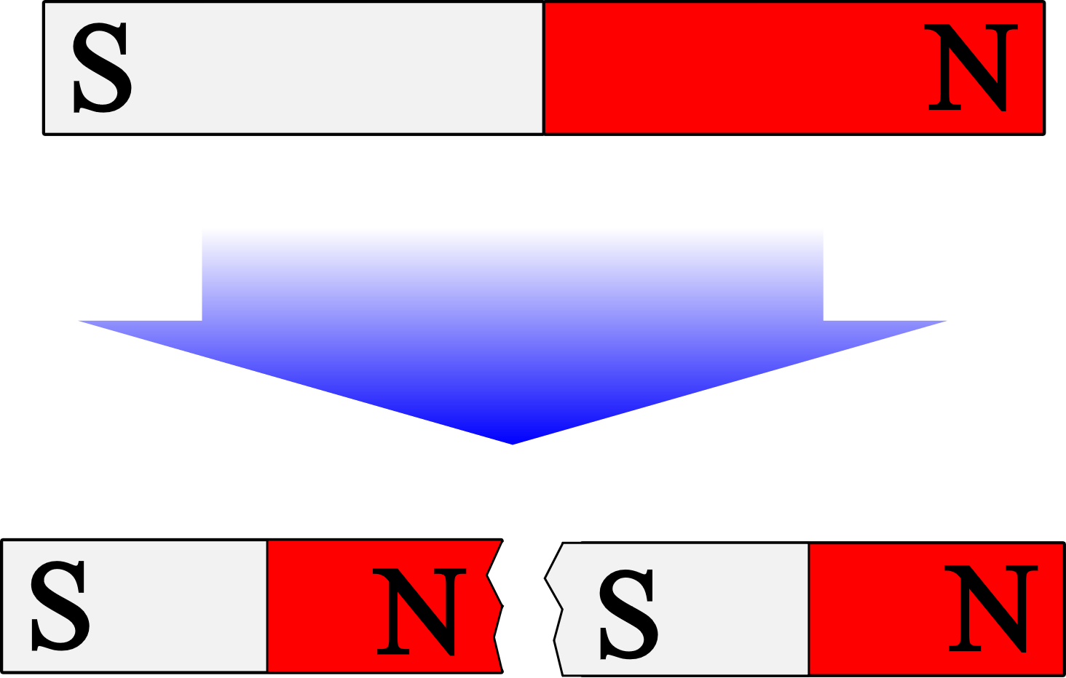

Slide 4
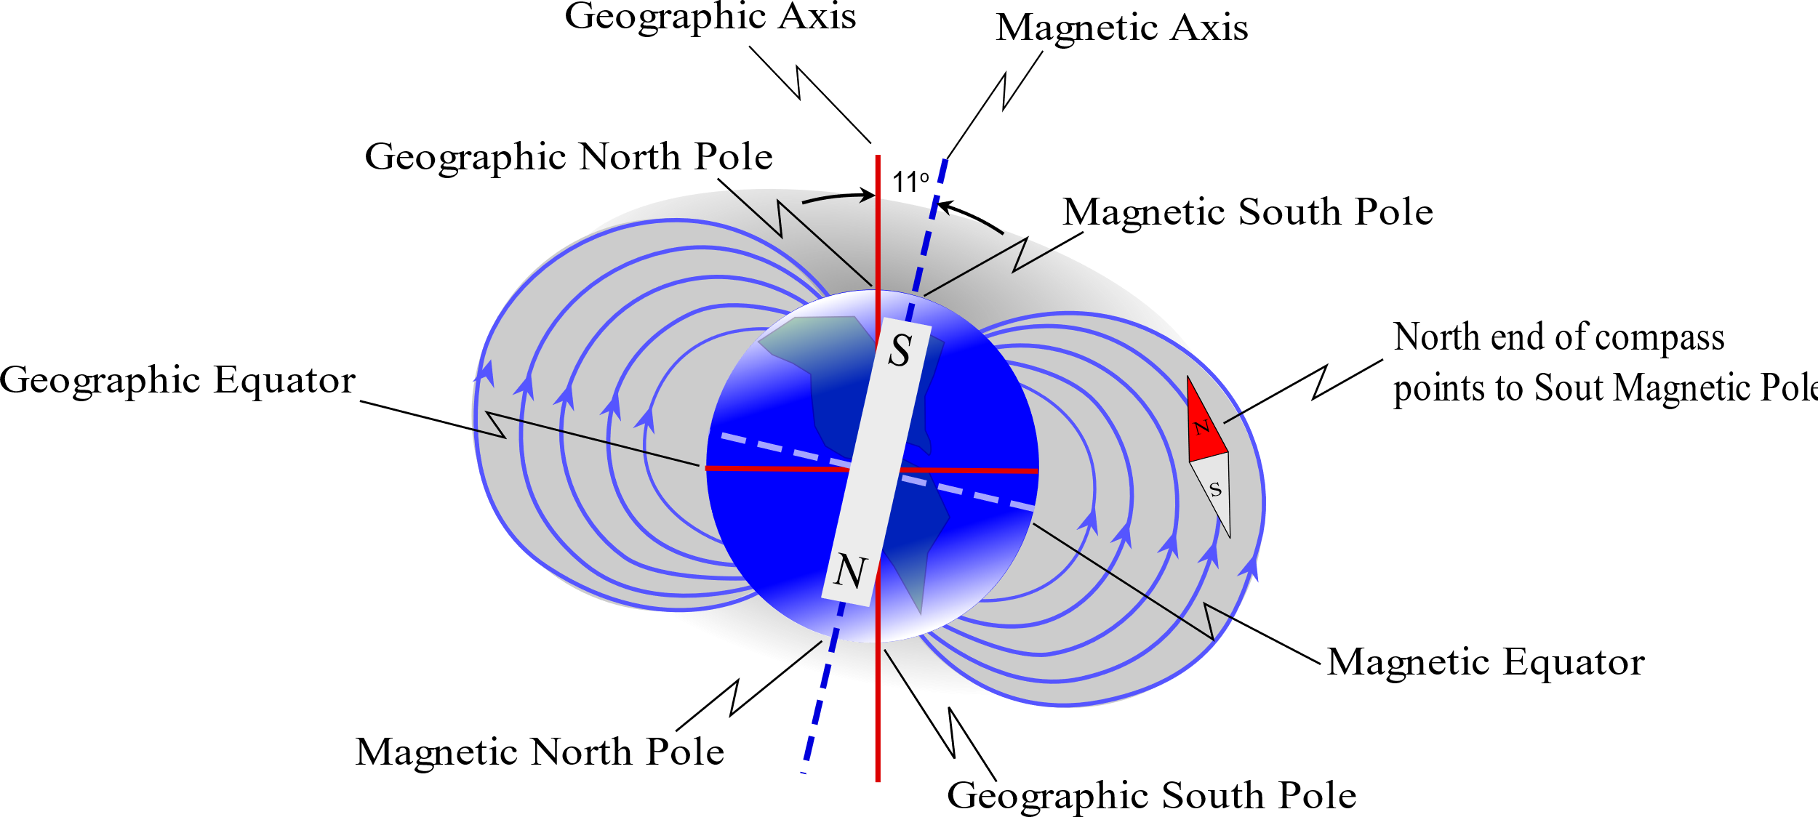

Slide 5
Question 223.38.1
Electrons create an electric field around themselves. If they move, they also create…
Sound waves
Laser beams
Magnetic fields

Slide 6
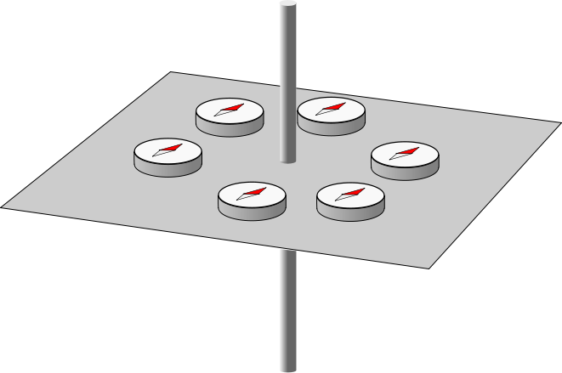

Slide 7
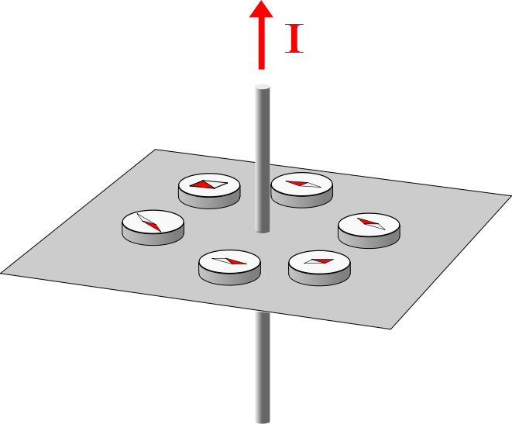

Slide 8
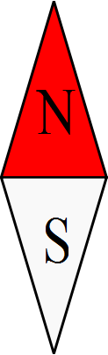
B
F_{m}
F_{m}

Slide 9
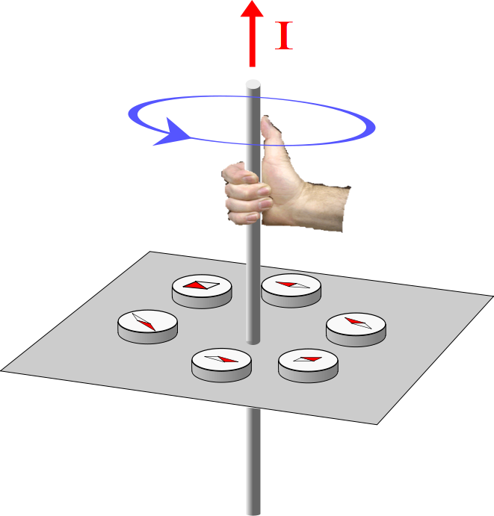

Slide 10
Question 223.38.2
The magnetic field due
to a long straight wire is
shown. The blue circle means
a) The magnetic field forms
a complete loop around
the wire
b) The magnetic field circulates around the wire
c) The magnetic field is tangent to the circle at every point on the circle

Slide 11
Question 223.38.2.1
What does it mean that the magnetic field forms loops around the wire?
The magnetic field only exists along the circle.
The magnitude of the B-field is constant at a given radius
The magnetic field is toroidal.

Slide 12

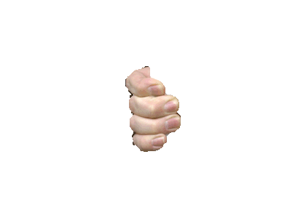
I

Slide 13
I

Slide 14
Top View

Slide 15
I

Slide 16
Question 223.38.3
The magnetic field due
to a long straight wire is
shown. Is there a magnetic
field above the hand position?
a) Yes
b) No
Yes but it is negligible

Slide 17
I

Slide 18
Question 223.38.4
The magnetic field due
to a long straight wire is
shown. Where would you
expect this field to have zero
magnitude?
a) At the wire location
b) 4 meters from the wire
Infinitely far away from the wire
Nowhere in the universe

Slide 19
I

Slide 20
I

Slide 21
I

Slide 22
Question 223.38.5
The magnetic field due
to a long straight wire is
shown. But so far our wire
Has always had a current in it.
Is there a field if there is no
current?
a) Yes
b) No

Slide 23
Question 223.38.6
The magnetic field due
to a long straight wire is
shown. What is making the field?
a) Moving electrons
b) Dissipated energy from
resistance
c) The atoms from the wire form the field

Slide 24
Question 223.38.4
The magnetic field due
to a long straight wire is
shown. Where would you
expect this field to have zero
magnitude?
a) At the wire location
b) 4 meters from the wire
Infinitely far away from the wire
Nowhere in the universe

Slide 25

Question
What is the magnitude of $\vec{A}×\vec{B}$?
$AB\cos{θ}$
$AB\sin{θ}$
$AB\tan{θ}$
AB

Slide 26
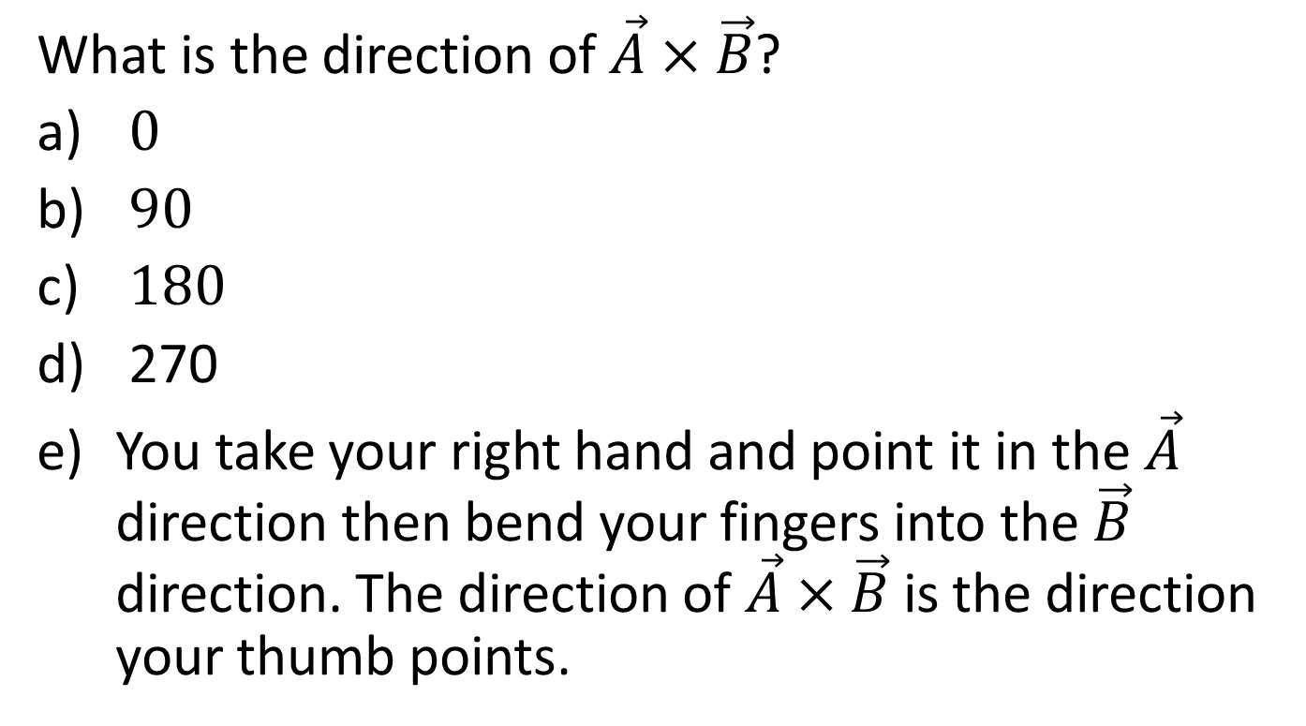
Question
What is the direction of $\vec{A}×\vec{B}$?
$0$
$90$
$180$
270
You take your right hand and point it in the $\vec{A}$ direction then bend your fingers into the $\vec{B}$ direction. The direction of $\vec{A}×\vec{B}$ is the direction your thumb points.

Slide 27
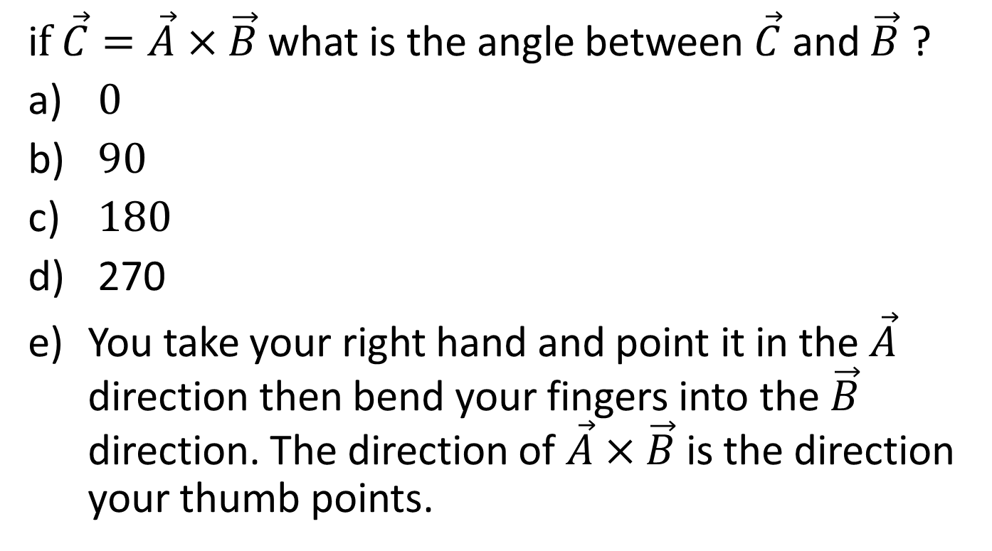
Question
i$f \vec{C}=\vec{A}×\vec{B}$ what is the angle between $\vec{C}$ and $\vec{B}$ ?
$0$
$90$
$180$
270
You take your right hand and point it in the $\vec{A}$ direction then bend your fingers into the $\vec{B}$ direction. The direction of $\vec{A}×\vec{B}$ is the direction your thumb points.

Slide 28
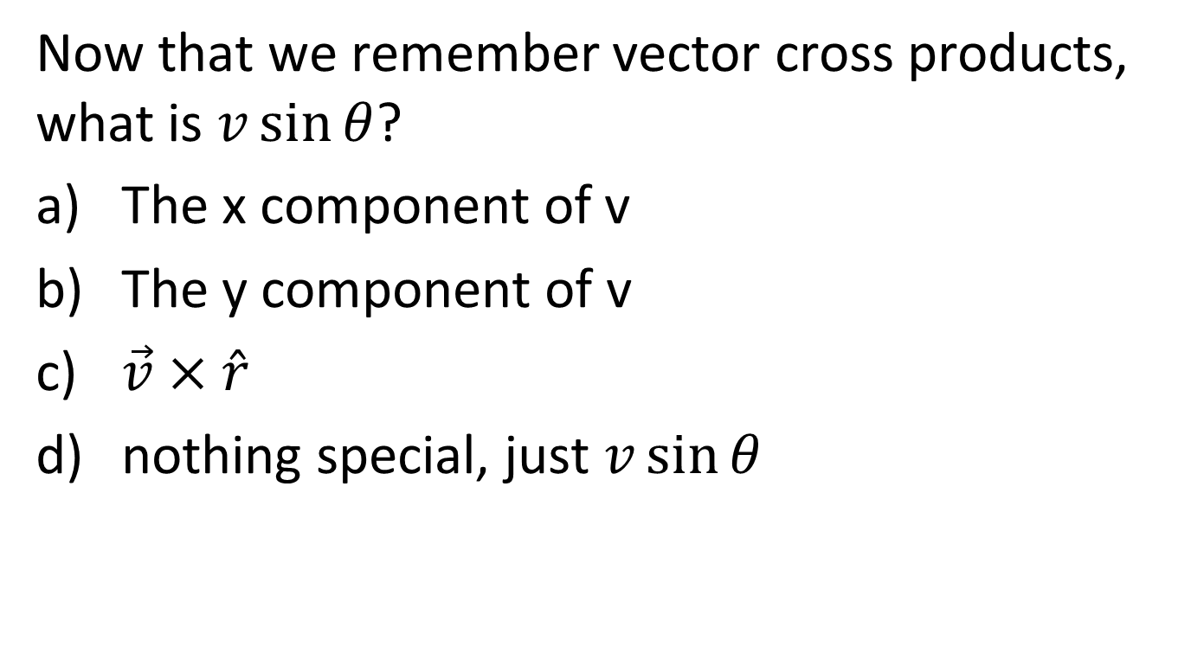
Question
Now that we remember vector cross products, what is $v\sin{θ}$?
The x component of v
The y component of v
$\vec{v}×\hat{r}$
nothing special, just $v\sin{θ}$

Slide 29
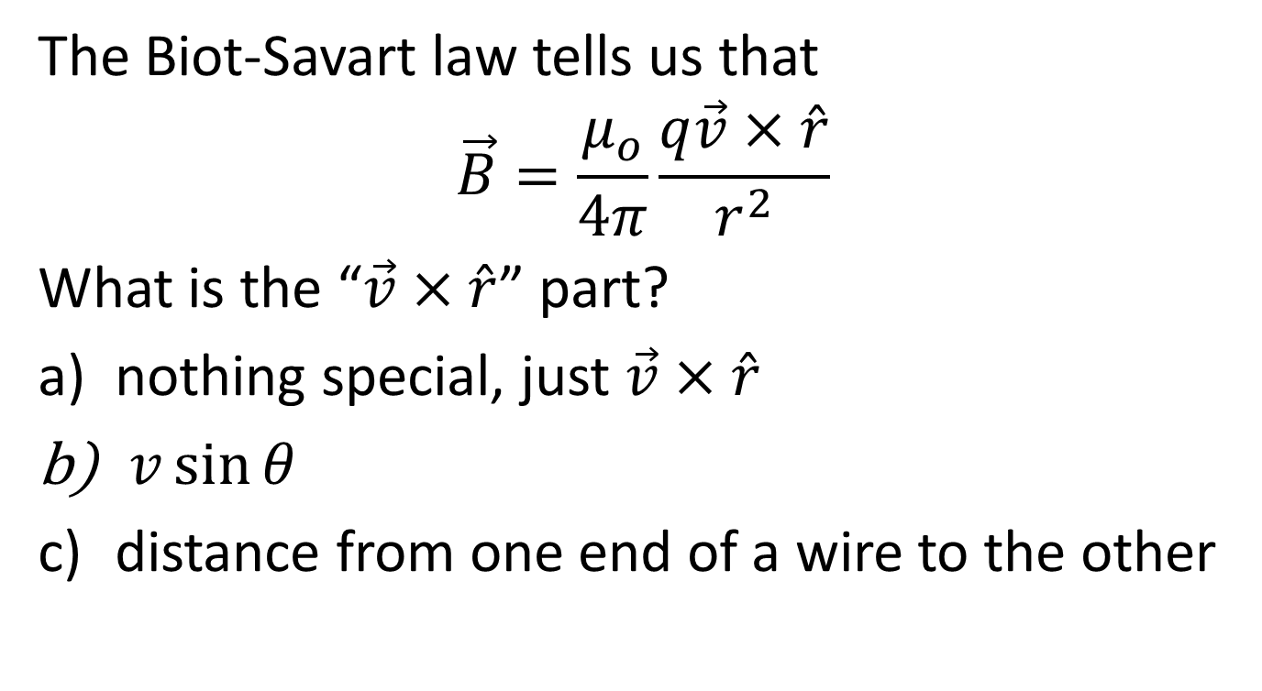
Question
The Biot-Savart law tells us that
$$\vec{B}=\frac{μ_{o}}{4π}\frac{q\vec{v}×\hat{r}}{r^{2}}$$
What is the “$\vec{v}×\hat{r}$” part?
nothing special, just $\vec{v}×\hat{r}$
$v\sin{θ}$
distance from one end of a wire to the other

Slide 30
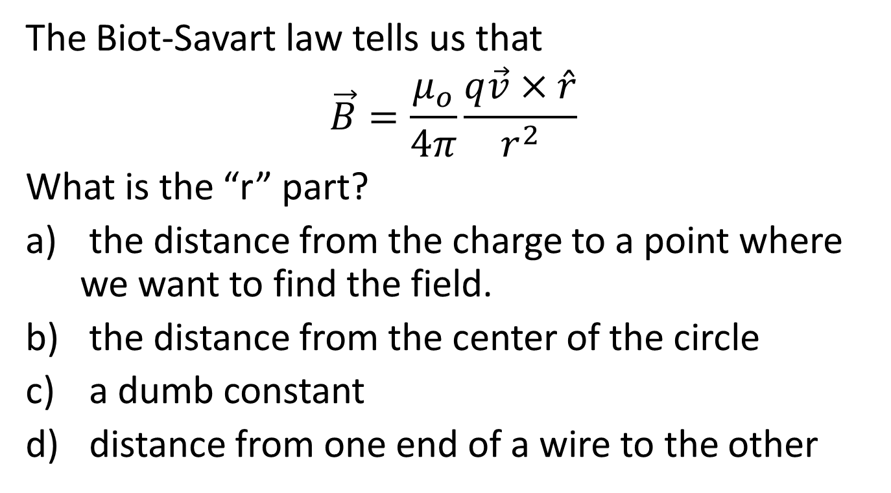
Question
The Biot-Savart law tells us that
$$\vec{B}=\frac{μ_{o}}{4π}\frac{q\vec{v}×\hat{r}}{r^{2}}$$
What is the “r” part?
the distance from the charge to a point where we want to find the field.
the distance from the center of the circle
a dumb constant
distance from one end of a wire to the other

Slide 31
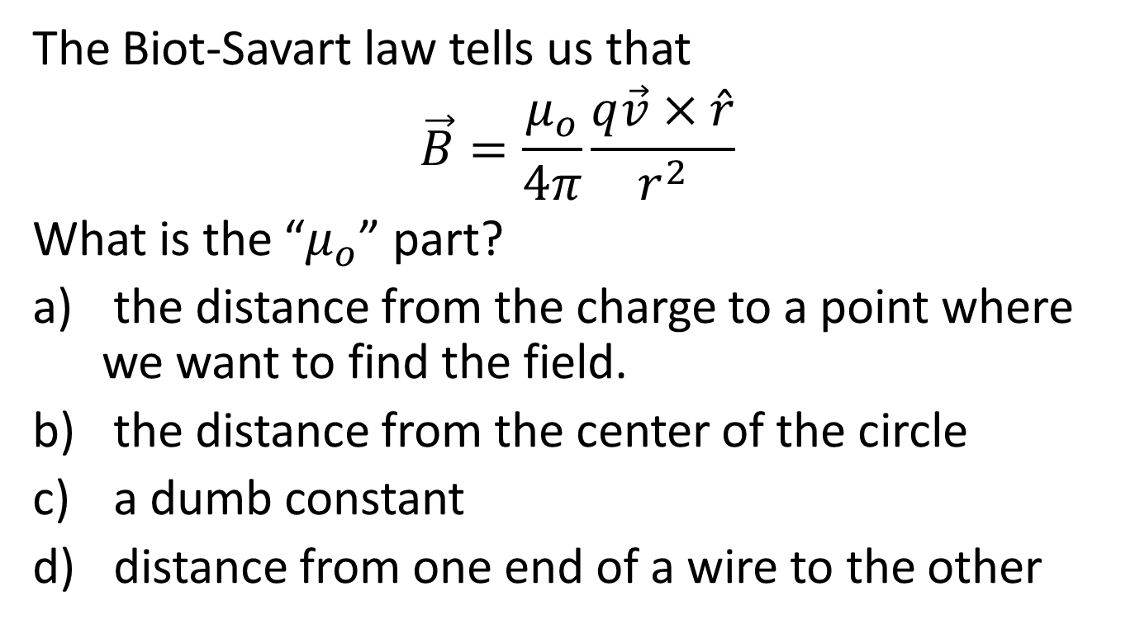
Question
The Biot-Savart law tells us that
$$\vec{B}=\frac{μ_{o}}{4π}\frac{q\vec{v}×\hat{r}}{r^{2}}$$
What is the “$μ_{o}$” part?
the distance from the charge to a point where we want to find the field.
the distance from the center of the circle
a dumb constant
distance from one end of a wire to the other

Slide 32
Question 223.38.7
x
Detector
P
1mm
r
v
Proton Path
y
z
Proton
Suppose we accelerate a proton and send it in the z-direction to a speed of 1.0×10⁷m /s. Is there a magnetic field at point P?
Yes
No

Slide 33
Question 223.38.8
x
Detector
P
1mm
r
v
Proton Path
y
z
Proton
Suppose we accelerate a proton and send it in the z-direction to a speed of 1.0×10⁷m /s. Is the magnetic field at point P stronger or weaker than the field at the detector?
Stronger
Weaker
Neither, there is no B-field at P

Slide 34
x
Detector
1mm
r
v
Proton Path
y
z
Proton

