Slide 1
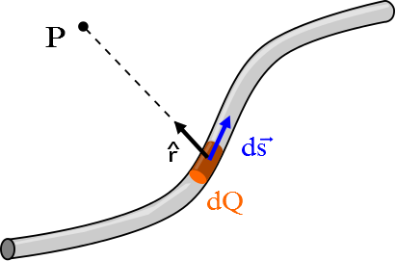
Question 223.39.1
At P the contribution to the magnetic field from dQ moving would be dB. The direction of dB would be
Perpendicular to ds
Perpendicular to r-hat
Some odd direction
Along the wire
Both a and b

Slide 2
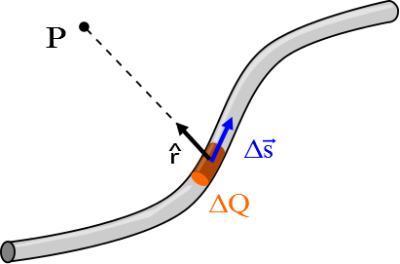

Slide 4
Question 223.39.2
At P the contribution to the magnetic field from dQ moving would be dB. The magnitude of dB would be
Proportional to r
Inversely proportional to r
Inversely proportional to r²
Would not depend on r
Both a and b

Slide 5
Question 223.39.3
At P the contribution to the magnetic field from dQ moving would be dB. The magnitude of dB would be
Proportional to I
Inversely proportional to I
Inversely proportional to I ²
Does not depend on I
Both a and b

Slide 6
Question 223.39.4
At P the contribution to the magnetic field from dQ moving would be dB. The magnitude of dB would be
Proportional to the length of ds
Inversely proportional to ds
Inversely proportional to ds ²
ds has the length 1, so dB can’t really be proportional to ds
Both a and b

Slide 7
Question 223.39.5
At P the contribution to the magnetic field from dQ moving would be dB. Would the magnitude of dB depend on the angle between ds and r-hat?
Yes
No
a and b but not c

Slide 8
Current Loop
I
P
2a
2a

Slide 9
Current Loop
I
P
2a
^
θ
r
dx
x

Slide 10
Current Loop
I
P
2a
^
θ
r
dx

Slide 11
Question 223.39.6
Does every circuit loop with a current make a magnetic field?
Yes
No
Maybe

Slide 12
Question 223.39.7
For an infinitely long wire with a current, I, the magnetic field due to that wire depends on
The current
The distance from the wire
The angle between the current direction and the direction to the point P
The width of the wire
Maybe more than one of the above but not d)

Slide 13
x
I
ds
φ
R
P
dB
y

Slide 14
x
ds
ϕ
I
ds
ϕ
R
x
θ
dB
θ
90°-θ
P
90°-θ
y
dB_{z}
y

Slide 15
x
dB
ds
ds
θ
x
R
θ
dB
90°-θ
θ
P
90°-θ
dB_{z}
I

Slide 16
http://ocw.mit.edu/ans7870/8/8.02T/f04/visualizations/magnetostatics/08-RingMagInt/08-ringMagInt320.html

Slide 17
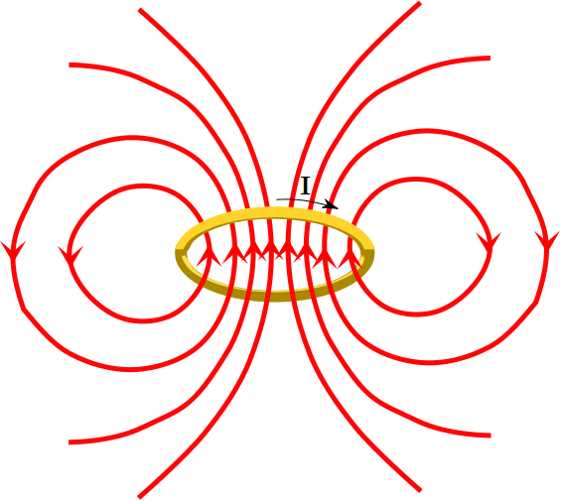

Slide 18
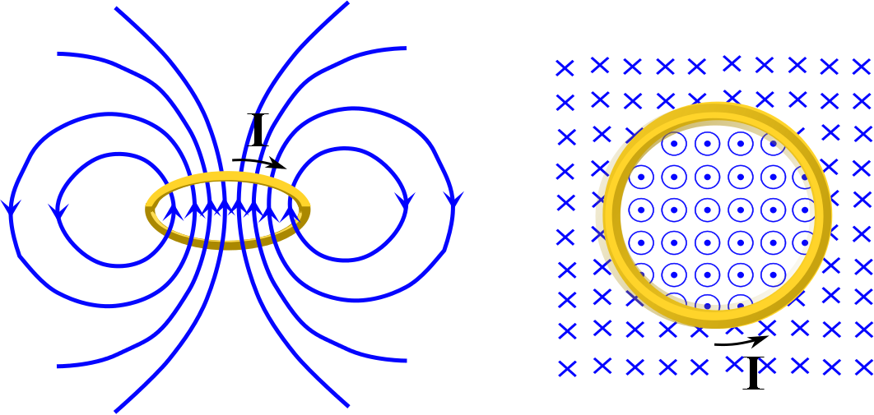

Slide 19
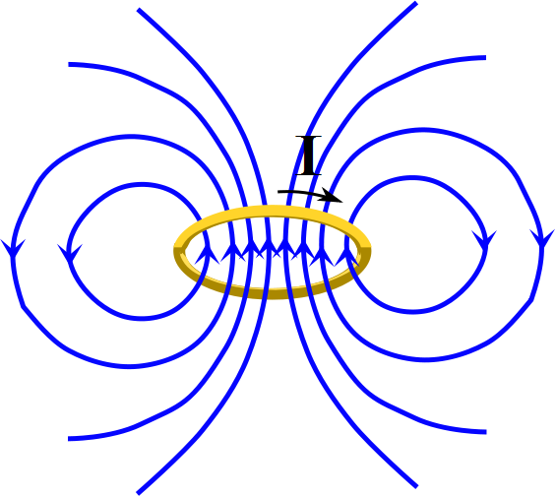

Slide 20
Question
We have the field from a current loop. Which end is the North End?
Above the loop
Below the loop
To the right of the loop
To the left of the loop
In front of the loop
In back of the loop

Slide 21
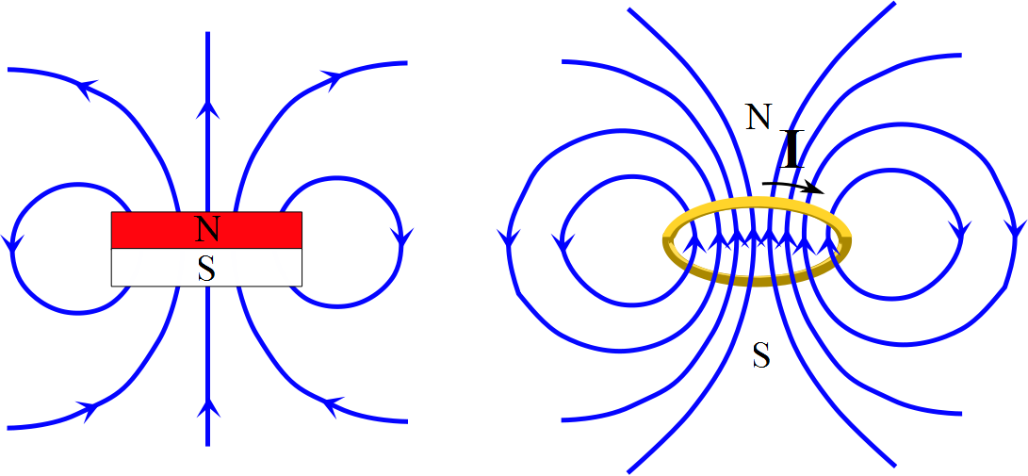

Slide 22
Question
For the current loop shown, which way is the magnetic dipole moment?
+z
-z
+x
-x
+y
-y
x
I
R
z
y

Slide 23
x
I
μ
R
z
y

Slide 24
End

Slide 26
Question 223.39.6.5
An electric circuit creates a magnetic field. As the current in the field changes, so does the field. Does this mean you can tell something about what the circuit is doing from relatively far away from the circuit?
Yes
No
Maybe

Slide 27
Question 18.3
We have current flowing through a wire. From our study of resistance, we can say…
The free charge carriers must be on the surface of the wire
The free charge must travel through the entire cross-sectional area of the wire
The free charge floats just off the surface in-between the wire and its insulating cover

Slide 28
ConcepTest 18.3a Wires I
Two wires, A and B, are made of the same metal and have equal length, but the resistance of wire A is four times the resistance of wire B. How do their diameters compare?
1) d_{A} = 4 d_{B}
2) d_{A} = 2 d_{B}
3) d_{A} = d_{B}
4) d_{A} = 1/2 d_{B}
5) d_{A} = 1/4 d_{B}

Slide 29
ConcepTest 18.3a Wires I
Two wires, A and B, are made of the same metal and have equal length, but the resistance of wire A is four times the resistance of wire B. How do their diameters compare?
1) d_{A} = 4 d_{B}
2) d_{A} = 2 d_{B}
3) d_{A} = d_{B}
4) d_{A} = 1/2 d_{B}
5) d_{A} = 1/4 d_{B}
The resistance of wire A is greater because its area is less than wire B. Since area is related to radius (or diameter) squared, the diameter of A must be two times less than B.

Slide 30
ConcepTest 18.3b Wires II
A wire of resistance R is stretched uniformly (keeping its volume constant) until it is twice its original length. What happens to the resistance?
1) it decreases by a factor 4
2) it decreases by a factor 2
3) it stays the same
4) it increases by a factor 2
5) it increases by a factor 4

Slide 31
ConcepTest 18.3b Wires II
A wire of resistance R is stretched uniformly (keeping its volume constant) until it is twice its original length. What happens to the resistance?
1) it decreases by a factor 4
2) it decreases by a factor 2
3) it stays the same
4) it increases by a factor 2
5) it increases by a factor 4
Keeping the volume (= area x length) constant means that if the length is doubled, the area is halved.
Since , this increases the resistance by four.

Slide 32
Concept Question 17.1 Temperature
You are listening to your Ipod on a hot summer day at the beach in the Bahamas. Is the resistance of the wires in the Ipod the same as it would be if you were in Siberia at the beach?
The resistance is larger in Siberia
It is larger in the Bahamas
It is the same-it does not depend on where you are!
It depends on which Ipod you buy.

Slide 33
ConcepTest 18.4 Dimmer
1) the power
2) the current
3) the voltage
4) both (1) and (2)
5) both (2) and (3)
When you rotate the knob of a light dimmer, what is being changed in the electric circuit?

Slide 34
ConcepTest 18.4 Dimmer
1) the power
2) the current
3) the voltage
4) both (1) and (2)
5) both (2) and (3)
When you rotate the knob of a light dimmer, what is being changed in the electric circuit?
The voltage is provided at 120 V from the outside. The light dimmer increases the resistance and therefore decreases the current that flows through the lightbulb.
Follow-up: Why does the voltage not change?

Slide 35
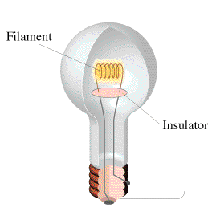
ConcepTest 18.5a Lightbulbs
Two lightbulbs operate at 120 V, but one has a power rating of 25 W while the other has a power rating of 100 W. Which one has the greater resistance?
1) the 25 W bulb
2) the 100 W bulb
3) both have the same
4) this has nothing to do with resistance

Slide 36
ConcepTest 18.5a Lightbulbs
Two lightbulbs operate at 120 V, but one has a power rating of 25 W while the other has a power rating of 100 W. Which one has the greater resistance?
1) the 25 W bulb
2) the 100 W bulb
3) both have the same
4) this has nothing to do with resistance
Since P = V² / R the bulb with the lower power rating has to have the higher resistance.
Follow-up: Which one carries the greater current?

Slide 37
ConcepTest 18.5b Space Heaters I
Two space heaters in your living room are operated at 120 V. Heater 1 has twice the resistance of heater 2. Which one will give off more heat?
1) heater 1
2) heater 2
3) both equally

Slide 38
ConcepTest 18.5b Space Heaters I
Two space heaters in your living room are operated at 120 V. Heater 1 has twice the resistance of heater 2. Which one will give off more heat?
1) heater 1
2) heater 2
3) both equally
Using P = V² / R, the heater with the smaller resistance will have the larger power output. Thus, heater 2 will give off more heat.
Follow-up: Which one carries the greater current?

