Slide 1
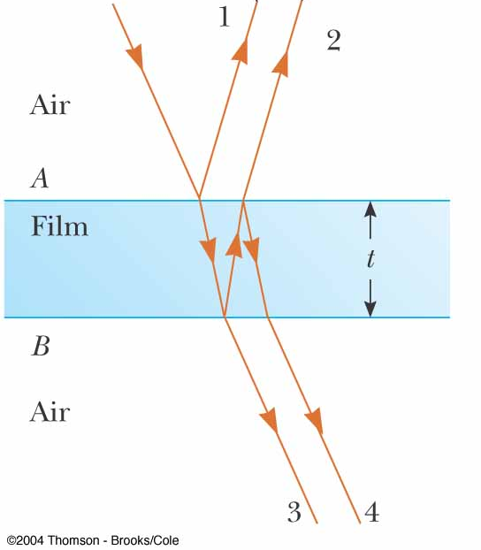
Question 223.8.1
In the figure, will rays 1 and 2 be in phase?
Yes
No
Can’t tell with the information given

Slide 2
Question 223.8.2
The thickness of the film is 2 wavelengths. Will rays 1 and 2 be in phase?
Yes
No
Can’t tell with the information given
1
2
n=1
t
n>1
n=1

Slide 4
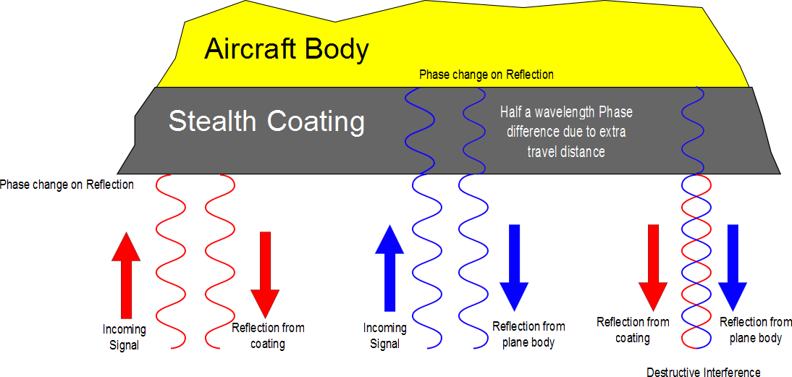

Slide 5
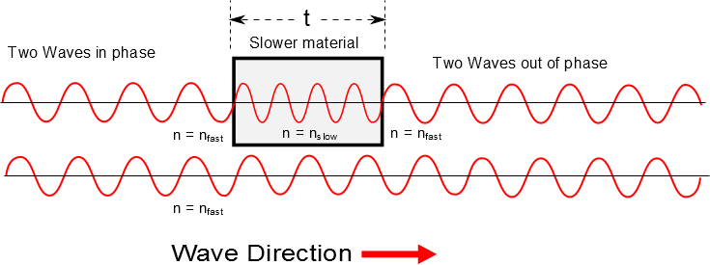

Slide 7
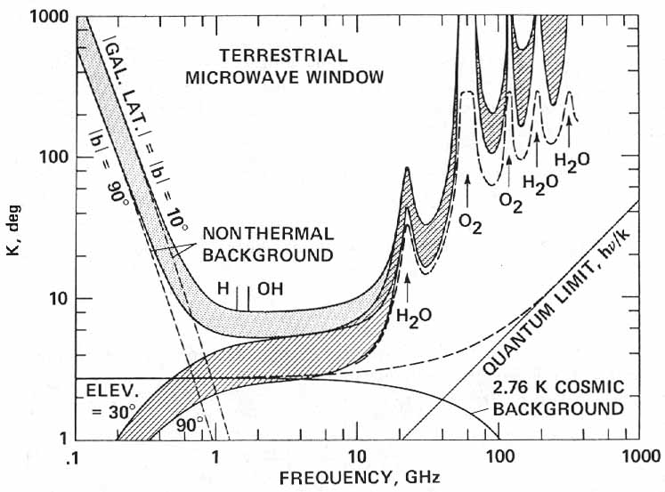

http://history.nasa.gov/CP-2156/p359.htm

Slide 8
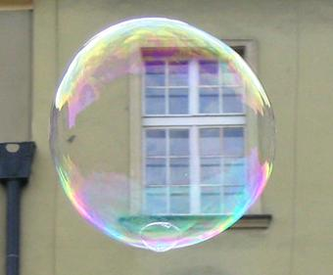
Phase Shift
No Phase Shift
n=1
n>1
n=1

Slide 9
Question 223.8.2.5
The thickness of the film is 2 wavelengths. Will rays 3 and 4 be in phase?
Yes
No
Can’t tell with the information given
1
2
n=1
t
n>1
n=1
3
4

Slide 10
Question 223.8.3
I have two waves coming from speakers in my room. I am sitting 3 wavelengths away from one speaker and 4.5 wavelengths away from the other speaker. I hear..
Twice the normal loudness
4 times the normal loudness
8 times the normal loudness
Practically nothing

Slide 11
Question 223.8.4
I have two waves coming from speakers in my room. I am sitting 3 wavelengths away from one speaker and 6 wavelengths away from the other speaker. I hear..
Twice the normal loudness
4 times the normal loudness
8 times the normal loudness
Practically nothing

Slide 12
A thin film of oil (n=1.25) is located on a smooth wet pavement. When viewed perpendicular to the pavement, the film reflects most strongly red light at 640nm and reflects no blue light at 512nm . How thick is the oil film?

Slide 13
Loud Spot

Slide 14
Loud Spot
Full wavelength farther from the green wave center

Slide 15
Loud Spots

Slide 16
Dead Spot
Half a wavelength farther from the green wave center

Slide 17
Dead Spots

Slide 18
3m
2m
2m

Slide 19
Example of Beats

