Slide 1
Question 223.18.1
Two campers wish to start a fire during the day. One camper is nearsighted and one is farsighted. Whose glasses should be used to focus the Sun’s rays onto some paper to start the fire?
either camper
the nearsighted camper
the farsighted camper

Slide 2
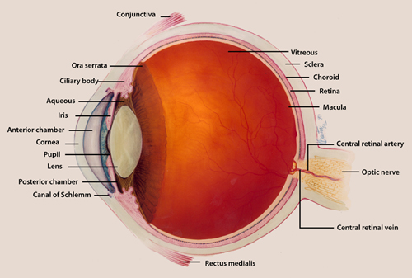

Slide 3
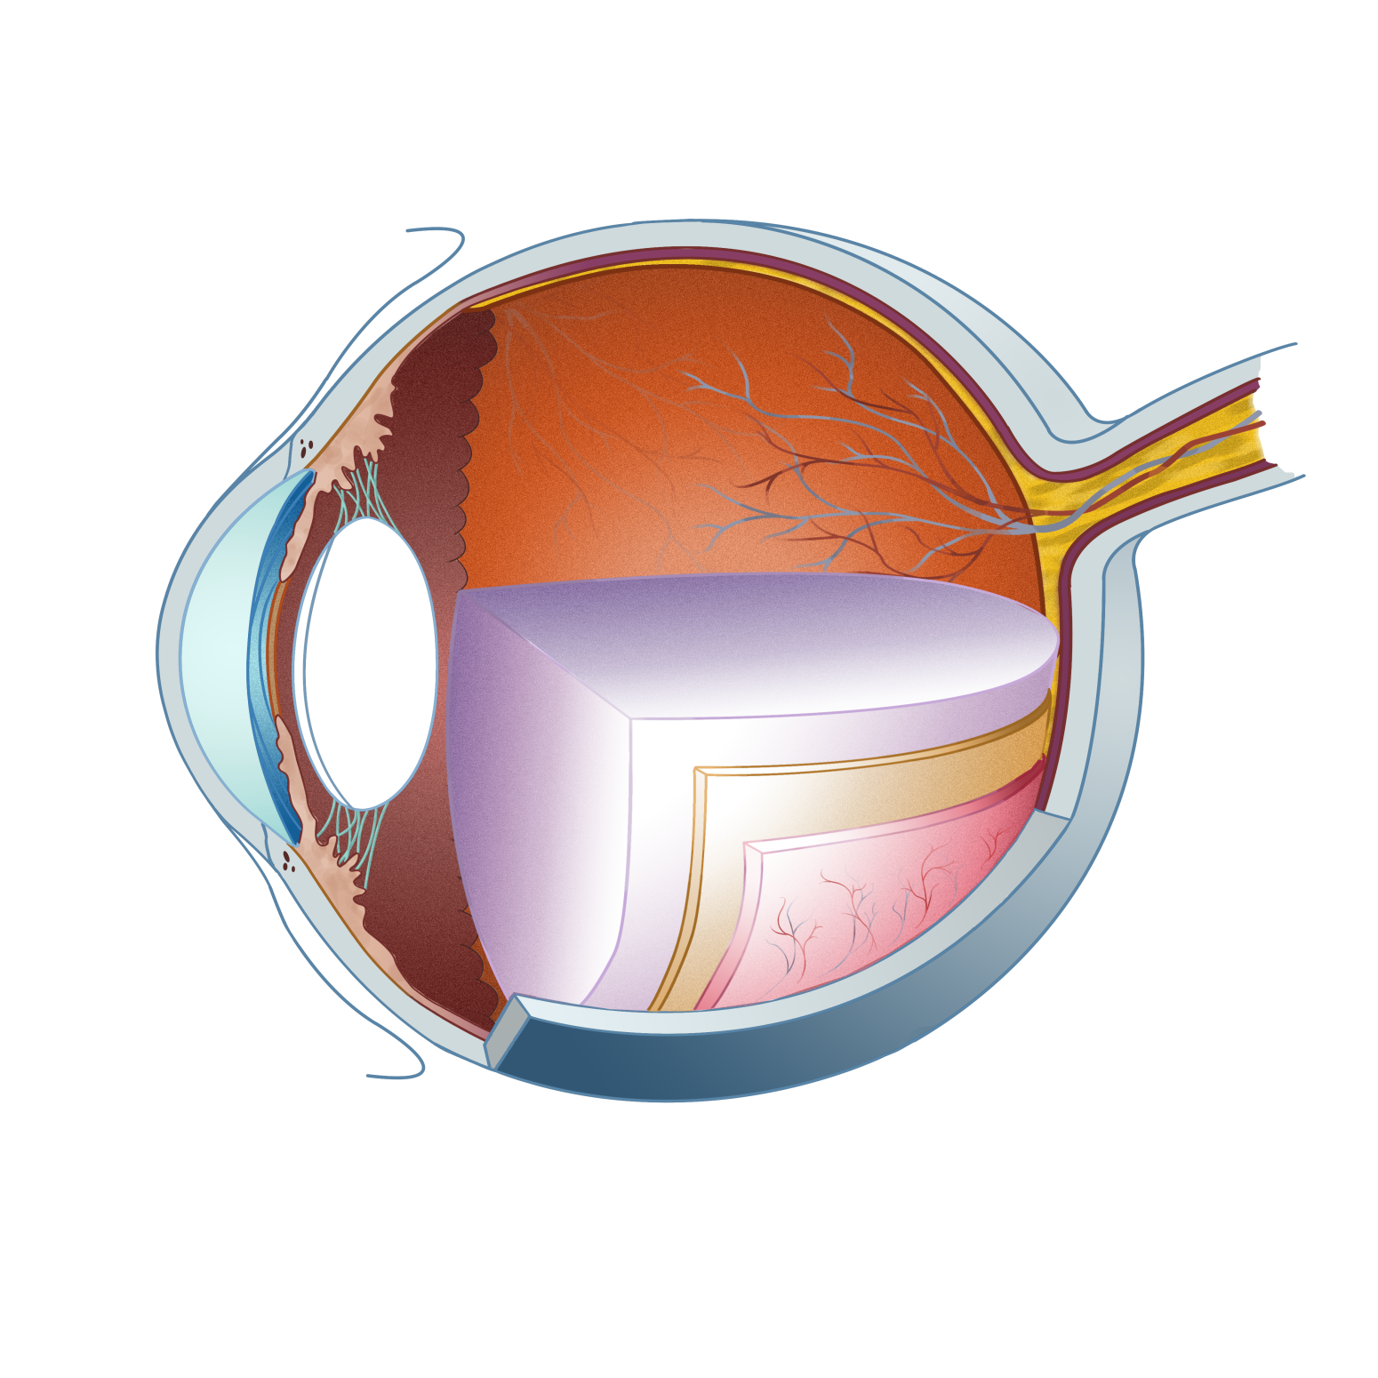
Vitreous humor
Lens
Aqueous humor
Pupil
Irisl
Cornea
Retina

Slide 5
532THz (red)
562THz (green)
714THz (blue)
Relative Sensitivity
Frequency

Slide 6
Relative Sensitivity
(red)
(green)
(blue)
Frequency

Slide 7
Question 223.18.2
What do biologists call the process of focusing the light in the eye?
focusing
accommodation
image formation
Contraction of the ciliary muscle

Slide 8
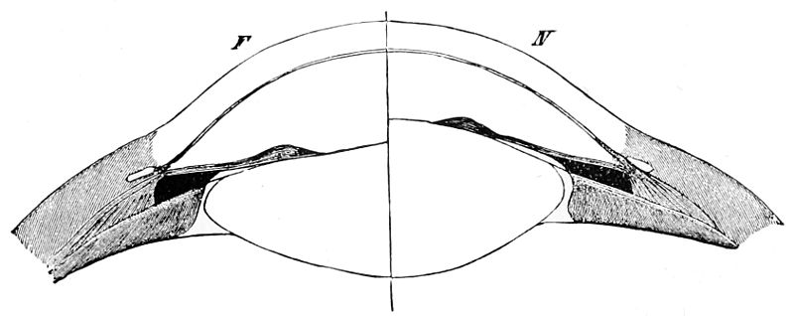
Accommodation by the Lens
Accommodation refers to dynamic changes in the shape of the lens.
As an object comes within about 20 feet the light rays originating at a point are no longer considered to be parallel.
Rather these light rays diverge and a greater refractive power is required to bring them into focus.
The lens can contribute about 12 or more diopters to the focusing of light rays on the back of the eye by rounding up.
Notes:
neuro4e-fig-11-02-0.jpg

Slide 9
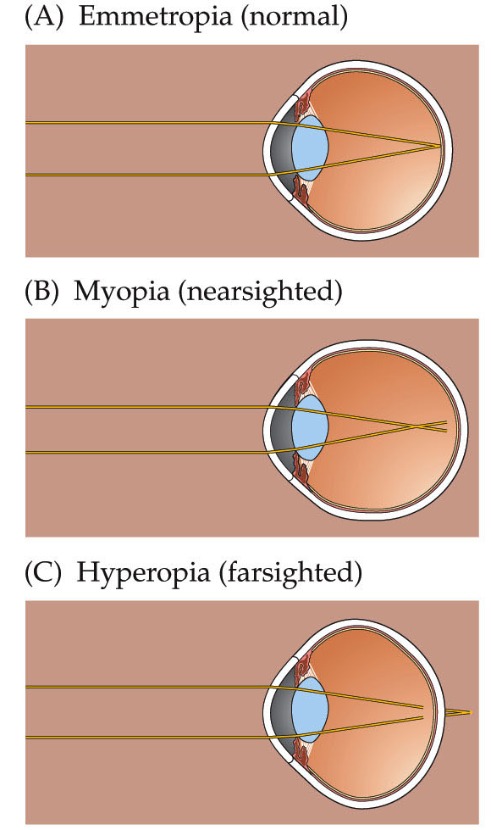
Myopia and Other Refractive Errors
Myopia – nearsightedness
The ability to see close objects clearly but distant objects are blurry
Cornea and lens focus object in front of the retina
Corrected by concave lens (minus lens), radial keratotomy, laser corneal sculpting.
Hyperopia - farsightedness
Ability to see distant objects but close objects are blurry
Image is focused behind the retina.
Corrected by convex lenses.
Notes:
neuro4e-box-11-a(1)-0.jpg

Slide 10
Normal
Myopia – nearsightedness
Corrected myopia

Slide 11
Normal
Hyperopia - farsightedness
Corrected Hyperopia

Slide 12
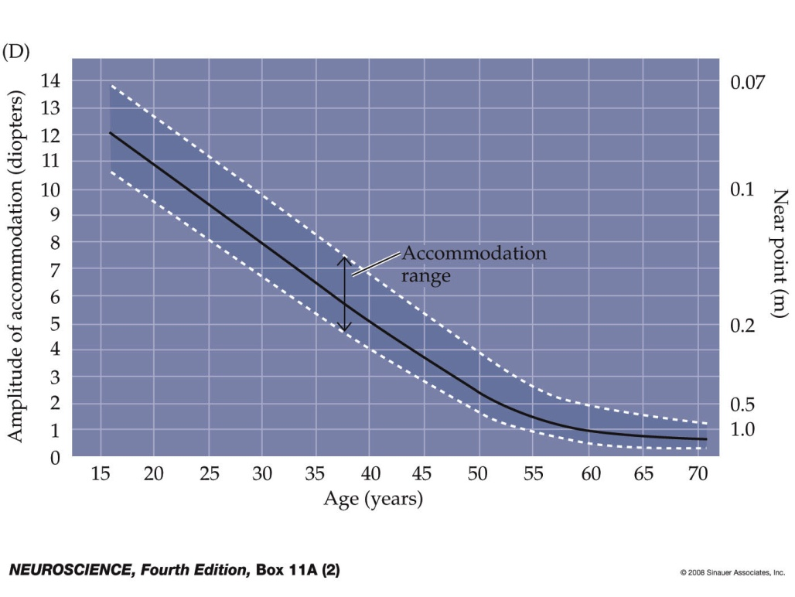
Myopia and Other Refractive Errors
Presbyopia - degeneration of accommodation
Lens becomes less flexible with age probably because new cells are being generated but old ones are not being destroyed.
Near point of vision has increased past 9 inches
Generally develops after 40 years or in people who do fine, close work.
What is your near point of vision?
Corrected by “reading glasses” or bifocal glasses used only for close work.
Notes:
neuro4e-box-11-a(2)-0.jpg

Slide 13
Question 223.18.4
What is the power (in Diopters) of a lens with a focal distance of 0.5m?
5
4
3
2
1

Slide 14
Question 223.18.3
What do we call the position of the closest thing we can see?
Near point
Far point
Squint point
conjunctiva

Slide 15
Simple Magnifier
A simple magnifier consists of a single converging lens
This device is used to increase the apparent size of an object
The size of an image formed on the retina depends on the angle subtended by the eye

Slide 16
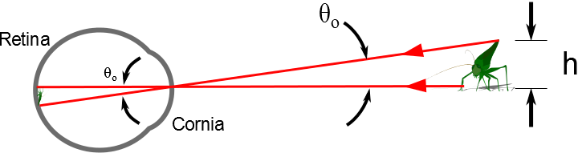

Slide 17
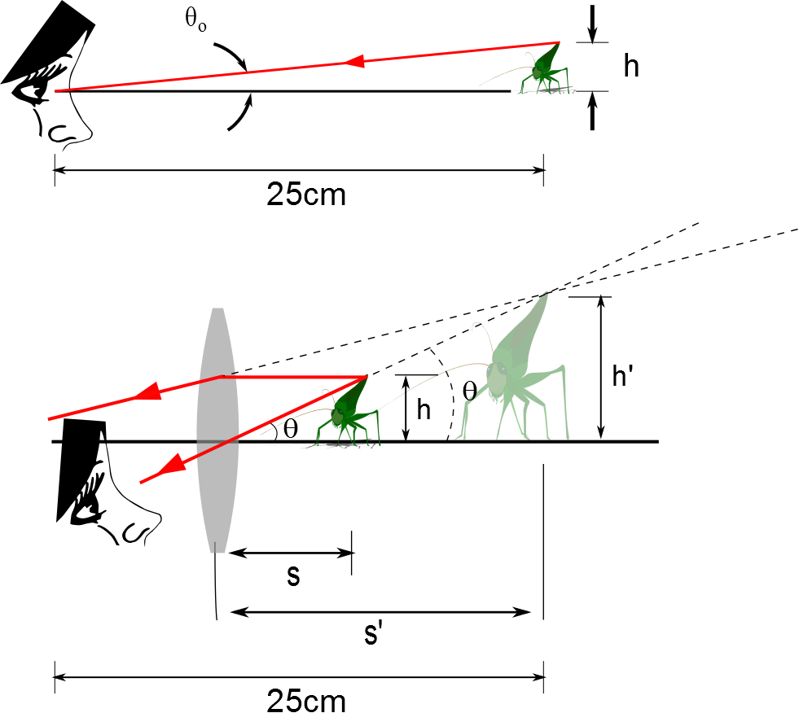
The Size of a Magnified Image
When an object is placed at the near point, the angle subtended is a maximum
The near point is about 25 cm
When the object is placed near the focal point of a converging lens, the lens forms a virtual, upright, and enlarged image

Slide 18
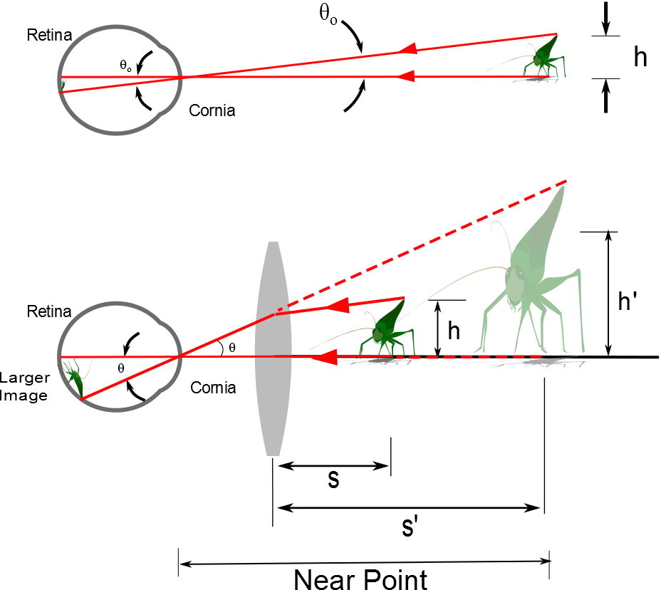

Slide 19
Angular Magnification
Angular magnification is defined as
The angular magnification is at a maximum when the image formed by the lens is at the near point of the eye
s’ = - 25 cm
Calculated by

Slide 20
Angular Magnification, cont.
The eye is most relaxed when the image is at infinity
Although the eye can focus on an object anywhere between the near point and infinity
For the image formed by a magnifying glass to appear at infinity, the object has to be at the focal point of the lens
The angular magnification is

Slide 21
Magnification by a Lens
With a single lens, it is possible to achieve angular magnification up to about 4 without serious aberrations
With multiple lenses, magnifications of up to about 20 can be achieved
The multiple lenses can correct for aberrations

Slide 22
The Compound Microscope

Slide 23
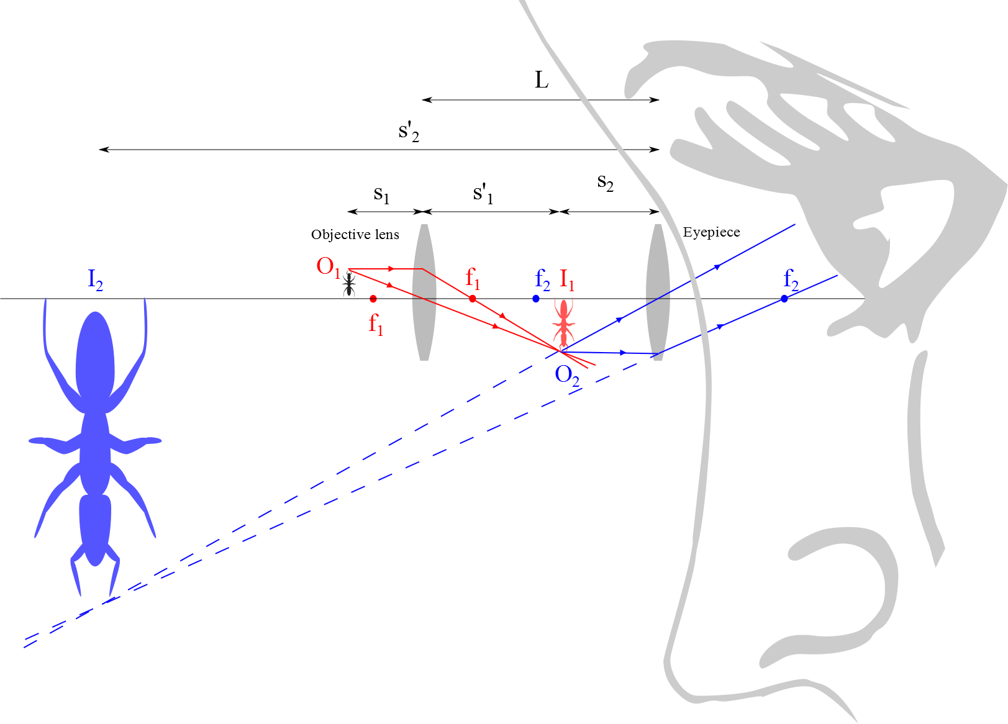
Compound Microscope

Slide 24
Compound Microscope, cont.
The lenses are separated by a distance L
L is much greater than either focal length
The object is placed just outside the focal point of the objective
This forms a real, inverted image
This image is located at or close to the focal point of the eyepiece
This image acts as the object for the eyepiece
The image seen by the eye, I₂, is virtual, inverted and very much enlarged

Slide 25
Magnification: Compound Microscope
The lateral magnification by the objective is
M_{o} = - L / ƒ_{o}
The angular magnification by the eyepiece of the microscope is
m_{e} = 25 cm / ƒ_{e}
The overall magnification of the microscope is the product of the individual magnifications

Slide 26
Wavelength and the Microscope
The ability of an optical microscope to view an object depends on the size of the object relative to the wavelength of the light used to observe it
For example, you could not observe an atom (d ≈ 0.1 nm) with visible light (λ ≈ 500 nm)

Slide 27
The telescope

Slide 28
Telescopes
Telescopes are designed to aid in viewing distant objects
Two fundamental types of telescopes
Refracting telescopes use a combination of lenses to form an image
Reflecting telescopes use a curved mirror and a lens to form an image
Telescopes can be analyzed by considering them to be two optical elements in a row
The image of the first element becomes the object of the second element

Slide 29
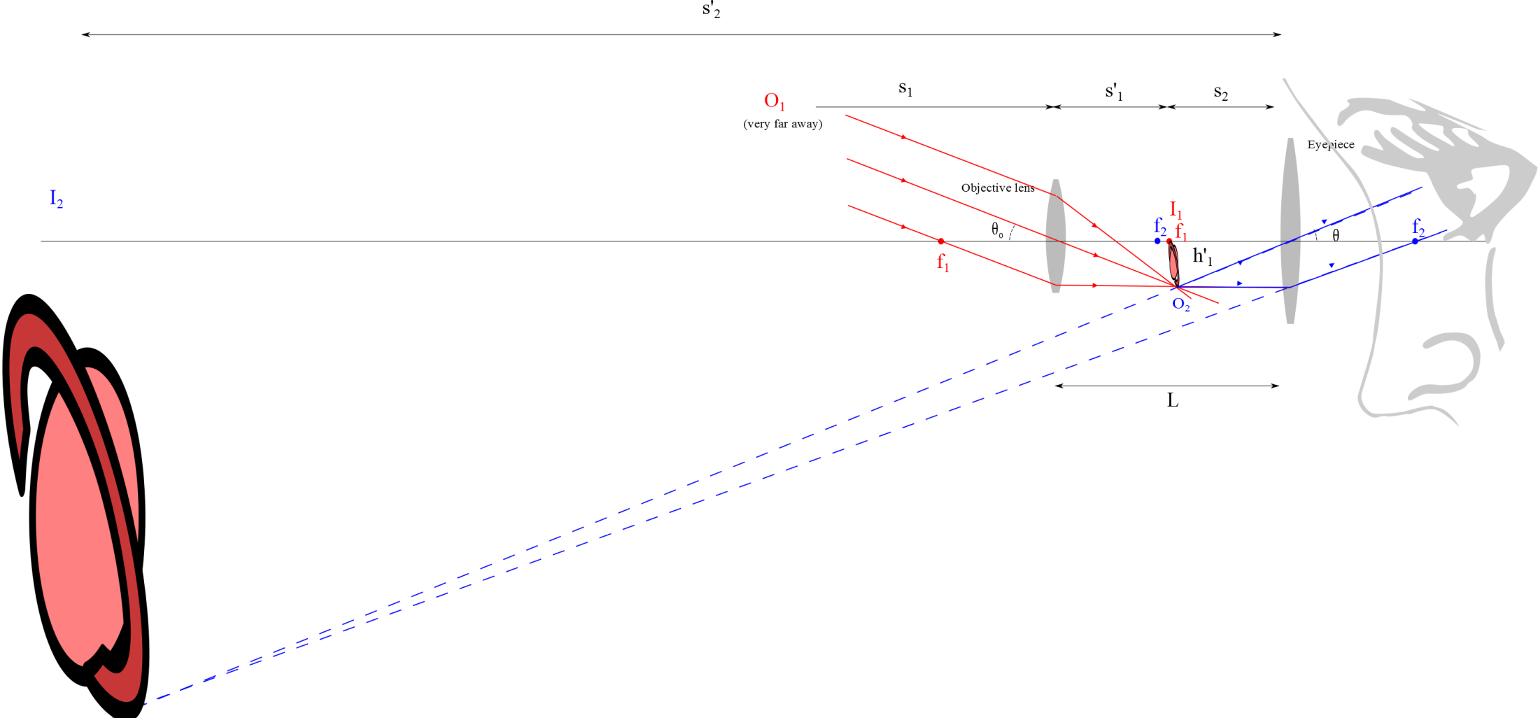
Refracting Telescope

Slide 30
Angular Magnification of a Telescope
The angular magnification depends on the focal lengths of the objective and eyepiece
The negative sign indicates the image is inverted
Angular magnification is particularly important for observing nearby objects
Nearby objects would include the sun or the moon
Very distant objects still appear as a small point of light

Slide 31
Disadvantages of Refracting Telescopes
Large diameters are needed to study distant objects
Large lenses are difficult and expensive to manufacture
The weight of large lenses leads to sagging which produces aberrations
Chromatic Aberration

Slide 32
Reflecting Telescope
Helps overcome some of the disadvantages of refracting telescopes
Replaces the objective lens with a mirror
The mirror is often parabolic to overcome spherical aberrations
In addition, the light never passes through glass
Except the eyepiece
Reduced chromatic aberrations
Allows for support and eliminates sagging

Slide 33
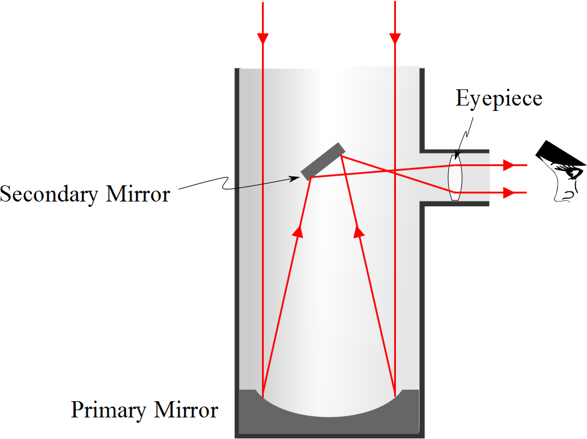
Reflecting Telescope: Newtonian

Slide 34
Examples of Telescopes
Reflecting Telescopes
Largest in the world are the 10-m diameter Keck telescopes on Mauna Kea in Hawaii
Each contains 36 hexagonally shaped, computer-controlled mirrors that work together to form a large reflecting surface
Refracting Telescopes
Largest in the world is Yerkes Observatory in Williams Bay, Wisconsin
Has a diameter of 1 m

