Slide 1
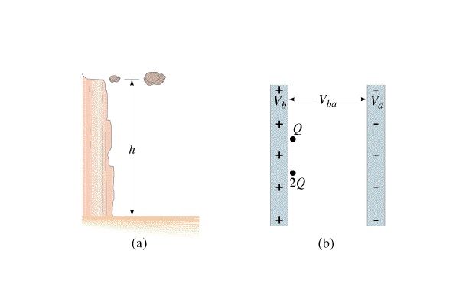
Question 223.28.8
A proton and an electron are in a constant electric field created by oppositely charged plates. You release the proton from the positive side and the electron from the negative side. When it strikes the opposite plate, which one has more KE?
1) proton
2) electron
3) both acquire the same KE
4) neither – there is no change of KE
5) they both acquire the same KE but with opposite signs
electron
electron
-
+
proton
proton

Slide 2
Question 223.28.8
A proton and an electron are in a constant electric field created by oppositely charged plates. You release the proton from the positive side and the electron from the negative side. When it strikes the opposite plate, which one has more KE?
1) proton
2) electron
3) both acquire the same KE
4) neither – there is no change of KE
5) they both acquire the same KE but with opposite signs
Since PE = qV and the proton and electron have the same charge in magnitude, they both have the same electric potential energy initially. Because energy is conserved, they both must have the same kinetic energy after they reach the opposite plate.
electron
electron
-
+
proton
proton

Slide 3
Question 223.29.0.1
I have an English literature graduate that is $60K in debt after college and a humanities graduate that is $20K in debt after college. Who has more economic potential?
The English lit grad
The humanities grad

Slide 4


F_{g}
Δr

Slide 5
Question 223.29.1
If I do work to move an object away from the Earth’s surface, the potential energy
Increases
Decreases
Stays the same

Slide 6
Question 223.29.2
I have an object a distance y from the Earth’s surface. If I somehow increase it’s mass, it’s potential energy…
Increases
Decreases
Stays the same

Slide 8
Question 223.29.3
What does it mean that the potential energy of the Earth-Moon system is negative
The moon is moving
The moon will explode
The Earth will heat up
The Moon is gravitationally bound to the Earth.

Slide 9
F_{e}
Δr

Slide 11
Question 223.29.4
What does it mean that the potential energy of a proton-electron system is negative
The electron is moving
The electron will explode
The proton will heat up
The electron is electrically bound to the Proton.

Slide 12
F_{e}
Δr

Slide 14
Question 223.29.5
Which group of charges took more work to bring together from a very large initial distance apart?
2
+1
1
d
+2
+1
d
d
+1
+1
3
d
Both took the same amount of work

Slide 15
Question 223.29.5
Which group of charges took more work to bring together from a very large initial distance apart?
2
+1
1
d
+2
+1
d
d
+1
+1
3
d
Both took the same amount of work
For case 1: only 1 pair
The work needed to assemble a collection of charges is the same as the total PE of those charges:
For case 2: there are 3 pairs
added over all pairs

Slide 16
ConcepTest 17.7a Work and Electric Potential I
Which requires the most work, to move a positive charge from P to points 1, 2, 3 or 4 ? All points are the same distance from P.
1) P → 1
2) P → 2
3) P → 3
4) P → 4
5) all require the same amount of work
3
2
1
4
P

Slide 17
ConcepTest 17.7a Work and Electric Potential I
Which requires the most work, to move a positive charge from P to points 1, 2, 3 or 4 ? All points are the same distance from P.
1) P → 1
2) P → 2
3) P → 3
4) P → 4
5) all require the same amount of work
3
For path #1, you have to push the positive charge against the E field, which is hard to do. By contrast, path #4 is the easiest, since the field does all the work.
2
1
4
P

Slide 18
E
p

Slide 20
Before
v
79q_{e}
2q_{e}
After
v
79q_{e}
2q_{e}

Slide 21
Question 223.28.8
Which requires zero work, to move a positive charge from P to points 1, 2, 3 or 4 ? All points are the same distance from P.
1) P → 1
2) P → 2
3) P → 3
4) P → 4
5) all require the same amount of work
3
2
1
4
P

Slide 22
Question 223.28.8
Which requires zero work, to move a positive charge from P to points 1, 2, 3 or 4 ? All points are the same distance from P.
1) P → 1
2) P → 2
3) P → 3
4) P → 4
5) all require the same amount of work
For path #3, you are moving in a direction perpendicular to the field lines. This means you are moving along an equipotential, which requires no work (by definition).
3
2
1
4
P
Follow-up: Which path requires the least work?

