Slide 1
Question 223.30.1
A capacitor with an electric potential energy difference of 120J and a plate separation of 0.01m has a proton placed inside of it. If the proton starts at the + side of the capacitor at rest, how much kinetic energy will it gain?
We would need to know the maximum speed
1.2J
120J
500J

Slide 2
Question 223.30.2
We found that the force per unit charge “was something” called an electric field. Is the potential energy per unit charge something physical?
No, it is a convenience quantity
Yes it is the electric potential
No, none of this is real

Slide 3
Question 223.30.3
Where does the electric potential exist?
Everywhere in space
Everywhere the field exists
Everywhere there is electrical potential energy
Hay wait a minute, more than one of these is right

Slide 4
Question 223.30.3
What are the units of electric potential?
N/C
Ergs
Joules
J/C
V

Slide 5
Question 223.30.4
What common item is marked in units of electric potential?
Capacitors
Inductors
Resistors
Batteries

Slide 6
Question
What is the electric potential of an ideal capacitor?
qEd
qE
Qd
Ed

Slide 7
High Potential Energy
Low Potential Energy
E
+
- - - - - - - - - - - - - - - - - - - - - - - - - - - - - -
- - - - - - - - - - - - - - - - - - - - - - - - - - - - - -
+ + + + + + + + + + + + + + + + + + + + + + + + + +
+ + + + + + + + + + + + + + + + + + + + + + + + + +
A
B
d

Slide 8
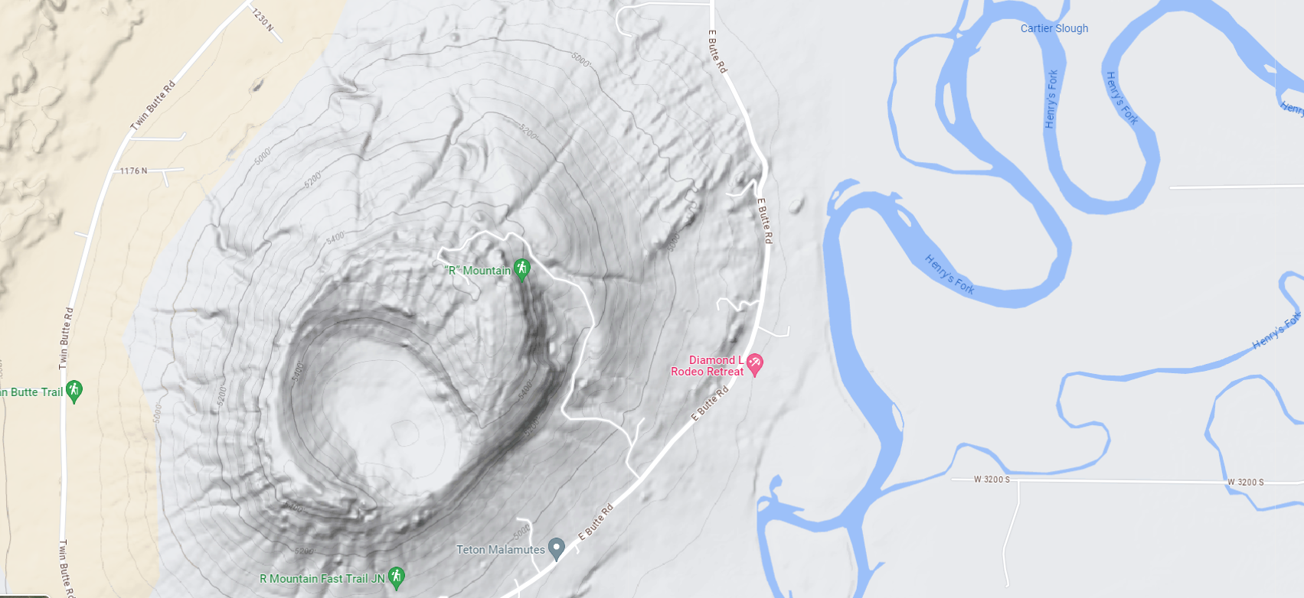
Question
What is this grey line that goes around
R Mountain?
A snake, there are snakes up there
It is a river
It is a line of constant elevation
It is a line of constant gravitational potential

Slide 9
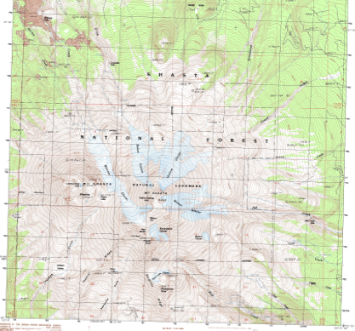
Question 223.30.5
Which point has a higher gravitational potential energy?
A
B

Slide 10
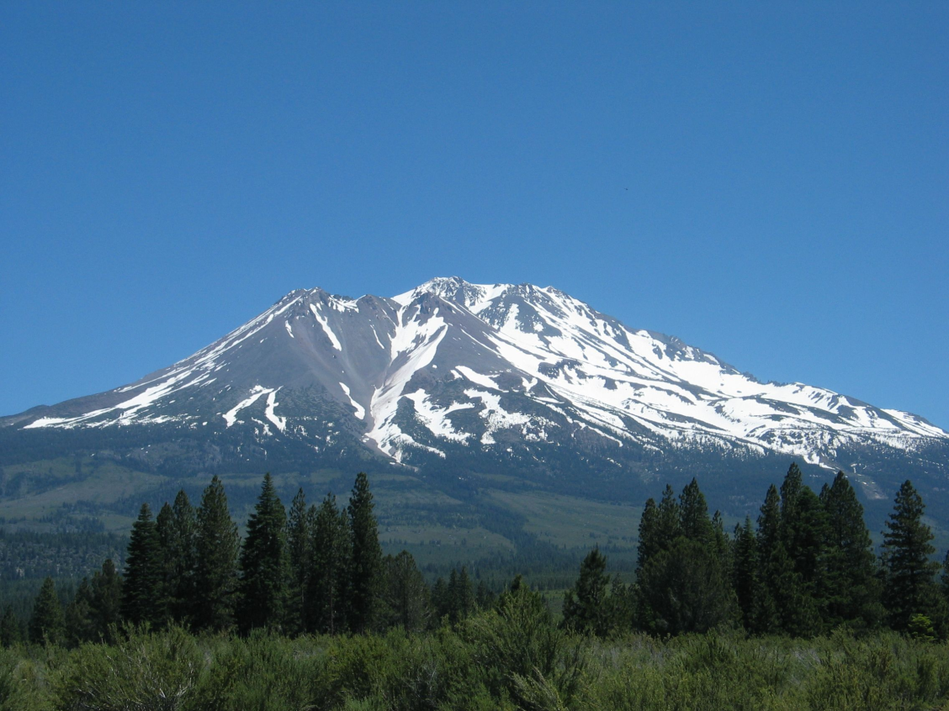
Shasta Example

Slide 11
-
-
-
-
-
-
What are the green lines that go around the charged conductor shown?
Still might be a snake
It is a river of charge
It is a line of constant electrical potential energy
It is a line of constant electrical potential
-
-
-
-
-
-
-
-
-
-
-
-
-
-
-
-
-
-
-
-
-
-
-
-
-
-
-
-
-
-
-

Slide 12
Equipotential Surfaces
High Potential Energy
Low Potential Energy
E
+
- - - - - - - - - - - - - - - - - - - - - - - - - - - - - -
- - - - - - - - - - - - - - - - - - - - - - - - - - - - - -
+ + + + + + + + + + + + + + + + + + + + + + + + + +
+ + + + + + + + + + + + + + + + + + + + + + + + + +
A
B
d

Slide 13
Question 223.30.6
Which point has a higher electric potential?
E
- - - - - - - - - - - - - - - - - - - - - - - - - - - - - -
- - - - - - - - - - - - - - - - - - - - - - - - - - - - - -
+ + + + + + + + + + + + + + + + + + + + + + + + + +
+ + + + + + + + + + + + + + + + + + + + + + + + + +
A
B

Slide 14
-
-
-
-
-
-
-
-
-
-
-
-
-
-
-
-
-
-
-
-
-
-
-
-
-
-
-
-
-
-
-
-
-
-
-
-
-

Slide 15
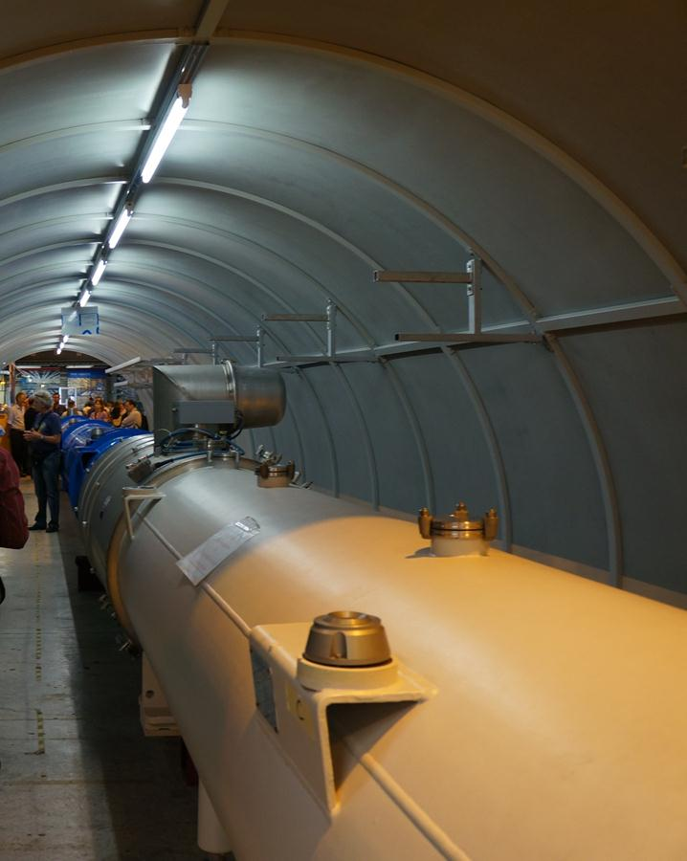
Section of the beam pipe of the LHC.
This section is no longer used, so you see people standing next to it (otherwise, standing next to the beam magnets would not be very safe!)

Slide 16
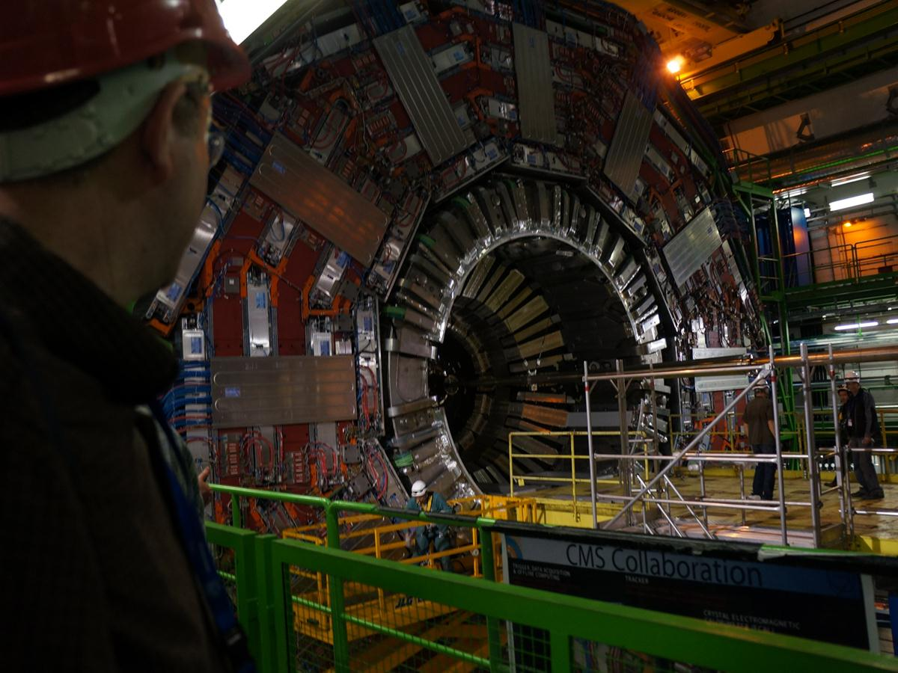

Slide 17
Question 223.30.7
A capacitor with an electric potential energy difference of 120V and a plate separation of 0.01m has a proton placed inside of it. If the proton starts at the + side of the capacitor at rest, how much kinetic energy will it gain?
We would need to know the maximum speed
1.9x10⁻¹⁷J
2x10⁻¹⁰J
120J
500J

Slide 18
Question 223.30.8
In our last question, we had a kinetic energy of 1.9x10⁻¹⁷J. How many electron volts is this?
1.2eV
about 12eV
about 120eV
about 1200eV

