Slide 1
Survey Results:
What do you hope to learn from this course?
I hope to learn physics!
Fundamentals of PH geared toward engineering (waves, magnetism, optics, etc.)
Not really sure. Never really know before I start.
What do you hope to do with this new knowledge?
Most said they wanted to apply what they learn in Engineering.
Expand my understanding of these principles to enable me to be a more competent engineer.
Also do well on the FE exam I plan on taking soon.

Slide 2
Survey Results
What do you expect the lectures to do for you?
Most wanted the lectures to answer questions and clarify concepts
This is in keeping with the Learning Model
Excite & motivate me about Physics. Learn interesting applications.
I expect the lectures to present the information in a way that allows me to associate new knowledge with old, and gives me a strong enough grasp of the material that I can teach it to others.

Slide 3
Survey Results
What do you expect the book to do for you?
Answers varied
Most said the book would be a source for learning the concepts we will study.
Give greater insight to lectured material
To be a source of deepening understanding of concepts. Good guide for the course. Reference source.
I expect the book to be a detailed resource providing information regarding the topics discussed throughout the course.
If it does anything more than provide equations, I'll be happy.

Slide 4
Reading
Some Studies show reading can be important
Studies in 1990’s showed that in introductory physics courses…”
30% of students read the book
30% of students pass the course
The studies showed that the book is most helpful if read in advance of lecture and homework
Think of an English class, could you discuss and understand Hamlet without reading it?
I wanted to capitalize on this gain.
I want every advantage we can get!
Post graduate learning is mostly from books working on your own.
How to do this?
We picked the best, most easy to read book we could find! (but it weights to much)
Quizzes will be given to help remind you to read – they will not be concept questions, just test whether or not you did the reading.

Slide 5
Survey Results
How many hours a week do you think it will take to learn all you need to know from this course?
Answers varied from 8 to 20.
Average was 11
I hope that it will be no more than 15
We meet 5 days a week and you expect two hours out of class for every hour in class = 15 hours
This is a 4 credit hour class, so we all expect it to be more work than the average class
It takes time and effort to grow new neurological connections that support these new skills
I want you to tell me how we are doing.
If you feel the load is too heavy
If you feel the load is too light
It will take some cooperation to make sure we neither kill you off nor send you to your jobs unprepared.

Slide 6
Transverse Wave
Longitudinal Wave

Slide 7
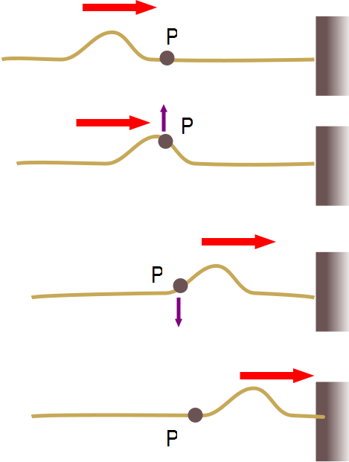

Slide 10
Before
9
After
9

Slide 12
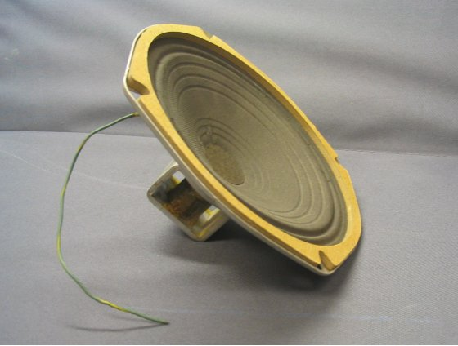

Slide 14
Question 7.5
For sound waves in air, something experiences simple harmonic motion, what is it?
A pipe
The air particles
The pressure
dust

Slide 15
Bar Graph of Displacement from Original Position

Slide 21
t = 0
t = t₁
t = t₂
t = t₃

Slide 22
t₁
t₂
t₃

