Slide 1
Lecture 5

Slide 2
Inertial Frames
Remember Inertial Reference Frames
The two observers can both take the view that they are stationary
Newton’s laws are all good in either frame
y
v_{x}
A
B
x

Slide 3
Spherical Emitter Setup
Spherical Wave Crests
Detector
Point Source

Slide 4
y
v_{x}
A
B
x

Slide 5
Moving Detector

Slide 6
y
v_{x}
A
B
x

Slide 7
Moving Detector

Slide 8
Moving Detector Math

Slide 9
y
A
B
x
v_{x}

Slide 10
Moving Source

Slide 11
y
A
B
x
v_{x}

Slide 12
Moving Source

Slide 13
Sonic Boom Setup
v_{s}
θ
s_{n}
s_{o}
s₁
s₂
s₃
s₄
v_{s}t

Slide 14

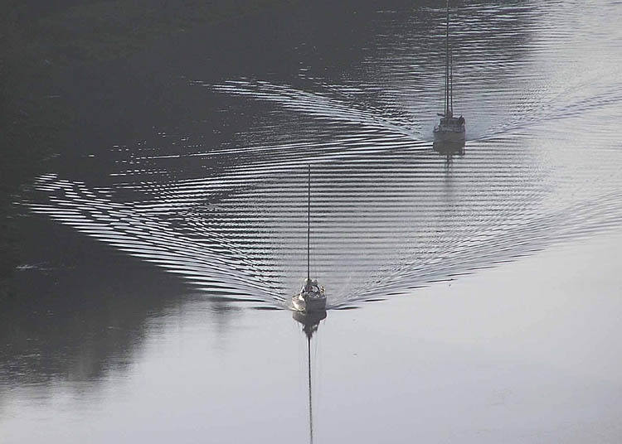

Slide 15
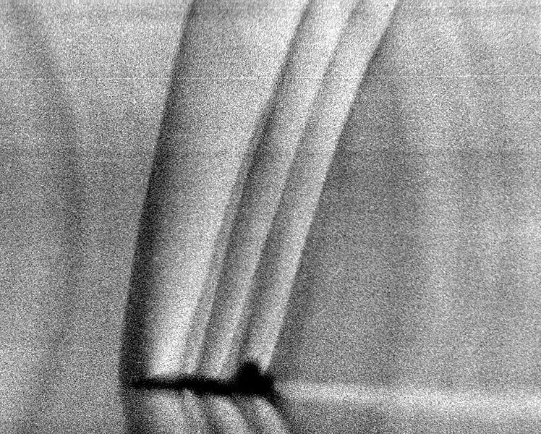

Slide 17
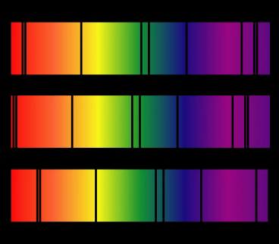
Top: Normal 'dark' spectral line positions at rest.
Middle: Source moving away from observer.
Bottom: Source moving towards observer.
http://www.jwst.nasa.gov/education/7Page45.pdf

Slide 18
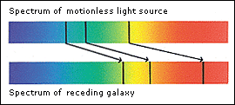

Slide 19
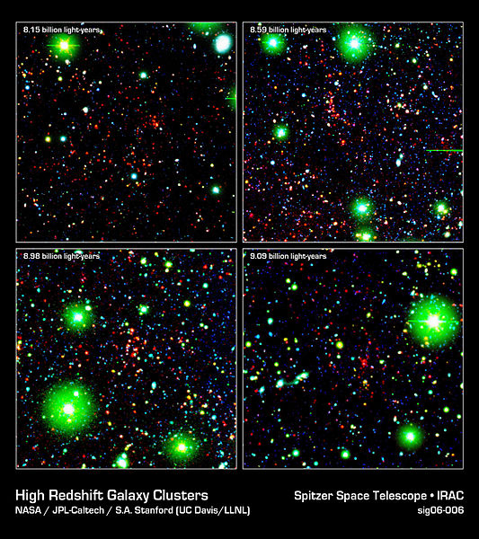

Slide 20
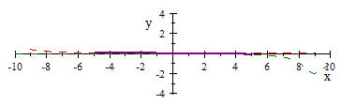

Slide 21
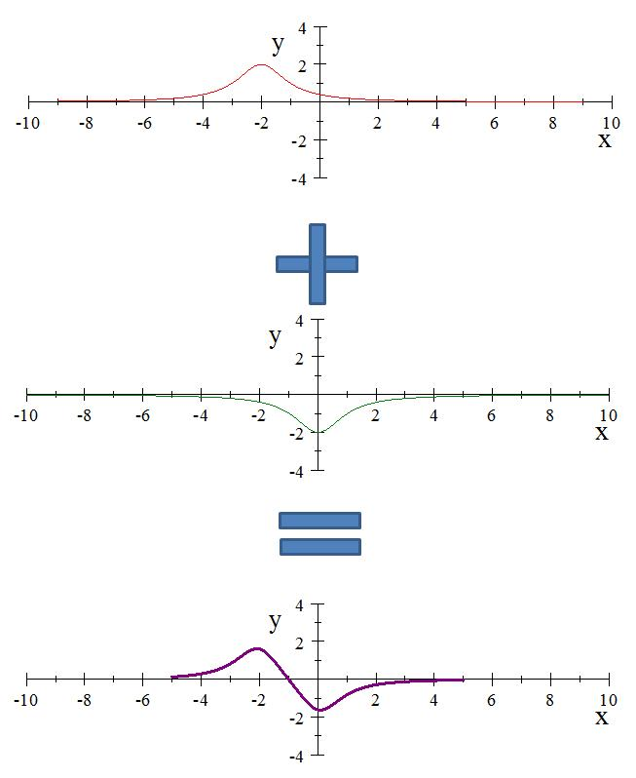

Slide 22
Question 11.3
A
B
C

Slide 23
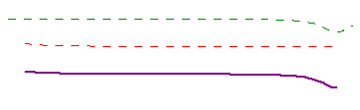

Slide 24
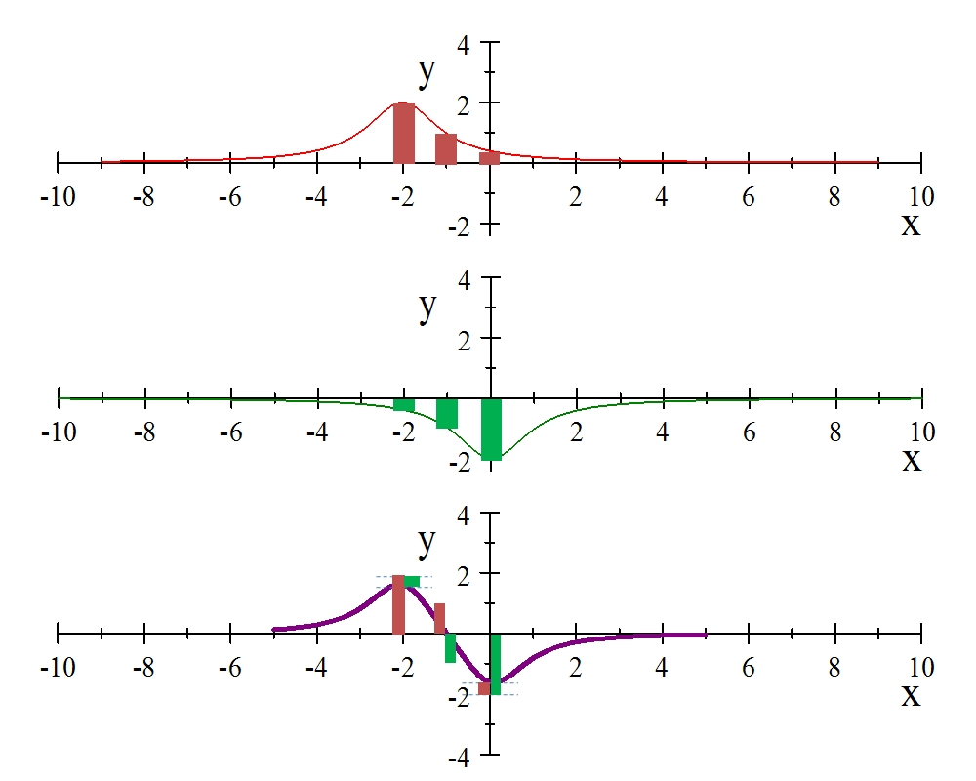

Slide 25
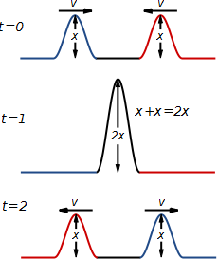
Constructive Interference

Slide 26
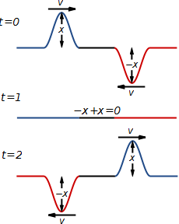
Destructive Interference

Slide 27
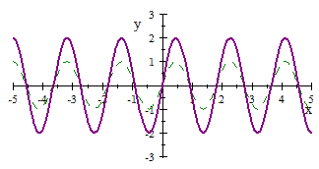

Slide 28
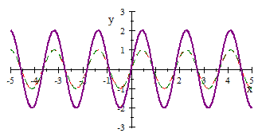

Slide 29
Question 11.4
Are the green and purple waves in phase?
Yes
No

Slide 30
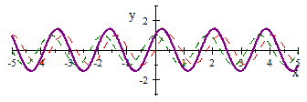

Slide 31
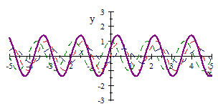

Slide 32
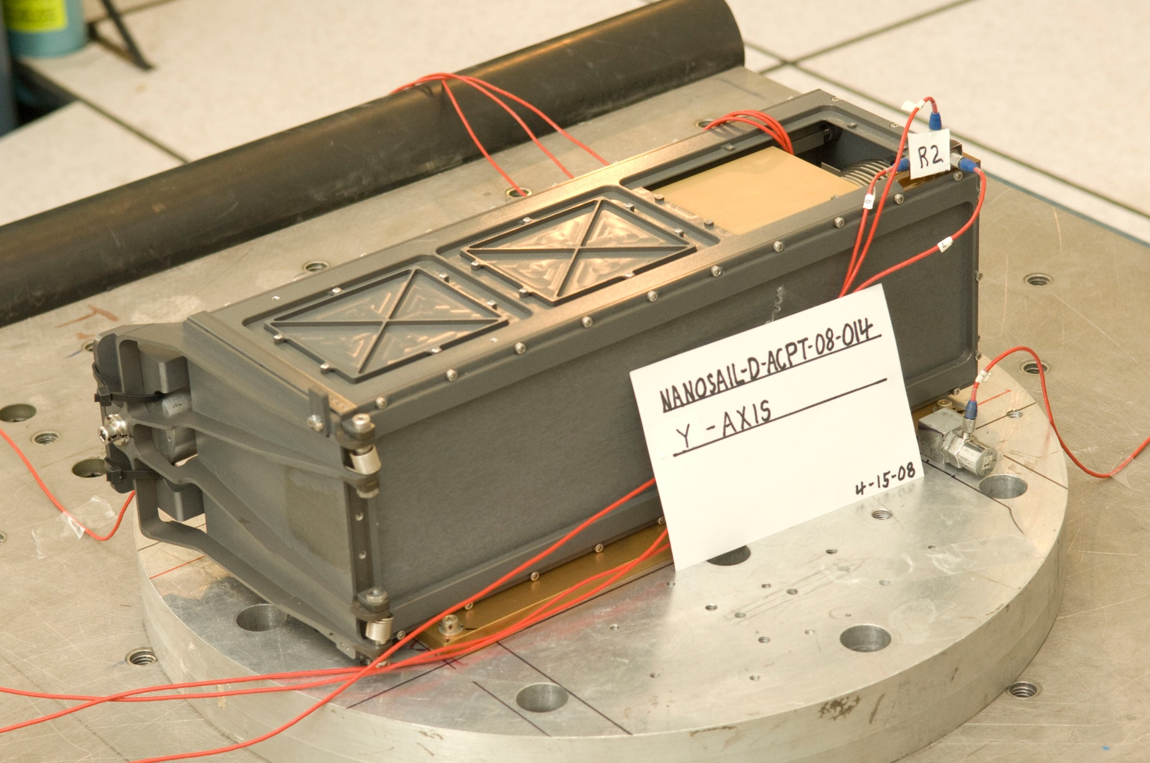

Slide 36
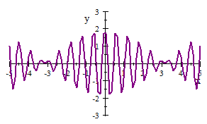

Slide 37
Question 11.5
Two graphs are shown below. Each graph represents the result of adding two waves together. For which graph is the frequency difference greater between the two original waves?.
A
B

