Slide 1
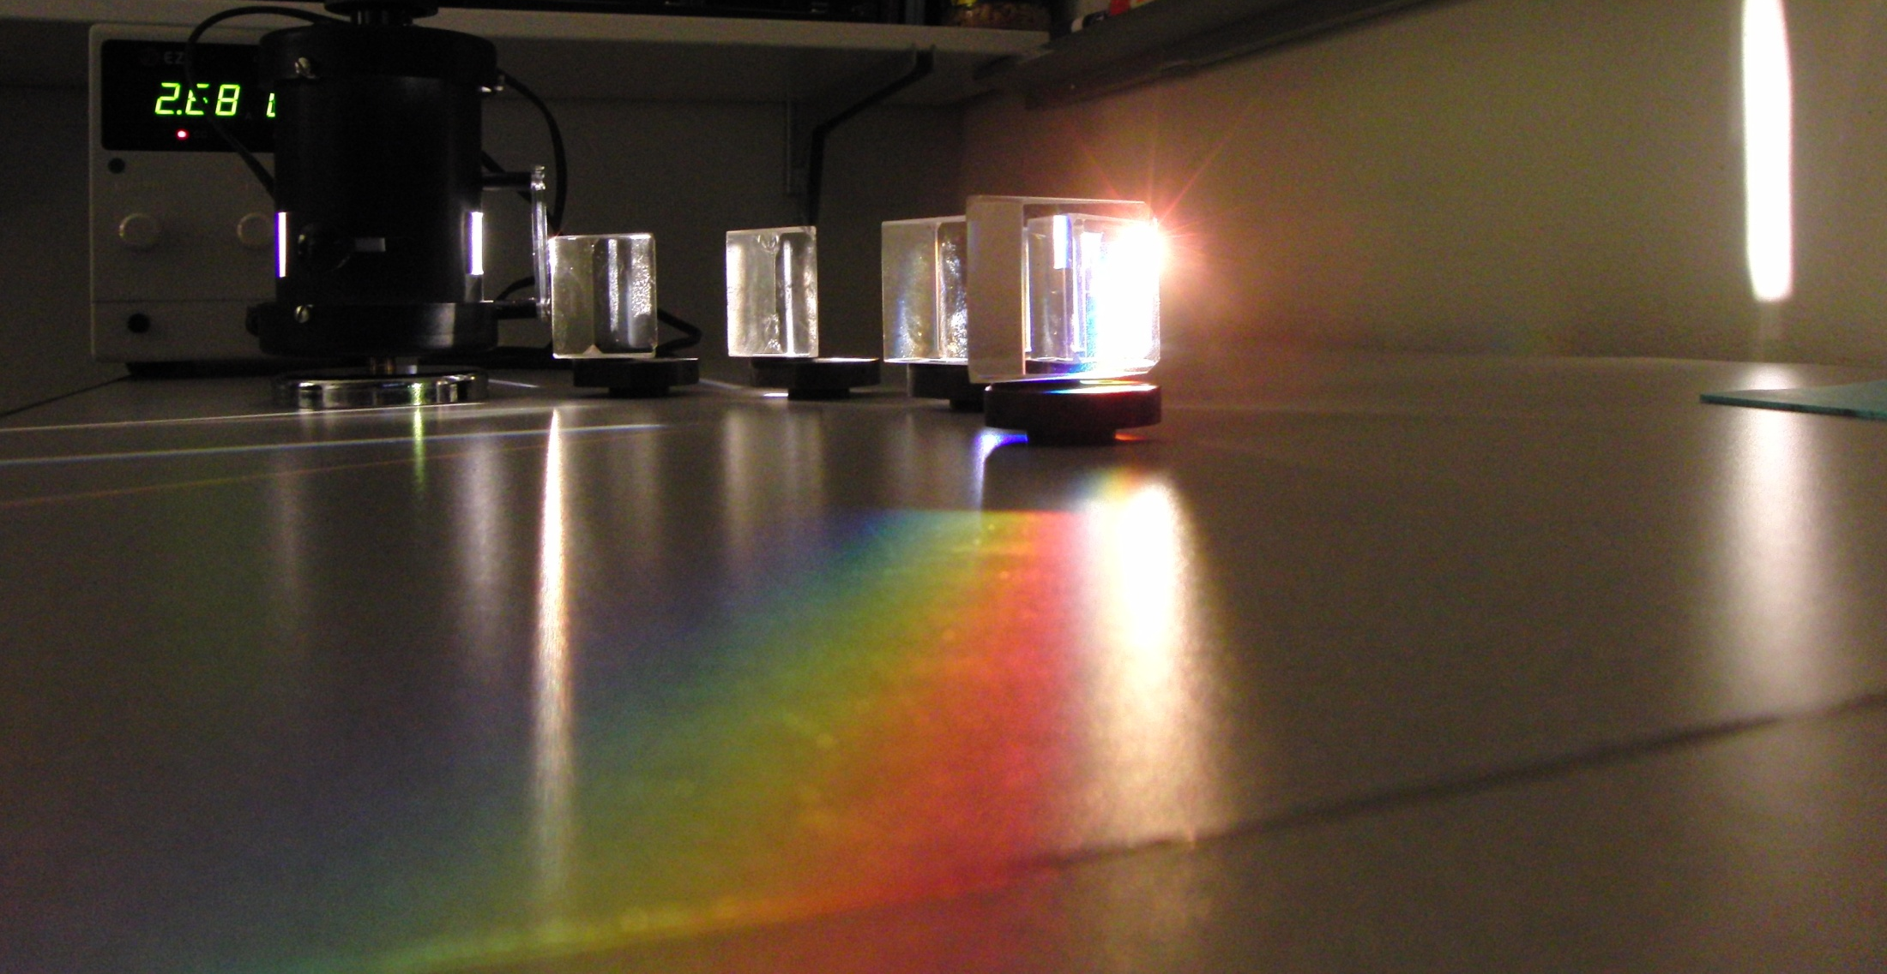

Slide 2
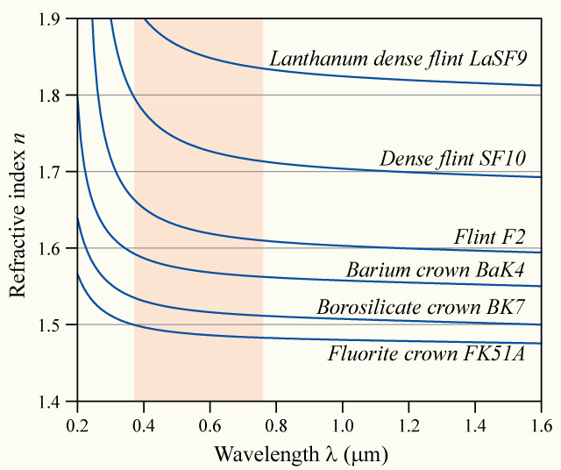

Slide 3
δ_{R}
White Light
δ_{B}
Red
Blue

Slide 4
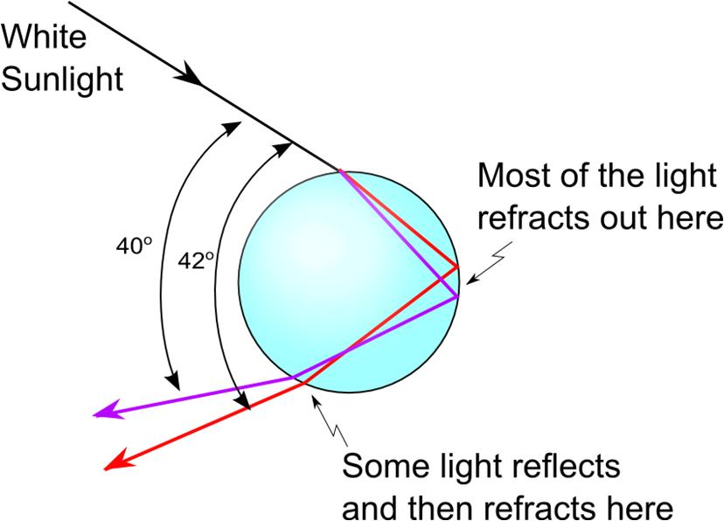

Slide 5
Light of wavelength 700nm is incident on the face of a fused quartz prism at an angle of 75.0℃ (with respect to the normal to the surface). The apex angle of the prism is 60.0℃ . Use the value of n=1.458 and calculate the angle
of refraction at this first surface,
of incidence at the second surface,
of refraction at the second surface, and
between the incident and emerging rays.

Slide 6
Finding δ
Φ/2
δ
η
φ
φ
φ
β
θ₁
α
α
θ₁
θ₂
θ₂
n

Slide 7
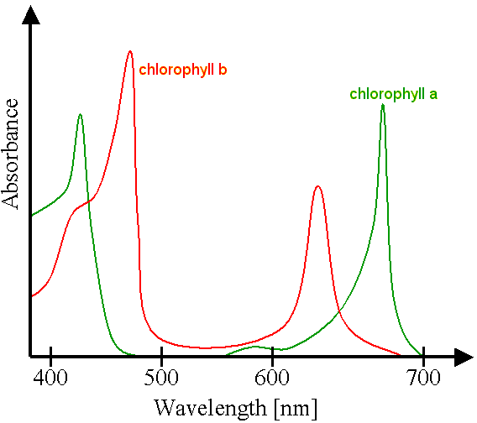

Slide 8


Image courtesy NASA (http://www.nasa.gov/centers/goddard/news/topstory/2004/0510westdrought.html)

Slide 9
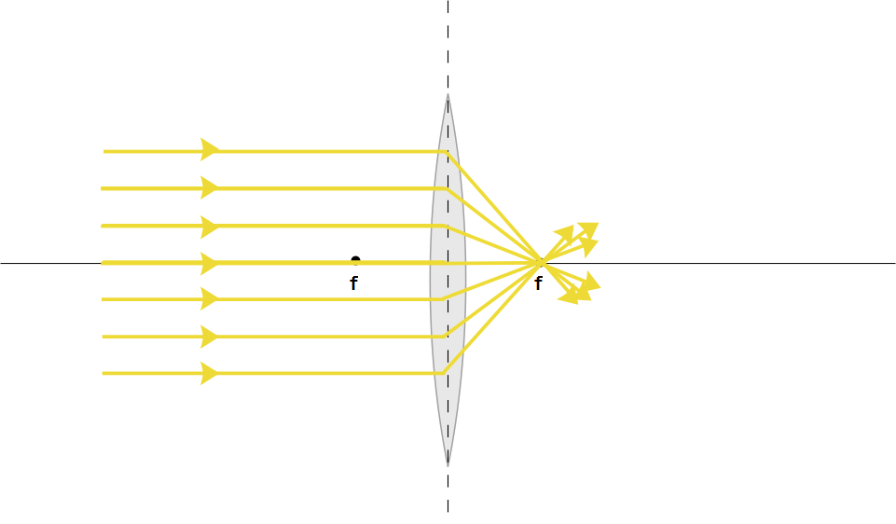

Slide 10
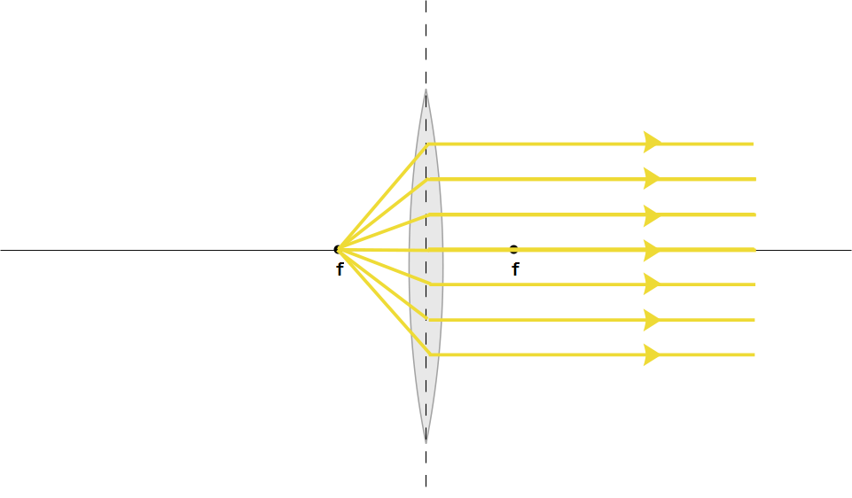

Slide 12
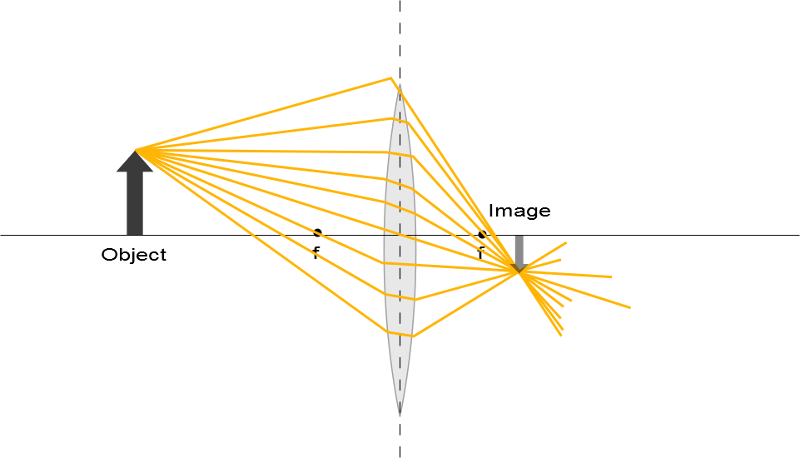

Slide 13
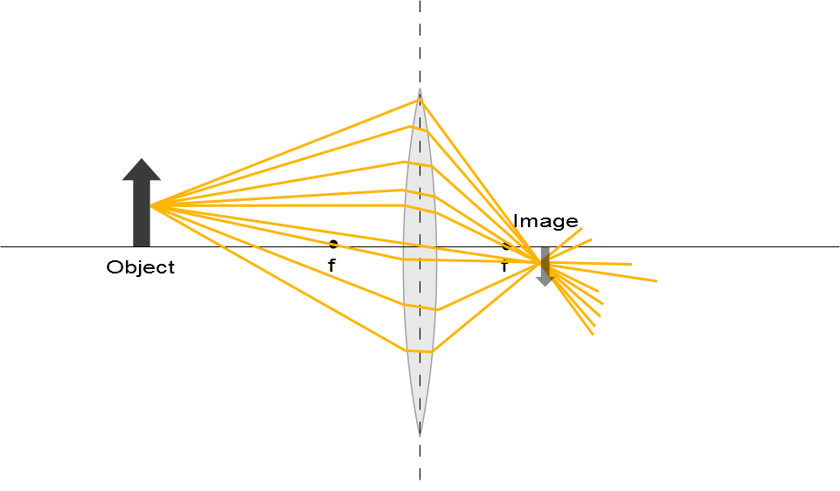

Slide 15
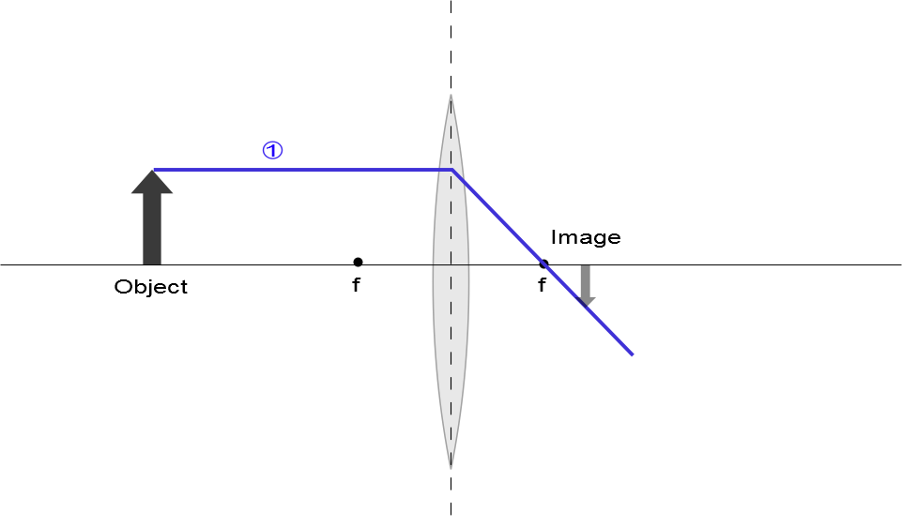

Slide 16
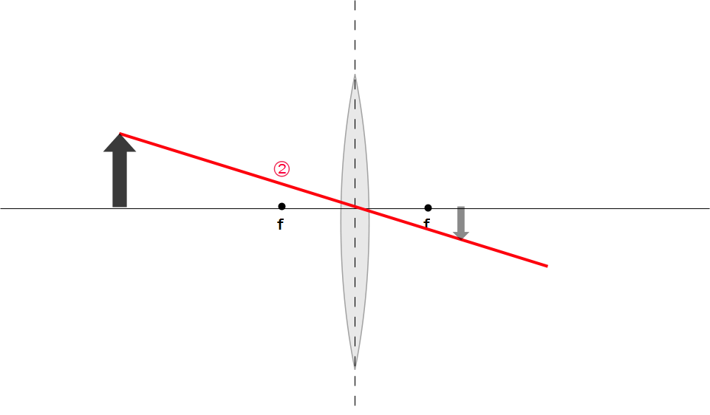
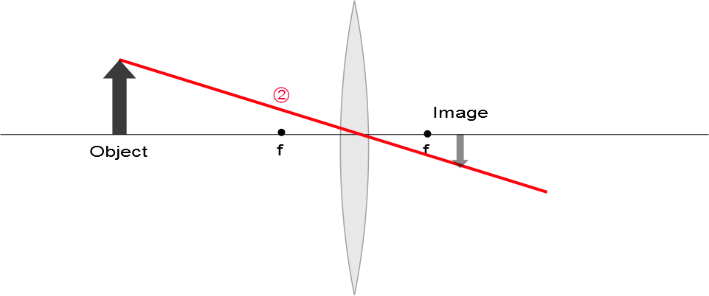

Slide 17
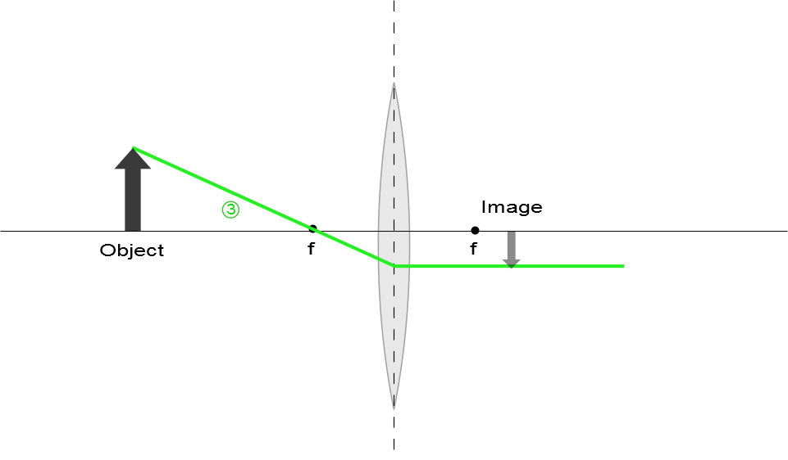

Slide 18
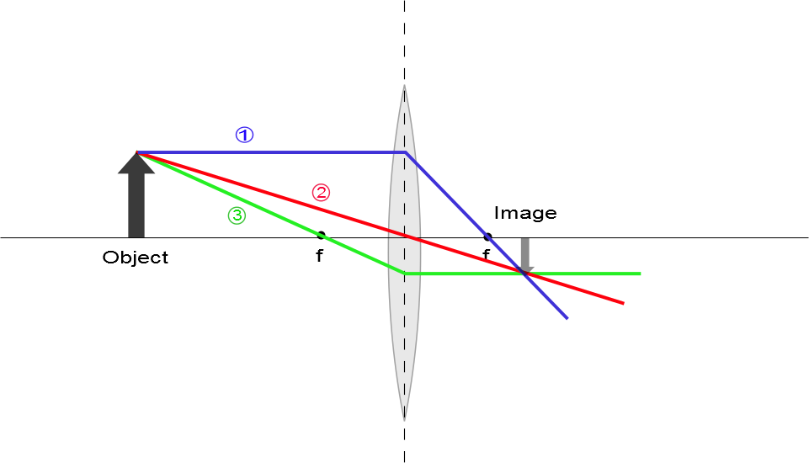
Ray Diagram for Converging Lens, s > f
The image is real
The image is inverted
The image is on the back side of the lens

Slide 19
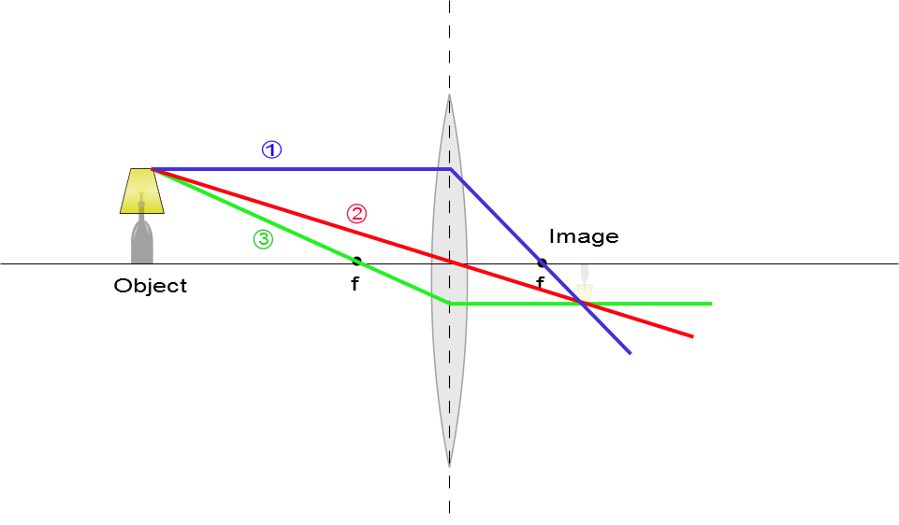
Ray Diagram for Converging Lens, s > f
The image is real
The image is inverted
The image is on the back side of the lens

Slide 20
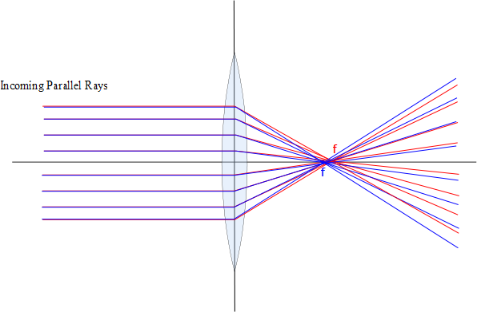

Slide 21
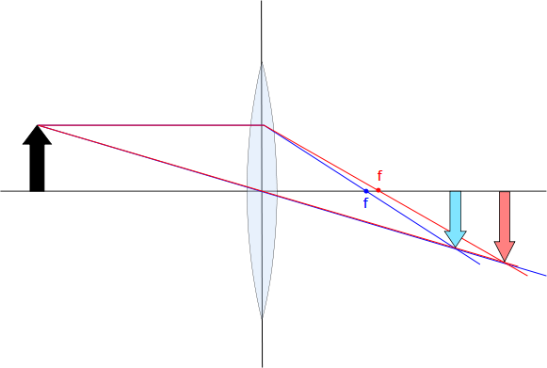

Slide 22



Slide 23
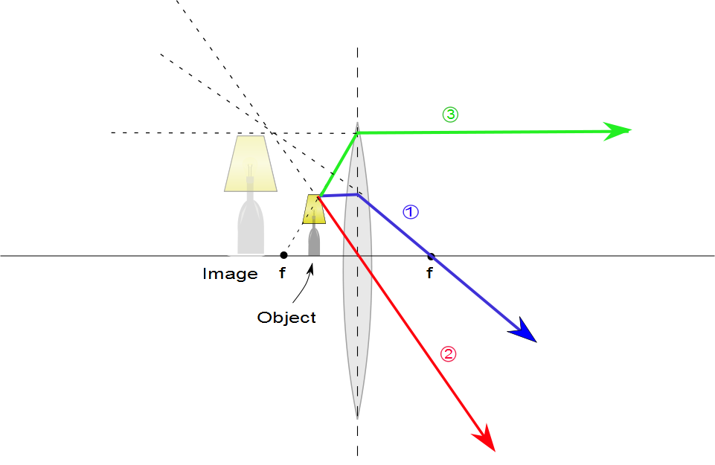
Ray Diagram for Converging Lens, p < f
The image is virtual
The image is upright
The image is larger than the object
The image is on the front side of the lens

Slide 24
Ray Diagrams for Thin Lenses – Diverging
For a diverging lens, the following three rays are drawn:
Ray 1 is drawn parallel to the principal axis and emerges directed away from the focal point on the front side of the lens
Ray 2 is drawn through the center of the lens and continues in a straight line
Ray 3 is drawn in the direction toward the focal point on the back side of the lens and emerges from the lens parallel to the principal axis

Slide 25
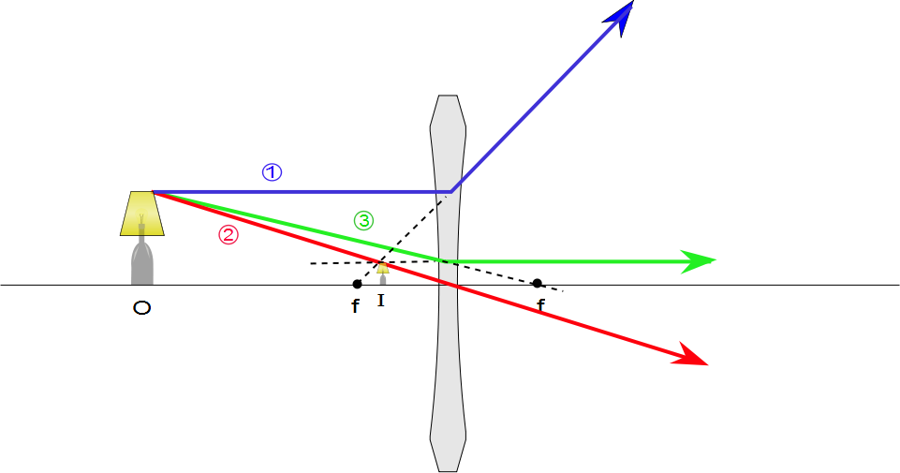
Ray Diagram for Diverging Lens
The image is virtual
The image is upright
The image is smaller
The image is on the front side of the lens

