Slide 1
Object
[Figure]
Convergence Point

Slide 2
A
θ₁
θ₂
η
S
d
α
β
γ
P
V
C
R
s
s’

Slide 3
Sign Convention

Slide 4
Front
Back
Object
[Figure]
Convergence Point

Slide 5
s
s’
Rays from fish
Fish in water
ℓ
Image of Fish
θ₂
θ₁
ℓ
θ₁
θ₂
Rays appear to come from here
n₁ (Large)
n₂ (Small)

Slide 6
Derivation of the Lens Equ.
B
A
C₁
C₂
P
S
n
t
R₂
s₁
s’₂
R₁

Slide 7
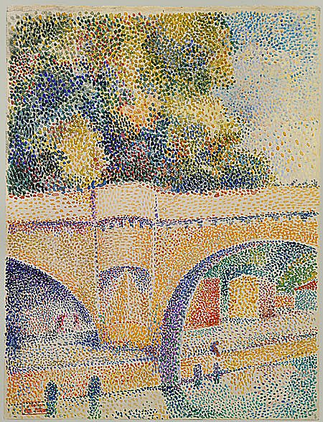

Slide 8
Derivation of the Lens Equ.
B
A
C₁
C₂
P
S
n
t
R₂
s₁
s’₂
R₁

Slide 9
Derivation of the Lens Equ.
A
P₁
C₁
S
n
S’₁
s₁
R₁

Slide 10
Derivation of the Lens Equ.
B
A
A
C₁
P₁
C₁
C₂
P₂
S
n
R₂
S’₁
s’₂
t
s₂

Slide 11
Derivation of the Lens Equ.
B
A
C₁
C₂
P
S
n
t
R₂
s₁
S’₂
R₁

Slide 12
Derivation of the Lens Equ.
R₁
S
C₂
n
C₁
P
R₂
s
s’

Slide 13
P₃
P₂
P₁
S₁
S₂
S₃
S
S’

Slide 15
Derivation of the Lens Equ.
Front
Back
R₁
S
C₂
n
C₁
P
R₂
s
s’

Slide 16
h
θ
I
O
n
θ
h’
s
s’

Slide 17
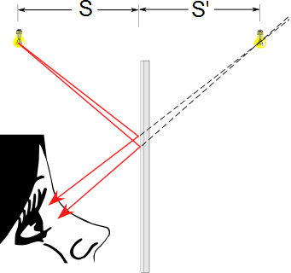
Flat Mirrors
Simplest possible mirror
Light rays leave the source and are reflected from the mirror
Point I is called the image of the object at point O
The image is virtual
O
I

Slide 18
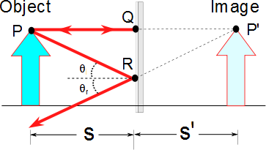
Flat Mirrors
One ray starts at point P, travels to Q and reflects back on itself
Another ray follows the path PR and reflects according to the law of reflection

Slide 19
Images Formed by Flat Mirrors, 4
To observe the image, the observer would trace back the two reflected rays to P’
Point P’ is the point where the rays appear to have originated
The image formed by an object placed in front of a flat mirror is as far behind the mirror as the object is in front of the mirror
|s| = |s’|

Slide 20
Lateral Magnification
Lateral magnification, M, is defined as
This is the general magnification for any type of mirror
It is also valid for images formed by lenses
Magnification does not always mean bigger, the size can either increase or decrease
M can be less than or greater than 1

Slide 21
Lateral Magnification of a Flat Mirror
The lateral magnification of a flat mirror is 1
This means that h’ = h for all images

Slide 22
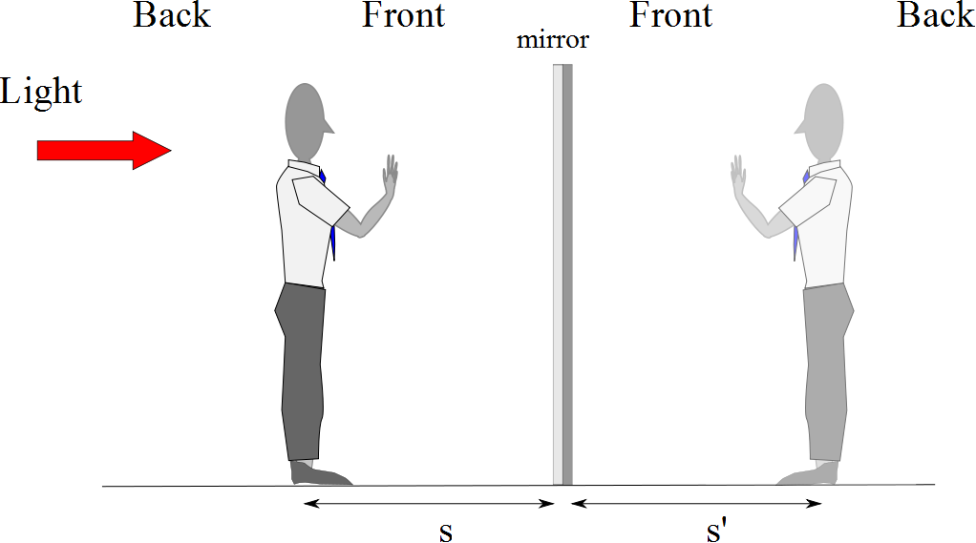
Reversals in a Flat Mirror

Slide 26
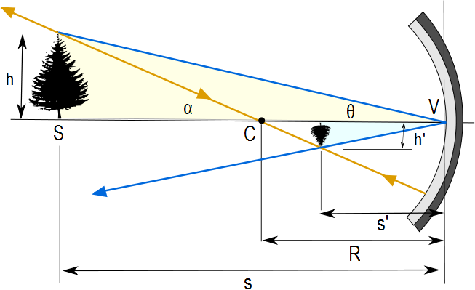
Image Formed by a Concave Mirror
Geometry can be used to determine the magnification of the image
h_{i} is negative when the image is inverted with respect to the object

Slide 27
Concave Mirror, Notation
The mirror has a radius of curvature of R
Its center of curvature is the point C
Point V is the center of the spherical segment
A line drawn from C to V is called the principal axis of the mirror

Slide 29
Paraxial Rays
We use only rays that diverge from the object and make a small angle with the principal axis
Such rays are called paraxial rays
All paraxial rays reflect through the image point

Slide 30
Spherical Aberration
Rays that are far from the principal axis converge to other points on the principal axis
This produces a blurred image
The effect is called spherical aberration

Slide 31
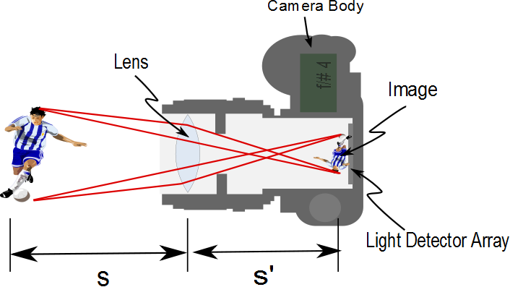

Slide 32
Image Formed by a Concave Mirror
Geometry also shows the relationship between the image and object distances
This is called the mirror equation
If p is much greater than R, then the image point is half-way between the center of curvature and the center point of the mirror
s → ∞ , then 1/ s ≈ 0 and s’ ≈ R/2

Slide 33
Focal Length
When the object is very far away, then s→ ∞ and the incoming rays are essentially parallel
In this special case, the image point is called the focal point
The distance from the mirror to the focal point is called the focal length
The focal length is ½ the radius of curvature

Slide 34
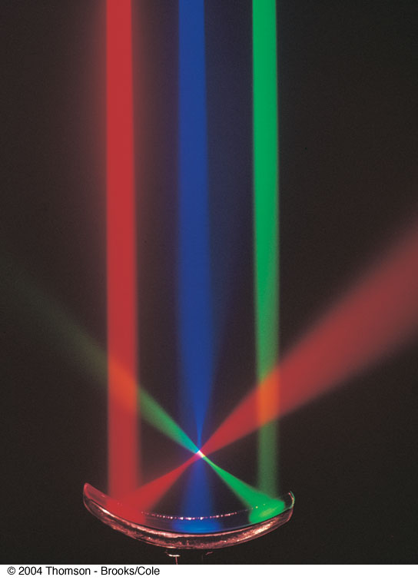
Focal Point, cont.
The colored beams are traveling parallel to the principal axis
The mirror reflects all three beams to the focal point
The focal point is where all the beams intersect
It is the white point

Slide 35
Focal Point and Focal Length, cont.
The focal point is dependent solely on the curvature of the mirror, not on the location of the object
It also does not depend on the material from which the mirror is made
ƒ = R / 2
The mirror equation can be expressed as

Slide 36
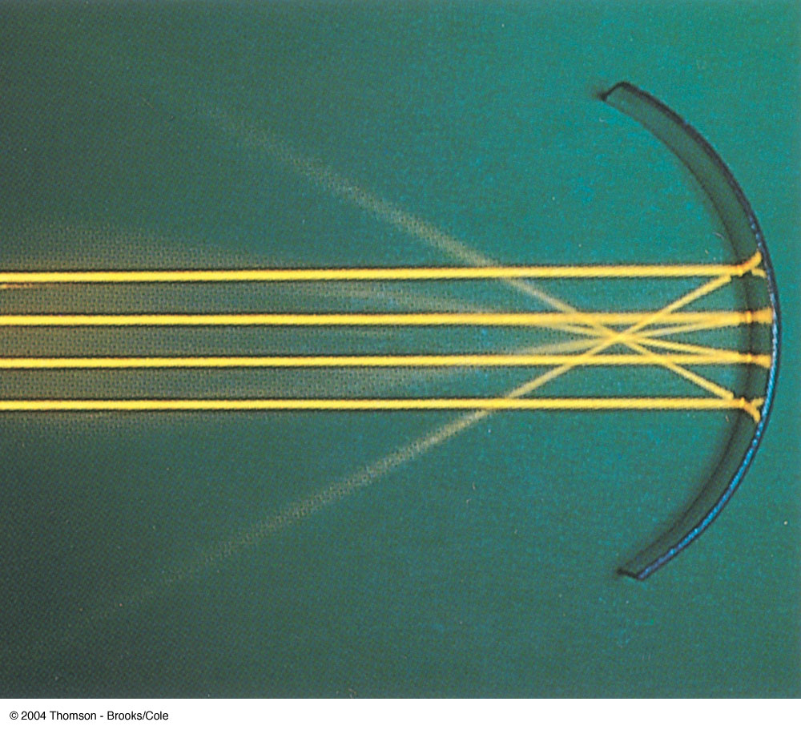
Focal Length Shown by Parallel Rays

Slide 37
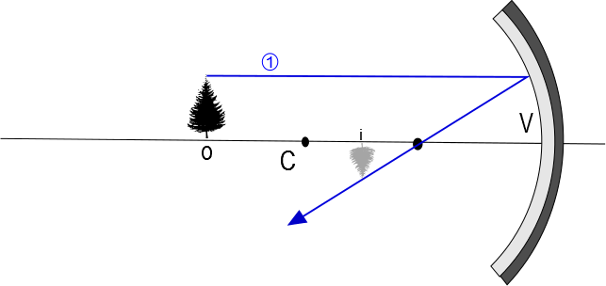

Slide 38
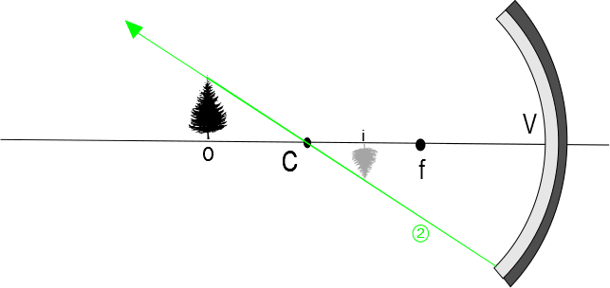

Slide 39
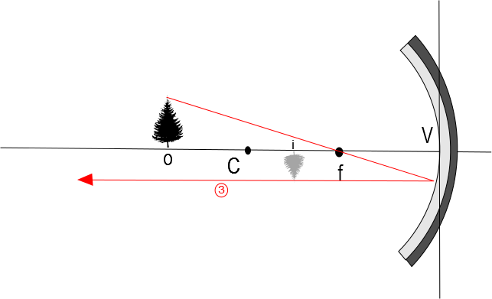

Slide 40
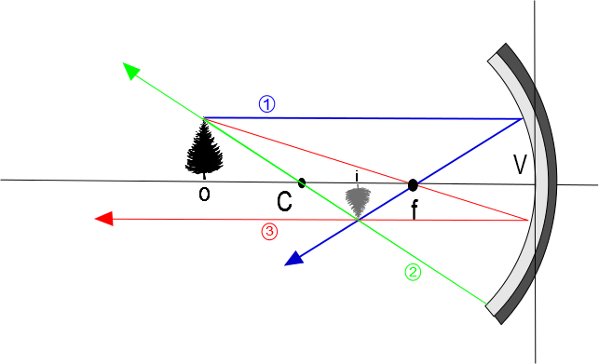

Slide 41
Convex Mirrors
A convex mirror is sometimes called a diverging mirror
The light reflects from the outer, convex side
The rays from any point on the object diverge after reflection as though they were coming from some point behind the mirror
The image is virtual because the reflected rays only appear to originate at the image point

Slide 42
Image Formed by a Convex Mirror
In general, the image formed by a convex mirror is upright, virtual, and smaller than the object

Slide 44
Front
Back

Slide 45
Ray Diagrams
A ray diagram can be used to determine the position and size of an image
They are graphical constructions which reveal the nature of the image
They can also be used to check the parameters calculated from the mirror and magnification equations

Slide 46
Drawing a Ray Diagram
To draw a ray diagram, you need to know:
The position of the object
The locations of the focal point and the center of curvature
Three rays are drawn
They all start from the same position on the object
The intersection of any two of the rays at a point locates the image
The third ray serves as a check of the construction

Slide 47
Ray Diagram – Concave Mirrors
Ray 1 is drawn from the top of the object parallel to the principal axis and is reflected through the focal point, F
Ray 2 is drawn from the top of the object through the focal point and is reflected parallel to the principal axis
Ray 3 is drawn through the center of curvature, C, and is reflected back on itself

Slide 48
Notes About the Rays
The rays actually go in all directions from the object
The three rays were chosen for their ease of construction
The image point obtained by the ray diagram must agree with the value of q calculated from the mirror equation

Slide 49
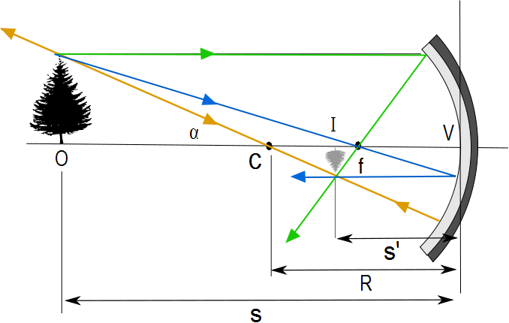
Ray Diagram for a Concave Mirror, s > R
The center of curvature is between the object and the concave mirror surface
The image is real
The image is inverted
The image is smaller than the object (reduced)

Slide 50
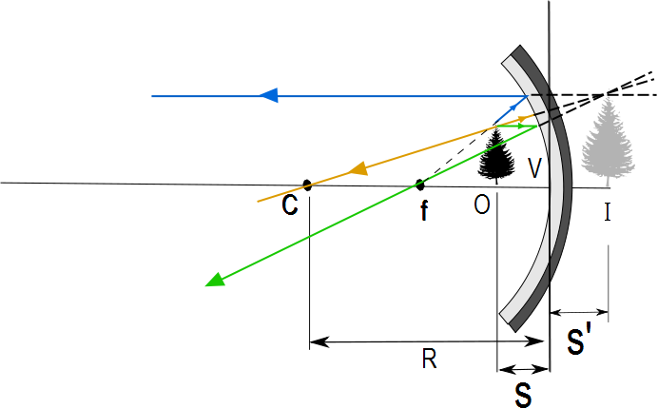
Ray Diagram for a Concave Mirror, s < f
The object is between the mirror surface and the focal point
The image is virtual
The image is upright
The image is larger than the object (enlarged)

Slide 51
The Rays in a Ray Diagram – Convex Mirrors
Ray 1 is drawn from the top of the object parallel to the principal axis and is reflected away from the focal point, F
Ray 2 is drawn from the top of the object toward the focal point and is reflected parallel to the principal axis
Ray 3 is drawn through the center of curvature, C, on the back side of the mirror and is reflected back on itself

Slide 52
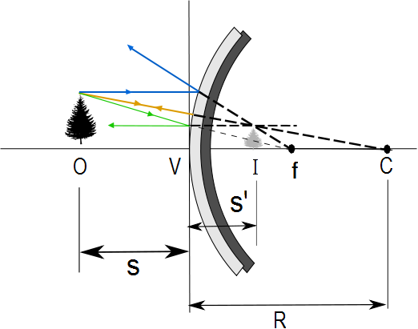
Ray Diagram for a Convex Mirror
The object is in front of a convex mirror
The image is virtual
The image is upright
The image is smaller than the object (reduced)

Slide 53
Notes on Images
With a concave mirror, the image may be either real or virtual
When the object is outside the focal point, the image is real
When the object is at the focal point, the image is infinitely far away
When the object is between the mirror and the focal point, the image is virtual
With a convex mirror, the image is always virtual and upright
As the object distance decreases, the virtual image increases in size

Slide 54
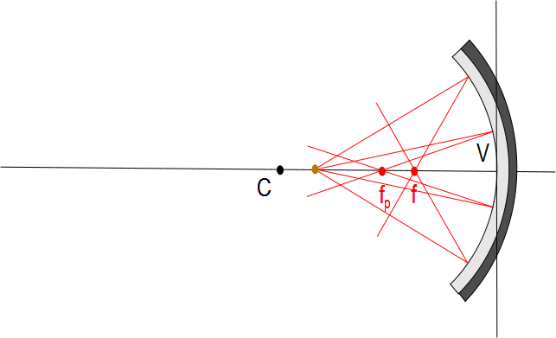

Slide 55
