Slide 1
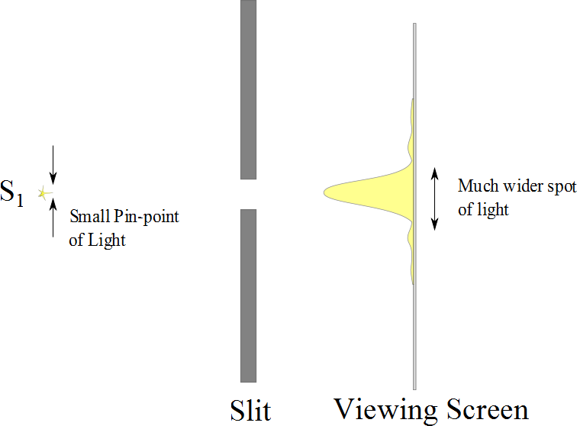

Slide 2
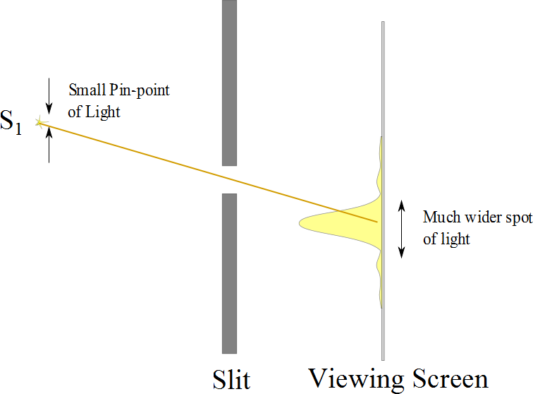

Slide 3
Resolution

Slide 4
Resolution
The ability of optical systems to distinguish between closely spaced objects is limited because of the wave nature of light
If two sources are far enough apart to keep their central maxima from overlapping, their images can be distinguished
The images are said to be resolved
If the two sources are close together, the two central maxima overlap and the images are not resolved

Slide 5
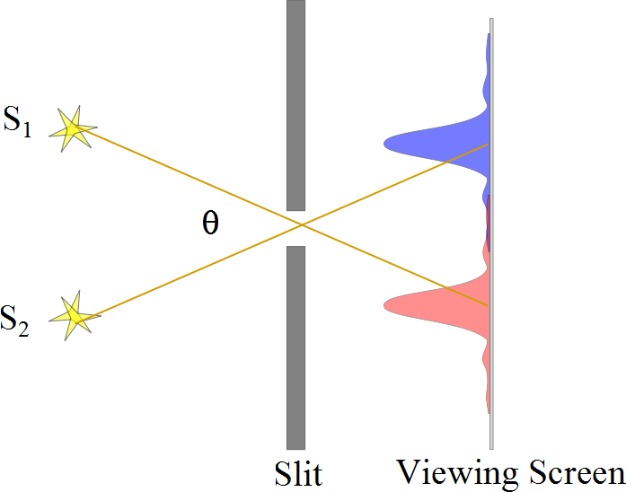
Resolved Images, Example

Slide 6
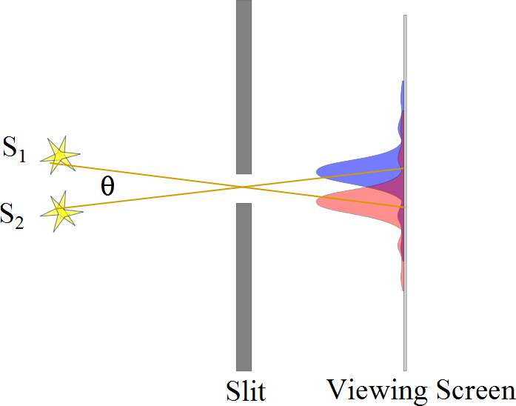
Barely Resolved, Example

Slide 7
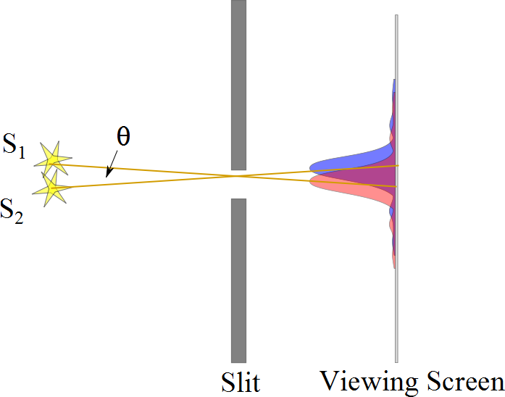
Images Not Resolved, Example

Slide 8
Resolution
The ability of optical systems to distinguish between closely spaced objects is limited because of the wave nature of light
If two sources are far enough apart to keep their central maxima from overlapping, their images can be distinguished
The images are said to be resolved
If the two sources are close together, the two central maxima overlap and the images are not resolved

Slide 10
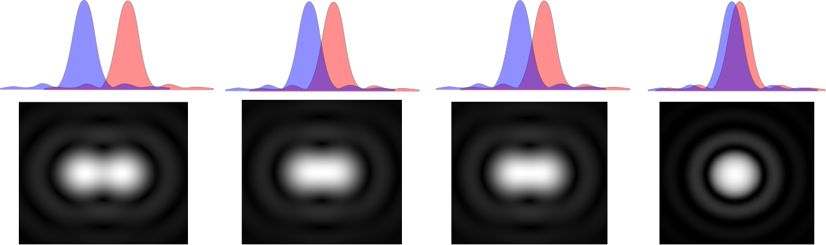

Slide 12
Resolution, Rayleigh’s Criterion
When the central maximum of one image falls on the first minimum of another image, the images are said to be just resolved
This limiting condition of resolution is called Rayleigh’s criterion

Slide 13
Resolution, Rayleigh’s Criterion, Equation
The angle of separation, θ_{min}, is the angle subtended by the sources for which the images are just resolved
Since λ << a in most situations, sin θ is very small and sin θ ≈ θ
Therefore, the limiting angle (in rad) of resolution for a slit of width a is
To be resolved, the angle subtended by the two sources must be greater than θ_{min}

Slide 14
Circular Apertures
The diffraction pattern of a circular aperture consists of a central bright disk surrounded by progressively fainter bright and dark rings
The limiting angle of resolution of the circular aperture is
D is the diameter of the aperture

Slide 15
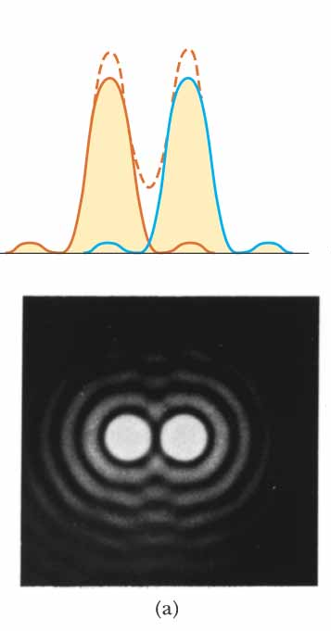
Circular Apertures, Well Resolved
The sources are far apart
The images are well resolved
The solid curves are the individual diffraction patterns
The dashed lines are the resultant pattern

Slide 16
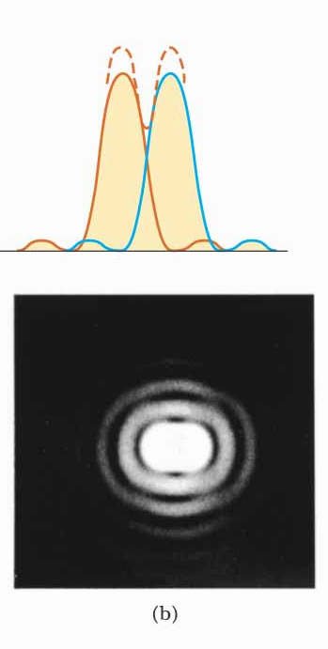
Circular Apertures, Just Resolved
The sources are separated by an angle that satisfies Rayleigh’s criterion
The images are just resolved
The solid curves are the individual diffraction patterns
The dashed lines are the resultant pattern

Slide 17
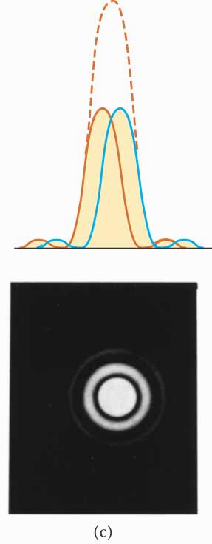
Circular Apertures, Not Resolved
The sources are close together
The images are unresolved
The solid curves are the individual diffraction patterns
The dashed lines are the resultant pattern

Slide 18
Completely Resolved
Rayleigh Criterion
Sparrow Criterion
Unresolved

Slide 19
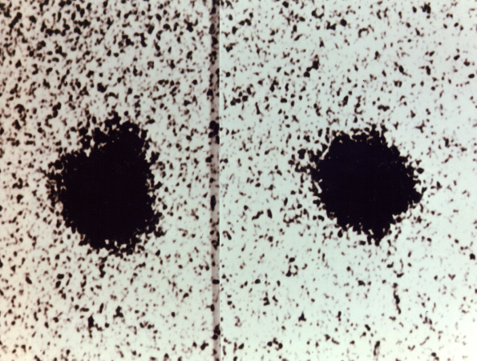
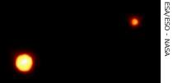
Resolution, Example
Charon
Pluto
Pluto and its moon, Charon
Left: Earth-based telescope is blurred
Right: Hubble Space Telescope clearly resolves the two objects

Slide 20
Disclaimer for Today’s Demonstrations
If the humidity is high, we will be in trouble
The fact that humidity is important is fascinating
If the humidity is high, we will consider why humidity is important as an extra credit problem! – so we will be OK either way.

Slide 21
-
-
-
-
-
-
-
-
-
-
-
-
-
-
-
-
-
-
-
-
-
-
-
-
-
-
-
-
-
-
-
-
-
-
-
-
-
-
-
-
-
-
-
-

Slide 22
+
+
+
+
+
+
+
+
+
+
+
+
+
+
+
+
+
+
+
+
+
+
+
+
+
+
+
+
+
+
+
+
+
+
+
+
+
+
+
+

Slide 23
-
-
-
-
-
-
-
-
-
+
+
+
+
+
-
-
-
-
-
+
+
+
+
+
-
-
-
-
-
-
-
-
+
+
+
+
+
+
+
+
+
+

Slide 24
-
-
-
-
-
-
-
-
-
+
-
-
-
-
-
-
+
-
-
-
-
-
-
-
-
-
-
+
+
-

Slide 25
-
-
-
-
-
-
-
-
-
-
-
+
+
-
-
-
-
-
-
-
-
-
-
-
-
-
Nucleus
+
+
-
-

Slide 26
+
-

Slide 27
+
-
-
-
-
-
-
-
-
-
-
-
-
-
-
-
-
-
-
-
-
-
-
-
+
-
-
-
-
-
-
-
-
-
-
-
-
-
-
-
-
-
-
-
-
-
-
-

Slide 28
+
-
+
+
+
+
+
+
+
+
+
+
+
+
+
+
+
+
+
+
+
+

Slide 29
+
-
+
-
-
-
-
-
-
+
-
-
-
-
-
-
-
-
-
+
-
-
-
-
-
-
+
-
+
-
-
-
-
-
+
-
+
-
+
-
+
+
-
-
+
-
+
-

Slide 30
+
-
-
-
+
+
+
+
+
-
+
-
-
-
-
+
-
+
-
+
-
+
-
+
+
-
+
-
+
-
+
-
+
-
-
+
-
+
-
-
-
-
-
-
-
-
+
-
-
-
-
-
-
-
-
+
+
+
+
-
-
-
-
-
-
-
-
+
-
-
-
+
+
+
+
+
-
-
-
-
-
-
-
-
-
+
-
-
-
+
+
+
+
+
+
+
-
-
+
+
-
-
-
-
-
-
-
-
-
-
-
-
-
-
-
-
+
+
+
+
-
-
-
-
-
-
-
+
-
-
-
+
+
-
-
-
-
-
-
-
-
-
-
-
+
+
+
-
-
+
+
+
-
+
+
+
+
+
-
-
+
-
-
+
+
-
+
-
+
-
+
+
+
+
+
+
+
-
+
+
+
+
+
+
+
+
+

Slide 31
+
-
+
+
+
+
-
+
-
-
-
-
-
+
-
+
-
+
-
+
-
+
-
+
+
-
+
-
+
-
+
-
+
-
-
-
+
-
+
-
-
-
-
-
-
-
+
-
-
-
-
-
-
-
-
-
+
+
+
+
-
-
-
-
-
-
-
+
-
-
-
+
+
-
-
-
-
-
-
-
-
-
+
-
+
+
-
+
-
+
+
+
+
+
+
+
-
-
+
-
-
-
-
-
+
-
+
-
-
-
-
-
-
-
-
-
+
+
-
-
-
-
-
-
-
+
-
+
+
-
+
-
-
+
+
+
+
+
-
-
-
-
-
-
+
-
-
+
-
-
-
-
-
+
-
-
-
-
-
-
-
-
-

