Slide 2
Electrons
+
Electron
Nucleus with protons and neutrons
Particles not drawn to scale

Slide 3
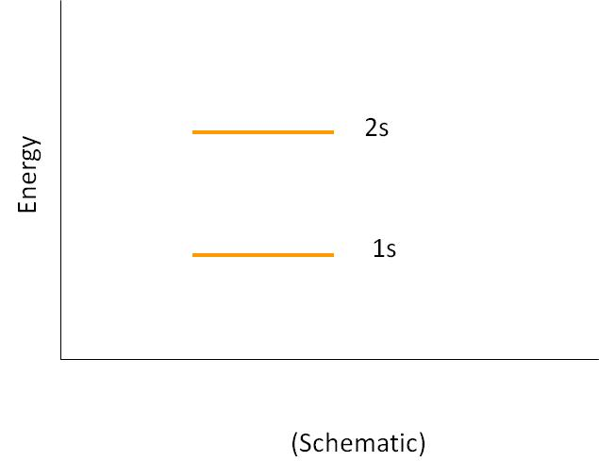
Energy Levels in Atoms
2s
Energy
1s
(Schematic)

Slide 4
Bringing Two Atoms Together
2s
Energy
1s
Distance, r
(Schematic)

Slide 5
Bringing 5 Atoms Together
2s
Energy
1s
Distance, r
(Schematic)

Slide 6
Many Atoms Together (A Solid)
2s
Energy
1s
Distance, r
(Schematic)

Slide 7
Many Atoms Together (A Solid)
2s
Energy
1s
r_{o}
Distance, r
(Schematic)

Slide 8
Energy Bands, Detail
Sodium example
Blue represents energy bands occupied by the sodium electrons when the atoms are in their ground states
Gold represents energy bands that are empty
White represents energy gaps
Electrons can have any energy within the allowed bands
Electrons cannot have energies in the gaps
3p
3s
2p
2s
1s

Slide 9
Energy Level Definitions
The valence band is the highest filled band
The conduction band is the next higher empty band
The energy gap has an energy, E_{g}, equal to the difference in energy between the top of the valence band and the bottom of the conduction band

Slide 10
Conductors
When a voltage is applied to a conductor, the electrons accelerate and gain energy
In quantum terms, electron energies increase if there are a high number of unoccupied energy levels for the electron to jump to
For example, it takes very little energy for electrons to jump from the partially filled to one of the nearby empty states

Slide 11
Insulators
The valence band is completely full of electrons
A large band gap separates the valence and conduction bands
A large amount of energy is needed for an electron to be able to jump from the valence to the conduction band
The minimum required energy is E_{g}
Conduction Band
Energy Gap, E_{g}
Valance Band

Slide 12
Semiconductors
A semiconductor has a small energy gap
Thermally excited electrons have enough energy to cross the band gap
The resistivity of semiconductors decreases with increases in temperature
The white area in the valence band represents holes
Conduction Band
Energy Gap, E_{g}
Valance Band

Slide 13
Insulator Conductor

Slide 14
-
-

Slide 15
TurboBlowTM
^{Blow Dryer}
The third wire in electrical devices is connect to the ground

Slide 16
+
-
+
-
-
-
-
-
-
+
-
-
-
-
-
-
-
-
-
+
-
-
-
-
-
-
+
-
+
-
-
-
-
-
+
-
+
-
+
-
+
+
-
-
+
-
+
-

Slide 17
-
-
-
-
-
-
-
-
-
-
-
+
+
-
-
-
-
-
-
-
-
-
-
-
-
-
Nucleus
+
+
-
-

Slide 18
Center of Negative Charge
-
-
Center of Positive Charge
+
+ + +
+
-
-

Slide 19
Center of Negative Charge
Center of Positive Charge

Slide 20
Center of Negative Charge
Center of Positive Charge

Slide 22
+
+
-
-
+
-
+
-
+
-
+
+
-
-
+
+
-
-
+
-
+
-
+
-

Slide 23
+ + + +
- - - -
+ + + + + +
- - - - - -
+ + + + + + +
- - - - - - -
+ + + + + + + +
- - - - - - - -
+ + + + + + +
- - - - - - -
+ + + + + +
- - - - - -
+ + + +
- - - -

Slide 24
Comparison to Gravity

