Slide 1
High Potential Energy
Low Potential Energy
E
+
- - - - - - - - - - - - - - - - - - - - - - - - - - - - - -
- - - - - - - - - - - - - - - - - - - - - - - - - - - - - -
+ + + + + + + + + + + + + + + + + + + + + + + + + +
+ + + + + + + + + + + + + + + + + + + + + + + + + +
A
B
d

Slide 2
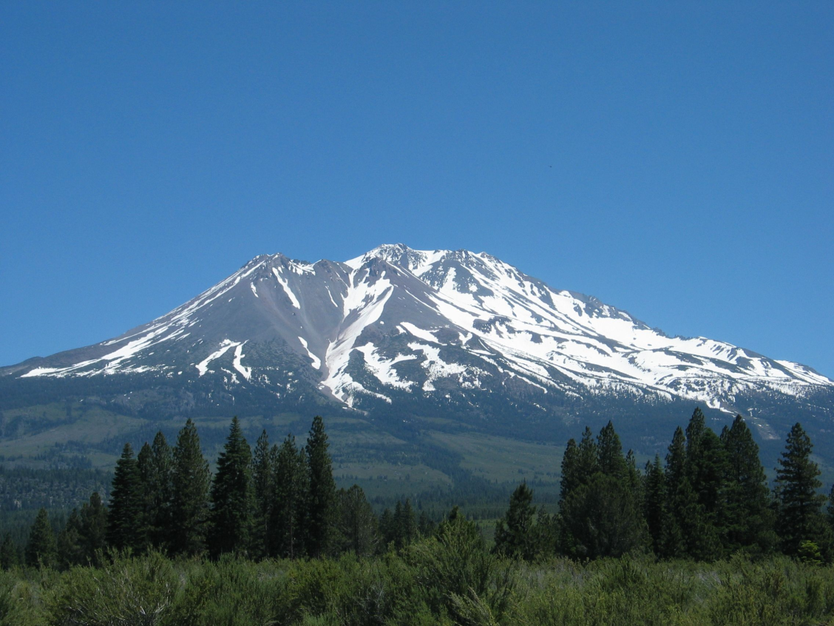
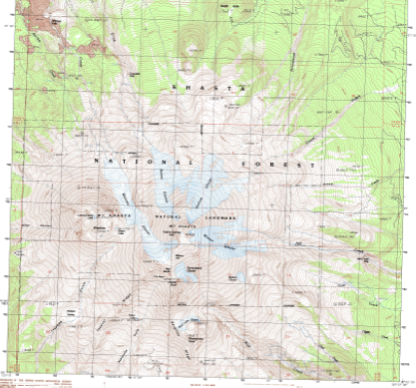
Shasta Example

Slide 3
Equipotential Surfaces
High Potential Energy
Low Potential Energy
E
+
- - - - - - - - - - - - - - - - - - - - - - - - - - - - - -
- - - - - - - - - - - - - - - - - - - - - - - - - - - - - -
+ + + + + + + + + + + + + + + + + + + + + + + + + +
+ + + + + + + + + + + + + + + + + + + + + + + + + +
A
B
d

Slide 4
-
-
-
-
-
-
-
-
-
-
-
-
-
-
-
-
-
-
-
-
-
-
-
-
-
-
-
-
-
-
-
-
-
-
-
-
-

Slide 5
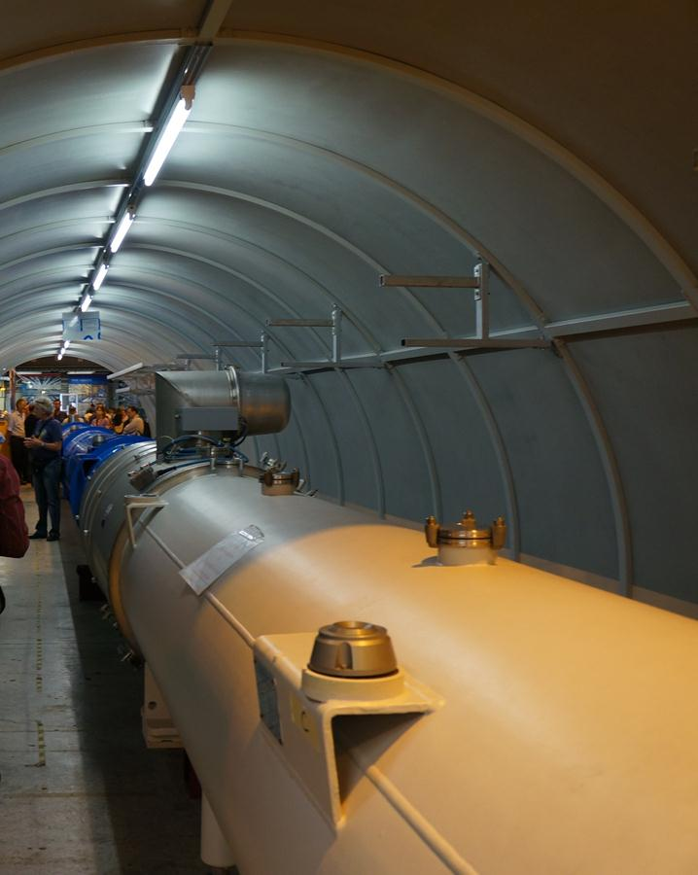
Section of the beam pipe of the LHC.
This section is no longer used, so you see people standing next to it (otherwise, standing next to the beam magnets would not be very safe!)

Slide 6
