Slide 1
y
x

Slide 4
High Potential
Low Potential
E
- - - - - - - - - - - - - - - - - - - - - - - - - - - - - -
- - - - - - - - - - - - - - - - - - - - - - - - - - - - - -
+ + + + + + + + + + + + + + + + + + + + + + + + + +
+ + + + + + + + + + + + + + + + + + + + + + + + + +
Equipotential Lines

Slide 5
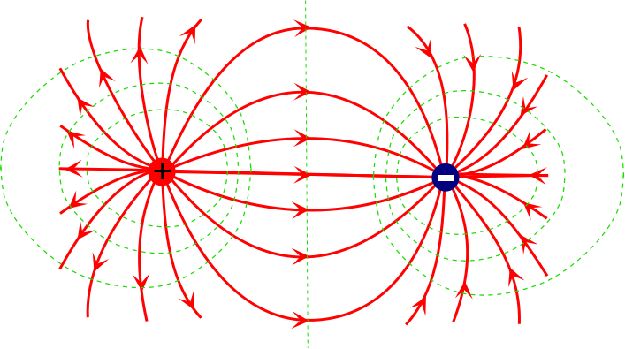

Slide 6
[Map courtesy USGS, Picture is in the Public Domain.]

Slide 7
Electric Potential for a Charged Conductor
Static Condition
The electric potential is constant inside the conductor.
The surface of the conductor is at the same electric potential (same as inside).
-
-
-
-
-
-
-
-
-
-
-
-
-
-
-
-
-
-
-
-
-
-
-
-
-
-
-
-
-
-
-
-
-
-
-
-
-

Slide 8
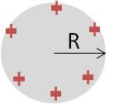

Slide 9
R

Slide 10
R

Slide 15
A
B

