Slide 2
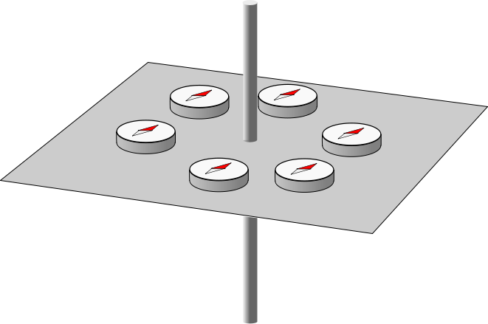

Slide 3
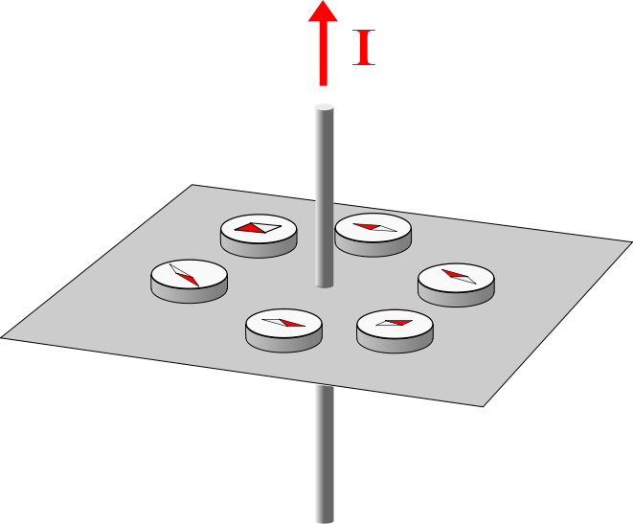

Slide 4

B
F_{m}
F_{m}

Slide 5
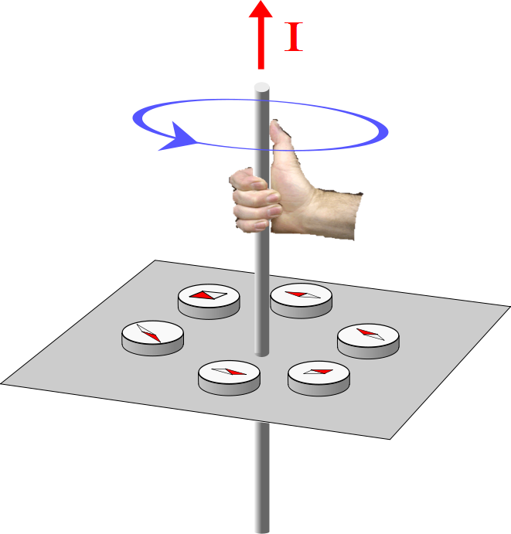

Slide 6


I

Slide 7
I

Slide 8
Top View

Slide 9
I

Slide 10
I

Slide 11
I

Slide 12
I

Slide 13
I

Slide 14
x
Detector
1mm
r
v
Proton Path
y
z
Proton

