Slide 1
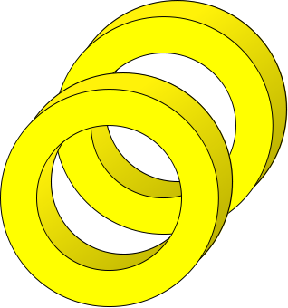

Slip rings
Brushes
N
S

Slide 2
A
B
θ
a/2

Slide 5
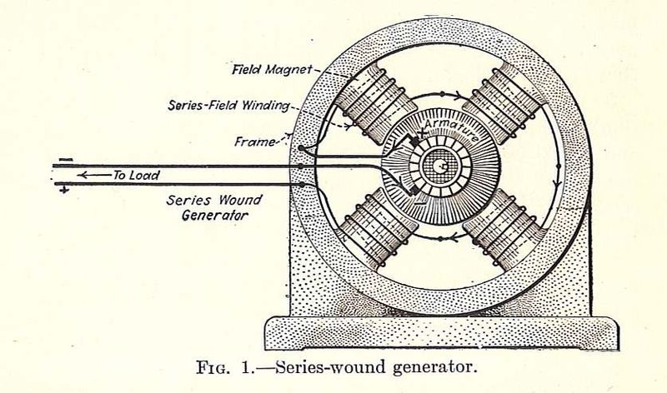

Slide 6
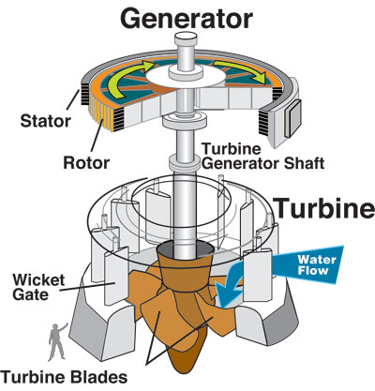

Slide 7
ΔV₁
ΔV₂
Iron Core
Switch
R
Alternating
Current Source
N₁
N₂

Slide 8
Induced E-fields
I
r
+

Slide 9
Induced E-fields
B
I
r
+
E

Slide 10
Induced E-fields
B
I
r
+
E

Slide 11
Changing B-Field
Induced E-Field
E

Slide 12
E
Changing E-Field
B
Induced B-Field

Slide 13
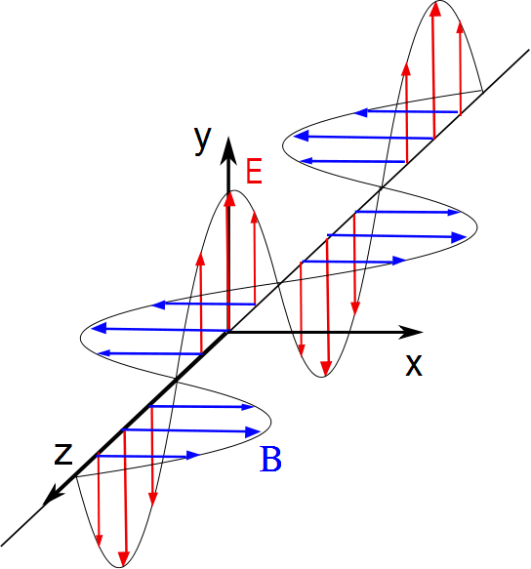

Slide 14
v
F
+

