Slide 1
Question
I have an LED emitting light. What shape is the wavefront leaving the tiny LED?
Linear points
Planer surfaces
Spherical surfaces
Cubical surfaces
Hexagonal surfaces

Slide 2
Question
I have an LED emitting light. IT makes a spherical wave front. But if I look at just one tiny point on the spere, what do the wave crests look like?
Linear points
Planer surfaces
Spherical surfaces
Cubical surfaces
Hexagonal surfaces
Just look here

Slide 3
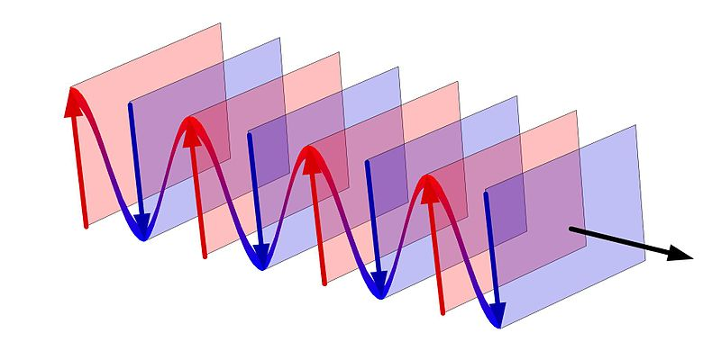

Slide 4
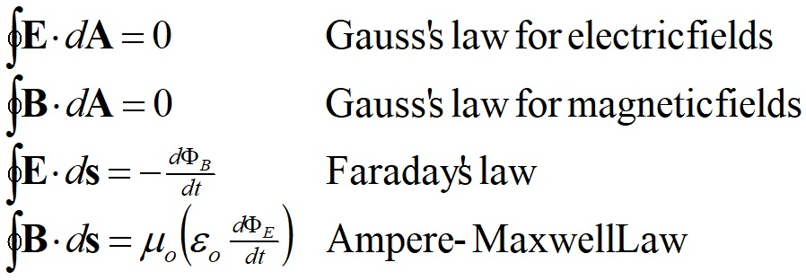

Slide 5
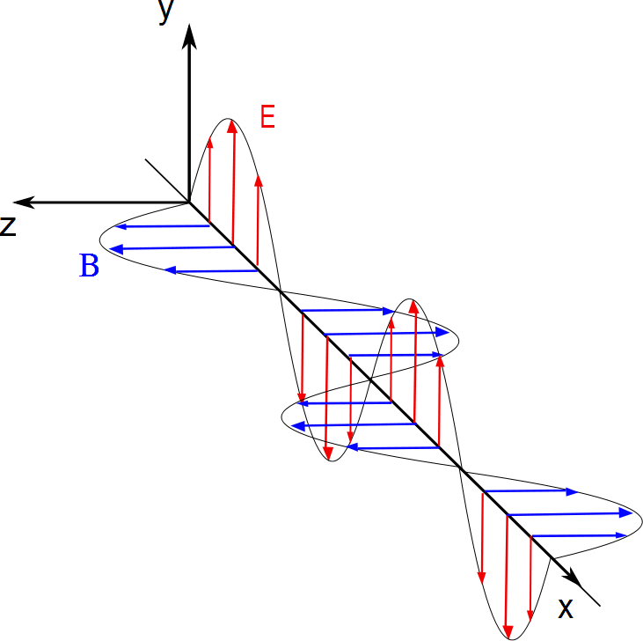
Electric and magnetic field measured along this line
Light Source

Slide 7
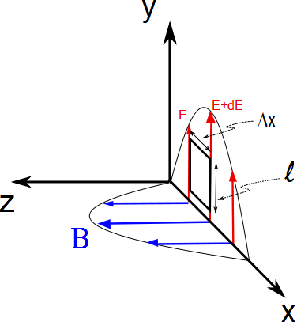

Slide 8
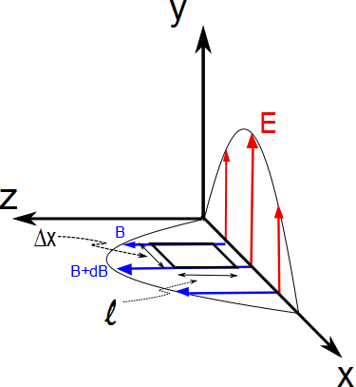

Slide 9
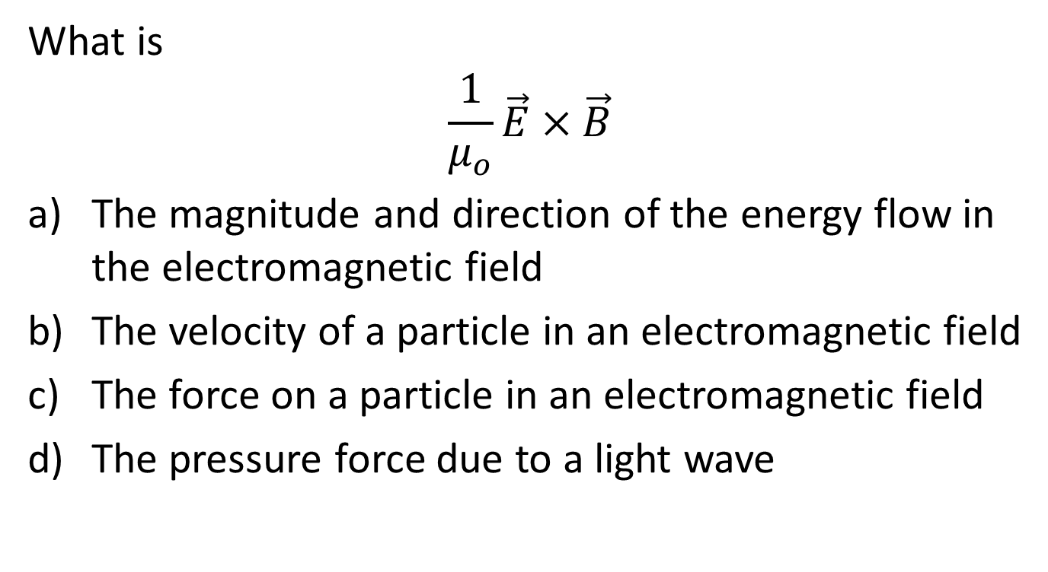
Question
What is
$$\frac{1}{μ_{o}}\vec{E}×\vec{B}$$
The magnitude and direction of the energy flow in the electromagnetic field
The velocity of a particle in an electromagnetic field
The force on a particle in an electromagnetic field
The pressure force due to a light wave

Slide 10
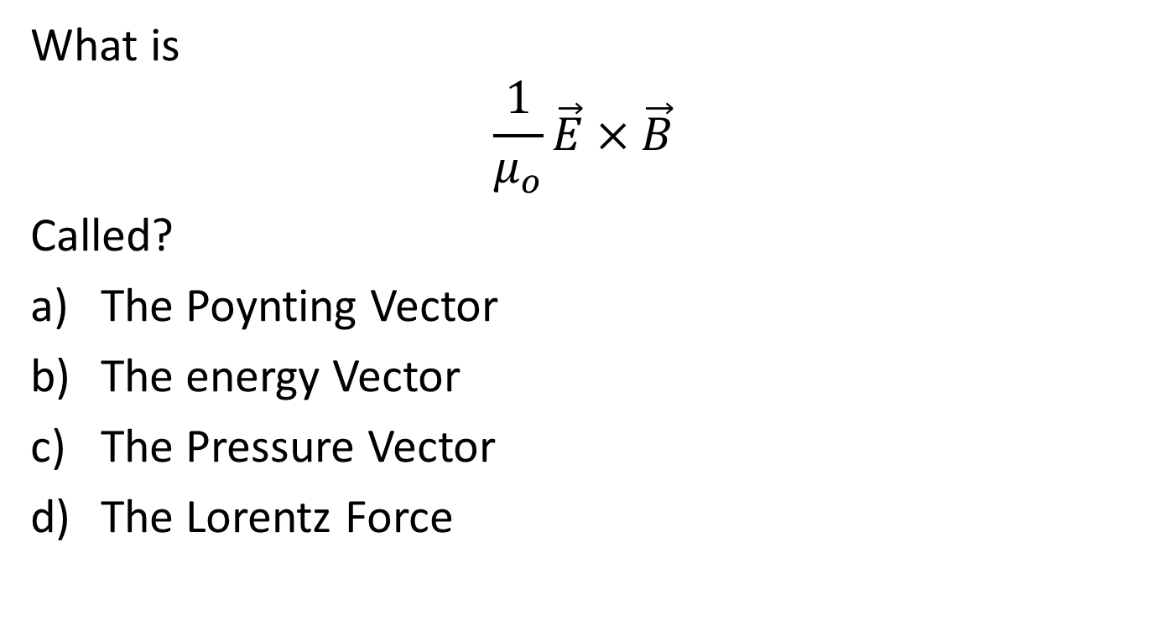
Question
What is
$$\frac{1}{μ_{o}}\vec{E}×\vec{B}$$
Called?
The Poynting Vector
The energy Vector
The Pressure Vector
The Lorentz Force

Slide 12
Question
What is the direction of energy flow for a circular current loop?
Along the wire
Out of the battery and into the wire
I
E

Slide 13
Question
What is the direction of energy flow for a circular current loop?
Along the wire
Out of the battery and into the wire
I
+
+
+
-
E
-
-

Slide 14
Question
What is the direction of energy flow for a circular current loop?
Along the wire
Out of the battery and into the wire
I
+
+
+
-
E
-
-

Slide 15
Question
What is the direction of energy flow for a circular current loop?
Along the wire
Out of the battery and into the wire
I
+
+
+
-
E
-
-

Slide 16
Question
What is the direction of energy flow for a circular current loop?
Along the wire
Out of the battery and into the wire
S
I
S
S
+
+
+
S
S
S
S
-
E
-
-
S
S

Slide 17
Question
The intensity of an electromagnetic wave is proportional to
E²
B²
c
S

Slide 18
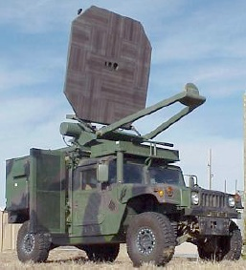

Slide 19
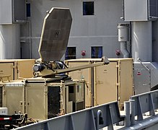
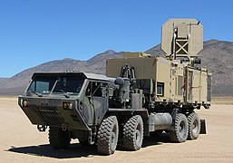
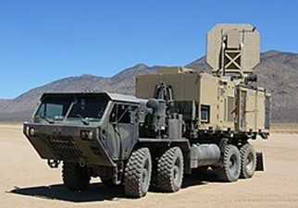

Slide 20
Question
Can you push something with a light wave?
Yes
No
Maybe

Slide 21
Question
How much pressure do we get from a light wave?
S/c
2S/c
B²
0

Slide 22
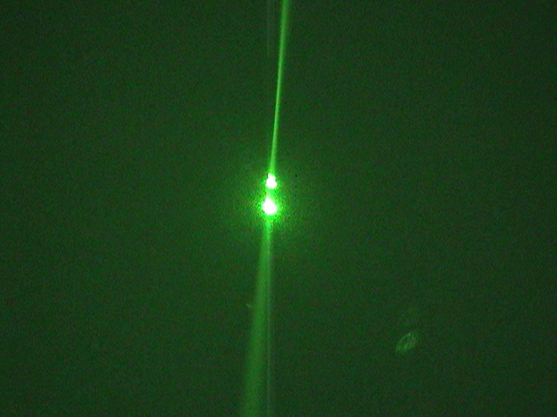

Slide 23
+++
--
~
~
~
~
---
++
A B C D

