Slide 1
Question 223.50.1
Which of the following is Faraday’s law?
a)
b)
c)
d)

Slide 2
Question 223.50.2
Which of the following is Gauss’s law?
a)
b)
c)
d)

Slide 3
Question 223.50.3
Which of the following is Ampere’s law?
a)
b)
c)
d)

Slide 4
Question 223.50.4
Which of the following is Faraday’s law?
a)
b)
c)
d)

Slide 5
Question 223.50.1
Which of the following is Gauss’s law for magnetic fields?
a)
b)
c)
d)

Slide 6
Question
We drew the E and B fields along a path from a source like this:
Is the E-field always vertical
From a light source?
Yes
No
Maybe

Slide 7
E

Slide 8
E

Slide 9
Question
What do we call a light wave that has an E-filed that oscillates in just one direction?
Confined
Polarized
Linear
Confocal
E

Slide 10
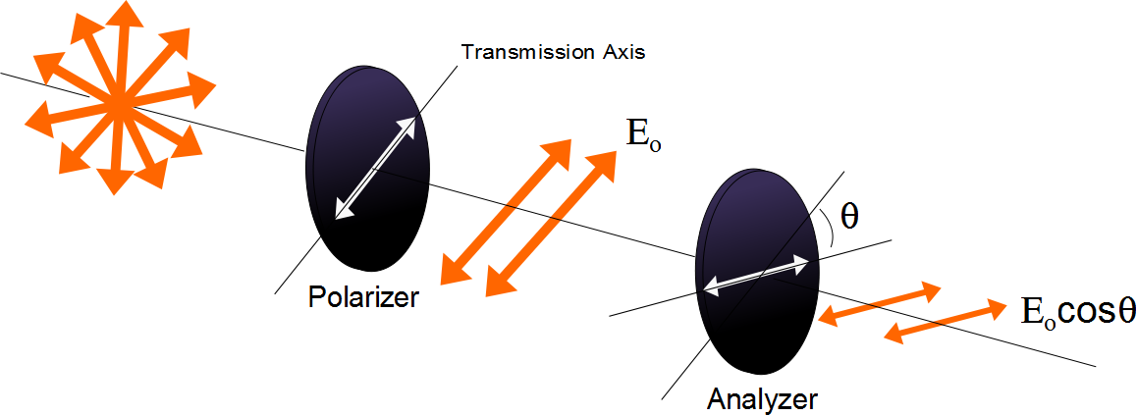

Slide 11
Question
I have two polarizers. If I pass light through both of them and their axes are aligned at 90 degrees from each other how much of the original light comes through?
All of it
30%
70%
None of it

Slide 12
E
Incident Beam
Reflected Beam
θ₁
θ₁
n₁
n₂
Transmitted Beam
θ₂

Slide 13
E
Reflected Beam
Has only the
perpendicular
polarization
Incident Beam
θ_{b}
θ_{b}
n₁
90°
n₂
Transmitted Beam
θ₂

Slide 14
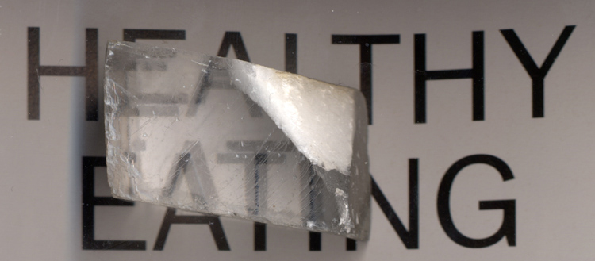

Slide 15
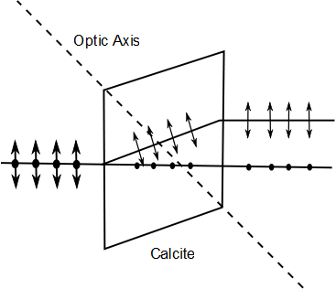
E-ray
Unpolarized Light
O-ray

Slide 16
Polarization by Double Refraction, Rays
The ordinary (O) ray is characterized by an index of refraction of n_{o}
This is the same in all directions
The second ray is the extraordinary (E) ray which travels at different speeds in different directions
Characterized by an index of refraction of n_{E} that varies with the direction of propagation

Slide 17
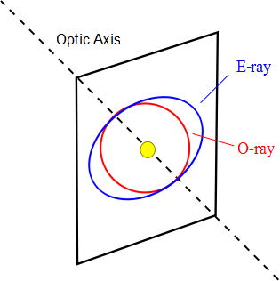

Slide 18

Optical Stress Analysis

Slide 19
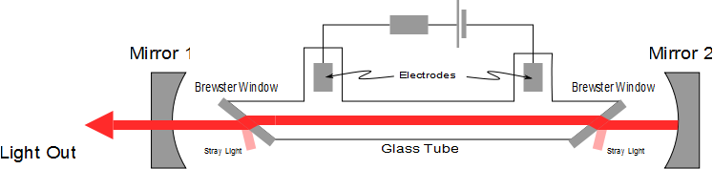
Laser Polarization

