Slide 2
Question 223.35.1
a) Be 10 times larger
b) Be 100 times larger
c) Will be 10 times smaller
d) Will be 3.123 times the original capacitance
If I give you a dielectric material with a dielectric constant of 10, and you place it between the plates of a charged capacitor that is not connected to a battery, the electric potential difference will

Slide 3
Question 223.35.2
The voltage of a capacitor drops when a dielectric is placed inside the plates of the capacitor because…
a) There is an induced charge on the surfaces of the dielectric
b) The dielectric screens-off the Coulomb force, so the potential is less
c) The electric field cannot penetrate a dielectric
d) This is all wrong, the voltage won’t drop

Slide 4
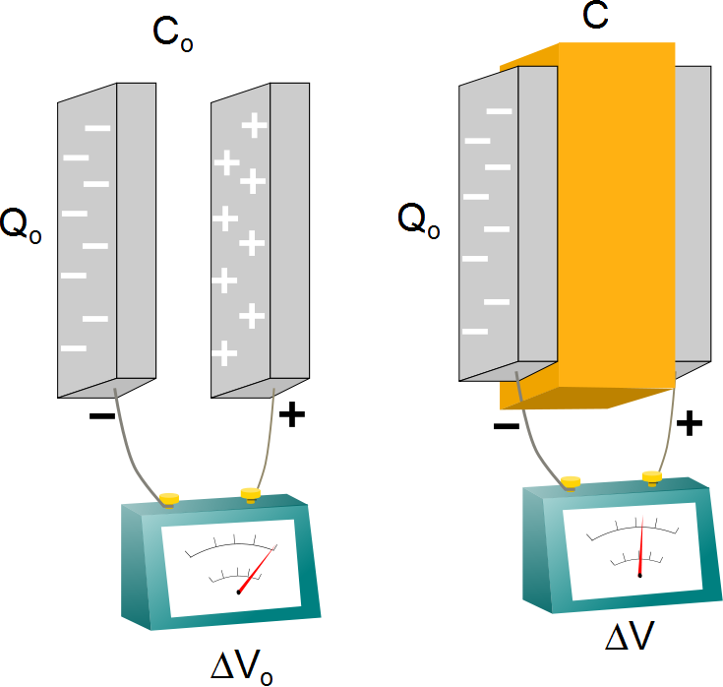

Slide 5
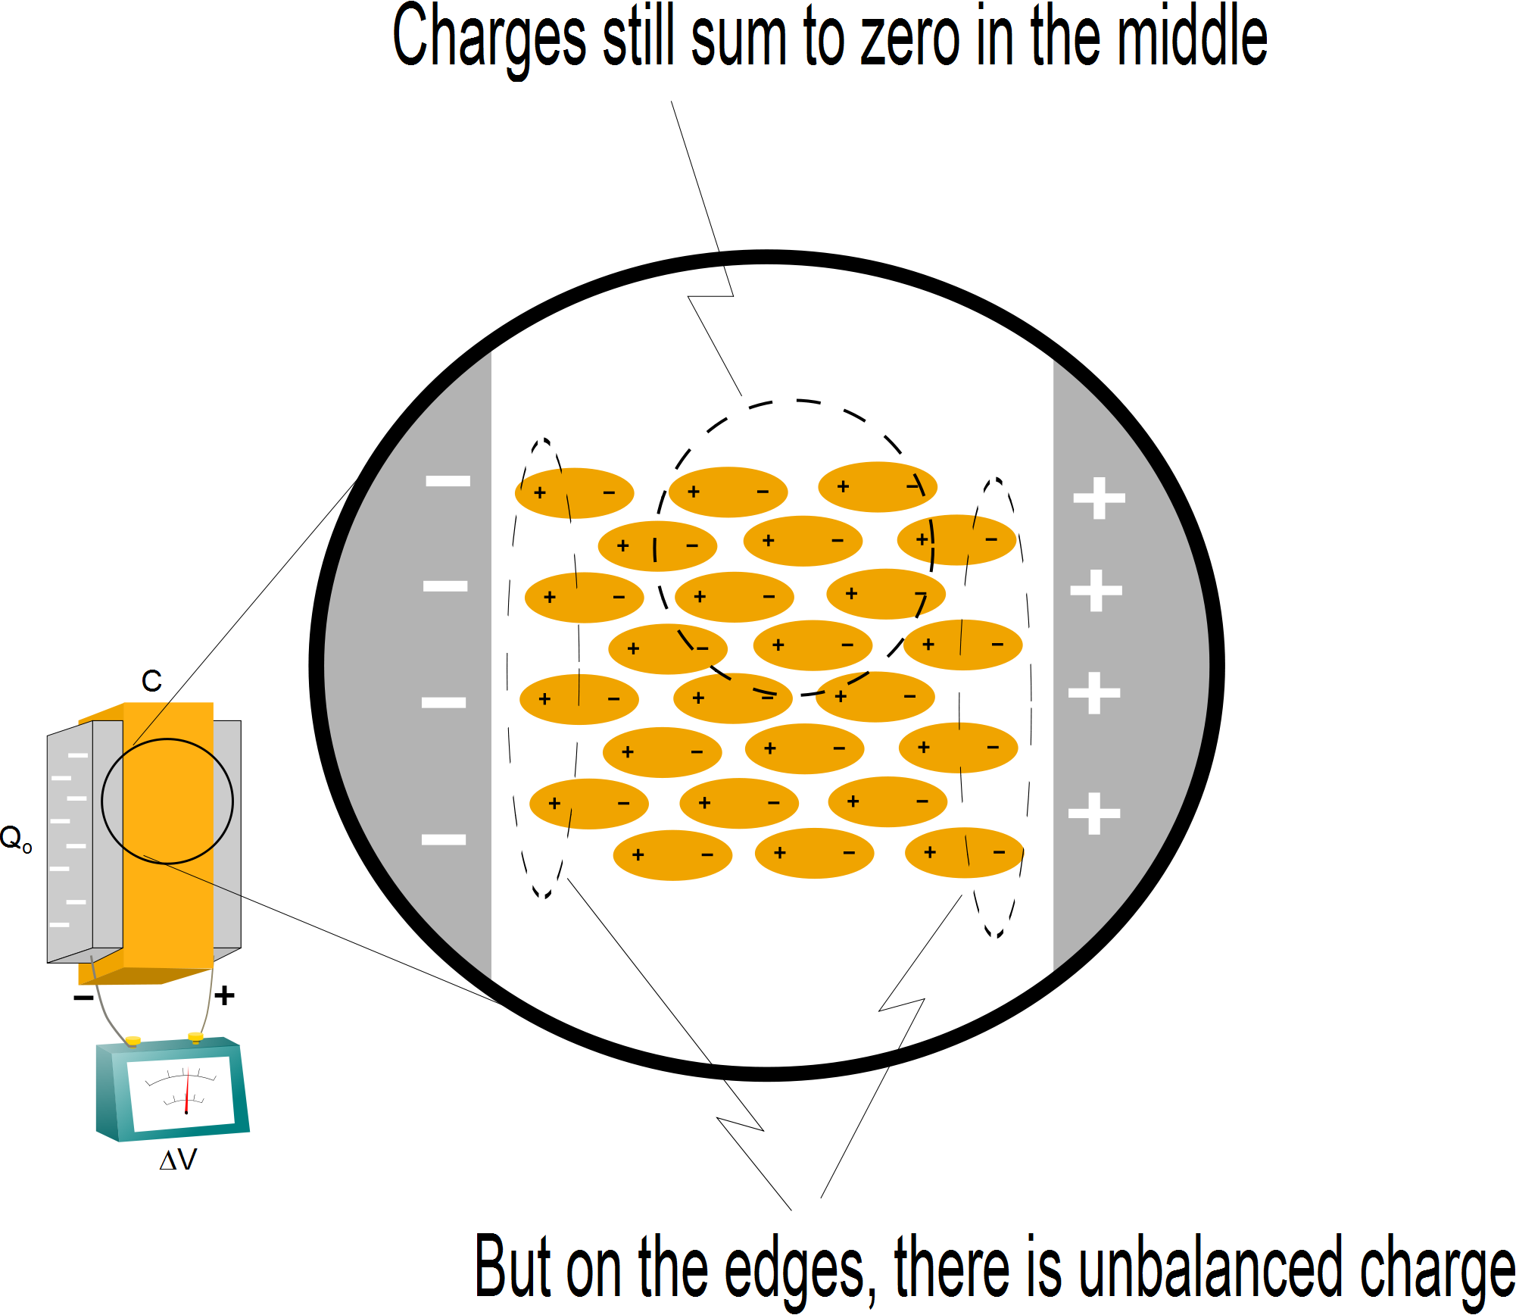

Slide 6
Question 223.35.3
a) Be 10 times larger
b) Be 100 times larger
c) Will be 10 times smaller
d) Will be 3.123 times the original capacitance
If I give you a dielectric material with a dielectric constant of 10, and you place it between the plates of a charged capacitor, the capacitance will

Slide 7
Question 223.35.3.5
How are you most likely to find a dielectric constant for polyvinylchloride?
By looking it up in a table
By measuring the voltage before and after a polyvinylchloride sample is placed in a capacitor of known dimensions.
By measuring the charge before and after a polyvinylchloride sample is placed in a capacitor of known dimensions.

Slide 9
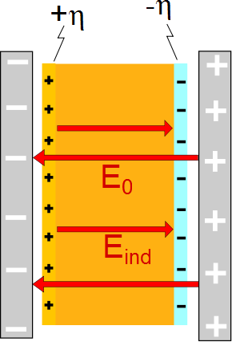

Slide 10
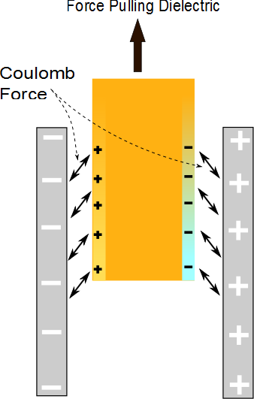

Slide 11
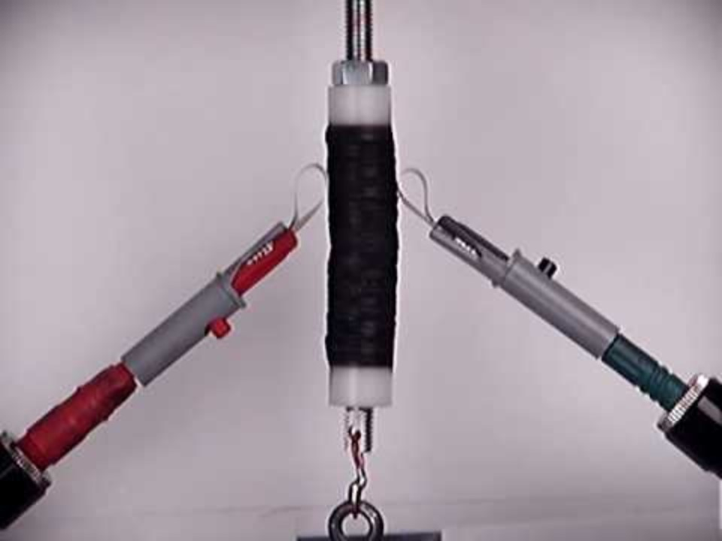

Slide 12
Question 223.35.4
When you flip a light switch, the light turns on very quickly, How fast do the electrons travel in the wires in your house?
At nearly the speed of light
Half the speed of light
¼ the speed of light
A tiny fraction of the speed of light

Slide 13
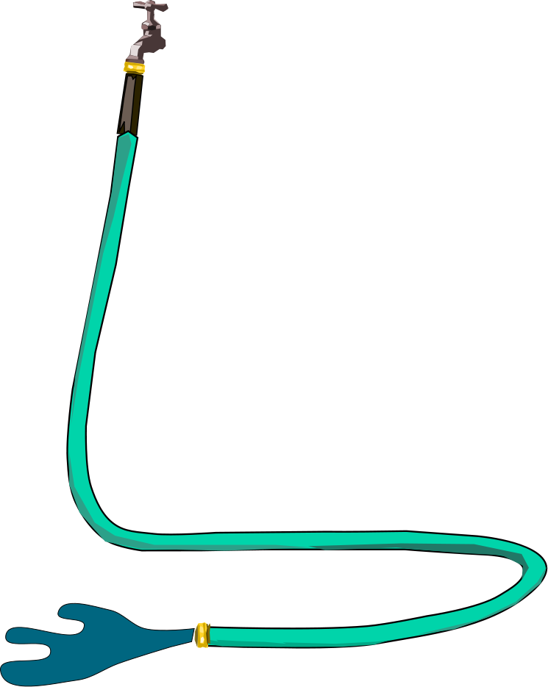
Question 223.35.5
When you turn on a hose, water seems to come out immediately. The water that comes out is…
The water that has just left the faucet
Water that was already in the hose and was near the hose end
Water that was spontaneously generated near the end of the hose
blue

Slide 15
Δ
Δ
x
x
q
q
v
v
d
d
A
A

Slide 16
Question 223.35.6
What would you call the number of electrons in one unit volume of wire?
Avogadro's number
Infinite
The surface charge density
The charge carrier number density

Slide 18
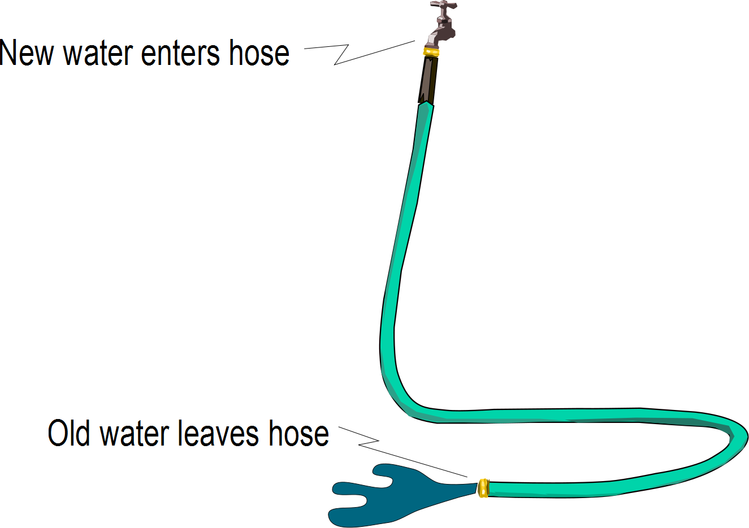

Slide 19
a

Slide 20
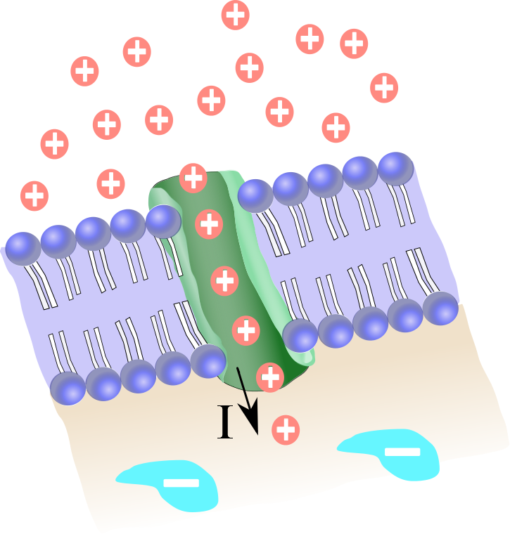

Slide 21
Question 223.35.7
What is the sign of the charge that moves in an electric current?
Positive
Negative
Positive and negative
Neutral

Slide 22
Question 223.35.7.1
Where will you find the free charges in a current carrying wire?
On the wire surface
Throughout the volume of the wire
All on one end of the wire

