Slide 1
Question 223.44.1
Can a changing magnetic field create an electric current?
Yes
No

Slide 2
Question 223.44.2
Can a changing magnetic field create an electric field?
Yes
No

Slide 3
B
v
`

Slide 4
B
v
F
`

Slide 5
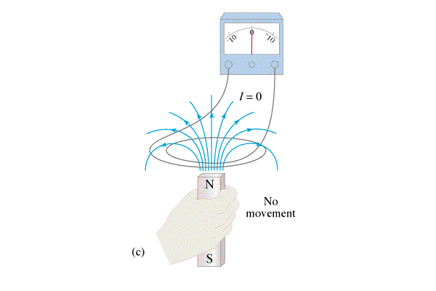
Question 223.44.3
In order to change the magnetic flux through the loop, what would you have to do?
a) drop the magnet
b) move the magnet upwards
c) move the magnet sideways
d) only (a) and (b)
e) all of the above

Slide 6
Question 223.44.3
In order to change the magnetic flux through the loop, what would you have to do?
a) drop the magnet
b) move the magnet upwards
c) move the magnet sideways
d) only (a) and (b)
e) all of the above
Moving the magnet in any direction would change the magnetic field through the loop and thus the magnetic flux.

Slide 7
B
v
F_{resistive}
E=B`v
F_{pull}
I
I

Slide 8
Question 223.43.0.1
A conducting rod slides on a conducting track in a constant B field directed into the page. What is the direction of the induced current?
a) clockwise
b) counterclockwise
c) no induced current
x x x x x x x x x x x
x x x x x x x x x x x
x x x x x x x x x x x
x x x x x x x x x x x
v

Slide 9
Question 223.43.0.1
A conducting rod slides on a conducting track in a constant B field directed into the page. What is the direction of the induced current?
a) clockwise
b) counterclockwise
c) no induced current
The B field points into the page. The flux is increasing since the area is increasing. The induced B field opposes this change and therefore points out of the page. Thus, the induced current runs counterclockwise according to the right-hand rule.
x x x x x x x x x x x
x x x x x x x x x x x
x x x x x x x x x x x
x x x x x x x x x x x
v
Follow-up: What direction is the magnetic force on the rod as it moves?

Slide 10
Question 223.43.1
We have a coil of wire with a small diode. The diode is bidirectional, so it shows a green light when the current goes one way through the diode, and shows a red light when it goes the other way. What do we see when the pendulum swings?
We see a red light
We see a green light
We see an alternating red and green light
Plaid
Bidirectional Diode
x x x x
x x x x
x x x x
B

Slide 11
Question 223.43.2
An aluminum plate is swung as a pendulum. The pendulum seems to brake if we include a magnetic field as shown. This is because
The plate is attracted to the magnet
The bar holding the plate is attracted to the magnet
There must be a current in the plate
x x x x
x x x x
x x x x
B

Slide 12
Question 223.43.3
An aluminum plate is swung as a pendulum. This time we have cut grooves in the plate as shown. What will happen when we release the pendulum
The plate swings normally with no braking
The braking effect increases
The plate speeds up as it passes through the field
x x x x
x x x x
x x x x
B

Slide 13
Area = A
E

Slide 14
Area = A
B

Slide 15
Area = A
B
θ

Slide 16
Area = A
B
θ
^
n

Slide 17
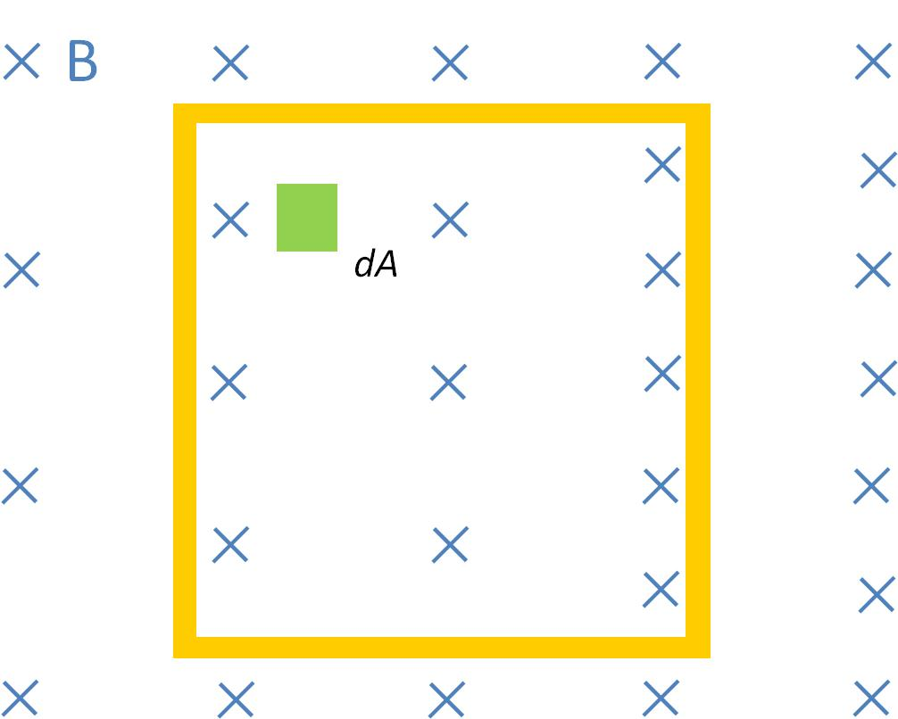
Question 223.43.4
For a square loop, what might be a good form for dA?
dxdy
dxdθ
dydθ
rdθ
rdrdθ

Slide 18
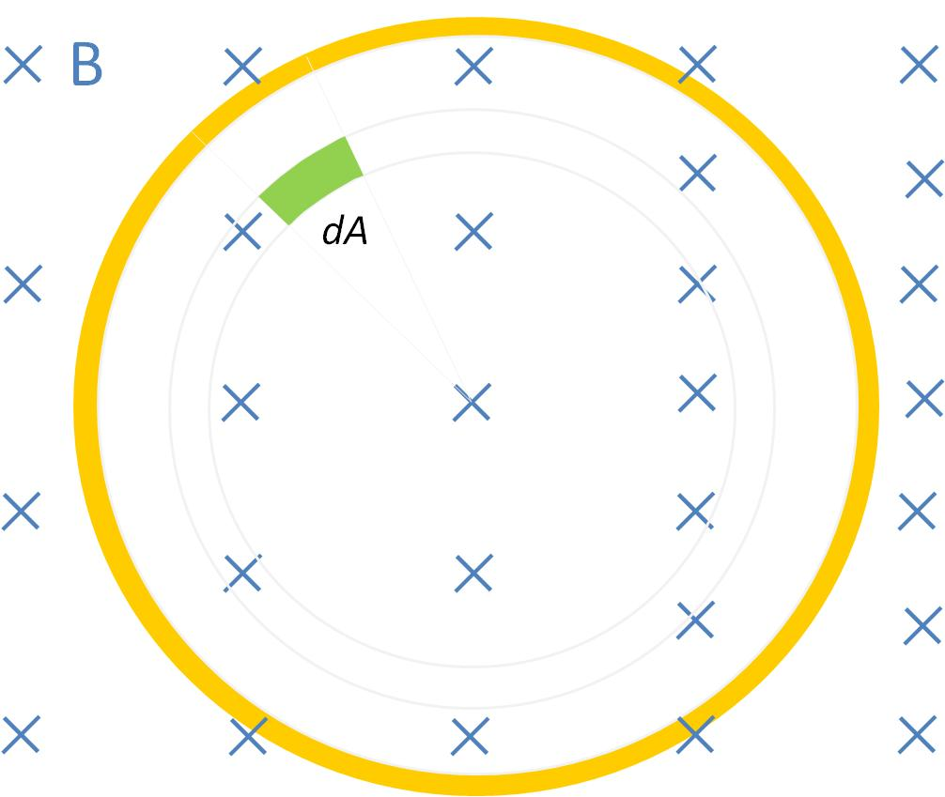
Question 223.43.5
For a circular loop, what might be a good form for dA?
dxdy
dxdθ
dydθ
rdθ
rdrdθ

Slide 19
B
dA

Slide 20
B
dA

Slide 21
Question 223.44.4
In order to change the magnetic flux through the loop, what would you have to do?
a) tilt the loop
b) change the loop area
c) use thicker wires
d) only (a) and (a
e) all of the above

Slide 22
Question 223.44.4
In order to change the magnetic flux through the loop, what would you have to do?
a) tilt the loop
b) change the loop area
c) use thicker wires
d) only (a) and (b)
e) all of the above
Since Φ = B A cosθ , changing the area or tilting the loop (which varies the projected area) would change the magnetic flux through the loop.

Slide 23
I
B
dA
b
r_{o}
a

Slide 25
I
B
dA
b
r_{o}
a

Slide 26
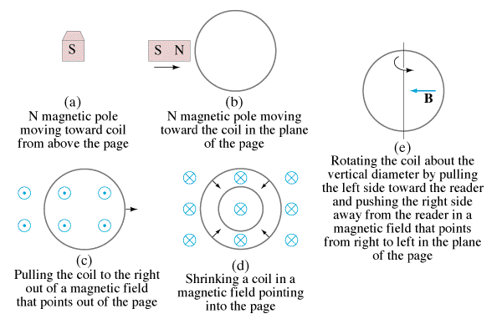
Question 223.44.5
If a North pole moves toward the loop from above the page, in what direction is the induced current?
a) clockwise
b) counterclockwise
c) no induced current

Slide 27
Question 223.44.5
If a North pole moves toward the loop from above the page, in what direction is the induced current?
a) clockwise
b) counterclockwise
c) no induced current
The magnetic field of the moving bar magnet is pointing into the page and getting larger as the magnet moves closer to the loop. Thus the induced magnetic field has to point out of the page. A counterclockwise induced current will give just such an induced magnetic field.
Follow-up: What happens if the magnet is stationary but the loop moves?

Slide 28
Question 223.44.6
If a North pole moves toward the loop in the plane of the page, in what direction is the induced current?
a) clockwise
b) counterclockwise
c) no induced current

Slide 29
Question 223.44.6
If a North pole moves toward the loop in the plane of the page, in what direction is the induced current?
a) clockwise
b) counterclockwise
c) no induced current
Since the magnet is moving parallel to the loop, there is no magnetic flux through the loop. Thus the induced current is zero.

Slide 30
Question 223.44.7
A wire loop is being pulled through a uniform magnetic field. What is the direction of the induced current?
a) clockwise
b) counterclockwise
c) no induced current
x x x x x x x x x x x x
x x x x x x x x x x x x
x x x x x x x x x x x x
x x x x x x x x x x x x
x x x x x x x x x x x x
x x x x x x x x x x x x
x x x x x x x x x x x x

Slide 31
Question 223.44.7
A wire loop is being pulled through a uniform magnetic field. What is the direction of the induced current?
a) clockwise
b) counterclockwise
c) no induced current
x x x x x x x x x x x x
x x x x x x x x x x x x
x x x x x x x x x x x x
x x x x x x x x x x x x
x x x x x x x x x x x x
x x x x x x x x x x x x
x x x x x x x x x x x x
Since the magnetic field is uniform, the magnetic flux through the loop is not changing. Thus no current is induced.
Follow-up: What happens if the loop moves out of the page?

Slide 32
Question 223.44.8
A wire loop is being pulled through a uniform magnetic field that suddenly ends. What is the direction of the induced current?
a) clockwise
b) counterclockwise
c) no induced current
x x x x x
x x x x x
x x x x x
x x x x x
x x x x x
x x x x x
x x x x x

Slide 33
Question 223.44.8
A wire loop is being pulled through a uniform magnetic field that suddenly ends. What is the direction of the induced current?
a) clockwise
b) counterclockwise
c) no induced current
x x x x x
x x x x x
x x x x x
x x x x x
x x x x x
x x x x x
x x x x x
The B field into the page is disappearing in the loop, so it must be compensated by an induced flux also into the page. This can be accomplished by an induced current in the clockwise direction in the wire loop.
Follow-up: What happens when the loop is completely out of the field?

Slide 34
Question 223.44.9
What is the direction of the induced current if the B field suddenly increases while the loop is in the region?
a) clockwise
b) counterclockwise
c) no induced current
x x x x x x x x x x x x
x x x x x x x x x x x x
x x x x x x x x x x x x
x x x x x x x x x x x x
x x x x x x x x x x x x
x x x x x x x x x x x x
x x x x x x x x x x x x
x x x x x
x x x x x
x x x x x
x x x x x
x x x x x
x x x x x
x x x x x

Slide 35
Question 223.44.9
What is the direction of the induced current if the B field suddenly increases while the loop is in the region?
a) clockwise
b) counterclockwise
c) no induced current
The increasing B field into the page must be countered by an induced flux out of the page. This can be accomplished by induced current in the counterclockwise direction in the wire loop.
x x x x x x x x x x x x
x x x x x x x x x x x x
x x x x x x x x x x x x
x x x x x x x x x x x x
x x x x x x x x x x x x
x x x x x x x x x x x x
x x x x x x x x x x x x
x x x x x
x x x x x
x x x x x
x x x x x
x x x x x
x x x x x
x x x x x
Follow-up: What if the loop stops moving while the field increases?

Slide 36
Question 223.44.10
If a coil is shrinking in a magnetic field pointing into the page, in what direction is the induced current?
a) clockwise
b) counterclockwise
c) no induced current

Slide 37
Question 223.44.10
If a coil is shrinking in a magnetic field pointing into the page, in what direction is the induced current?
a) clockwise
b) counterclockwise
c) no induced current
The magnetic flux through the loop is decreasing, so the induced B field must try to reinforce it and therefore points in the same direction — into the page. According to the right-hand rule, an induced clockwise current will generate a magnetic field into the page.
Follow-up: What if the B field is oriented at 90° to its present direction?

Slide 38
Question 223.44.11
If a coil is rotated as shown, in a magnetic field pointing to the left, in what direction is the induced current?
a) clockwise
b) counterclockwise
c) no induced current

Slide 39
Question 223.44.11
If a coil is rotated as shown, in a magnetic field pointing to the left, in what direction is the induced current?
a) clockwise
b) counterclockwise
c) no induced current
As the coil is rotated into the B field, the magnetic flux through it increases. According to Lenz’s Law, the induced B field has to oppose this increase, thus the new B field points to the right. An induced counterclockwise current produces just such a B field.

Slide 40
Question 223.44.12
Wire #1 (length L) forms a one-turn loop, and a bar magnet is dropped through. Wire #2 (length 2L) forms a two-turn loop, and the same magnet is dropped through. Compare the magnitude of the induced voltages in these two cases.
a) V₁ > V₂
b) V₁ < V₂
c) V₁ = V₂ ≠ 0
d) V₁ = V₂ = 0
S
S
N
N
2
1

Slide 41
Question 223.44.12
Wire #1 (length L) forms a one-turn loop, and a bar magnet is dropped through. Wire #2 (length 2L) forms a two-turn loop, and the same magnet is dropped through. Compare the magnitude of the induced voltages in these two cases.
a) V₁ > V₂
b) V₁ < V₂
c) V₁ = V₂ ≠ 0
d) V₁ = V₂ = 0
Faraday’s law:
depends on N (number of loops) so the induced emf is twice as large in the wire with 2 loops.
S
S
N
N
2
1

Slide 42
Question 223.44.13
Wire #1 (length L) forms a one-turn loop, and a bar magnet is dropped through. Wire #2 (length 2L) forms a two-turn loop, and the same magnet is dropped through. Compare the magnitude of the induced currents in these two cases.
a) I₁ > I₂
b) I₁ < I₂
c) I₁ = I₂ ≠ 0
d) I₁ = I₂ = 0
S
S
N
N
2
1

Slide 43
Question 223.44.13
Wire #1 (length L) forms a one-turn loop, and a bar magnet is dropped through. Wire #2 (length 2L) forms a two-turn loop, and the same magnet is dropped through. Compare the magnitude of the induced currents in these two cases.
a) I₁ > I₂
b) I₁ < I₂
c) I₁ = I₂ ≠ 0
d) I₁ = I₂ = 0
Faraday’s law:
says that the induced emf is twice as large in the wire with 2 loops. The current is given by Ohm’s law: I = V/R. Since wire #2 is twice as long as wire #1, it has twice the resistance, so the current in both wires is the same.
S
S
N
N
2
1

Slide 44
Question 223.44.14
A bar magnet is held above the floor and dropped. In 1, there is nothing between the magnet and the floor. In 2, the magnet falls through a copper loop. How will the magnet in case 2 fall in comparison to case 1?
a) it will fall slower
b) it will fall faster
c) it will fall the same
S
S
1
2
N
N
copper
loop

Slide 45
Question 223.44.14
A bar magnet is held above the floor and dropped. In 1, there is nothing between the magnet and the floor. In 2, the magnet falls through a copper loop. How will the magnet in case 2 fall in comparison to case 1?
a) it will fall slower
b) it will fall faster
c) it will fall the same
When the magnet is falling from above the loop in 2, the induced current will produce a North pole on top of the loop, which repels the magnet.
When the magnet is below the loop, the induced current will produce a North pole on the bottom of the loop, which attracts the South pole of the magnet.
S
S
1
2
N
N
copper
loop
Follow-up: What happens in case 2 if you flip the magnet so that the South pole is on the bottom as the magnet falls?

Slide 46
Question 223.44.15
If there is induced current, doesn’t that cost energy? Where would that energy come from in case 2?
a) induced current doesn’t need any energy
b) energy conservation is violated in this case
c) there is less KE in case 2
d) there is more gravitational PE in case 2
S
S
1
2
N
N
copper
loop

Slide 47
Question 223.44.15
If there is induced current, doesn’t that cost energy? Where would that energy come from in case 2?
a) induced current doesn’t need any energy
b) energy conservation is violated in this case
c) there is less KE in case 2
d) there is more gravitational PE in case 2
In both cases, the magnet starts with the same initial gravitational PE.
In case 1, all the gravitational PE has been converted into kinetic energy.
In case 2, we know the magnet falls slower, thus there is less KE. The difference in energy goes into making the induced current.
S
S
1
2
N
N
copper
loop

Slide 48
Question 223.44.16
A wire loop is being pulled away from a current-carrying wire. What is the direction of the induced current in the loop?
a) clockwise
b) counterclockwise
c) no induced current
I
Notes:
[CORRECT 5 ANSWER]

Slide 49
Question 223.44.16
A wire loop is being pulled away from a current-carrying wire. What is the direction of the induced current in the loop?
a) clockwise
b) counterclockwise
c) no induced current
The magnetic flux is into the page on the right side of the wire and decreasing due to the fact that the loop is being pulled away. By Lenz’s Law, the induced B field will oppose this decrease. Thus, the new B field points into the page, which requires an induced clockwise current to produce such a B field.
I

Slide 50
Question 223.44.17
What is the induced current if the wire loop moves in the direction of the blue arrow ?
a) clockwise
b) counterclockwise
c) no induced current
I
Notes:
[CORRECT 5 ANSWER]

Slide 51
Question 223.44.17
What is the induced current if the wire loop moves in the direction of the yellow arrow ?
a) clockwise
b) counterclockwise
c) no induced current
The magnetic flux through the loop is not changing as it moves parallel to the wire. Therefore, there is no induced current.
I

Slide 52
Question 223.44.E1
At the moment shown, what direction is the induced current?
a) clockwise
b) counterclockwise
c) no induced current

Slide 53
Question 223.44.E2
At the moment shown, what direction is the induced current?
a) clockwise
b) counterclockwise
c) no induced current

