Slide 1
Question 223.44.12
Wire #1 (length L) forms a one-turn loop, and a bar magnet is dropped through. Wire #2 (length 2L) forms a two-turn loop, and the same magnet is dropped through. Compare the magnitude of the induced voltages in these two cases.
1) V₁ > V₂
2) V₁ < V₂
3) V₁ = V₂ ≠ 0
4) V₁ = V₂ = 0
S
S
N
N
2
1

Slide 2
Question 223.44.12
Wire #1 (length L) forms a one-turn loop, and a bar magnet is dropped through. Wire #2 (length 2L) forms a two-turn loop, and the same magnet is dropped through. Compare the magnitude of the induced voltages in these two cases.
1) V₁ > V₂
2) V₁ < V₂
3) V₁ = V₂ ≠ 0
4) V₁ = V₂ = 0
Faraday’s law:
depends on N (number of loops) so the induced emf is twice as large in the wire with 2 loops.
S
S
N
N
2
1

Slide 3
Question 223.44.13
Wire #1 (length L) forms a one-turn loop, and a bar magnet is dropped through. Wire #2 (length 2L) forms a two-turn loop, and the same magnet is dropped through. Compare the magnitude of the induced currents in these two cases.
1) I₁ > I₂
2) I₁ < I₂
3) I₁ = I₂ ≠ 0
4) I₁ = I₂ = 0
S
S
N
N
2
1

Slide 4
Question 223.44.13
Wire #1 (length L) forms a one-turn loop, and a bar magnet is dropped through. Wire #2 (length 2L) forms a two-turn loop, and the same magnet is dropped through. Compare the magnitude of the induced currents in these two cases.
1) I₁ > I₂
2) I₁ < I₂
3) I₁ = I₂ ≠ 0
4) I₁ = I₂ = 0
Faraday’s law:
says that the induced emf is twice as large in the wire with 2 loops. The current is given by Ohm’s law: I = V/R. Since wire #2 is twice as long as wire #1, it has twice the resistance, so the current in both wires is the same.
S
S
N
N
2
1

Slide 5
Question 223.44.14
A bar magnet is held above the floor and dropped. In 1, there is nothing between the magnet and the floor. In 2, the magnet falls through a copper loop. How will the magnet in case 2 fall in comparison to case 1?
1) it will fall slower
2) it will fall faster
3) it will fall the same
S
S
1
2
N
N
copper
loop

Slide 6
Question 223.44.14
A bar magnet is held above the floor and dropped. In 1, there is nothing between the magnet and the floor. In 2, the magnet falls through a copper loop. How will the magnet in case 2 fall in comparison to case 1?
1) it will fall slower
2) it will fall faster
3) it will fall the same
When the magnet is falling from above the loop in 2, the induced current will produce a North pole on top of the loop, which repels the magnet.
When the magnet is below the loop, the induced current will produce a North pole on the bottom of the loop, which attracts the South pole of the magnet.
S
S
1
2
N
N
copper
loop
Follow-up: What happens in case 2 if you flip the magnet so that the South pole is on the bottom as the magnet falls?

Slide 7
Question 223.44.15
If there is induced current, doesn’t that cost energy? Where would that energy come from in case 2?
1) induced current doesn’t need any energy
2) energy conservation is violated in this case
3) there is less KE in case 2
4) there is more gravitational PE in case 2
S
S
1
2
N
N
copper
loop

Slide 8
Question 223.44.15
If there is induced current, doesn’t that cost energy? Where would that energy come from in case 2?
1) induced current doesn’t need any energy
2) energy conservation is violated in this case
3) there is less KE in case 2
4) there is more gravitational PE in case 2
In both cases, the magnet starts with the same initial gravitational PE.
In case 1, all the gravitational PE has been converted into kinetic energy.
In case 2, we know the magnet falls slower, thus there is less KE. The difference in energy goes into making the induced current.
S
S
1
2
N
N
copper
loop

Slide 9
Question 223.44.16
A wire loop is being pulled away from a current-carrying wire. What is the direction of the induced current in the loop?
1) clockwise
2) counterclockwise
3) no induced current
I
Notes:
[CORRECT 5 ANSWER]

Slide 10
Question 223.44.16
A wire loop is being pulled away from a current-carrying wire. What is the direction of the induced current in the loop?
1) clockwise
2) counterclockwise
3) no induced current
The magnetic flux is into the page on the right side of the wire and decreasing due to the fact that the loop is being pulled away. By Lenz’s Law, the induced B field will oppose this decrease. Thus, the new B field points into the page, which requires an induced clockwise current to produce such a B field.
I

Slide 11
Question 223.44.17
What is the induced current if the wire loop moves in the direction of the blue arrow ?
1) clockwise
2) counterclockwise
3) no induced current
I
Notes:
[CORRECT 5 ANSWER]

Slide 12
Question 223.44.17
What is the induced current if the wire loop moves in the direction of the yellow arrow ?
1) clockwise
2) counterclockwise
3) no induced current
The magnetic flux through the loop is not changing as it moves parallel to the wire. Therefore, there is no induced current.
I

Slide 13
Question 223.45.1
A wire loop is in a uniform magnetic field. Current flows in the wire loop, as shown. What does the loop do?
(1) moves to the right
(2) moves up
(3) remains motionless
(4) rotates
(5) moves out of the page

Slide 14
Question 223.45.1
A wire loop is in a uniform magnetic field. Current flows in the wire loop, as shown. What does the loop do?
(1) moves to the right
(2) moves up
(3) remains motionless
(4) rotates
(5) moves out of the page
There is no magnetic force on the top and bottom legs, since they are parallel to the B field. However, the magnetic force on the right side is into the page, and the magnetic force on the left side is out of the page. Therefore, the entire loop will tend to rotate.
This is how a motor works !!

Slide 15
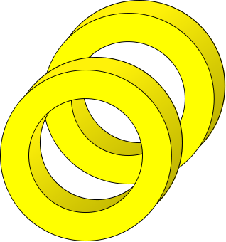

Slip rings
Brushes
N
S

Slide 16
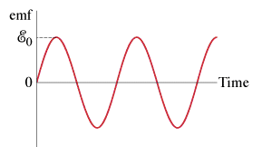
Question 223.45.2
A generator has a coil of wire rotating in a magnetic field. If the rotation rate increases, how is the maximum output voltage of the generator affected?
1) increases
2) decreases
3) stays the same
4) varies sinusoidally

Slide 17
Question 223.45.2
A generator has a coil of wire rotating in a magnetic field. If the rotation rate increases, how is the maximum output voltage of the generator affected?
1) increases
2) decreases
3) stays the same
4) varies sinusoidally
The maximum voltage is the leading term that multiplies sin(ωt) and is given by ε₀ = NBAω. Therefore, if ω increases, then ε₀ must increase as well.

Slide 18
A
B
θ
a/2

Slide 21
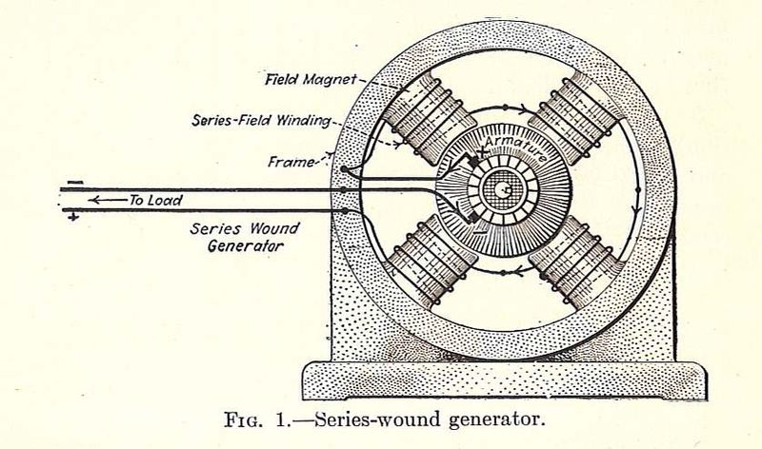

Slide 22
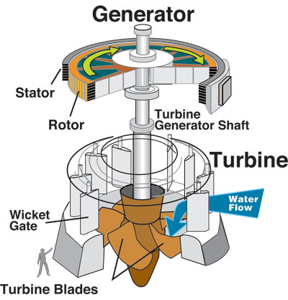

Slide 23
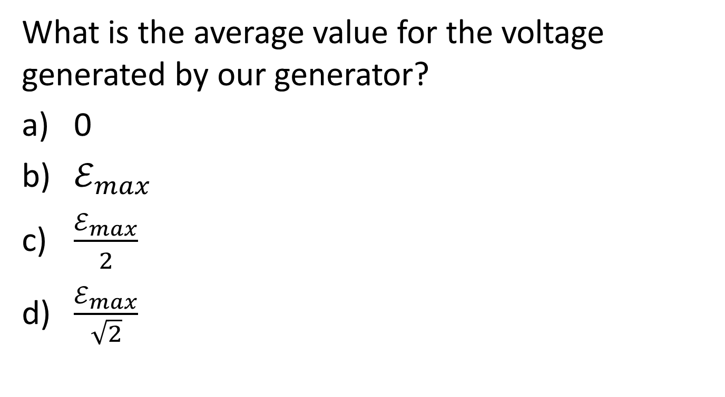
Question
What is the average value for the voltage generated by our generator?
0
$ℰ_{max}$
$\frac{ℰ_{max}}{2}$
$\frac{ℰ_{max}}{\sqrt{2}}$

Slide 28
ΔV₁
ΔV₂
Iron Core
Switch
R
Alternating
Current Source
N₁
N₂

Slide 29
Question 223.45.3
What is the voltage across the lightbulb?
1) 30 V
2) 60 V
3) 120 V
4) 240 V
5) 480 V
120 V

Slide 30
Question 223.45.3
What is the voltage across the lightbulb?
1) 30 V
2) 60 V
3) 120 V
4) 240 V
5) 480 V
The first transformer has a 2:1 ratio of turns, so the voltage doubles. But the second transformer has a 1:2 ratio, so the voltage is halved again. Therefore, the end result is the same as the original voltage.
120 V
240 V
120 V

Slide 31
Question 223.45.4
Given that the intermediate current is 1 A, what is the current through the lightbulb?
1) 1/4 A
2) 1/2 A
3) 1 A
4) 2 A
5) 5 A
1 A
120 V
240 V
120 V

Slide 32
Question 223.45.4
1) 1/4 A
2) 1/2 A
3) 1 A
4) 2 A
5) 5 A
Given that the intermediate current is 1 A, what is the current through the lightbulb?
Power in = Power out
240 V × 1 A = 120 V × ???
The unknown current is 2 A.
1 A
120 V
240 V
120 V

Slide 33
Question 223.45.5
A 6 V battery is connected to one side of a transformer. Compared to the voltage drop across coil A, the voltage across coil B is:
1) greater than 6 V
2) 6 V
3) less than 6 V
4) zero
A
B
6 V

Slide 34
Question 223.45.5
A 6 V battery is connected to one side of a transformer. Compared to the voltage drop across coil A, the voltage across coil B is:
1) greater than 6 V
2) 6 V
3) less than 6 V
4) zero
The voltage across B is zero. Only a changing magnetic flux induces an EMF. Batteries can only provide DC current.
A
B
6 V

Slide 35
Induced E-fields
I
r
+

Slide 36
Induced E-fields
B
I
r
+
E

Slide 37
Induced E-fields
B
I
r
+
E

Slide 38
Question 223.45.6
Does the induced electric field create a force given by
F=qE
Yes
No

Slide 39
Question 223.45.7
I have a region is space that has an electric field in it. Can I tell if the field is created by charges or by changing magnetic fields?
Yes
No

Slide 40
Question 223.45.8
If the magnetic field is time-varying, we expect a current. Does it take work to move the charges?
Yes
No
I
r
+

Slide 41
Changing B-Field
Induced E-Field
E

Slide 42
Question 223.45.9
Are the Electric and Magnetic field equations symmetric
Yes
They seem to be
No
They seem not to be

Slide 43
E
Changing E-Field
B
Induced B-Field

Slide 44
Question 223.45.10
Is there a physical justification that we know of that says the field equations must be symmetric?
Yes
No

Slide 45
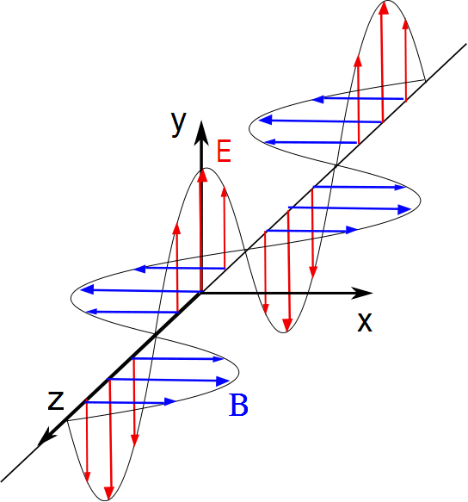

Slide 46
v
F
+

Slide 47
END

