Slide 1
Question 223.46.1
What is self inductance?
It is the material and geometric factors that affect the induced emf do to a changing current.
It is ΔI/ Δt
It is ΔΦ/ Δt
A ceremony performed when you make your own club and you, yourself, join the club as its first member

Slide 3
Question 223.46.2
The inductance of a solenoid is proportional to
The cross sectional area of the solenoid
The length of the solenoid
The temperature of the solenoid
Q
Maybe more than one of the above

Slide 4
Magnetic field inside a solenoid
Basic Equation: Ampere’s Law
2
1
3
4

Slide 5
Inductance of a solenoid
Basic Equations:
A

Slide 6
Question 223.46.3
There is energy stored in a capacitor, is there energy stored in an inductor?
Yes
No

Slide 8
Question 223.46.4
The energy density in a magnetic field is proportional to
B
B²
E
C

Slide 9
Inductor Symbol

Slide 10
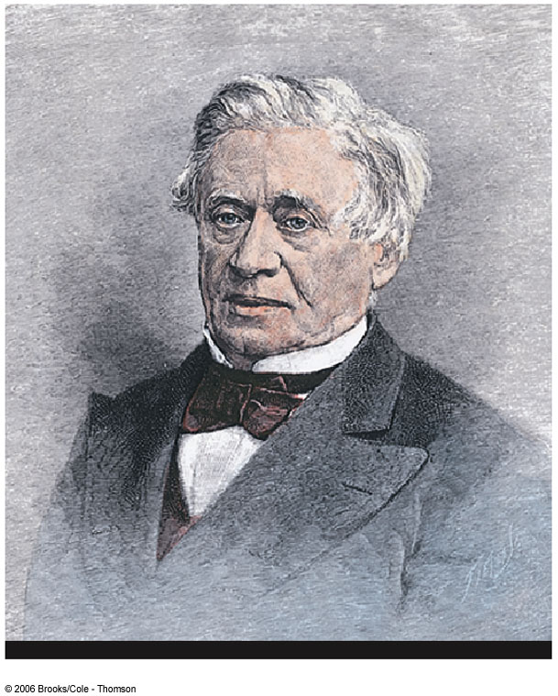
Joseph Henry
1797 – 1878
First director of the Smithsonian
First president of the Academy of Natural Science
First to produce an electric current with a magnetic field
Improved the design of the electro-magnetic and constructed a motor
Discovered self-inductance

Slide 12
Question 223.46.5
How do K and U change when a mass-spring system oscillate?
The energy changes smoothly from K to U
The energy is all K
The energy is all U
The energy jumps from K=0 to K_{max} and from U_{max} to U=0

Slide 13
Spring Mass System
Basic Equations:
V_{max}
m
x=0
x_{max}
Differential Equation
k
V=0
V=0
m
m
x=0
x_{max}
-x_{max}
x=0
V_{max}
Solution
m
x=0
x_{max}
Is the amplitude of the oscillation
Is the angular frequency
Is the phase (time offset)

Slide 14
LC Circuit, Charge, Current
Basic Equations:
L
C
Assumptions:
No Resistance
No Radiation
Solution function:
Differential Equation
Use Initial Conditions

Slide 15
LC Circuit, Charge, Current
90° out of phase
Q
When Q =Q_{max}, I=0
When I=I_{max}, Q=0
I
T/2
T

Slide 16
LC Circuit, Energy
Basic Equations:
L
C
Assumptions:
No Resistance
No Radiation
1
Reasonable?

Slide 17
U_{B}
U_{E}
L
C
U_{B}
U_{E}
U_{B}
U_{E}
L
C
L
C
L
C
L
C
U_{B}
U_{E}
U_{B}
U_{E}
L
C
L
C
L
C
U_{B}
U_{E}
U_{B}
U_{E}
U_{B}
U_{E}
After Halliday and Resnick Figure 35-1

Slide 19
RLC Circuit, Analysis
The total energy is not constant, since there is a transformation to internal energy in the resistor at the rate of dU/dt = -I ²R
Radiation losses are still ignored
The circuit’s operation can be expressed as

Slide 20
RLC Circuit Compared to Damped Oscillators
The RLC circuit is analogous to a damped harmonic oscillator
When R = 0
The circuit reduces to an LC circuit and is equivalent to no damping in a mechanical oscillator

Slide 21
RLC Circuit Compared to Damped Oscillators, cont.
When R is small:
The RLC circuit is analogous to light damping in a mechanical oscillator
Q = Q_{max} e^{-Rt/2L} cos ω_{d}t
ω_{d} is the angular frequency of oscillation for the circuit and

Slide 22
RLC Circuit Compared to Damped Oscillators, final
When R is very large, the oscillations damp out very rapidly
There is a critical value of R above which no oscillations occur
If R = R_{C}, the circuit is said to be critically damped
When R > R_{C}, the circuit is said to be overdamped

Slide 23
S₁
R
L
E
C
S₂

Slide 24
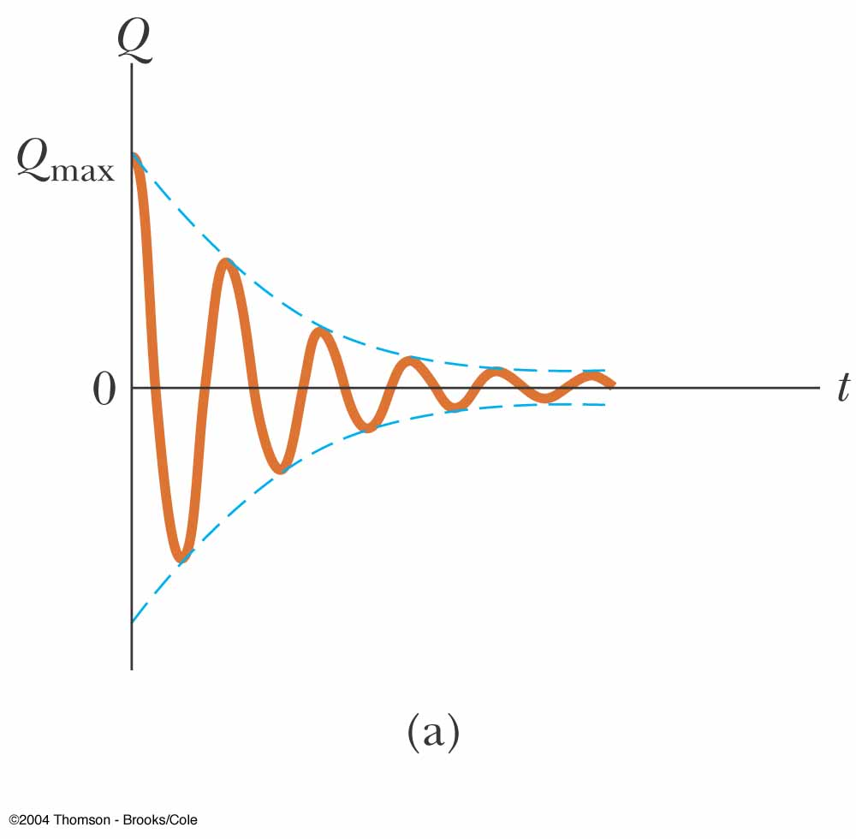
Damped RLC Circuit, Graph
The maximum value of Q decreases after each oscillation
R < R_{C}
This is analogous to the amplitude of a damped spring-mass system

Slide 26
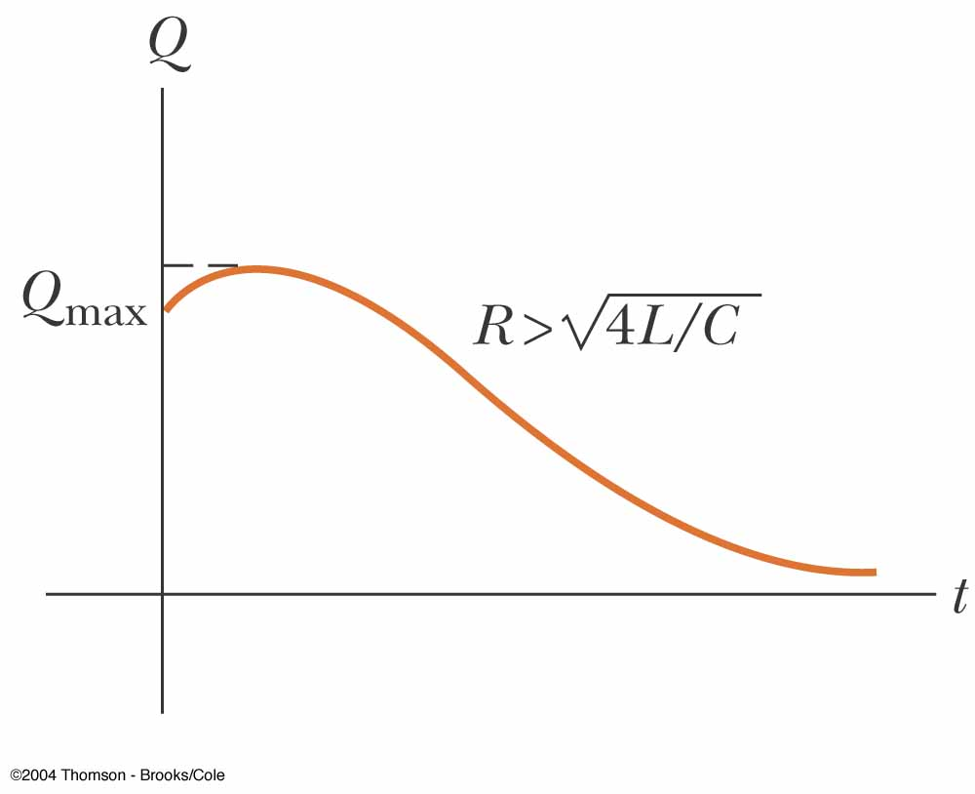
Overdamped RLC Circuit, Graph
The oscillations damp out very rapidly
Values of R are greater than R_{C}

Slide 27
Strange Circuit 1
A
x x
x x x x
x x
V₁
R₁
R₂
V₂
D
Changing Magnetic Flux

Slide 28
Strange Circuit 1
A
I₁
I
I₂
x x
x x x x
x x
V₁
R₁
R₂
V₂
D
Changing Magnetic Flux

Slide 29
Strange Circuit 2
R
E
I

Slide 30
Strange Circuit 2
ds
R
E
B
I

Slide 31
Strange Circuit 2
ds
R
V
E
B
I

Slide 32
Strange Circuit 2
ds
R
V
E
B
I
New Loop Area

Slide 33
Inductor in a Circuit
Inductance can be interpreted as a measure of opposition to the rate of change in the current
Remember resistance R is a measure of opposition to the current
As a circuit is completed, the current begins to increase, but the inductor produces an emf that opposes the increasing current
Therefore, the current doesn’t change from 0 to its maximum instantaneously

Slide 34
RL Circuit
When the current reaches its maximum, the rate of change and the back emf are zero
The time constant, τ, for an RL circuit is the time required for the current in the circuit to reach 63.2% of its final value

Slide 35
RL Circuit, cont
The time constant depends on R and L
The current at any time can be found by

Slide 36
Energy Stored in a Magnetic Field
The emf induced by an inductor prevents a battery from establishing an instantaneous current in a circuit
The battery has to do work to produce a current
This work can be thought of as energy stored by the inductor in its magnetic field
PE_{L} = ½ L I²

Slide 37
Finding the Current in and RL Circuit
R
Basic Equations:
E
L
Find
Change variables
Where

Slide 38
Finding the Current in an RL Circuit
R
Basic Equations:
L
then
Choose a function for I

Slide 39
L
C

Slide 40
Energy in the B-field (RL Circuit)
Basic Equations:
R
E
L
Example:
Identify
Solve for energy in the Inductor
Compare

Slide 41
Energy in the B-field (Solenoid)
Basic Equations:
R
E
L
Multiply by 1
Rearrange Terms
Result is true in general!
Compare
Volume of Solenoid

Slide 42
R
E
L

Slide 43
N₁
N₂
Φ₁₂
Coil 1
Coil 2

Slide 44
Mutual Induction
N₁
N₂
Basic Equations:
Φ₁₂
Coil 1
Coil 2
Note:

Slide 45
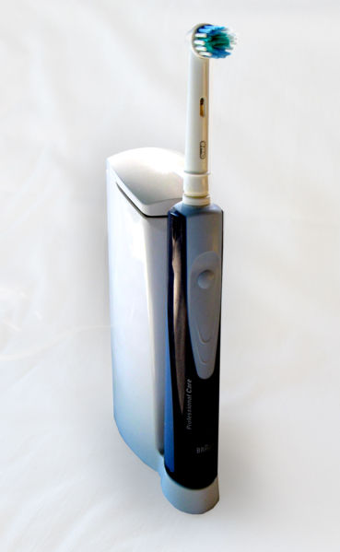

Slide 46
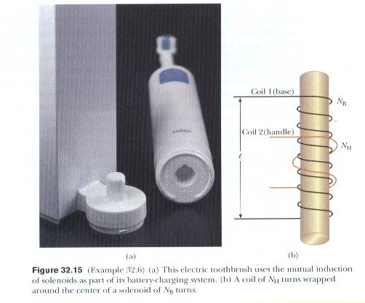
Serway and Jewett

Slide 47
I
l
a
b

Slide 48
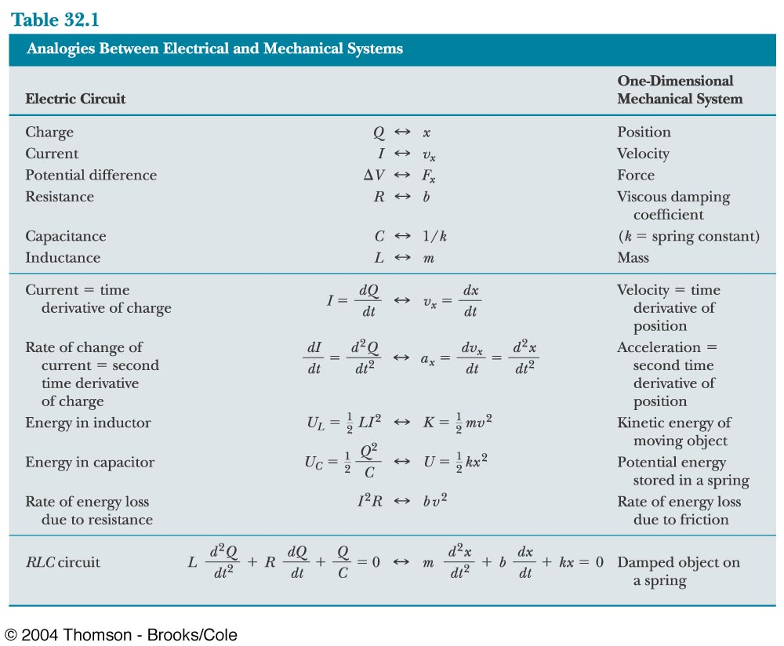

Slide 49
Question 223.46.6
How do U_{C} and U_{L} change when a mass-spring system oscillate?
The energy changes smoothly from U_{C} to U_{L}
The energy is all U_{C}
The energy is all U
The energy jumps from U_{C} =0 to U_{C max} and from U_{max} to U=0

