Slide 1
Question 223.27.1
I have a charge of +Q inside a spherical Gaussian surface with radius r₁. I have a second charge of +Q inside a larger Gaussian surface with radius r₂. Which surface has the larger flux?
The one with radius r₁
The one with radius r₂
The flux is the same for both
r₂
r₁
+
+
Q
Q

Slide 2
Charge in Closed Surface
Spherical Closed Surface
r
+
Q

Slide 3
E

Slide 4
+
Q

Slide 5
Question 223.27.1
I have a charge of +Q at the center of a spherical Gaussian surface. I have a second charge of +Q inside a Gaussian surface but it is not at the center of the surface. Which surface has the larger flux?
The centered one
The off-center one
The flux is the same for both
+
Q
+
Q

Slide 6
Spherical Closed Surface
+
Q

Slide 7
+
Q

Slide 8
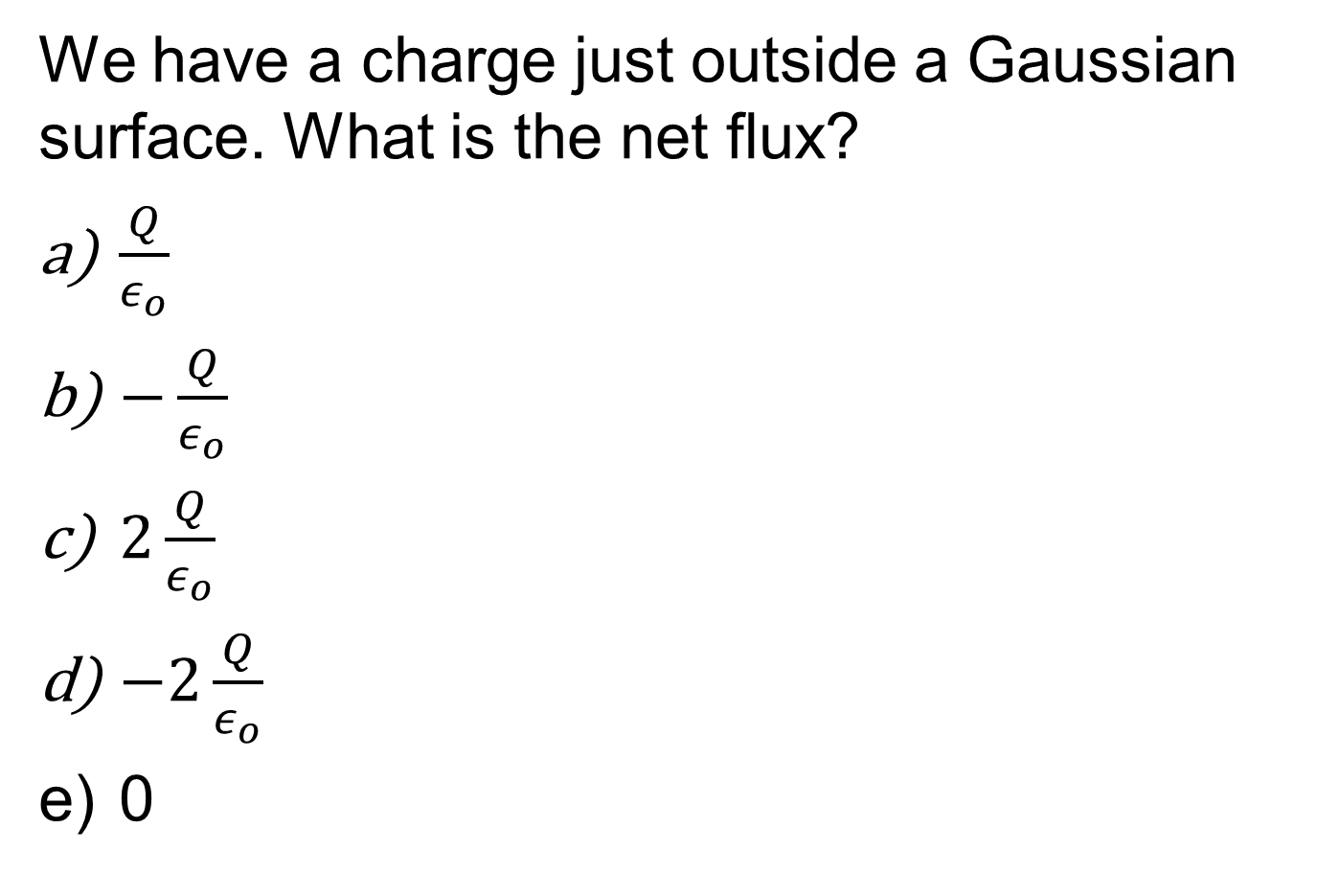
Question
We have a charge just outside a Gaussian surface. What is the net flux?
$\frac{Q}{ε_{o}}$
$−\frac{Q}{ε_{o}}$
$2\frac{Q}{ε_{o}}$
$−2\frac{Q}{ε_{o}}$
0
+
Q

Slide 9
+
Q

Slide 10
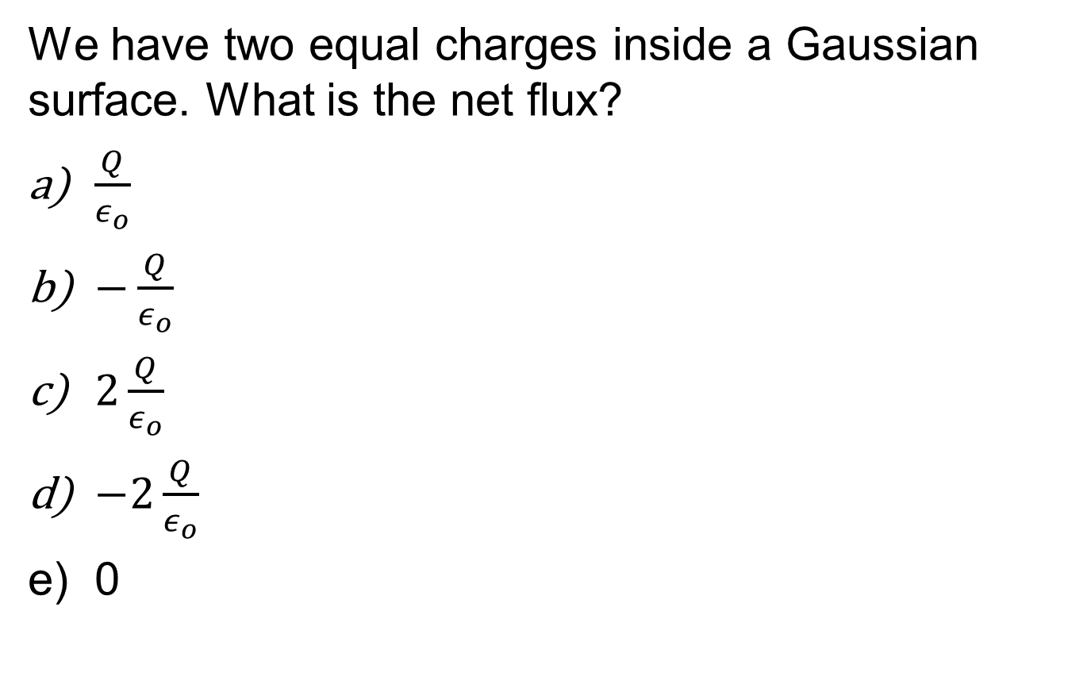
Question
We have two equal charges inside a Gaussian surface. What is the net flux?
$\frac{Q}{ε_{o}}$
$−\frac{Q}{ε_{o}}$
$2\frac{Q}{ε_{o}}$
$−2\frac{Q}{ε_{o}}$
0
+
+
Q
Q

Slide 11
+
+
Q
Q

Slide 12
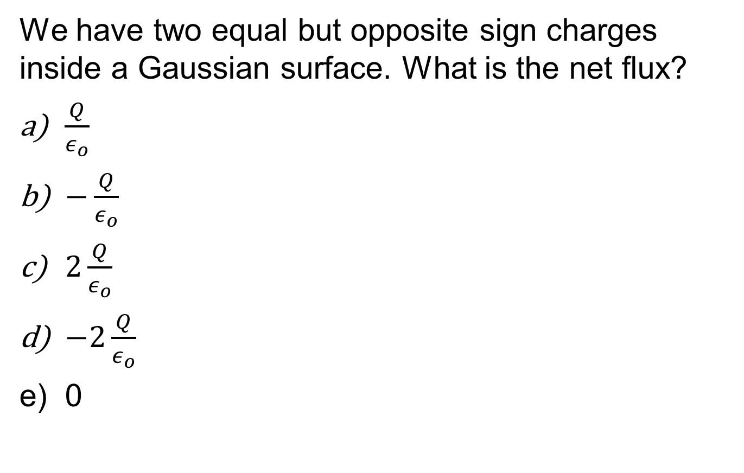
Question
We have two equal but opposite sign charges inside a Gaussian surface. What is the net flux?
$\frac{Q}{ε_{o}}$
$−\frac{Q}{ε_{o}}$
$2\frac{Q}{ε_{o}}$
$−2\frac{Q}{ε_{o}}$
0
+
-
Q
-Q

Slide 13
Gauss’ Law
Gauss’ Law states that the electric flux through any closed surface is equal to the net charge Q inside the surface divided by ε_{o}
ε_{o} is the permittivity of free space and equals 8.85 x 10⁻¹² C²/Nm²
The area in Φ is an imaginary surface, a Gaussian surface, it does not have to coincide with the surface of a physical object

Slide 14
Finally, Spherical Shells!

Slide 15
Question 223.27.2
Spherical Closed Surface
I have a spherical closed shell of total charge, Q, as shown. What is the electric field strength, E, inside the shell?
Q/ε_{o}
Q/(4 πε_{o}r²)
4Q/(ε_{o})
zero
+
+
+
+
+
+
+
+
+
+
+
+
+
+
+
+

Slide 16
Charged Spherical Shell
Draw the charge distribution
+
+
+
+
+
+
+
+
+
+
+
+
+
+
+
+
+
+

Slide 17
Charged Spherical Shell
2. Draw the field lines using symmetry
E
+
+
+
+
+
+
+
+
+
+
+
+
+
+
+
+
+
+

Slide 18


Charged Spherical Shell
Spherical Closed Surface
3. Choose, make up, invent, a closed surface that makes
Either
Or
0
+
+
+
+
dA
dA
+
+
E
dA
+
E
E
$$\overset{⃑}{E}∙d\overset{⃑}{A}$$
+
dA
E
dA
+
E
+
+
+
E
E
+
E
+
+
dA
dA
$$EdA$$
+
dA
+
+

Slide 19
Charged Spherical Shell
Spherical Closed Surface
4. Find Q_{in}
+
+
+
+
+
+
+
+
+
+
+
+
+
+
+
+
+
+

Slide 20
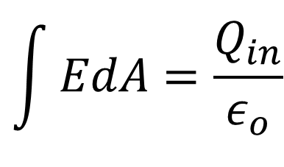
Charged Spherical Shell
Spherical Closed Surface
5. Solve (guess, like Gauss)
to find E
+
+
+
+
+
+
+
$$\int{EdA=\frac{Q_{in}}{ε_{o}}}$$
+
+
+
+
+
+
+
+
+
+
+

Slide 21
Charged Spherical Shell
Spherical Closed Surface
+
+
+
+
+
+
+
+
+
+
+
+
+
+
+
+

Slide 22
Spherical Closed Surface
E
dA
E
dA
+
+
E
+
+
+
dA
+
+
dA
+
+
dA
E
+
+
E
+
+
+
dA
+
+
dA
+
+
E
E
dA
E

Slide 23
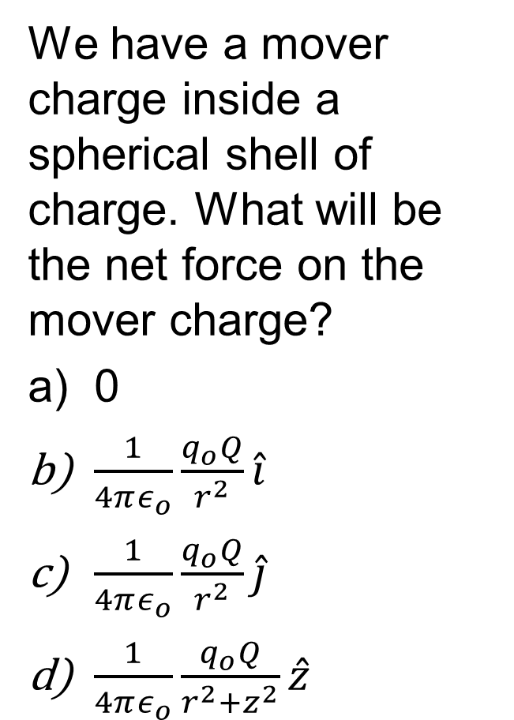
Question
We have a mover charge inside a spherical shell of charge. What will be the net force on the mover charge?
0
$\frac{1}{4πε_{o}}\frac{q_{o}Q}{r^{2}}\hat{i}$
$\frac{1}{4πε_{o}}\frac{q_{o}Q}{r^{2}}\hat{j}$
$\frac{1}{4πε_{o}}\frac{q_{o}Q}{r^{2}+z^{2}}\hat{z}$
Spherical Closed Surface
+
+
+
+
+
+
+
+
+
+
q_{o}
+
+
+
+
+
+

Slide 24
Charged Spherical Shell
Spherical Closed Surface
+
+
+
+
+
+
+
+
+
+
q_{o}
+
+
+
+
+
+

Slide 25
Question 223.27.3
I have a spherical closed shell of total charge, Q, as shown. What is the electric field strength, E, outside the shell?
Q/ε_{o}
Q/(4 πε_{o}r²)
4Q/(ε_{o})
zero
Spherical Closed Surface
+
+
+
+
+
+
+
+
+
+
+
+
+
+
+
+

Slide 26
Question
In an earlier lecture we integrated over a infinite sheet of charge to find the field. We found that the field due to an infinite sheet of charge is
Q/(4 πε_{o}r²)
4Q/(ε_{o})
η/(2 ε_{o})
+ + + + + + + + + + + + + + + + + + + + + + + + + + + + + + + + + + + + + + + + + + + +

Slide 27
Question
In an earlier lecture we integrated over a infinite sheet of charge to find the field. Could we have skipped the nasty integration by using Gauss’ law?
Yes
No
Why didn’t you tell us sooner
+ + + + + + + + + + + + + + + + + + + + + + + + + + + + + + + + + + + + + + + + + + + +

Slide 28
Question
To find the field due to an infinite sheet of charge using Gauss’ law, what Gaussian surface should we make up?
A sphere
A cube
A cylinder
A pyramid
+ + + + + + + + + + + + + + + + + + + + + + + + + + + + + + + + + + + + + + + + + + + +

Slide 29
Sheet of Charge
Remember superposition
Here are a few charges from our sheet
+ + + + + + + + + + + + + + + + + + + + + + + + + + + + + + + + + + + + + + + + + + + +
+
+
+

Slide 30
Sheet of Charge
Think about along the sheet
Cancel
Cancel
+
+
+

Slide 31
Sheet of Charge
Remember superposition
Here are a few charges from our sheet
Y - components add
Y - components add
+
+
+
x - components Cancel
x - components Cancel

Slide 32
Sheet of Charge
So the result is that you have only upward E-field
+
+
+
Remember that this only works if we have the rest of the sheet
to cancel the components on the end charges shown

Slide 33
Sheet of Charge
+
+
+
+
+
+
+

Slide 34
+
+
+
+
+
+
+

Slide 35
dA
dA
+
+
+
+
+
+
+
dA

Slide 36
End

Slide 37
Question 223.27.4
Suppose instead of a semi-infinite sheet of charge, I have a semi infinite conductor. It is infinite in the x, y and –z directions. The conductor has a surface charge density that is the same as our sheet of charge. What would the electric field strength be just outside of the conductor?
a) Zero
b) η/(2ε_{o})
c) η /(ε_{o})
d) Infinite

Slide 38
Derivation of Gauss’ law slides

Slide 39
Solid Angle
z
ΔA
r
ΔΩ
x
y

Slide 40
Derivation of Gauss’ Law
z
Arbitrary Surface, S
q
y

Slide 41
Derivation of Gauss’ Law
Projection of Face of ΔA onto surface of sphere
z
Face of ΔA
θ
ΔA
r
Arbitrary Surface, S
ΔΩ
q
x
y

Slide 42
END

Slide 43
+ + + +
P
+ + + + + +
+ + + + + + +
+ + + + + + + +
+ + + + + + +
+ + + + + +
+ + + +

Slide 44
+ + + +
P
+ + + + + +
+ + + + + + +
+ + + + + + + +
+ + + + + + +
+ + + + + +
+ + + +

Slide 45
Spherical Closed Surface
+ + + +
P
+ + + + + +
E
E
+ + + + + + +
E
E
+ + + + + + + +
E
+ + + + + + +
E
E
E
+ + + + + +
+ + + +

Slide 46
Spherical Closed Surface
+ + + +
dA
dA
P
+ + + + + +
E
E
dA
+ + + + + + +
E
E
+ + + + + + + +
dA
E
dA
+ + + + + + +
E
E
E
dA
+ + + + + +
dA
+ + + +
dA

