Slide 1
Lecture 15

Slide 2
Review

Slide 3
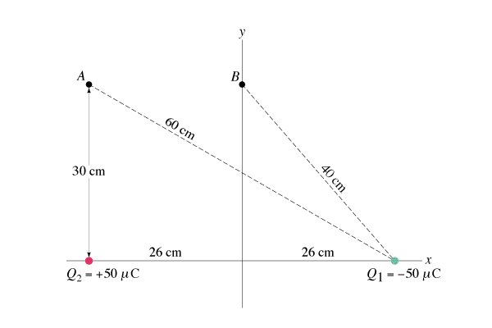
Question 223.31.3
What is the electric potential at point B?
1) V > 0
2) V = 0
3) V < 0
A
B

Slide 4
Question 223.31.3
What is the electric potential at point B?
1) V > 0
2) V = 0
3) V < 0
Since Q₂ and Q₁ are equidistant from point B, and since they have equal and opposite charges, then the total potential is zero.
A
B
Follow-up: What is the potential at the origin of the x-y axes?

Slide 5
Question 223.31.4
Four point charges are arranged at the corners of a square. Find the electric field E and the potential V at the center of the square.
1) E = 0 V = 0
2) E = 0 V ≠ 0
3) E ≠ 0 V ≠ 0
4) E ≠ 0 V = 0
5) E = V regardless of the value
-Q
+Q
-Q
+Q

Slide 6
Question 223.31.4
Four point charges are arranged at the corners of a square. Find the electric field E and the potential V at the center of the square.
1) E = 0 V = 0
2) E = 0 V ≠ 0
3) E ≠ 0 V ≠ 0
4) E ≠ 0 V = 0
5) E = V regardless of the value
The potential is zero: the scalar contributions from the two positive charges cancel the two minus charges.
However, the contributions from the electric field add up as vectors, and they do not cancel (so it is non-zero).
-Q
+Q
-Q
+Q
Follow-up: What is the direction of the electric field at the center?

Slide 7
Capacitors

Slide 8

Question
What is the field inside an ideal capacitor?
$\frac{η}{ε_{o}}$
$\frac{1}{4πε_{o}}\frac{Q}{r^{2}}$
$\frac{1}{4πε_{o}}\frac{2λ}{r}$

Slide 9
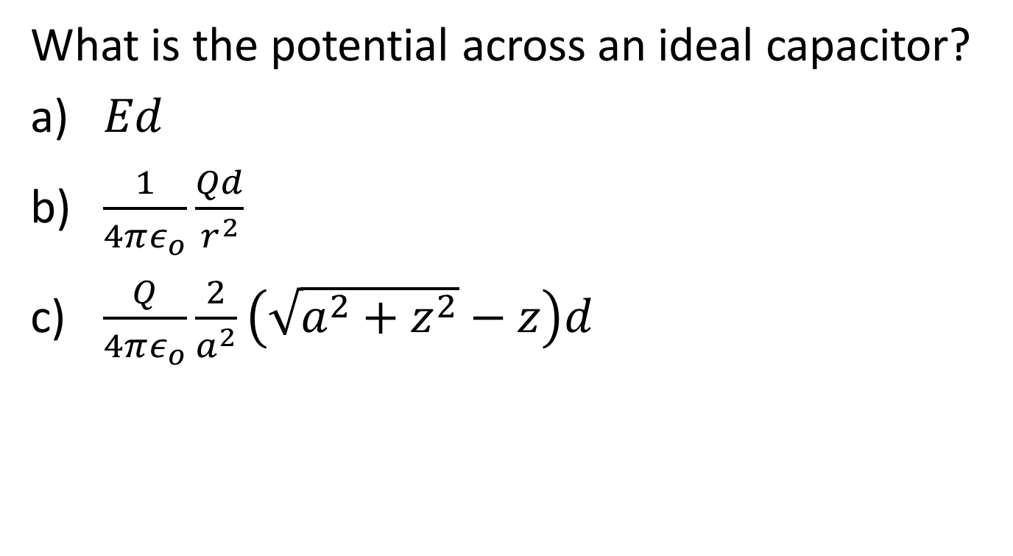
Question
What is the potential across an ideal capacitor?
$Ed$
$\frac{1}{4πε_{o}}\frac{Qd}{r^{2}}$
$\frac{Q}{4πε_{o}}\frac{2}{a^{2}}\left(\sqrt{a^{2}+z^{2}}−z\right)d$

Slide 10

Question
How much charge is on an ideal capacitor?
$C∆V$
$\frac{A}{d}$ $ε_{o}$
0

Slide 11
Question
What does capacitance tell us?
It tells us the maximum charge that a capacitor can hold.
It tells us how much charge we get on a capacitor for a particular voltage.
It has all the physical characteristics of a capacitor design
Nothing, this is like a foreign language

Slide 12
Question
What is our unit for capacitance?
The coulomb-volt.
The farad
The ohm
The henry

Slide 13
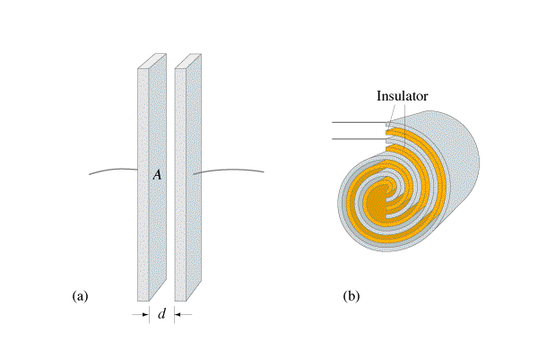
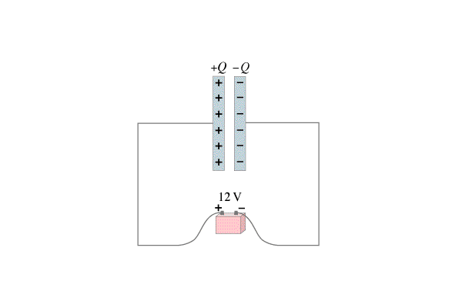
Question 223.34.1
Capacitor C₁ is connected across a battery of 5 V. An identical capacitor C₂ is connected across a battery of 10 V. Which one has the most charge?
a) C₁
b) C₂
c) both have the same charge
d) it depends on other factors
C₁
C₂
+Q₂
–Q₂
+Q₁
–Q₁
5V
10V

Slide 14
Question 223.34.1
Capacitor C₁ is connected across a battery of 5 V. An identical capacitor C₂ is connected across a battery of 10 V. Which one has the most charge?
a) C₁
b) C₂
c) both have the same charge
d) it depends on other factors
+Q
–Q
Since Q = C V and the two capacitors are identical, the one that is connected to the greater voltage has the most charge, which is C₂ in this case.

Slide 15

Question
An old-fashioned capacitor is made from two metal balls. The capacitor is connected to the battery and the circuit has a switch. What happens when the switch is closed?
The capacitor jumps instantaneously to its maximum charge Q
The capacitor slowly charges at a constant rate to it’s maximum charge Q
The capacitor initially charges quickly but then charges more slowly asymptotically approaching the maximum charge Q
Switch

Slide 16
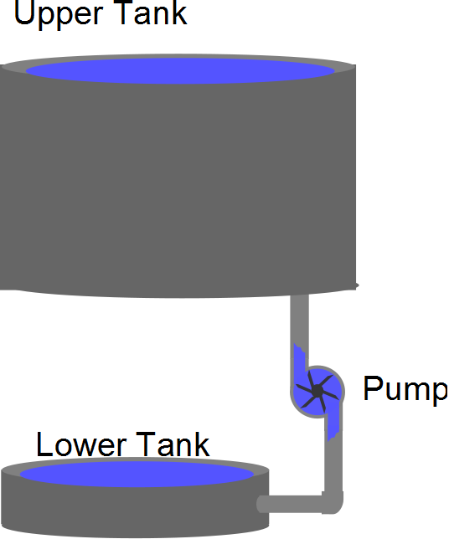

Slide 18
Charge built up on the capacitor plate
New charge repelled

Slide 19
Question 223.34.2
What must be done to a capacitor in order to increase the amount of charge it can hold (for a constant voltage)?
a) increase the area of the plates
b) decrease separation between the plates
c) decrease the area of the plates
d) either (a) or (b)
e) either (b) or (c)
+Q
–Q

Slide 20
Question 223.34.2
What must be done to a capacitor in order to increase the amount of charge it can hold (for a constant voltage)?
a) increase the area of the plates
b) decrease separation between the plates
c) decrease the area of the plates
d) either (a) or (b)
e) either (b) or (c)
+Q
–Q
Since Q = C V, in order to increase the charge that a capacitor can hold at constant voltage, one has to increase its capacitance. Since the capacitance is given by , that can be done by either increasing A or decreasing d.

Slide 21
Question 223.34.3
A parallel-plate capacitor has an initial voltage of 400 V and stays connected to the battery. If the plate spacing is then doubled, what happens?
a) the voltage decreases
b) the voltage increases
c) the charge decreases
d) the charge increases
e) both voltage and charge change
+Q
–Q

Slide 22
Question 223.34.3
A parallel-plate capacitor has an initial voltage of 400 V and stays connected to the battery. If the plate spacing is then doubled, what happens?
a) the voltage decreases
b) the voltage increases
c) the charge decreases
d) the charge increases
e) both voltage and charge change
Since the battery stays connected, the voltage must remain constant ! Since when the spacing d is doubled, the capacitance C is halved. And since Q = C V, that means the charge must decrease.
+Q
–Q
Follow-up: How do you increase the charge?

Slide 23
Question 223.34.4
A parallel-plate capacitor has an initial potential difference of 400 V and is then disconnected from the charging battery. If the plate spacing is then doubled (without changing Q), what is the new value of the voltage?
a) 100 V
b) 200 V
c) 400 V
d) 800 V
e) 1600 V
+Q
–Q

Slide 24
Question 223.34.4
A parallel-plate capacitor has an initial potential difference of 400 V and is then disconnected from the charging battery. If the plate spacing is then doubled (without changing Q), what is the new value of the voltage?
a) 100 V
b) 200 V
c) 400 V
d) 800 V
e) 1600 V
Once the battery is disconnected, Q has to remain constant, since no charge can flow either to or from the battery. Since when the spacing d is doubled, the capacitance C is halved. And since Q = C V, that means the voltage must double.
+Q
–Q

Slide 25
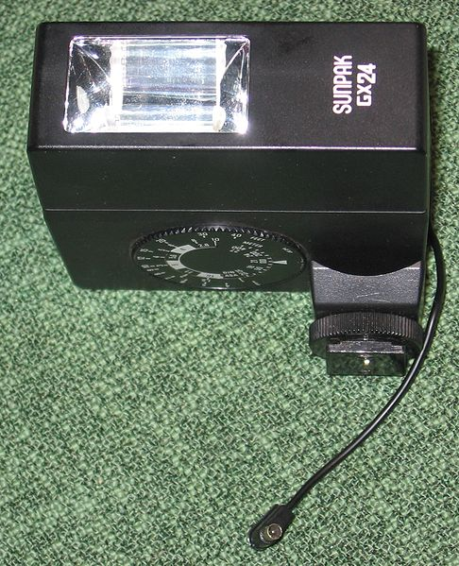

Slide 26


Capacitance of a Cylindrical Capacitor
From Gauss’s Law, the field between the cylinders is
E = 2k_{e}λ / r
ΔV = -2k_{e} λ ln (b/a)
The capacitance becomes
b
a
$$C=\frac{Q}{∆V}=\frac{ℓ}{2kln(\frac{r_{a}}{r_{b}})}$$

Slide 27
Capacitance of a Cylindrical Capacitor
From Gauss’s Law, the field between the cylinders is
E = 2k_{e}λ / r
ΔV = -2k_{e}λ ln (b/a)
The capacitance becomes
E

Slide 28
3v
0v
Time
3v
3v
Time
3v
3v
Time

Slide 29
Drawing Items
Capacitor
Battery
Capacitor
-
+
Battery

Slide 30
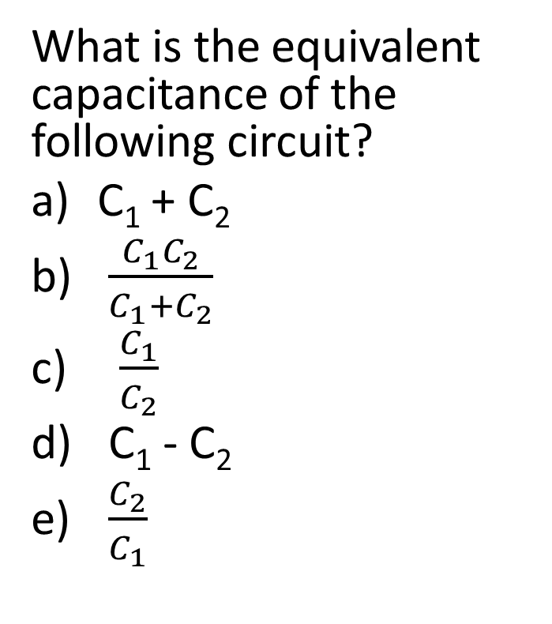
Question
C₁
What is the equivalent capacitance of the following circuit?
C₁ + C₂
$\frac{C_{1}C_{2}}{C_{1}+C_{2}}$
$\frac{C_{1}}{C_{2}}$
C₁ - C₂
$\frac{C_{2}}{C_{1}}$
C₂
-
+

Slide 31
Question
What is the equivalent capacitance of the following circuit?
C₁ + C₂
$\frac{C_{1}C_{2}}{C_{1}+C_{2}}$
$\frac{C_{1}}{C_{2}}$
C₁ - C₂
$\frac{C_{2}}{C_{1}}$
C₁
C₂
-
+

Slide 32
Question 223.34.5
a) C_{eq} = 3/2 C
b) C_{eq} = 2/3 C
c) C_{eq} = 3 C
d) C_{eq} = 1/3 C
e) C_{eq} = 1/2 C
What is the equivalent capacitance, C_{eq} , of the combination below?
o
C
C_{eq}
C
C
o

Slide 33
Question 223.34.5
a) C_{eq} = 3/2 C
b) C_{eq} = 2/3 C
c) C_{eq} = 3 C
d) C_{eq} = 1/3 C
e) C_{eq} = 1/2 C
What is the equivalent capacitance, C_{eq} , of the combination below?
The 2 equal capacitors in series add up as inverses, giving 1/2 C. These are parallel to the first one, which add up directly. Thus, the total equivalent capacitance is 3/2 C.
o
C
C_{eq}
C
C
o

Slide 34
C₁
C₂
-
+

Slide 35
C₁
C₂
-
+

Slide 36
END

Slide 37
ΔV
Q
ΔQ

Slide 38
Question 223.34.5.5
Suppose we charge up a capacitor. Is there energy stored in the capacitor?
Yes
No
Maybe

Slide 39
Question 223.34.5.6
Suppose we charge up a capacitor. If there is energy stored in the capacitor, where did it come from?
Chemical potential energy converted to electrical potential energy
Mechanical energy converted to electrical potential energy
Work being done on charges to put them in place on the capacitor
Pushing the capacitor up hill

Slide 40
Question 223.34.6
If I double the charge on a capacitor, the amount of energy stored in the capacitor will
a) double
b) quadruple
c) Be halved
d) Stay the same

Slide 41
Question 223.34.7
I have two capacitors hooked to a battery. C₁ has twice the capacitance of C₂. Which capacitor is storing more energy?
a) C₁
C₂
Neither, they will have the same energy stored

Slide 42
Question 223.34.8
In a charged capacitor, where is the energy stored?
a) On the positive plate
b) On the negative plate
c) In the air inside the capacitor
d) In the electric field in the capacitor

