Slide 1
Lecture 24

Slide 2
Question 223.23.6
Which Picture best shows the field from a semi-infinite sheet of charge.
A B C
D

Slide 3
Question 23.5
Which expression best fits our notation for an element of charge from a semi-infinite sheet of charge?
σΔA
ρΔV
λΔl

Slide 4
x
dA
dr
θ
R’
z
P
dE
y
R

Slide 5
Question
For our disk problem, what would dq be?
λdl
ηdA
ρdV
ηRdφdR
I don’t understand this question
x
dA
dr
θ
R’
z
P
dE
y
R

Slide 6
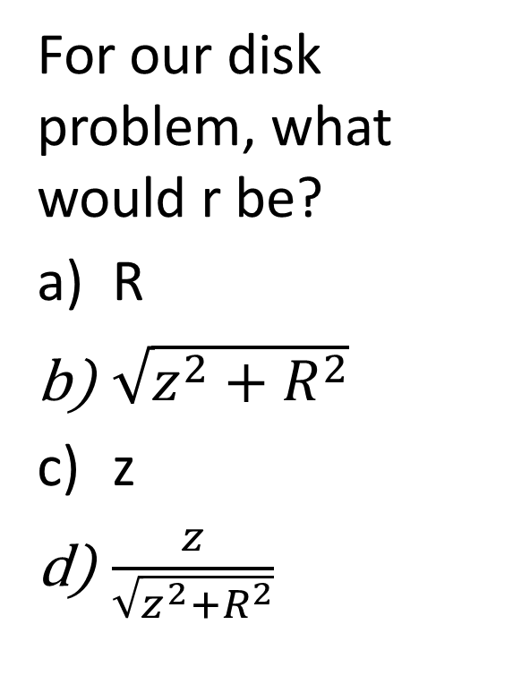
Question
For our disk problem, what would r be?
R
$\sqrt{z^{2}+R^{2}}$
z
$\frac{z}{\sqrt{z^{2}+R^{2}}}$
x
dA
dr
θ
R’
z
P
dE
y
R

Slide 7
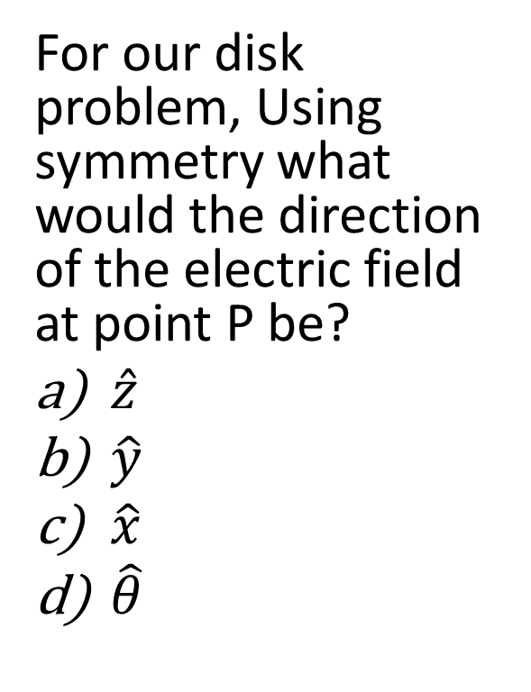
Question
For our disk problem, Using symmetry what would the direction of the electric field at point P be?
$\hat{z}$
$\hat{y}$
$\hat{x}$
$\hat{θ}$
x
dA
dr
θ
R’
z
P
dE
y
R

Slide 8
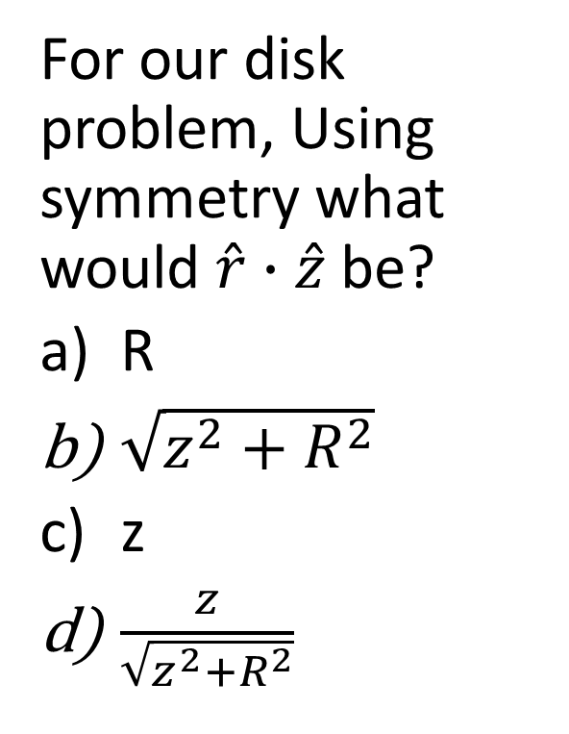
Question
For our disk problem, Using symmetry what would $\hat{r}∙\hat{z}$ be?
R
$\sqrt{z^{2}+R^{2}}$
z
$\frac{z}{\sqrt{z^{2}+R^{2}}}$
x
dA
dr
θ
R’
z
P
dE
y
R

Slide 9
Two charged Parallel Plates
+Q
-Q

Slide 10
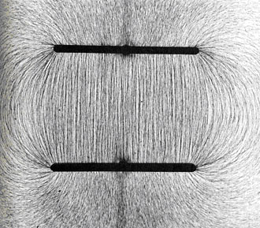
http://stargazers.gsfc.nasa.gov/images/geospace_images/electricity/charged_plates.jpg]

Slide 11
Question
For an ideal capacitor, what is the electric field outside of the capacitor?
η/(2ϵ_{o})
2η/(2ϵ_{o})
-2η/(2ϵ_{o})
0

Slide 12
Fields are equal in strength and opposite in direction
+ + + + + + + + + + + + + + + + + + + + + + + + + +
+ + + + + + + + + + + + + + + + + + + + + + + + + +
Fields are equal in strength and in the same direction
- - - - - - - - - - - - - - - - - - - - - - - - - - - - - -
- - - - - - - - - - - - - - - - - - - - - - - - - - - - - -
All bets are off near the edges

Slide 13
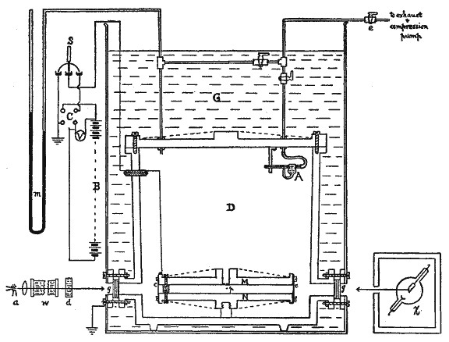
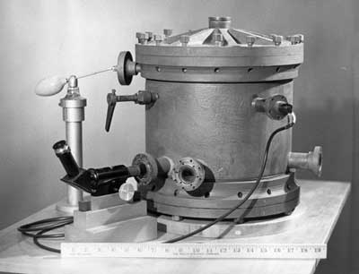
Charged Plates
Atomizer
Telescope

Slide 14
Oil Drops
F_{e}
F_{D}
d
v
q
F_{g}

Slide 15
Gravity Analogy
+ + + + + + +
q
d
d
⁻ ⁻ ⁻ ⁻ ⁻ ⁻

Slide 17
Question 223.24.1
In a uniform electric field in empty space, a 4 C charge is placed and it feels an electrical force of 12 N. If this charge is removed and a 6 C charge is placed at that point instead, what force will it feel?
1) 12 N
2) 8 N
3) 24 N
4) no force
5) 18 N
Q

Slide 18
Question 223.24.1
In a uniform electric field in empty space, a 4 C charge is placed and it feels an electrical force of 12 N. If this charge is removed and a 6 C charge is placed at that point instead, what force will it feel?
1) 12 N
2) 8 N
3) 24 N
4) no force
5) 18 N
Since the 4 C charge feels a force, there must
be an electric field present, with magnitude:
E = F / q = 12 N / 4 C = 3 N/C
Once the 4 C charge is replaced with a 6 C
charge, this new charge will feel a force of:
F = q E = (6 C)(3 N/C) = 18 N
Q

Slide 19
+ + + + + + + + + + + + + + + + + + + + + + + + + +
+ + + + + + + + + + + + + + + + + + + + + + + + + +
+
d
-
- - - - - - - - - - - - - - - - - - - - - - - - - - - - - -
- - - - - - - - - - - - - - - - - - - - - - - - - - - - - -

Slide 20
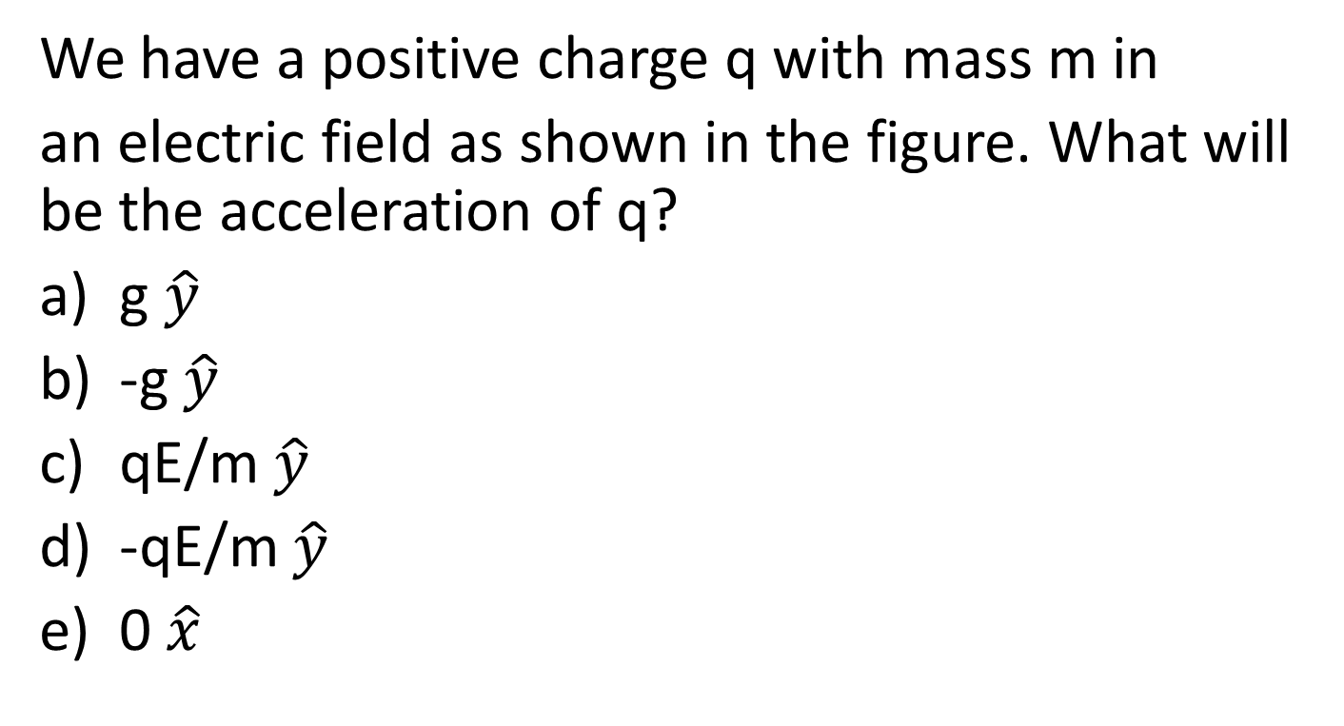
Question
We have a positive charge q with mass m in
an electric field as shown in the figure. What will be the acceleration of q?
g $\hat{y}$
-g $\hat{y}$
qE/m $\hat{y}$
-qE/m $\hat{y}$
0 $\hat{x}$
+ + + + + + + + + + + + + + + + + + + + + + + + + +
+ + + + + + + + + + + + + + + + + + + + + + + + + +
+
d
- - - - - - - - - - - - - - - - - - - - - - - - - - - - - -
- - - - - - - - - - - - - - - - - - - - - - - - - - - - - -

Slide 21
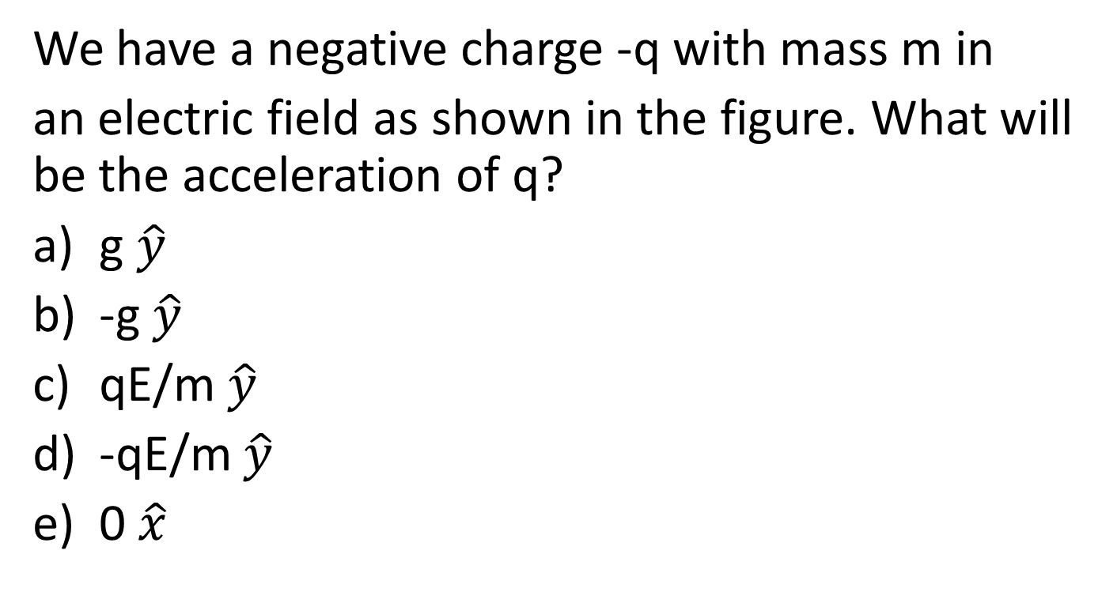
Question
We have a negative charge -q with mass m in
an electric field as shown in the figure. What will be the acceleration of q?
g $\hat{y}$
-g $\hat{y}$
qE/m $\hat{y}$
-qE/m $\hat{y}$
0 $\hat{x}$
+ + + + + + + + + + + + + + + + + + + + + + + + + +
+ + + + + + + + + + + + + + + + + + + + + + + + + +
-
d
- - - - - - - - - - - - - - - - - - - - - - - - - - - - - -
- - - - - - - - - - - - - - - - - - - - - - - - - - - - - -

Slide 22
+ + + + + + + + + + + + + + + + + + + + + + + + + +
+ + + + + + + + + + + + + + + + + + + + + + + + + +
+
d
-
- - - - - - - - - - - - - - - - - - - - - - - - - - - - - -
- - - - - - - - - - - - - - - - - - - - - - - - - - - - - -

Slide 23
+ + + + + + + + + + + + + + + + + + + + + + + + + +
+ + + + + + + + + + + + + + + + + + + + + + + + + +
+
d
-
- - - - - - - - - - - - - - - - - - - - - - - - - - - - - -
- - - - - - - - - - - - - - - - - - - - - - - - - - - - - -

Slide 24
L
+ + + + + + + + + + + + + + + + + + + + + + + + + +
+ + + + + + + + + + + + + + + + + + + + + + + + + +
-
v
- - - - - - - - - - - - - - - - - - - - - - - - - - - - - -
- - - - - - - - - - - - - - - - - - - - - - - - - - - - - -

Slide 25
L
+ + + + + + + + + + + + + + + + + + + + + + + + + +
+ + + + + + + + + + + + + + + + + + + + + + + + + +
-
- - - - - - - - - - - - - - - - - - - - - - - - - - - - - -
- - - - - - - - - - - - - - - - - - - - - - - - - - - - - -

