Slide 1
Lecture 31

Slide 2
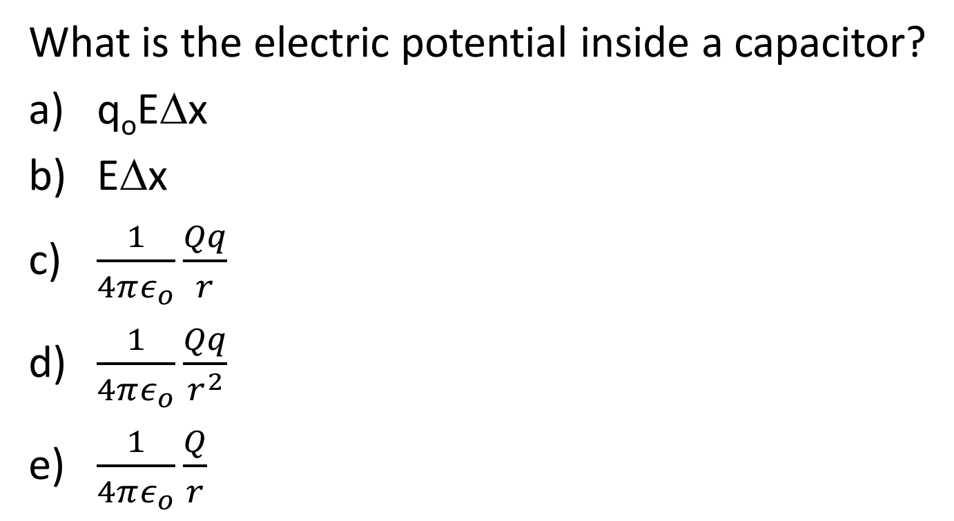
Question
What is the electric potential inside a capacitor?
q_{o}EΔx
EΔx
$\frac{1}{4πε_{o}}\frac{Qq}{r}$
$\frac{1}{4πε_{o}}\frac{Qq}{r^{2}}$
$\frac{1}{4πε_{o}}\frac{Q}{r}$

Slide 3
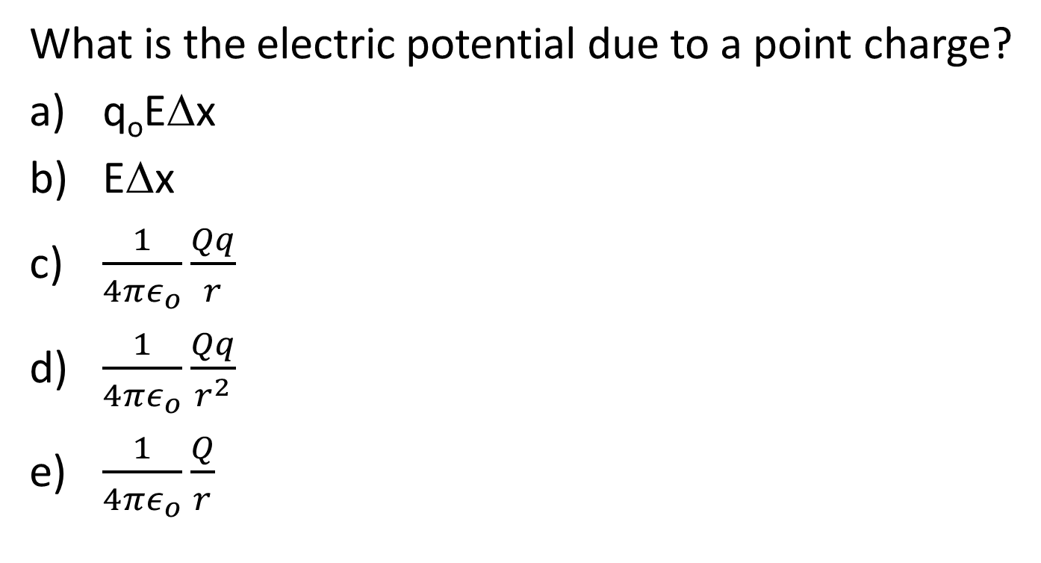
Question
What is the electric potential due to a point charge?
q_{o}EΔx
EΔx
$\frac{1}{4πε_{o}}\frac{Qq}{r}$
$\frac{1}{4πε_{o}}\frac{Qq}{r^{2}}$
$\frac{1}{4πε_{o}}\frac{Q}{r}$

Slide 4
Question 223.31.4.5
What is the equation for finding the electric potential difference between two points in an electric field?

Slide 7
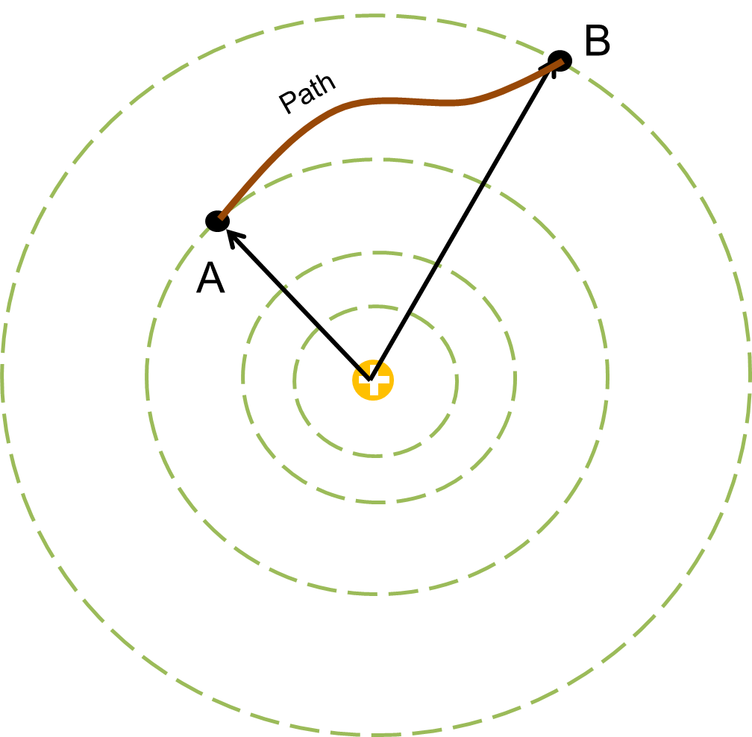
Question 223.31.1
Does the potential difference between two points near a single point charge depend on the path we take from one point to the next?
Yes
No
Maybe

Slide 8
B
Path
A

Slide 9
E₄
E₅
B
E₃
E₂
Δs₄
Δs₆
Δs₅
E₁
Δs₃
Δs₂
Δs₁
A

Slide 10
B
ds
dr
dθ
A

Slide 11
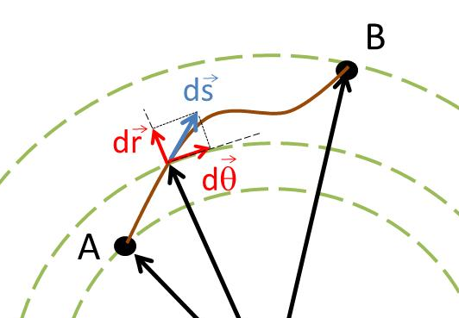
φ

Slide 13
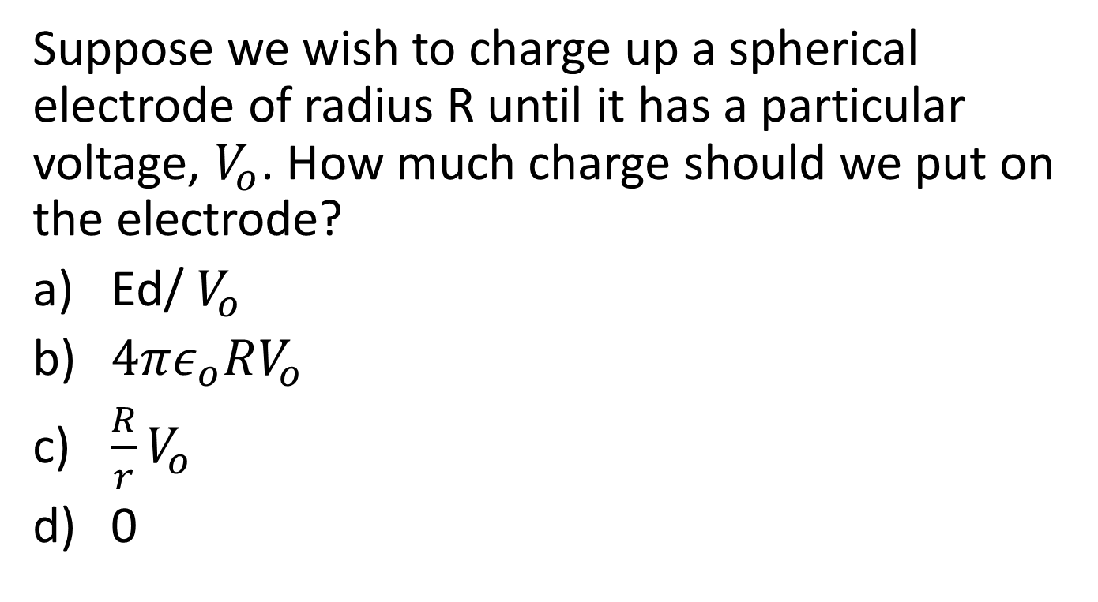
Question
Suppose we wish to charge up a spherical electrode of radius R until it has a particular voltage, $V_{o}$. How much charge should we put on the electrode?
Ed/ $V_{o}$
$4πε_{o}RV_{o}$
$\frac{R}{r}V_{o}$
0

Slide 14
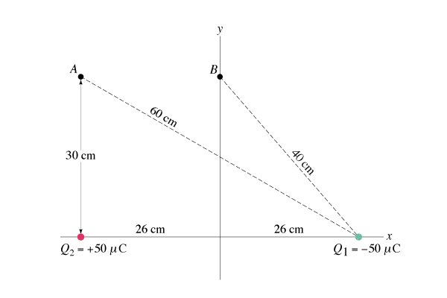
Question 223.31.2
What is the electric potential at point A?
1) V > 0
2) V = 0
3) V < 0
A
B

Slide 15
Question 223.31.2
What is the electric potential at point A?
1) V > 0
2) V = 0
3) V < 0
Since Q₂ (which is positive) is closer to point A than Q₁ (which is negative) and since the total potential is equal to V₁ + V₂, then the total potential is positive.
A
B

Slide 16
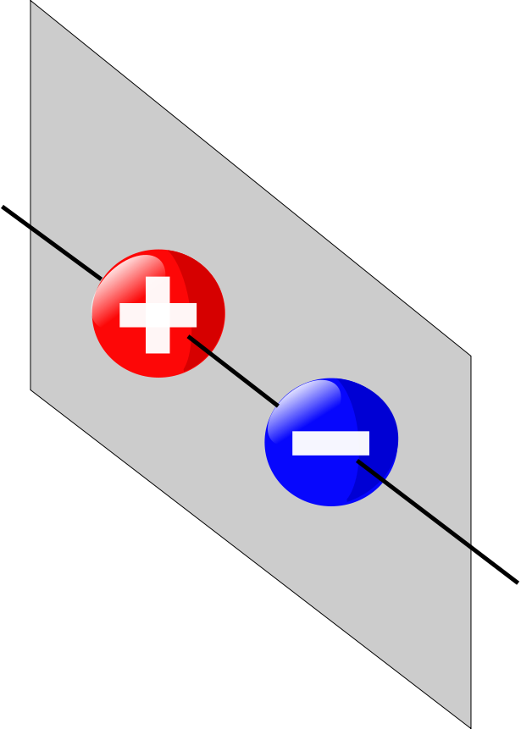

Slide 20
Question 223.31.3
What is the electric potential at point B?
1) V > 0
2) V = 0
3) V < 0
A
B

Slide 21
Question 223.31.3
What is the electric potential at point B?
1) V > 0
2) V = 0
3) V < 0
Since Q₂ and Q₁ are equidistant from point B, and since they have equal and opposite charges, then the total potential is zero.
A
B
Follow-up: What is the potential at the origin of the x-y axes?

Slide 22
Question 223.31.4
Four point charges are arranged at the corners of a square. Find the electric field E and the potential V at the center of the square.
1) E = 0 V = 0
2) E = 0 V ≠ 0
3) E ≠ 0 V ≠ 0
4) E ≠ 0 V = 0
5) E = V regardless of the value
-Q
+Q
-Q
+Q

Slide 23
Question 223.31.4
Four point charges are arranged at the corners of a square. Find the electric field E and the potential V at the center of the square.
1) E = 0 V = 0
2) E = 0 V ≠ 0
3) E ≠ 0 V ≠ 0
4) E ≠ 0 V = 0
5) E = V regardless of the value
The potential is zero: the scalar contributions from the two positive charges cancel the two minus charges.
However, the contributions from the electric field add up as vectors, and they do not cancel (so it is non-zero).
-Q
+Q
-Q
+Q
Follow-up: What is the direction of the electric field at the center?

Slide 24
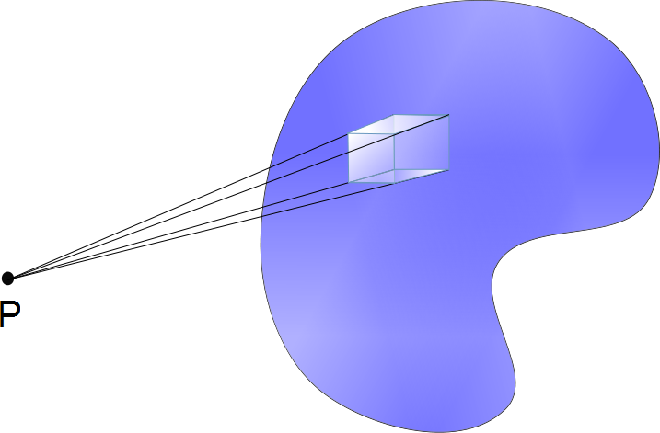
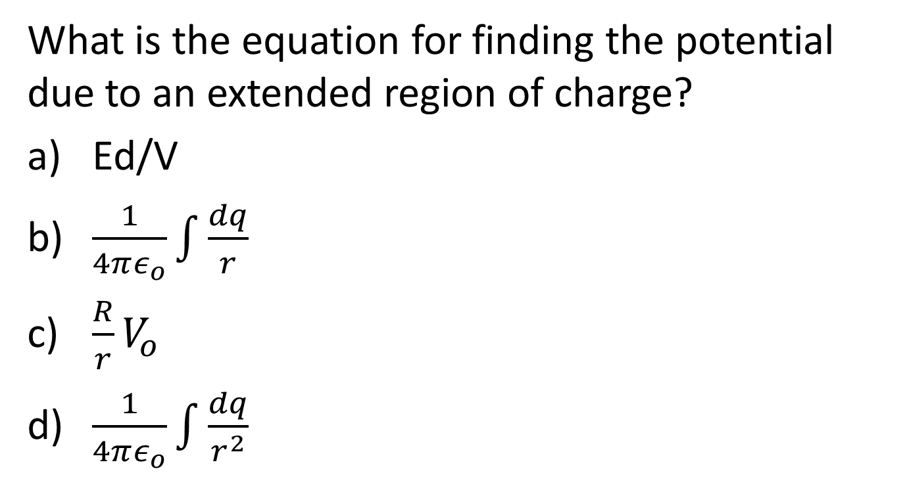
Question
What is the equation for finding the potential due to an extended region of charge?
Ed/V
$\frac{1}{4πε_{o}}\int{\frac{dq}{r}}$
$\frac{R}{r}V_{o}$
$\frac{1}{4πε_{o}}\int{\frac{dq}{r^{2}}}$

Slide 26
P

Slide 28
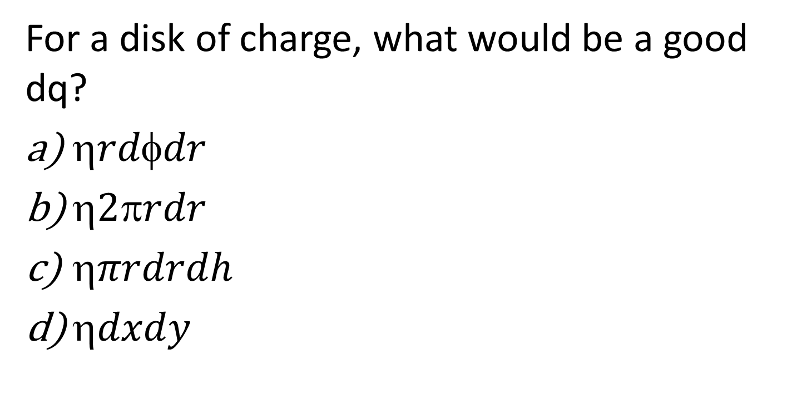
Question 223.31.5
For a disk of charge, what would be a good dq?
$rddr$
$2rdr$
$πrdrdh$
$dxdy$

Slide 29
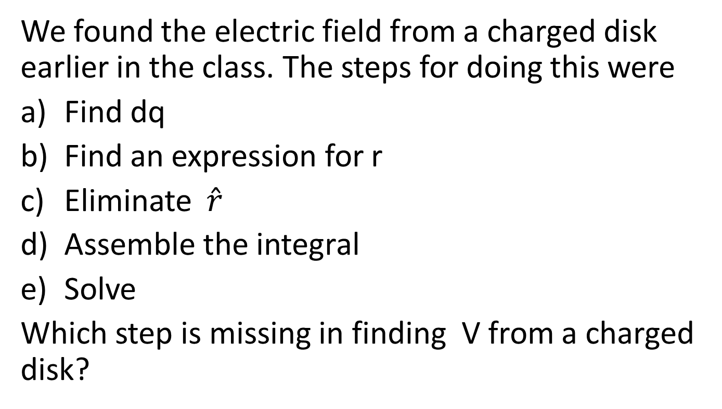
Question 223.31.6
We found the electric field from a charged disk earlier in the class. The steps for doing this were
Find dq
Find an expression for r
Eliminate $\hat{r}$
Assemble the integral
Solve
Which step is missing in finding V from a charged disk?

Slide 30
ConcepTest 17.5a Equipotential Surfaces I
At which point does V = 0?
1
5) all of them
2
3
+Q
–Q
4

Slide 31
ConcepTest 17.5a Equipotential Surfaces I
At which point does V = 0?
1
5) all of them
2
3
+Q
–Q
4
All of the points are equidistant from both charges. Since the charges are equal and opposite, their contributions to the potential cancel out everywhere along the mid-plane between the charges.
Follow-up: What is the direction of the electric field at all 4 points?

Slide 32
ConcepTest 17.5b Equipotential Surfaces II
Which of these configurations gives V = 0 at all points on the x-axis?
+2μC
+1μC
+2μC
+1μC
+2μC
-2μC
x
x
x
-2μC
-1μC
-1μC
-2μC
-1μC
+1μC
1)
2)
3)
4) all of the above 5) none of the above

Slide 33
ConcepTest 17.5b Equipotential Surfaces II
Which of these configurations gives V = 0 at all points on the x-axis?
+2μC
+1μC
+2μC
+1μC
+2μC
-2μC
x
x
x
-2μC
-1μC
-1μC
-2μC
-1μC
+1μC
1)
2)
3)
4) all of the above 5) none of the above
Only in case (1), where opposite charges lie directly across the x-axis from each other, do the potentials from the two charges above the x-axis cancel the ones below the x-axis.

Slide 34
ConcepTest 17.5c Equipotential Surfaces III
Which of these configurations gives V = 0 at all points on the y-axis?
+2μC
+1μC
+2μC
+1μC
+2μC
-2μC
x
x
x
-2μC
-1μC
-1μC
-2μC
-1μC
+1μC
1)
2)
3)
4) all of the above 5) none of the above

Slide 35
ConcepTest 17.5c Equipotential Surfaces III
Which of these configurations gives V = 0 at all points on the y-axis?
+2μC
+1μC
+2μC
+1μC
+2μC
-2μC
x
x
x
-2μC
-1μC
-1μC
-2μC
-1μC
+1μC
1)
2)
3)
4) all of the above 5) none of the above
Only in case (3), where opposite charges lie directly across the y-axis from each other, do the potentials from the two charges above the y-axis cancel the ones below the y-axis.
Follow-up: Where is V = 0 for configuration #2?

Slide 36
ConcepTest 17.6 Equipotential of Point Charge
1) A and C
2) B and E
3) B and D
4) C and E
5) no pair
Which two points have the same potential?
A
C
B
Q
D
E

Slide 37
ConcepTest 17.6 Equipotential of Point Charge
1) A and C
2) B and E
3) B and D
4) C and E
5) no pair
Which two points have the same potential?
Since the potential of a point charge is:
only points that are at the same distance from charge Q are at the same potential. This is true for points C and E.
They lie on an Equipotential Surface.
A
C
B
Q
D
E
Follow-up: Which point has the smallest potential?

