Slide 1
Question 30.1
When we studied Gauss’ law in electrostatics, we found
What would Gauss’ law give for magnetism?
A
B
C
D
None of the above

Slide 2
Question 223.42.1
Magnetic fields are generated by currents. Is there a current in a permanent magnet?
Yes
No
Maybe

Slide 4
Question 223.42.1.5
Do electrons orbit the nucleus in atoms?
Yes
No
Maybe

Slide 5
Question 223.42.1.5
Do electrons have orbital angular momentum?
Yes
No
Maybe

Slide 6
U = ∞
U = ∞
Region 1
Region 2
Region 3
“Forbidden”
“Forbidden”
E₂ = 9E_{o}
E₂ = 4E_{o}
E₁ = E_{o}
U = 0
L

Slide 7
λ
r

Slide 11
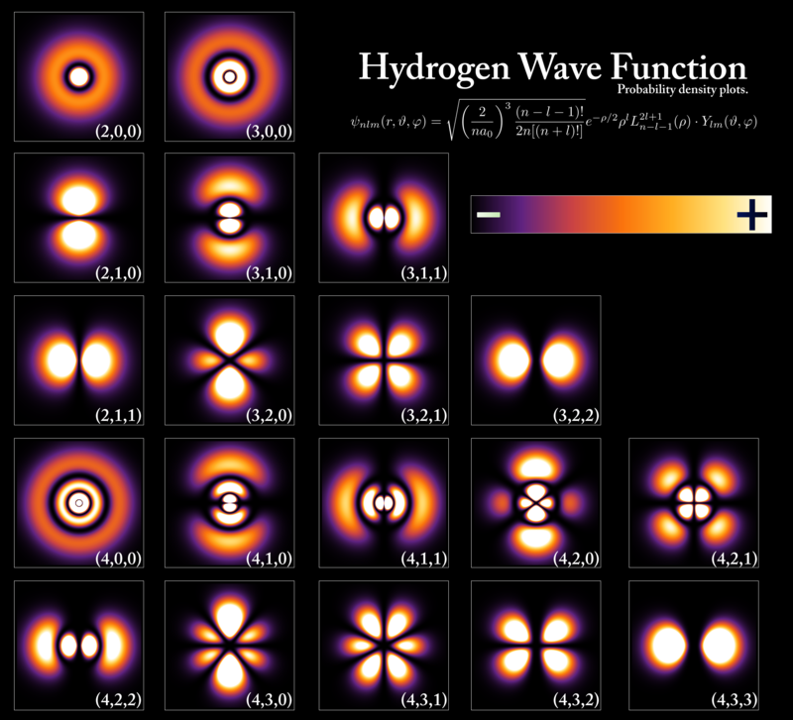

Slide 12
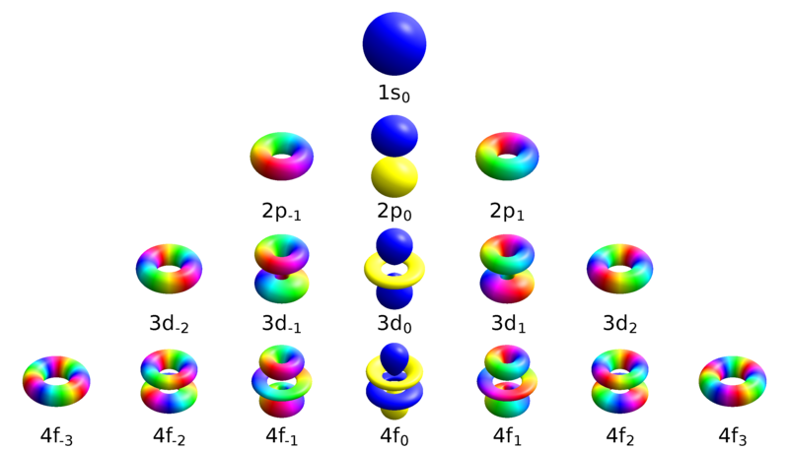
Geek3 https://commons.wikimedia.org/wiki/File:Atomic_orbitals_spdf_m-eigenstates.png

Slide 13
Question 223.42.1.5
Do electrons spin?
Yes
No
Maybe

Slide 14
Question 223.42.1.5
Do electrons have “spin” angular momentum?
Yes
No
Maybe

Slide 15
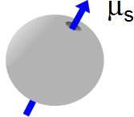

Slide 16
Question 223.42.3
The book talked about magnetic domains. What is a magnetic domain?
A small region of a ferromagnetic material where the electron spins are aligned
The region of a diamagnetic material which has an applied magnetic field
The region of a magnetic media that has paired electrons.

Slide 17
Question
Some metals have magnetic domains. Within each domain the electrons spins of some electrons line up. So the domain is a small magnet. Are the magnetic moments of the domains likely to be aligned?
Yes
No
Maybe

Slide 18
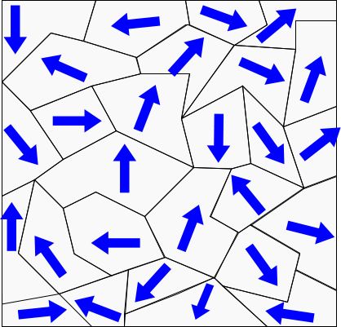

Slide 19
Question
Some metals have magnetic domains. Within each domain the electrons spins of some electrons line up. So the domain is a small magnet. If we place the piece of metal in an external magnetic field, are the magnetic moments of the domains likely to be aligned?
Yes
No
Maybe

Slide 20
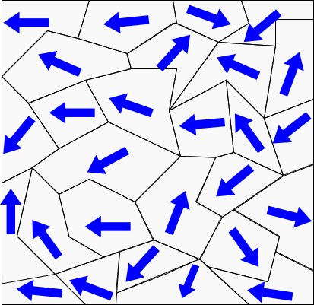

Slide 21
Question
Can any material form magnetic domains that can line up?
Yes
No
Maybe

Slide 22
Question
We place a piece of iron in an external magnetic field. The domains’ magnetic moments align. Will they stay aligned?
Yes
No
Maybe

Slide 23
Question
We place a piece of iron in an external magnetic field. The domains’ magnetic moments align. How could we force them to (mostly) stay aligned?
a) Beat the piece of metal with a hammer
Heat the piece of iron and let it cool
It is impossible

Slide 24
Solenoid approximation
Take two atoms
Their magnetic moments are like having two small current loops next to each other
In between, the currents oppose each other
So in between, it is like having no net current.
I
I
I
I

Slide 25
Solenoid approximation
So the over-all current is like having just the outsides contribute
I
I

Slide 26
Solenoid approximation
Now picture many small current loops
We are left with effective current only on the outside
I
I
I
I
I
I
I
I
I
I
I
I

Slide 27
If we picture the atoms three dimensionally, we have something that looks like layers of current loops
This is just like a solenoid!
I
I
I
I
I
I
I
I

Slide 28
Question 223.42.4
What is magnetic hysteresis?
It is a medical technique
It is when ferromagnetic material follows a different path on a B vs. H graph as B changes.
It is when a field is induced in a magnetic material

Slide 30
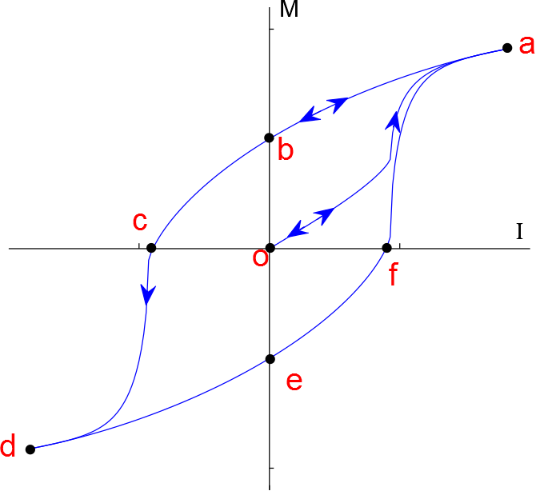
Magnetization Curve

Slide 31
Curie Temperature
The Curie temperature is the critical temperature above which a ferromagnetic material loses its residual magnetism and becomes paramagnetic
Above the Curie temperature, the thermal agitation is great enough to cause a random orientation of the moments
M
Paramagnetic
Ferromagnetic
T
T_{C}

Slide 32
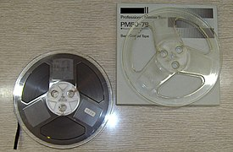

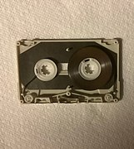
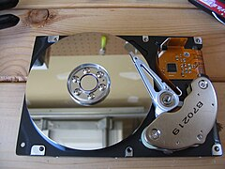

Slide 33
Question 223.42.5
If I have a magnetic field, but I change that field, can it be that I create an electric field?
Yes
No
Agh! this seems crazy

Slide 34
Question 223.42.5.1
What makes charge accelerate?
Electric fields
Magnetic fields
Electrical Potential
Magnetic Potential

Slide 35
Question 223.42.5.2
What makes charge accelerate in electrical circuits?
Electric fields
Magnetic fields
Electrical Potential
Magnetic Potential

Slide 36
High Potential
Low Potential
E
+ + + + + + + + + + + + + + + + + + + + + + + + + +
+ + + + + + + + + + + + + + + + + + + + + + + + + +
+
A
B
- - - - - - - - - - - - - - - - - - - - - - - - - - - - - -
- - - - - - - - - - - - - - - - - - - - - - - - - - - - - -
d

Slide 37
