Slide 1
Lecture 31
Damping and Resonance and Waves

Slide 2
Trigonometry
ĵ
Remember defining trig functions on a unit circle?
P
y
h
θ
x
î

Slide 3
Trigonometry
ĵ
Suppose we define points along the x-axis (and let the circle have radius h)
P
y
h
θ
-x_{max}
x
x_{max}
î

Slide 4
Relationship to SHM
ĵ
The projection of the position of point P on the x axis displays SHM!
P
h
θ
-x_{max}
x
x_{max}
î
SHM along a straight line can be thought of as a projection of a uniform circular motion along a diameter of a reference circle

Slide 5
More Geometry
ĵ
We can also define points along the y-axis
y_{max}
P
y
h
θ
-x_{max}
x
x_{max}
î
-y_{max}

Slide 6
Relationship to SHM
ĵ
This is just two SHOs
One in the x direction
One is the y direction
y_{max}
P
y
h
θ
-x_{max}
x
x_{max}
î
-y_{max}

Slide 7
Equations for the two SHOs
The equation in X is familiar
The projection onto the y-axis is a sine function
An old trig identity says:
What does this say about the phases of the two SHOs?

Slide 8
Rotation and Velocity
Look at the Angular Speed
Then
Let’s take the x-component
ĵ
v
v_{x}
θ
y
θ
v_{x}
î
ĵ
P
y
x_{max}
θ
x
î
x_{max}

Slide 9
Rotation and Acceleration
The acceleration of the particle at P is given by
Taking the x- component
ĵ
a_{x}
θ
a
y
θ
a_{x}
î
ĵ
P
y
x_{max}
θ
x
î
x_{max}

Slide 10
Pendulum
The forces on M are F_{g}, the tension on the string
The tangential component of F_{g} is always directed toward
This is a restoring force! Take
Then the restoring force is
θ
T
L
m
s
θ
mg
If we restrict ourselves to small angles
Which looks familiar

Slide 11
Pendulum
SHM Problem
θ
T
L
m
θ
mg
Solution

Slide 12
Physical Pendulum
o
Pivot
Suppose we build a pendulum by making a large solid object swing from one point.
Restoring force
Remember that
θ
d
CM
Pivot
dsin(θ)
CM
F_{g}
Then
Or
Another familiar differential EQ

Slide 13
Physical Pendulum
SHM Problem
o
Pivot
θ
d
CM
dsin(θ)
F_{g}
Solution

Slide 14
Torsional Pendulum
A torsional pendulum is made by suspending a rigid body from a wire. The body rotates.
twisted wire exerts a restoring torque on the body that is proportional to the angular position (sound familiar)
Rotational version of Newton’s 2nd Law
P
Then
Physics majors and those taking PH 220 in the future, you will see a torsional pendulum again!

Slide 15
Motion of a Torsional Pendulum
P
P
θ=0
θ=θ_{max}
θ=0
θ = -θ_{max}

Slide 16
Torsional Pendulum
SHM Problem
P
Solution

Slide 17
Add a frictional force
Suppose we add in a force that is proportional to the velocity
Viscosity follows this pattern
b is the damping coefficient
Newton’s 2nd law gives
This is another differential equation. It is harder to guess its solution

Slide 18
Solution
Where
Three Cases
The retarding force is small: (bv_{max}< kA), the system oscillates, but the amplitude is smaller as as time goes on. We call this "underdamped"
The retarding force is large: (bv_{max}> kA), The system does not oscillate. we call this "overdamped." We can also say that (after we define ω_{o} below)
Case The system is critically damped (see below)

Slide 19
Example
x
t
The gray lines are the “envelope” function
They describe how the amplitude changes

Slide 20
Larger b-value
x
t

Slide 21
Even Larger b-value
x
Note Scale Change!
t
Oscillation has stopped,
Only the exponential decay is observed.
we are critically damped

Slide 22
Critical Damping
Condition for critical damping
Then
Where is the natural frequency of the system
We define
Remark When the solution in equation (damped solution) is not valid!
You will find out more about this situation in your advanced mechanics classes.

Slide 23
Driving Force
Last section we added a force that killed our oscillation
Suppose we want to keep it going
Add a force
where F_{o} is a constant and where ω_{f} is the angular frequency of the driving force
This one is very hard to solve

Slide 24
Steady State
Let’s assume that we add in enough energy with the driving force that we make up for the energy lost in the damping force
Then the solution is
EXCEPT
We will drop the subscript f for convenience

Slide 25
Example
Notice that right at ω_{o} our solution gets very big
A
ω

Slide 26
Resonance
To see why resonance happens, think of the velocity
And our driving force is
The rate at which work is done (power) is
if F and v are in phase, the power will be at a maximum!

Slide 27
Example
Resistive force is never really zero in real systems
It can be small
A
Small b
Large b
ω

Slide 28
Remember Tacoma Narrows?
The wind gusts formed a periodic driving force that allowed a driving harmonic oscillation to form.
Since the bridge was resonant with the gust frequency, the amplitude grew until the bridge materials broke.

Slide 29
Summary
SHM along a straight line can be thought of as a projection of a uniform circular motion along a diameter of a reference circle
Pendulum
Physical Pendulum
Torsoinal Pendulum
Damped Oscillation
Forced Oscillation

Slide 30
Waves

Slide 31
Question 223.2.1
For a wave to exist, you need the following
Source of disturbance, a medium, and a connection between medium elements
A fluid, an energy source, and distance
A liquid, a disturbance, and a transfer of energy
A really good touchdown that gets the crowd excited

Slide 32
Question 223.2.2
What is the medium for an ocean wave?…
The electromagnetic field
Air molecules
Free space
Water molecules

Slide 33
Transverse Wave
Longitudinal Wave

Slide 34
Question 223.2.4
At a football game, “the wave” might circulate through the stands and move around the stadium. In this wave motion, people stand up and sit down as the wave passes. What type of wave would this be characterized as?
polarized wave
a) longitudinal wave
b) lateral wave
c) transverse wave
d) soliton wave
e) Cougar wave

Slide 35
Question 223.2.3
Is an ocean wave …
Transverse
Longitudinal
A combination of transverse and longitudinal

Slide 36
Question 223.2.5
In an ocean wave, what would be the most likely path a single particle traverses as the wave moves by?
B
A
C

Slide 37
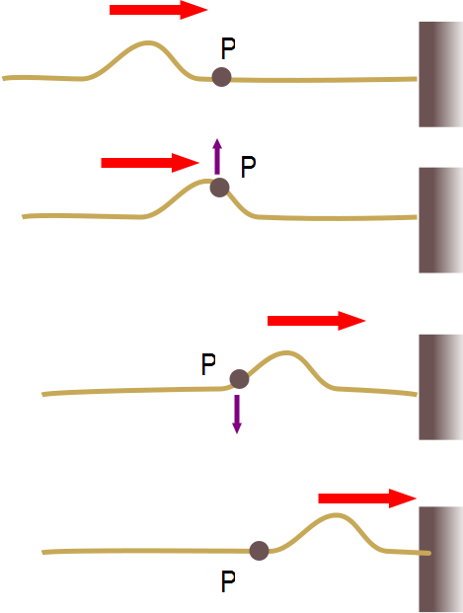

Slide 39
Question 223.2.7
Does a wave on a string move faster for a heavier or lighter rope?
Heavier
lighter

Slide 40
Question 223.2.7.5
A wave is traveling on a rope. Does the wave speed increase or decrease as you pull harder on a rope
Increase
Decrease

Slide 41
Question 223.2.6
We learned that the speed of waves on strings is given by
Will this equation work for a wave traveling along a large vertically hanging chain?
Yes, this is a general formula
No, because chains are not strings
No, because the tension along the chain varies
No, because tension is unique to ropes and strings, and really chains experience normal forces between the links.

Slide 43
Before
9
After
9

Slide 45
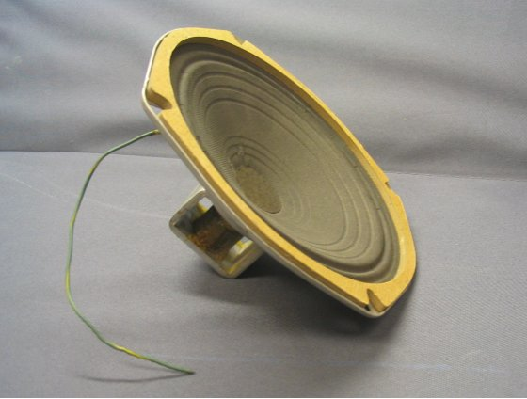

Slide 47
Question 7.5
For sound waves in air, something experiences simple harmonic motion, what is it?
A pipe
The air particles
The pressure
dust

Slide 48
Bar Graph of Displacement from Original Position

Slide 52
Question 223.2.8.1
S
x
In the displacement graph for a sound wave shown above. What does the light green bar represent?
The particle that was at this position has moved to the left
The particle that was at this position has moved to the right
The particle that was once where the pink bar is has moved to where the light green bar is
The particle that was once where the blue bar is has moved to where the light green bar is

Slide 53
Question 223.2.8.2
S
x₁
x_{P}
x₂
x
P
In the displacement graph for a sound wave shown above. What does the displacement, s, at point P represent?
The particle that was at x_{P} has moved to the left
The particle that was at x_{P} has moved to the right
The particle that was once at x₁ has moved to x_{P}
The particle that was once at x₂ has moved to x_{P}

Slide 54
Question 233.2.8.5
What is the energy transfer mechanism for sound waves?
Elastic forces between molecules
Pressure forces between molecules
Electrical forces between molecules
Collisions between molecules

Slide 55
Question 223.2.9
We found that the equation
Gave a pulse that moved to the right with velocity v
What will the following equation give
A pulse that moves to the right (it is the same equation)
A pulse that moves to the left
This gives a non-real result and is not a pulse
A pulse that moves in the +y direction

Slide 58
Question 223.2.10
y
A
A traveling wave is shown below moving to the right at 1m/s in a snapshot view. What might the history graph look like for the position x=0?
time
y
B
time
y
C
time

Slide 59
t = 0
t = t₁
t = t₂
t = t₃

Slide 60
t = 0
t = t₁
t = t₂
t = t₃

Slide 61
t₁
t₂
t₃

Slide 62
t₀
t₁
t₂
t₃

Slide 63
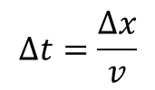
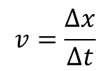

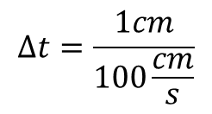
1) Find the time for 1cm distance
D(mm)
t=0
D(mm)
t=0.03s
2
2
$$v=\frac{∆x}{∆t}$$
-2
2
4
6
8
10
x(cm)
-2
2
4
6
8
10
x(cm)
-2
-2
$$∆t=\frac{∆x}{v}$$
D(mm)
t=0.01s
D(mm)
t=0.04s
$$∆t=\frac{1cm}{100\frac{cm}{s}}$$
2
2
-2
2
4
6
8
10
x(cm)
-2
2
4
6
8
10
x(cm)
$$∆t=0.01s$$
-2
-2
2) Make snapshot graphs that are Δt apart in time and mark where the wave medium is at x=2m (red dots)
D(mm)
t=0.02s
D(mm)
t=0.05s
2
2
-2
2
4
6
8
10
x(cm)
-2
2
4
6
8
10
x(cm)
-2
-2
3) Make a history graph for x=2m for each time that you used to make a snapshot graph. Just use the red dot positions for x=2m at the time for each snapshot graph
D(mm)
X=2m
2
0.01
0.02
0.03
0.04
0.05
t(s)
-2

