Slide 1
Review

Slide 2
Question 223.2.10
y
A
A traveling wave is shown below moving to the right at 1m/s in a snapshot view. What might the history graph look like for the position x=0?
time
y
B
time
y
C
time

Slide 3
Question 223.4.0.1
For sound waves, what is a compression?
It is a region of higher pressure
It is a region of lower pressure
It is an area over which a force is applied
It refers to the collision time of molecules

Slide 5
New Stuff

Slide 6
Question 223.4.0.1
For sound waves, what is a compression?
It is a region of higher pressure
It is a region of lower pressure
It is an area over which a force is applied
It refers to the collision time of molecules

Slide 7
Question 223.4.0.2
For sound waves, a compression is a high pressure region, what do we call a low pressure region?
Low pressure region
Pressure minimimization
hypopresurization
Rarefaction

Slide 8
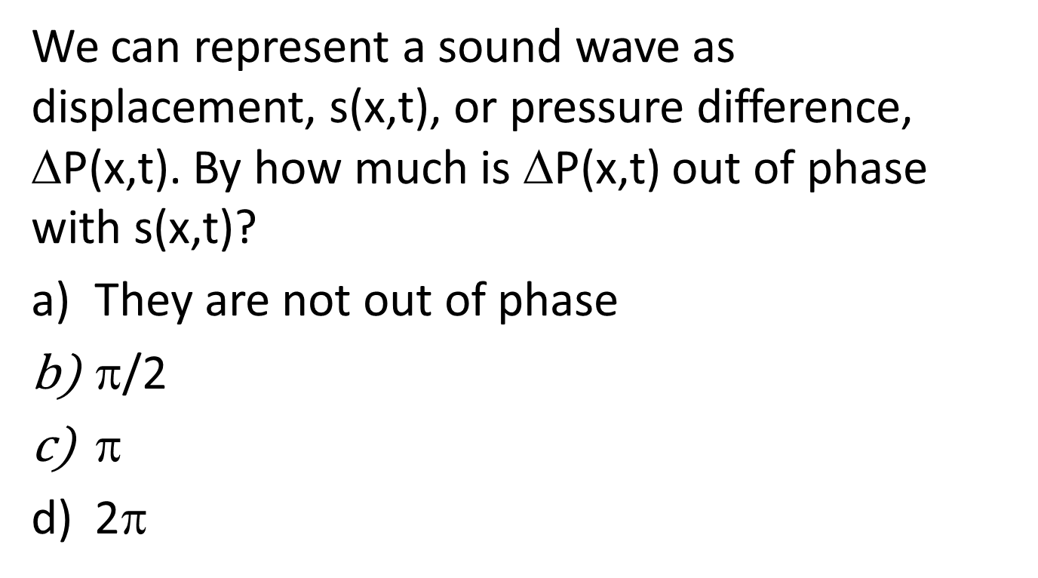
Question 223.4.0.3
We can represent a sound wave as displacement, s(x,t), or pressure difference, ΔP(x,t). By how much is ΔP(x,t) out of phase with s(x,t)?
They are not out of phase
$$/2
$$
2$$

Slide 9
Question 223.4.2
The speed of sound in water is about 1.4km/s. Will the speed of sound be faster or slower in air?
Faster
Slower
Can’t tell

Slide 10
Bar Graph of Displacement from Original Position

Slide 13
Bar Graph of Displacement from Original Position

Slide 14
Wave Function
Propagating rarefaction
Fluid displaced to fill void
s
s_{max}
x

Slide 15
Pressure change is large here
Pressure change is almost zero here

Slide 16
Pressure is higher than normal here
Pressure is lower than normal here
Pressure change is almost zero here

Slide 17
Displacement
x
Change in Pressure
x

Slide 18
Question 223.4.2
Will sound travel faster on a hot day or a cold day?
Hot
Cold
Can’t tell

Slide 19
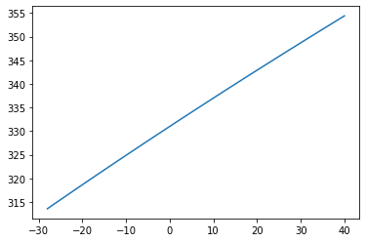
Speed of sound (m/s)
Temperature (°C)
Rexburg Winter
Amazon

Slide 20
Question 223.4.3
When a sound wave passes from air into water, what properties of the wave will change?
the frequency f
the wavelength λ
the speed of the wave
both f and λ
both v_{wave} and λ

Slide 21
Question 223.4.4
A wave travels across a boundary between two different weight ropes. If it goes from the heavier to the lighter rope, the wave speed
Increases
Decreases
Stays the same
Can’t tell

Slide 22
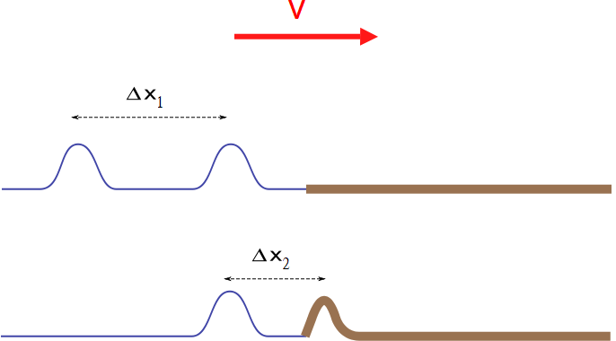

Slide 23
Question 223.4.4.5
Two ropes of different linear mass density are tied together. A sinusoidal wave goes from rope A rope where the wave speed is 4.0 m/s to rope B where the wave speed is 2.0 m/s. If the initial wave has a wavelength of 3.0 m, what is the wavelength in rope B?
2/3 m
3/2 m
3 m
6 m
1/6 m

Slide 24

Question 223.4.4.1
Can sound travel through space?
Yes
No
Only if you are George Lucas?

Slide 25
Question 223.4.4.2
Can light travel through space?
Yes
No

Slide 26
Question 223.4.4.3
What is the medium for a light wave?…
The electromagnetic field
Air molecules
Free space
Water molecules

Slide 28
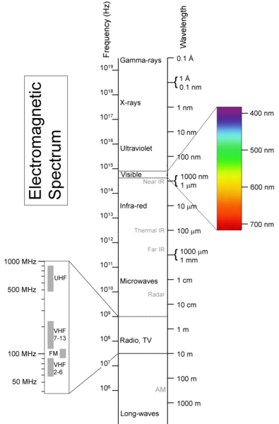
From Materialscientist, used under the Creative Commons Attribution-Share Alike 2.5 Generic License.

Slide 29
Question 223.4.5 123.22.1
A 60W light bulb is allowed to burn for 3600s. How much energy has been used?
36000J
72000J
144000J
216000J
5400000J

Slide 30
Question 223.4.5.1
If the index of refraction is n = 2, how fast is the light going in the material medium?
Twice the speed of light
Half the speed of light
A quarter the speed of light
1/16 the speed of light

Slide 31
Question 223.4.6 123.22.2
Suppose I do 50J of work in two hours, then I do 50J of work in one hour. For which set of work was the power larger?
The first
The second
They are the same
Neither amount of work had power associated with it.

Slide 32
Question 223.4.7 123.22.3
Tuning Fork: Which tuning fork is louder, the
mounted one
free one

Slide 33
Question 223.4.8 123.22.4
If you cup your hand to your ear, you can hear better. This is because
You change the frequency of the sound with your hand
You increase the collection area
You increase the amplitude of the wave
Can’t tell

Slide 34
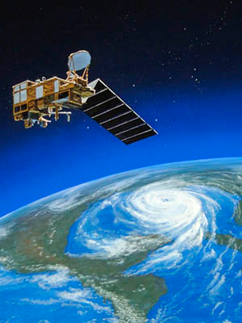
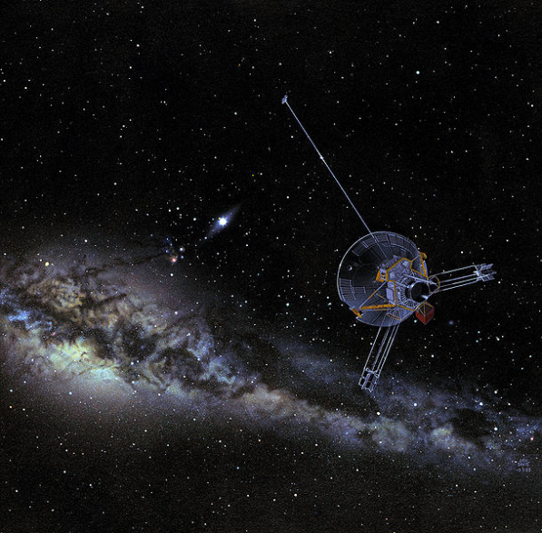
Question 223.4.9
The Pioneer 10 spacecraft has a large dish antenna, the Earth Observation System spacecraft has a much smaller antenna. Why?
Pioneer 10 is really smaller, it just looks like it is big in the picture.
The intensity of the communication signal goes down with the square of the distance. Pioneer 10 must be designed to work farther away.
The EOS satellite probably does not need to communicate as much as the Pioneer 10 spacecraft.
The Pioneer 10 spacecraft must have a wimpy transceiver.
No good reason, they have artists design the look of these things so they look far out and cool

Slide 35
Question 223.4.10 123.22.5
I have 100W of power coming from my speaker. What is the intensity 0.5m from the speaker?
a) 0.01W
b) Just under 1W
c) A little over 10W
d) A little over 30W

Slide 36
Intensity
r
Point Source

Slide 37
Intensity in W/m²
Distance in meters

Slide 38
Intensity
1m
2m
3m
30m
20m
10m

Slide 39
Question 223.4.11 123.22.7
Suppose I have a loud speaker and 1m away from that loud speaker I measure an intensity of 1W /m². What is the sound level?
a) 3dB
b) 10dB
c) 120dB
d) 150dB

Slide 40
Question 223.4.12 123.22.8
Suppose I have a loud speaker and 10m away from that loud speaker I measure an intensity of 0.01 W /m². What is the sound level?
a) 30dB
b) 100dB
c) 120dB
d) 150dB

Slide 41
Question 223.4.13 123.22.9
Suppose I have two French horn players both playing the same note at the same time. I stand a meter away and find that they are each playing with an intensity of 0.00001 W/m². What is the sound level?
a) 0.00001
b) 70dB
c) 73dB
d) 1400dB

Slide 42
Question 223.4.14 123.22.10
You are sitting in church. The speaker is talking into a microphone. The sound system radiates sound with a power of 50W . You are 20m from the sound system output. What is the sound level?
a) 78dB
b) 80dB
c) 100dB
d) 120dB

Slide 43
Question 223.4.15 GR 123.22.11 GR
You are standing outside a Guns & Roses Concert. The concert is in a stadium. You are 40 m from the stadium. You have a sound level meter with you and find that where you stand the sound level is 120dB. How much acoustic power are the “musicians” creating at their output location?
a) 78W
b) 134W
c) 545W
d) 20106W

Slide 44
Question 223.4.16 123.22.12
You are sitting in church. The speaker is talking into a microphone. The sound system radiates sound with a power of 100W . You are 10m from the sound system output. What is the sound level? We can find this using our new SIL equation that includes power and distance.
a)50dB
b) 78dB
c) 109dB
d) 140dB

Slide 46
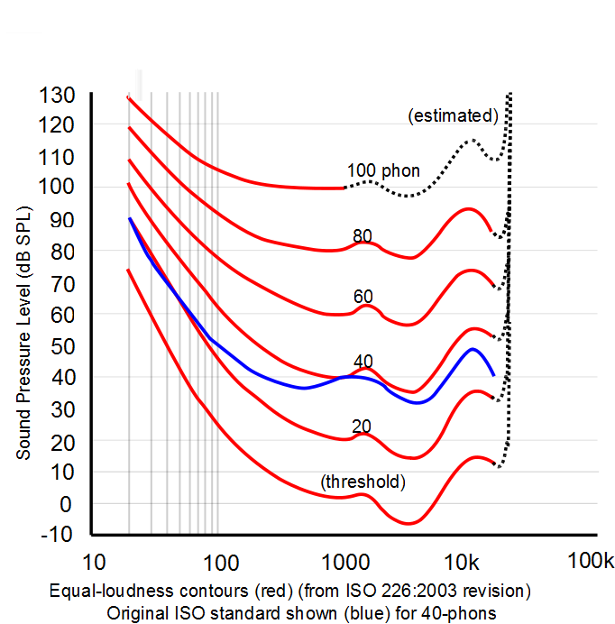
Frequency Response

Slide 47
