Slide 1
Lecture 5

Slide 2
Question 223.5.1 123.22.13
You are a parent standing at platform 9.75. The Hogwarts Express is just leaving the station. The whistle blows. The engineer (if there is one) hears a perfect middle C (256 Hz). What do you hear as the train leaves?
A higher pitch than 256 Hz
A lower pitch than 256 Hz
Middle C (256 Hz)
Nothing

Slide 3
Question 223.5.2 Question 123.22.14
A train passes you while blowing its whistle. Describe the frequency change
The change is nearly instantaneous
The change is gradual, as the train approaches the frequency changes proportionately with the distance from you
The change is gradual, as the train approaches the frequency changes inverse proportionately with the distance from you
Can’t tell

Slide 4
Question 223.5.3 Question 123.22.15
You are sitting on the Hogwarts Express. It is just leaving the station. The whistle blows. The engineer (if there is one) hears a perfect middle C (256 Hz). What do you hear as the train leaves?
A higher pitch than 256 Hz
A lower pitch than 256 Hz
Middle C (256 Hz)
Nothing

Slide 5
Inertial Frames
Remember Inertial Reference Frames
The two observers can both take the view that they are stationary
Newton’s laws are all good in either frame
y
v_{x}
A
B
x

Slide 6
Spherical Emitter Setup
Spherical Wave Crests
Detector
Point Source

Slide 7
y
v_{x}
A
B
x

Slide 8
Moving Detector

Slide 9
y
v_{x}
A
B
x

Slide 10
Demonstration
https://astro.unl.edu/classaction/animations/light/dopplershift.html
https://ophysics.com/w11.html

Slide 11
Moving Detector

Slide 12
Moving Detector Math

Slide 13
y
A
B
x
v_{x}

Slide 14
Moving Source

Slide 15
y
A
B
x
v_{x}

Slide 16
Moving Source

Slide 17
Sonic Boom Setup
v_{s}
θ
s_{n}
s_{o}
s₁
s₂
s₃
s₄
v_{s}t

Slide 18
Question 225.5.4
Often a single jet will create two sonic booms, why?
One is from the plane and one is from the condensation trail that follows the plane
The nose and the tail both act as wave sources
One is from the plane and one is a Newton's third law reaction

Slide 19

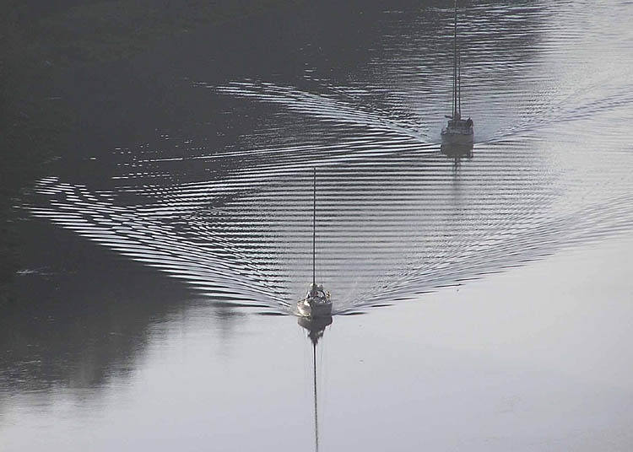

Slide 20
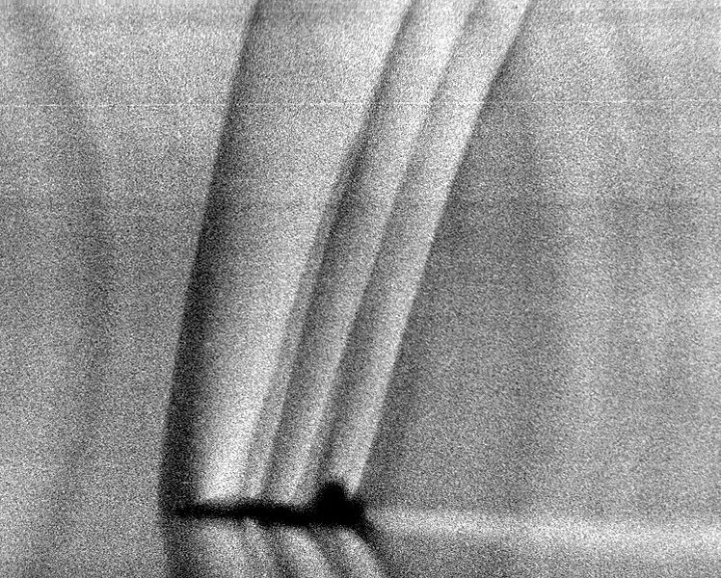

Slide 21
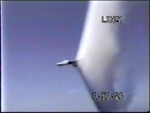

Slide 22

Top: Normal 'dark' spectral line positions at rest.
Middle: Source moving away from observer.
Bottom: Source moving towards observer.
http://www.jwst.nasa.gov/education/7Page45.pdf

Slide 23
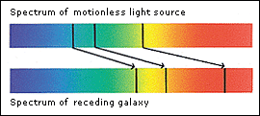

Slide 24
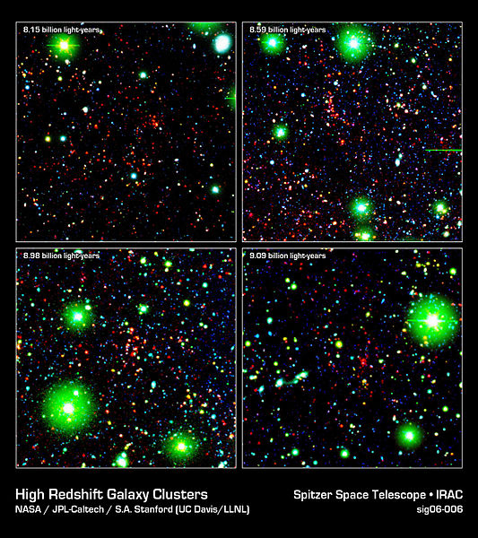

Slide 25
Question 223.5.5 Question 123.22.16
A
B
https://www.youtube.com/watch?v=gH-6JG0NeGg
C

Slide 26
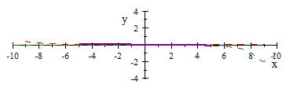

Slide 27
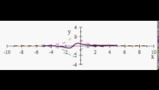

Slide 28
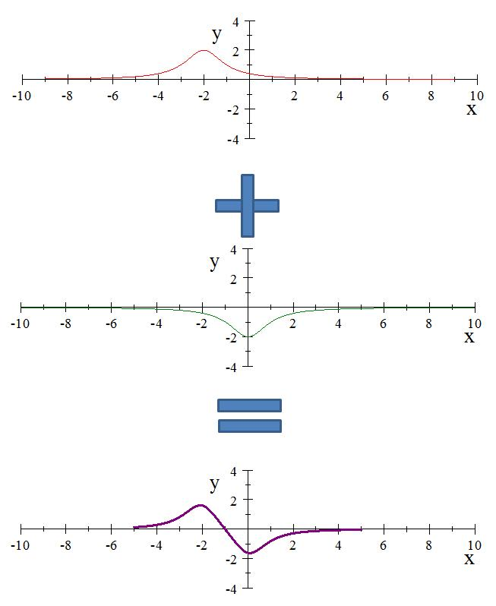

Slide 29
Question 11.3
A
B
C

Slide 30
Question 223.5.6
Two pulses travel along a string in opposite directions. One pulse is inverted. When they meet, the string looks flat. Something must have canceled out. What is it?
Wave velocities
Segment velocities
Energy of the waves
Power of the waves

Slide 31
Question 223.5.7
I add two sinusoidal waves on a string and the two waves have the same amplitude and frequency, but are going the opposite direction. If the phase difference is equal to a half a wavelength, what do I get?
Twice the amplitude of the original waves
Half the amplitude of the original waves
A negative amplitude
Nothing

Slide 32
Question 223.5.8
I add two sinusoidal waves on a string and the two waves have the same amplitude and frequency, but are going the opposite direction. If the phase difference is equal to a whole wavelength, what do I get?
Constructive Interference
Destructive Interference
A negative amplitude
Nothing

Slide 33
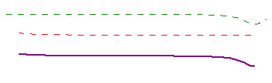

Slide 34
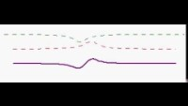

Slide 35
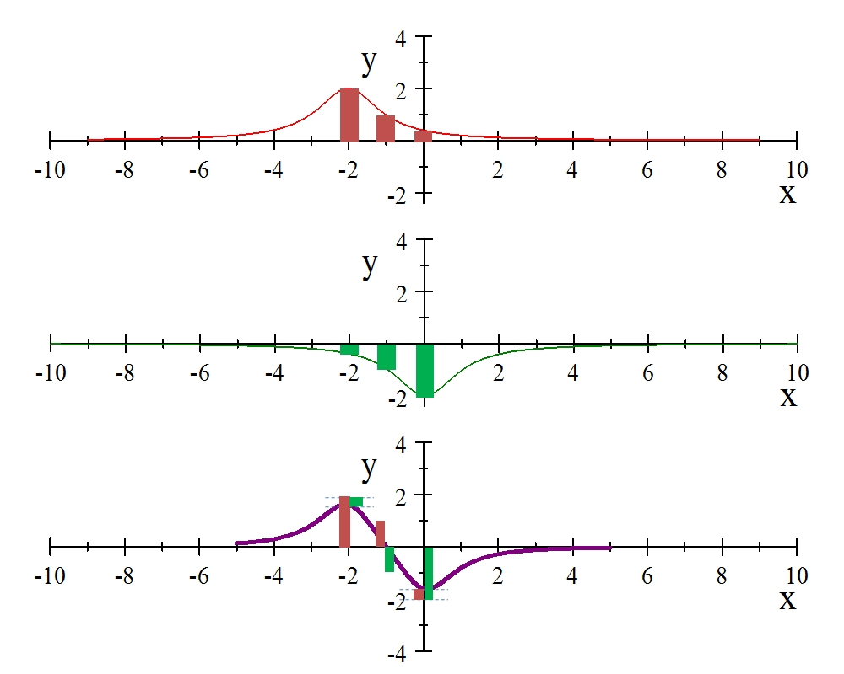

Slide 36
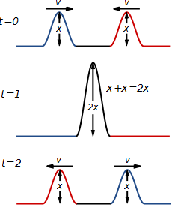
Constructive Interference

Slide 37
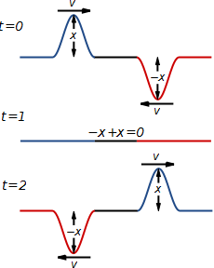
Destructive Interference

Slide 38
Question 223.6.0.1
I have two sinusoidal waves in the same medium. The waves travel the same direction (unlike our class demonstration). If the resultant wave has a larger amplitude than the original waves we call this…
Constructive interference
Destructive interference
A miracle

Slide 39
Question 223.6.0.2
I have two sinusoidal waves in the same medium. The waves travel the same direction (unlike our class demonstration). If the resultant wave has a smaller amplitude than the original waves we call this…
Constructive interference
Destructive interference
Depressing

Slide 40
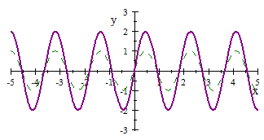

Slide 41
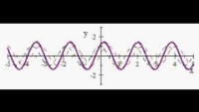

Slide 43
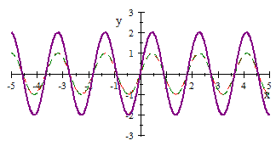

Slide 44
Question 11.4
Are the green and purple waves in phase?
Yes
No

Slide 45
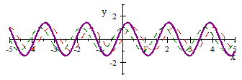

Slide 46
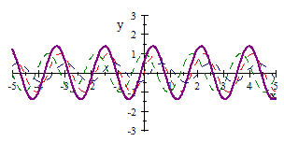

Slide 47
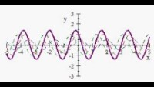

Slide 48
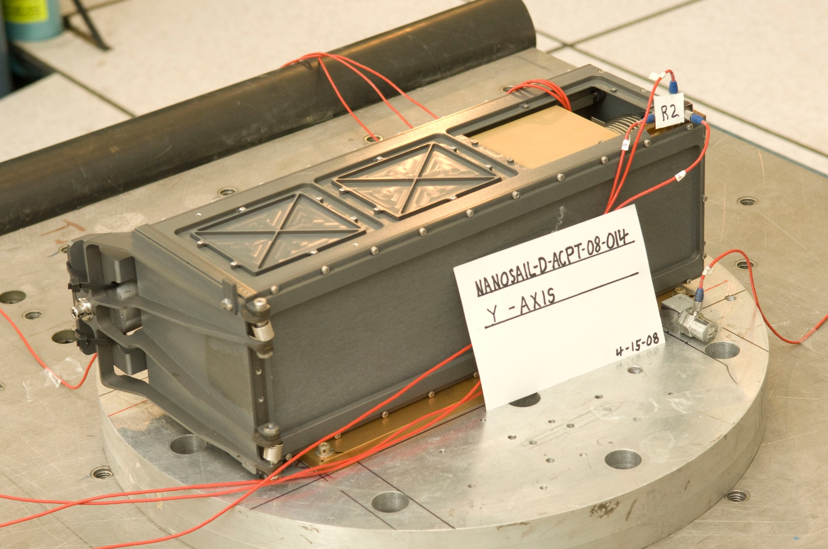

Slide 49
Question 223.6.0.3
I have two sinusoidal waves in the same medium. The waves travel the same direction (unlike our class demonstration). Sometimes we get constructive and sometimes destructive interference. What makes the difference?
The relative amplitude of the waves
The relative phase constant of the waves
The wavelength of the waves
Random processes

Slide 50
END

Slide 54
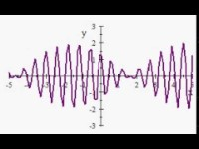

Slide 55
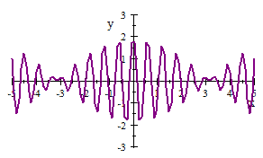

Slide 56
Question 11.5
Two graphs are shown below. Each graph represents the result of adding two waves together. For which graph is the frequency difference greater between the two original waves?.
A
B

