Slide 1
Lecture 17
Optical Systems

Slide 2
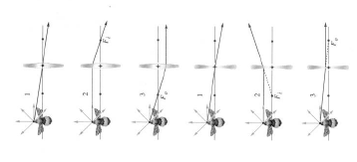

Slide 3


1
2
f
f
3

Slide 4
f
f

Slide 5
f
f

Slide 6
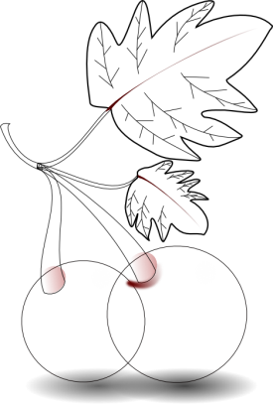
3
1
f
f
2

Slide 7
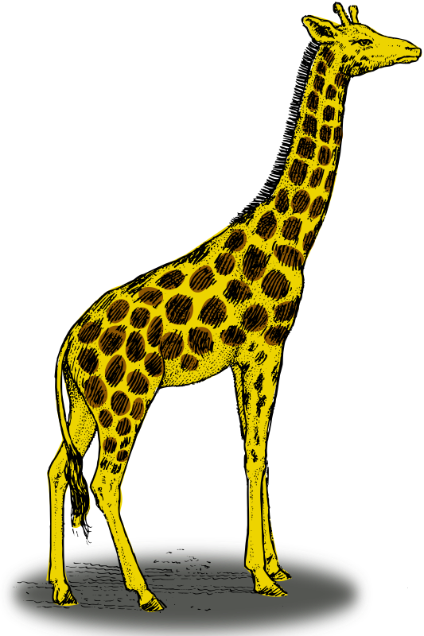
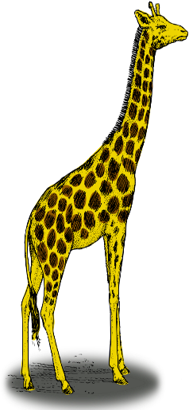
Δx_{i}
Δy_{o}
f
f
Δy_{i}
Δx_{o}

Slide 8
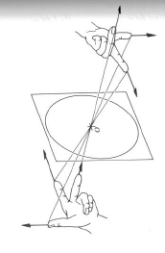

Slide 9
Combination of Lenses
S
P
s₀₁
s_{i1}
s_{o2}
s_{i2}
d
f₁
f₂

Slide 10
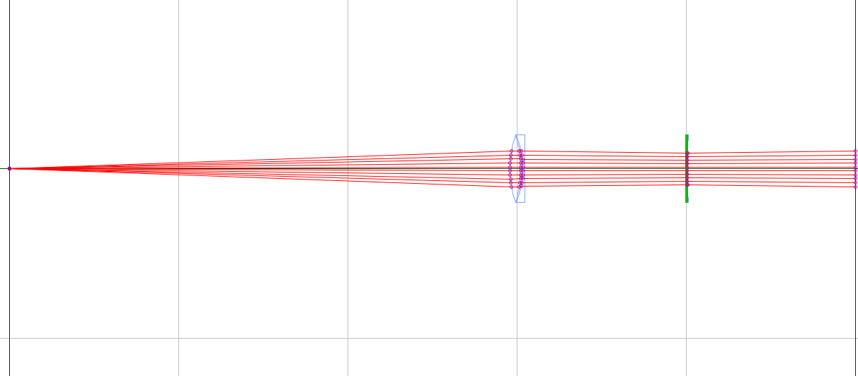

Slide 11
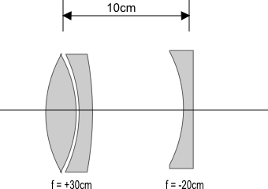
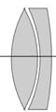

Slide 12
End

Slide 13
Question 223.16.2
If the image is on the same side of the air-glass interface as the object, we call this a virtual image. What would be the sign of the image distance, s’?
Positive
Negative
Neutral

Slide 14
Question 223.16.3
If the image inverted, what is the sign of the image height?
Positive
Negative
Neutral

Slide 15
Question 223.16.4
If the image is inverted, what is the sign of the magnification?
Positive
Negative
Neutral

Slide 16
Question 223.16.5
What would
Be for a thin lens?
The radius ratio
The lens thickness
The lens width
The focal length

Slide 17
Question 223.16.7
Diving masks often have a lens built into the glass for divers who do not have perfect vision. This allows the individual to dive without the necessity for glasses, because the lenses in the faceplate perform the necessary refraction to provide clear vision. The proper design allows the diver to see clearly with the mask on both under water and in the open air. Normal eyeglasses have lenses that are curved on both the front and rear surfaces. The lenses in a diving mask should be curved
only on the front surface
only on the rear surface
on both the front and rear surfaces

Slide 18
Question 223.16.8
Consider a flat mirror. Which of the following is true?
The image is as far behind the mirror as the object is in front
The image is twice as far away as the object is from the mirror
The image is farther away, but you would need to know the particular circumstances to know how far.
The image is in the same place as the object.

Slide 19
Question 223.16.9
What is the magnification of a flat mirror
1
2
-1
½
The image is unmagnified

Slide 20
Question 223.16.10
When you look in a flat mirror you observe
Left right reversal
Top bottom reversal
Front back reversal
No reversal

Slide 21
Question 223.26.4.6
Suppose I have a spherical mirror and I tell you that s is positive and s’ is negative. What type of mirror might I have
Concave
Convex
Can’t tell

Slide 22
Question 223.16.11
I have a concave mirror. If I place an object closer than the focal distance, the image is
Inverted and has a magnification greater than 1
Not inverted and has a magnification greater than 1
Inverted and has a magnification smaller than 1
Not inverted and has a magnification smaller than 1

Slide 23
Question 223.16.12
Will a refractive spherical optic display spherical aberration?
Yes
No
Sometimes yes, sometimes no

Slide 24
Question 223.15.8
A
C
f
C
f
B
C
f
A ray enters a mirror as shown above. Which of the choices to the right shows how the ray will exit the mirror?
C
C
f

Slide 25
Question 223.15.8
A
C
f
C
f
B
C
f
A ray enters a mirror as shown above. Which of the choices to the right shows how the ray will exit the mirror?
C
C
f

Slide 26
Question 223.15.8
A
C
f
C
f
B
C
f
A ray enters a mirror as shown above. Which of the choices to the right shows how the ray will exit the mirror?
C
C
f

Slide 27
Question 223.17.1
I have two lenses placed next to each other to form an optical system. The focal length of the combined system is…..
25cm
f₁ +f₂
f₁ x f₂
No simple relationship

Slide 28
Question 223.17.2
I have two lenses placed right next to each other. The magnification of the combined system is…..
25cm
m₁ + m₂
m₁ x m₂
No simple relationship

Slide 29
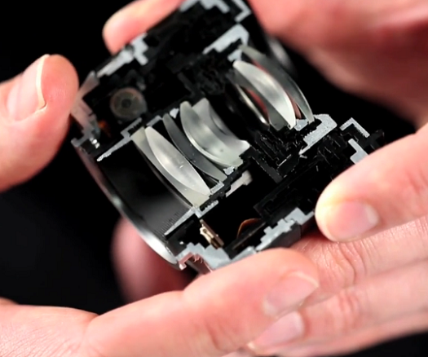
http://sonyalphanex.blogspot.com/

Slide 30
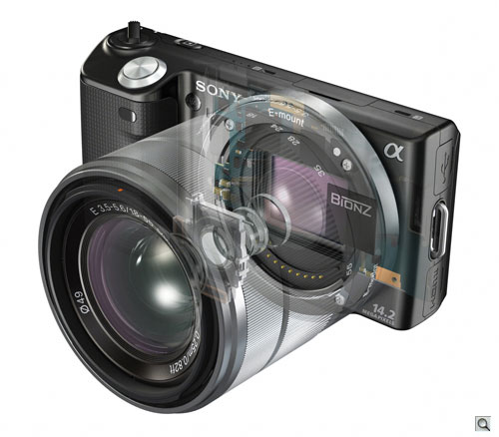
http://www.imaging-resource.com/PRODS/NEX5/NEX5A.HTM

Slide 31
I₁
O₂
f₁
f₂
O₁
f₁
f₂
I₂
s₁
s’₁
s₂
s’₂
d
f₁
f₂

Slide 32
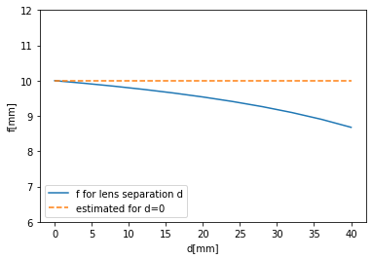
s = 50mm
f₁ = 30mm
f₂ = 15mm

Slide 34
Combination of Lenses
I₂
I₁ O₂
f₁
f₂
O₁
f₁
f₂
s₁
s’₁
s₂
d
f₁
f₂
s’₂

Slide 35
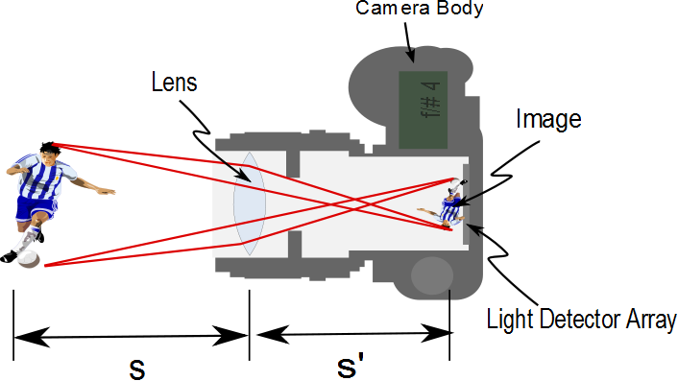
Aperture

Slide 36
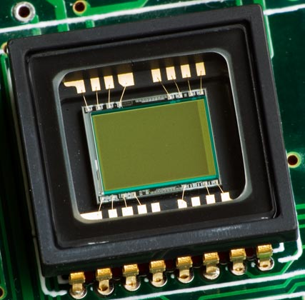

Slide 37
Question 223.17.3
I have two lenses placed with a separation of 1m to form an optical system. The focal length of the combined system is…..
25cm
f₁ + f₂
f₁ x f₂
No simple relationship

Slide 38
Question 223.17.4
For a camera, usually the object distance is large. If that is true, about how big is the image distance?
About 10cm
About as big as the focal length
About as big as the diameter of the lens
About as big as the object

Slide 39
Question 223.17.5
For a camera, usually the object distance is large. If that is true, what can we say about the image size?
It’s 10cm
It is proportional to the focal length
It is proportional to the diameter of the lens
Nothing

Slide 40
Question 223.17.6
For a camera, usually the object distance is large. What can we say about the intensity of the light that strikes the focal plane array?
It’s 10²cm
It is proportional to the focal length squared
It is proportional to the diameter of the lens squared
Nothing squared

Slide 41
Question 223.17.6.5
For a camera, will a larger or a smaller aperture let in more light?
Larger
Smaller
Impossible to tell

Slide 42
Question 223.17.7
What does the f/# tell you?
It gives you a relative intensity measurement
It tells you how large your lens is
It tells you how flat your focal plan array is
Still nothing

Slide 43
Say we wish to take a picture of Aunt Sally. Aunt Sally is about 1. 5m tall. She is standing about 5m away. Then to fit the image of Aunt Sally on our 35mm detector, we must have
h=1.5m
h′=0.035m
s=5m
f=0.058m
find s′ and m.

Slide 44
Now suppose we want to photograph a 1000m tower from 2km away. Then to fit the image of our tower on our 35mm detector, we must have
h= 1000m
h′=0.035m
s= 2000m
f=0.058m
find s′ and m.

Slide 45
