Slide 1
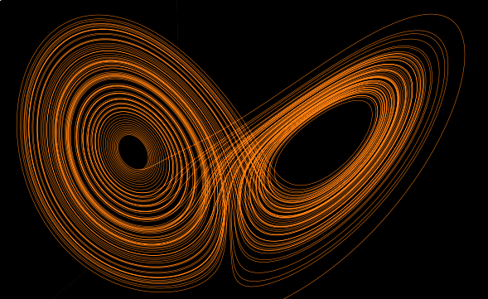
T
Turns counter clockwise at a particular speed
Turns clockwise at a particular speed

