Slide 1
Plane Wave
Particle

Slide 2
Plane Wave
Particle
Scattered Wave

Slide 3
Array of dipole locations
Array of dipole locations
Particle
Dipoles in rough shape of particle and scaled to better match particle shape

Slide 4
TD
TD
TD

Slide 5
TD
LD
TD
TD

Slide 6
0
1
2
3
4
1
2
3
4

Slide 7
Dipole Center Locations
(-1/2,-3/2)
(1/2,-3/2)
(3/2,-3/2)
0
1
2
3
4
(-3/2,-3/2)
1
(3/2,-1/2)
(-3/2,-1/2)
(3/2,-1/2)
(-1/2,-1/2)
2
(-1/2,1/2)
(3/2,1/2)
(3/2,1/2)
(-3/2,1/2)
3
(3/2,3/2)
(-3/2,3/2)
4
(-1/2,3/2)
(3/2,1/2)

Slide 8
Fine Structure Center Locations (i=0)
(-13/2,-15/8)
(-11/8,-15/8)
(-15/8,-15/8)
(-9/8,-15/8)
0
1
2
3
4
1
2
3
4

Slide 9
Fine Structure Center Locations (i=1)
(-5/2,-15/8)
(-3/8,-15/8)
(-7/8,-15/8)
(-1/8,-15/8)
0
1
2
3
4
1
2
3
4

Slide 10
0

Slide 11
Array of dipole locations
Array of dipole locations
Particle
Dipoles in rough shape of particle and scaled to better match particle shape

Slide 12
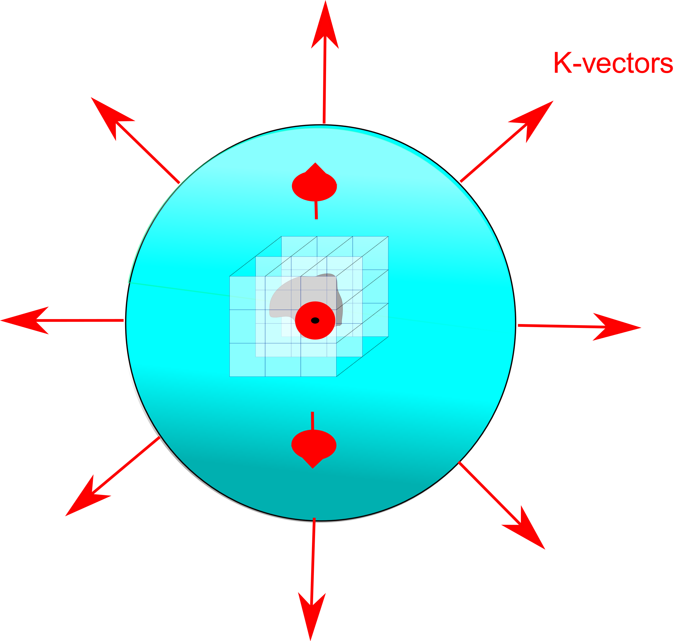
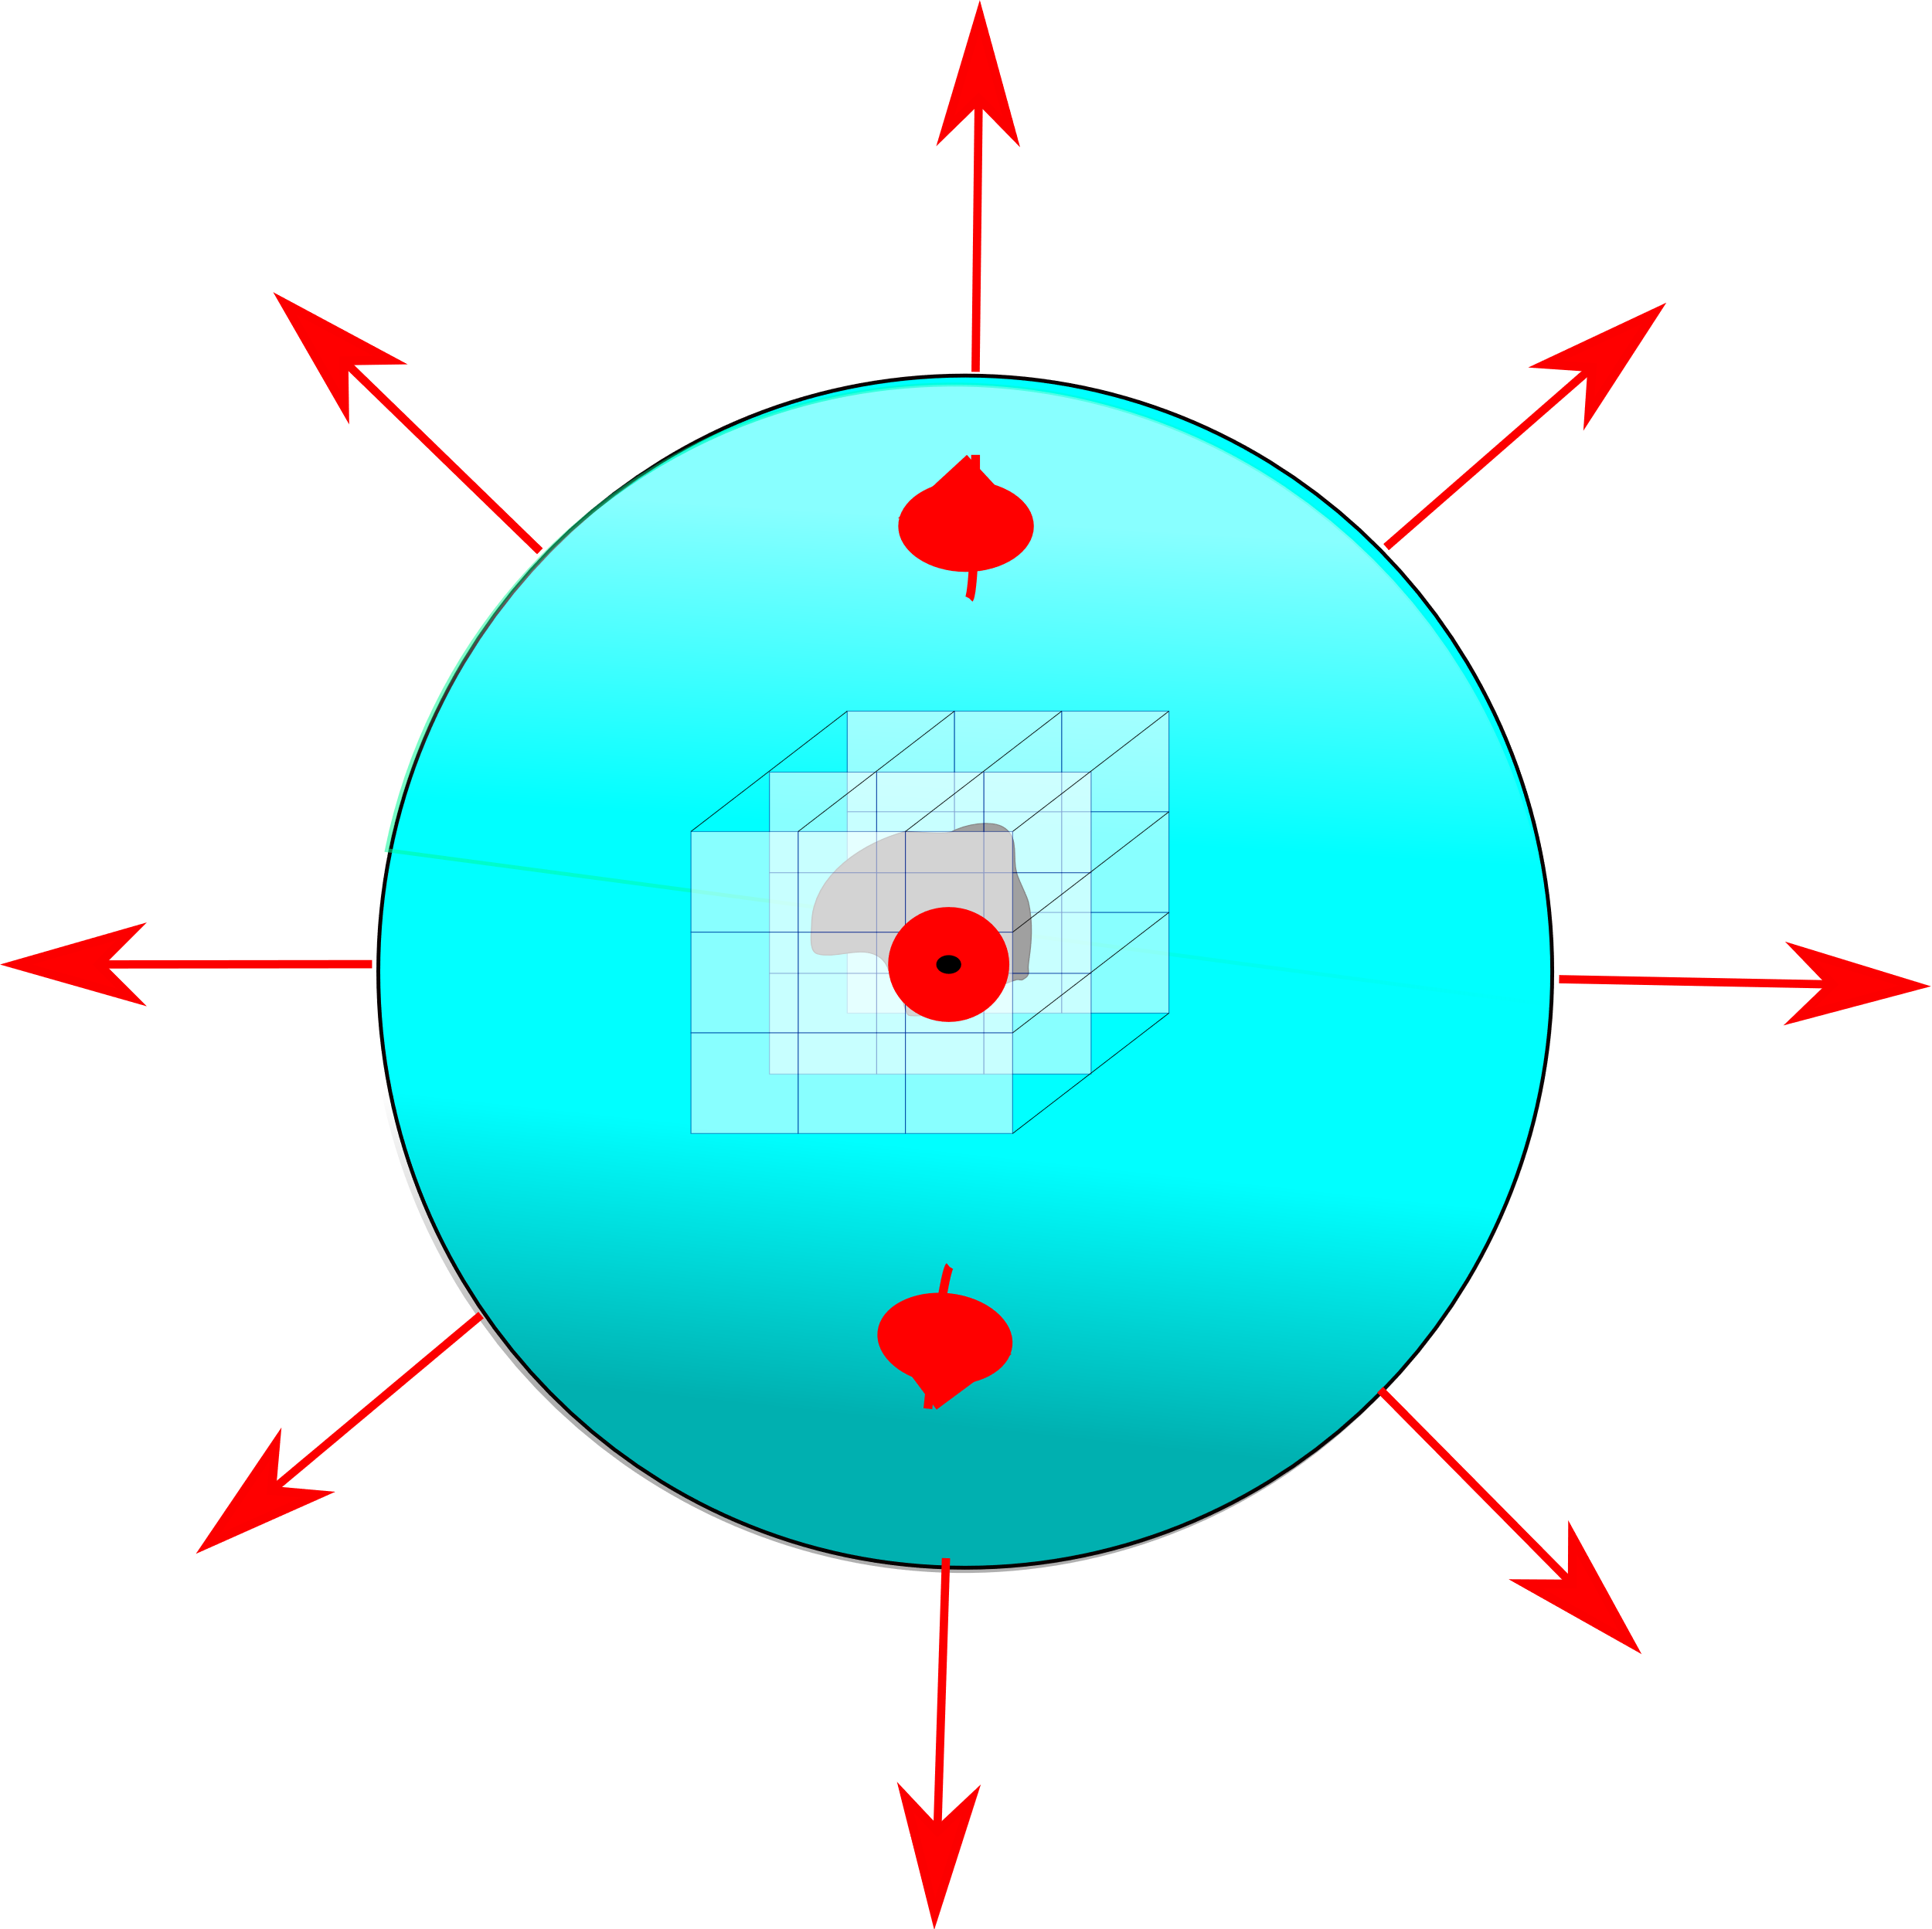

Slide 13
