Slide 1
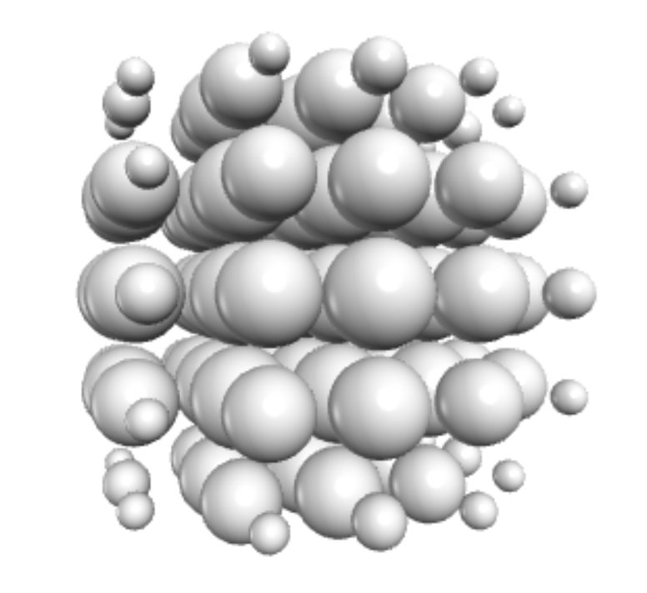
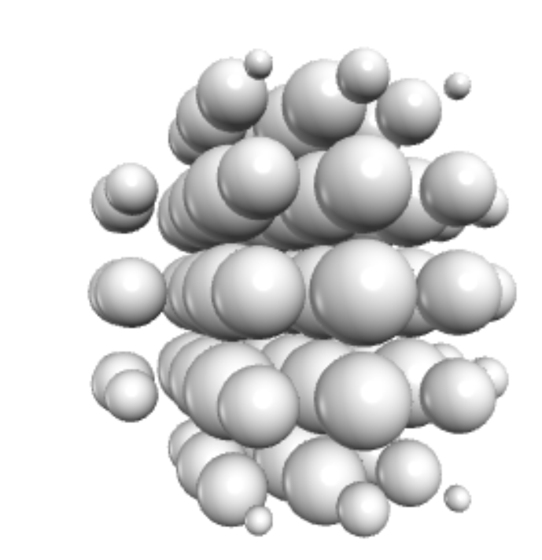
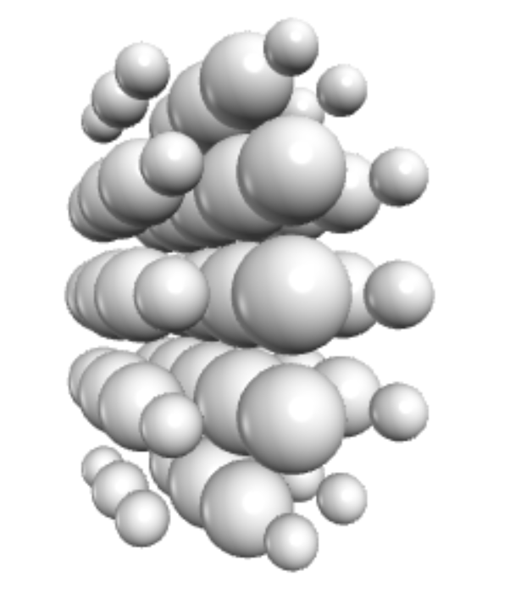
Aspect ratio = 0.8
Aspect ratio = 0.5
Aspect ratio = 1

Slide 2
Point where we want the average power scattered at angle φ
Incident Plane Wave
φ
Backscatter Direction
Forward Direction
Particle

Slide 3
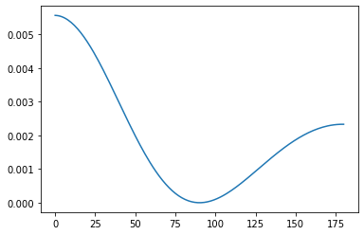
Points where we want the average power scattered at angles φ
Incident Plane Wave
φ
Backscatter Direction
Forward Direction
Particle
Differential Scattering Cross Section
φ (deg)

Slide 4
Power scattered into the forward direction
Differential Scattering Cross Section
Power scattered into the backward direction
Power scattered 90 degrees from the incident direction
φ (deg)

Slide 5
Plane Wave
Particle

Slide 6
Plane Wave
Particle
Scattered Wave

Slide 7
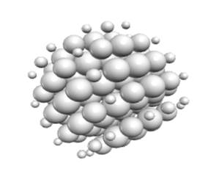

Slide 8
Array of dipole locations
Array of dipole locations
Particle
Dipoles in rough shape of particle and scaled to better match particle shape

Slide 9
TD
TD
TD

Slide 10
TD
LD
TD
TD

Slide 11
0
1
2
3
4
1
2
3
4

Slide 12
Dipole Center Locations
(-1/2,-3/2)
(1/2,-3/2)
(3/2,-3/2)
0
1
2
3
4
(-3/2,-3/2)
1
(3/2,-1/2)
(-3/2,-1/2)
(3/2,-1/2)
(-1/2,-1/2)
2
(-1/2,1/2)
(3/2,1/2)
(3/2,1/2)
(-3/2,1/2)
3
(3/2,3/2)
(-3/2,3/2)
4
(-1/2,3/2)
(3/2,1/2)

Slide 13
Fine Structure Center Locations (i=0)
(-13/2,-15/8)
(-11/8,-15/8)
(-15/8,-15/8)
(-9/8,-15/8)
0
1
2
3
4
1
2
3
4

Slide 14
Fine Structure Center Locations (i=1)
(-5/2,-15/8)
(-3/8,-15/8)
(-7/8,-15/8)
(-1/8,-15/8)
0
1
2
3
4
1
2
3
4

Slide 15
0

Slide 16
Array of dipole locations
Array of dipole locations
Particle
Dipoles in rough shape of particle and scaled to better match particle shape

Slide 17
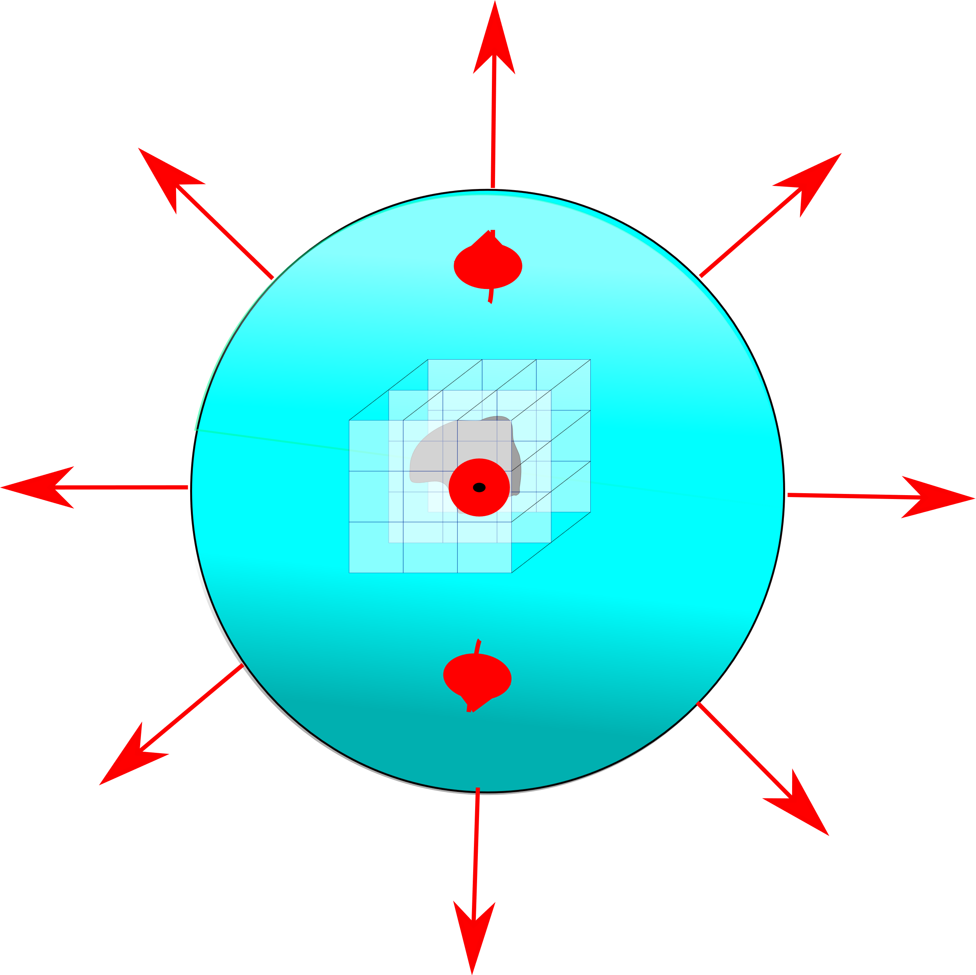
Discretized Particle
Field Expansion term directions

Slide 18
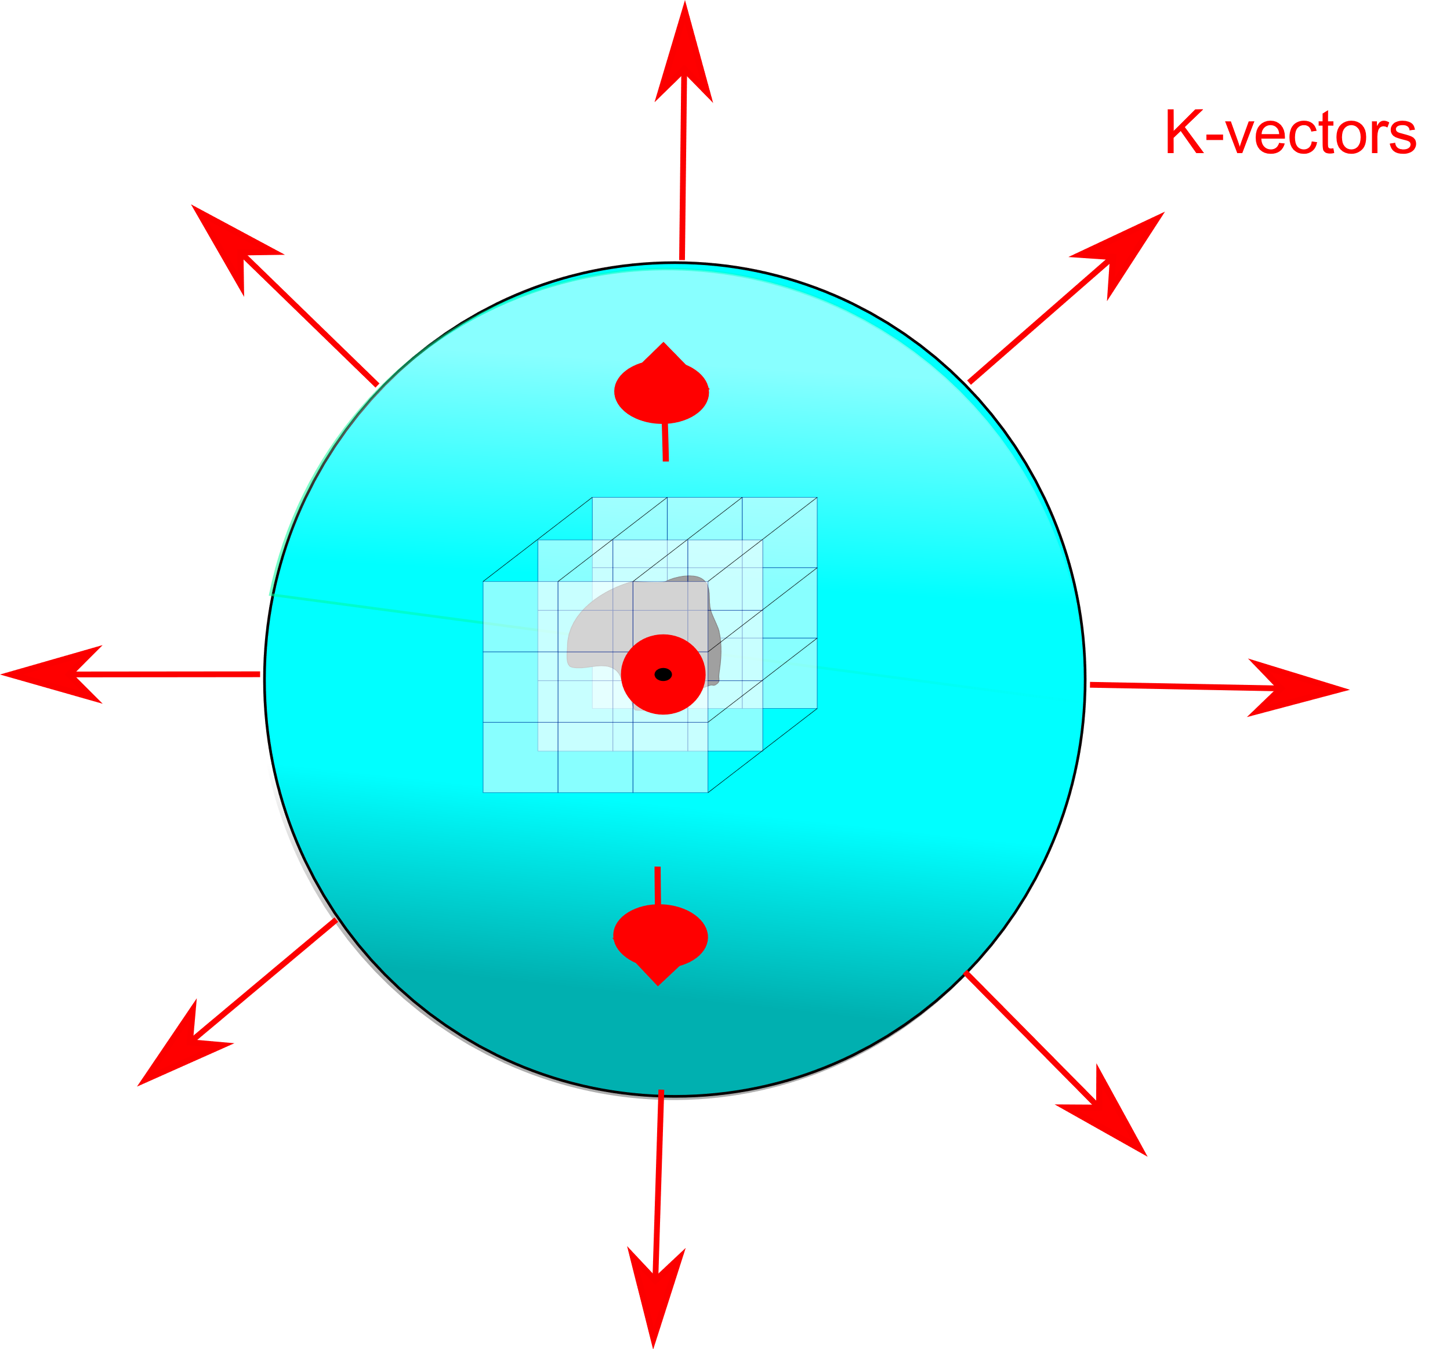

Slide 19


