Slide 1
RTPD Criminal database

Slide 2
Introduction
Robert Maggs. Associate’s Degree in Science, Software Engineering
Terry Barthelemy. Associate’s Degree in Science, Software Engineering

Slide 3
Overview
Tool used by Detectives to store information on Criminals
Detectives will use the messenger to communicate details about a crime
Announcement board available for meetings, training info, announcements etc.

Slide 4
Timeline
The website started out as your local police department website. Regular pedestrians had access to the site.
We began to think of more tools for the backend to make the site more interactive for the user.
We obliterated the front end and made the site a tool for law enforcement only.

Slide 5
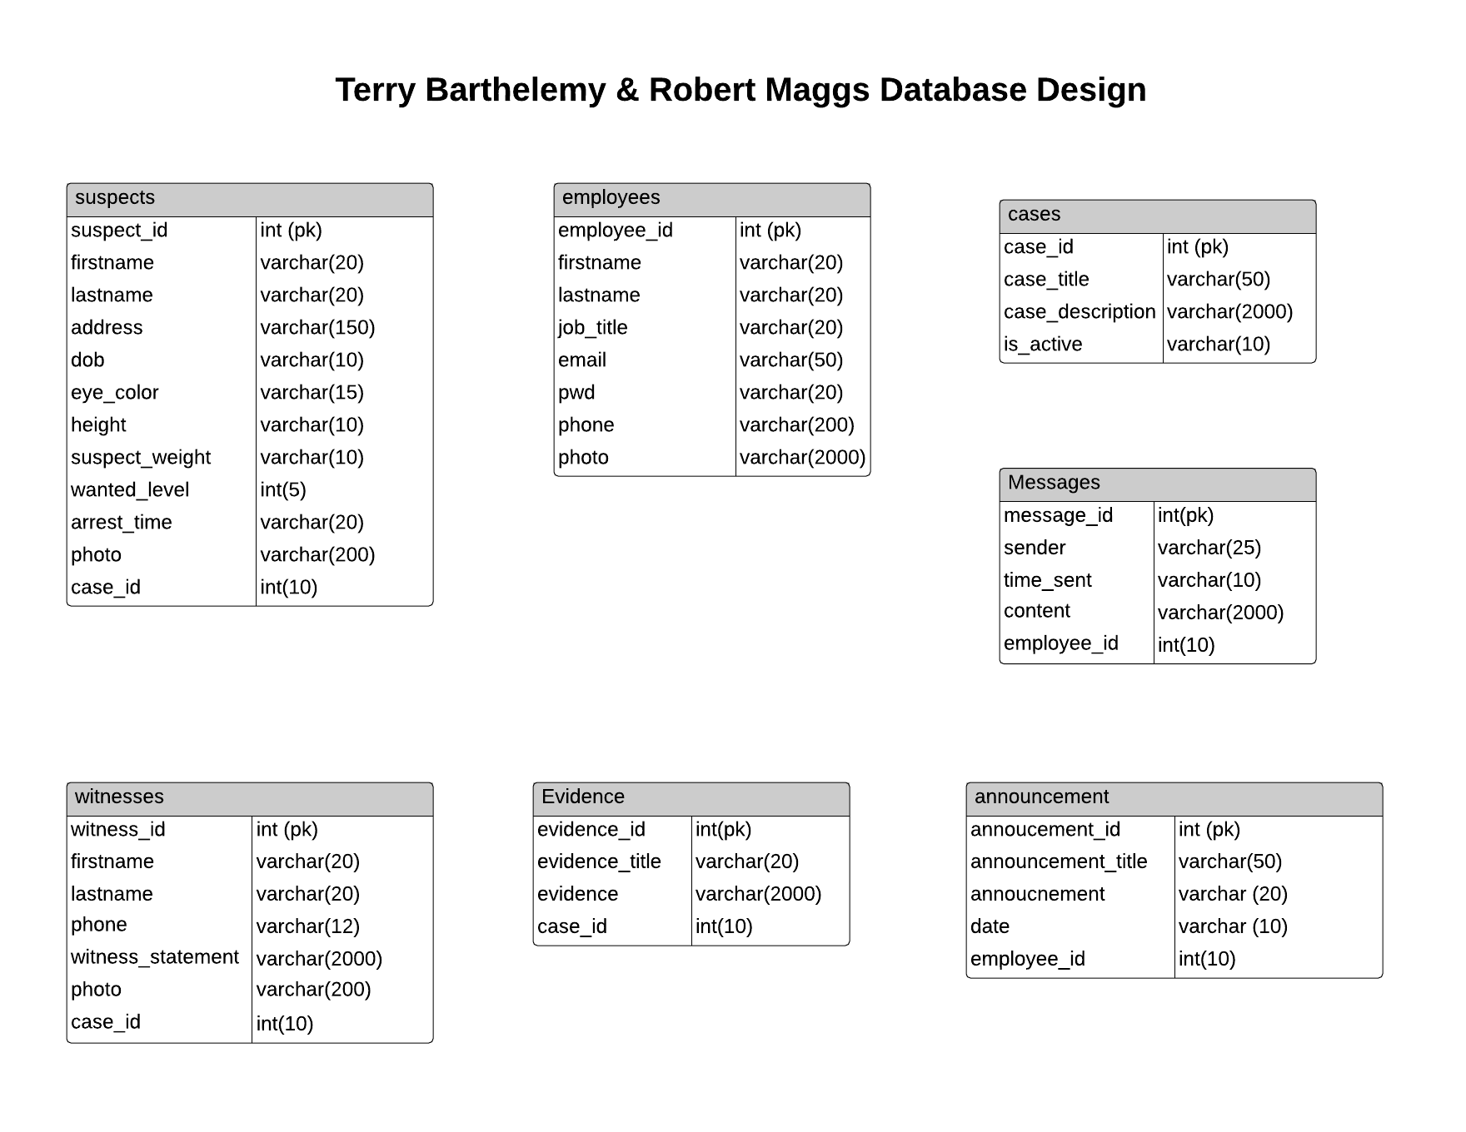
Database Organization

Slide 6
Obstacles
Deciding on the final design and what we were going to implement in this project
Git proficiency was a little struggle (For Terry)

Slide 7
Tech Design
Login.php - Ability to log in as user or admin
Admin_announcements.php – Create, Update Delete announcements
Admin_employees.php – Create, Update and Delete employees
User_case_details.php – Create, Update and Delete witnesses, suspects, cases and evidence (Upload Photos)
Messages.php – user to user messages

Slide 8
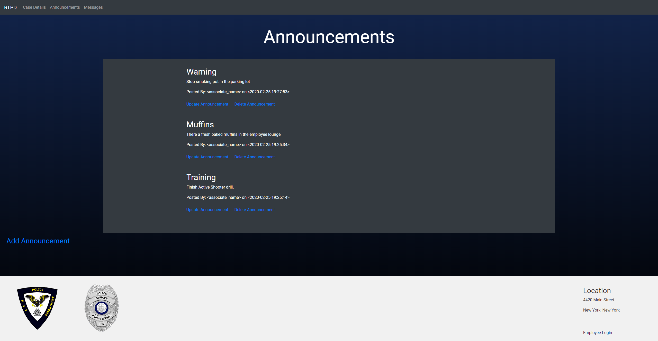

Slide 9
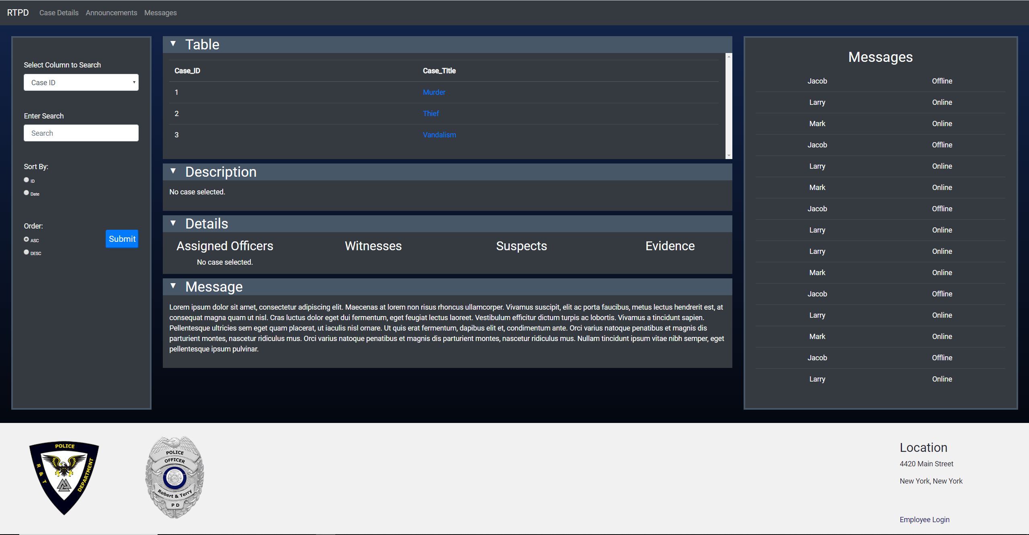

Slide 10
