Slide 1


The Hitchhiker’s Guide to Testing Statistical Significance in NLP
Rotem Dror, Gili Baumer, Segev Shlomov, and Roi Reichart
ACL 2018
https://github.com/rtmdrr/testSignificanceNLP

Slide 2
I want to be… state of the art
Ingredients
$A$ – my new algorithm
𝐴 – my new algorithm
$B$ – current SOTA algorithm
𝐵 – current SOTA algorithm
Data - $D$
Data - 𝐷
Directions
Apply algorithm $A$ on $D$
Apply algorithm 𝐴 on 𝐷
Apply algorithm $B$ on $D$
Apply algorithm 𝐵 on 𝐷
Evaluation measure $m$
Evaluation measure 𝑚
Test if $$m\left(A,D\right)>m(B,D)$$
Test if 𝑚(𝐴,𝐷)>𝑚(𝐵,𝐷)

Slide 3

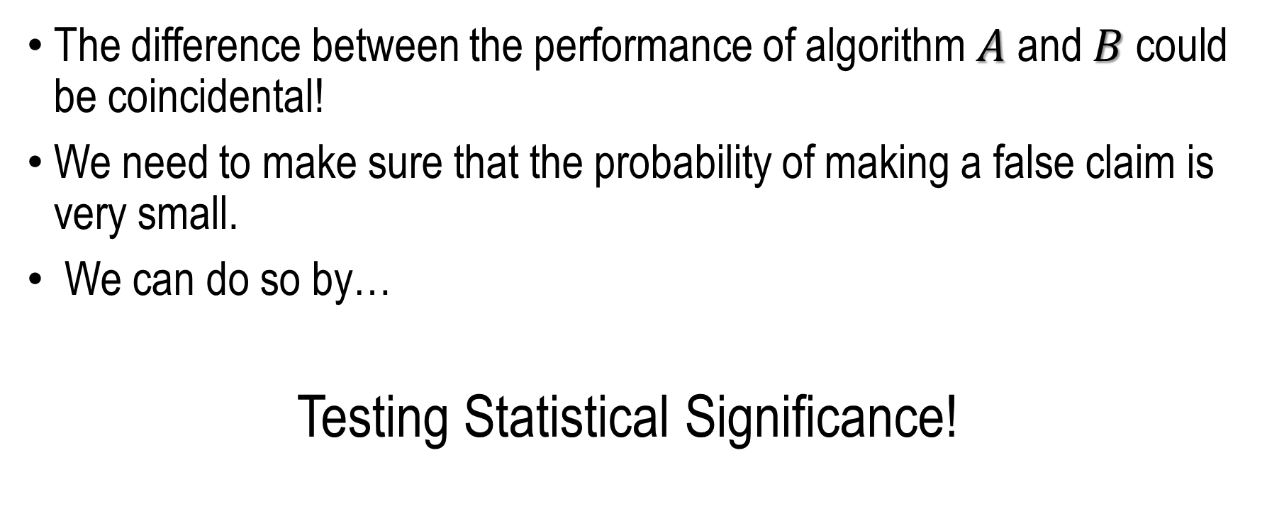
This is not enough!
The difference between the performance of algorithm $A$ and $B$ could be coincidental!
We need to make sure that the probability of making a false claim is very small.
We can do so by…
Testing Statistical Significance!

Slide 4

NLP & Hypothesis Testing – Survey ACL 2017
180 experimental long papers
63 checked statistical significance
Only 42 mentioned the name of the statistical test
Only 36 used the correct statistical test - $1/5$ of all papers!
180 experimental papers
Checked significance
OK!

Slide 5
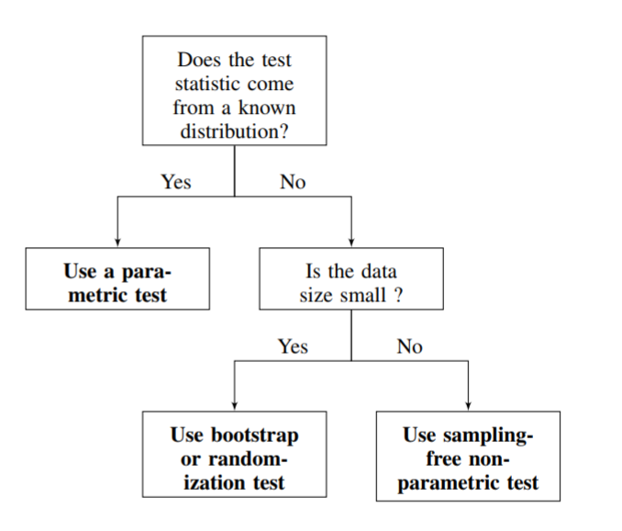
Simple Guide

Slide 6

Statistical Significance Hypothesis Testing
Let: $δ\left(D\right)=m\left(A,D\right)−m(B,D)$.
$$\left\{\begin{aligned}H_{0}:δ\left(D\right)≤0 \\ H_{1}:δ\left(D\right)>0 \end{aligned}\right.$$
$$p−value=P_{H_{0}}(δ\left(D\right)≥δ_{observed})$$

Slide 7
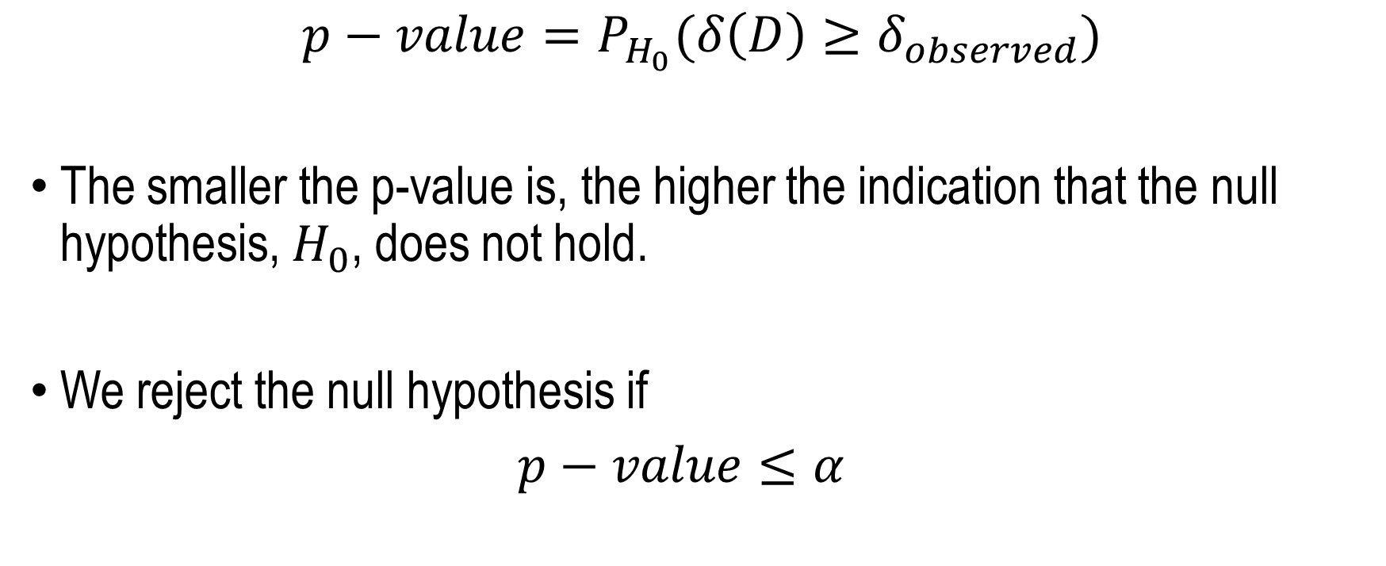
Statistical Significance Hypothesis Testing
$$p−value=P_{H_{0}}(δ\left(D\right)≥δ_{observed})$$
The smaller the p-value is, the higher the indication that the null hypothesis, $H_{0}$, does not hold.
We reject the null hypothesis if
$p−value≤α$

Slide 8
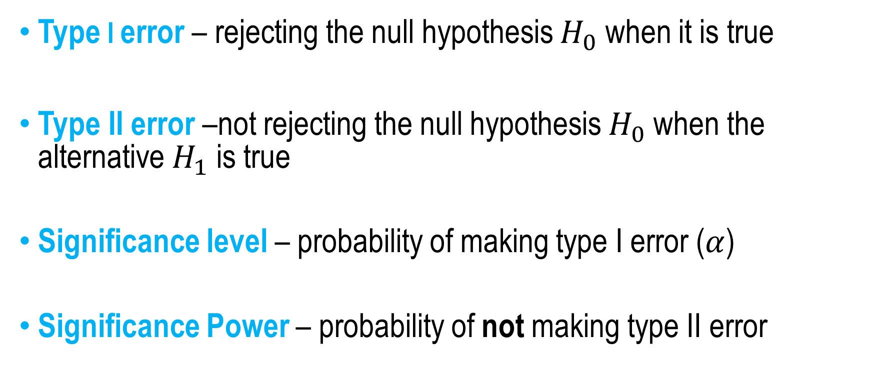
Statistical Significance Hypothesis Testing
Type I error – rejecting the null hypothesis $H_{0}$ when it is true
Type II error –not rejecting the null hypothesis $H_{0}$ when the alternative $H_{1}$ is true
Significance level – probability of making type I error ($α$)
Significance Power – probability of not making type II error

Slide 9
So…
Let’s all test for statistical significance!
Why not?
OK
☹
☹
☹
☹

Slide 10


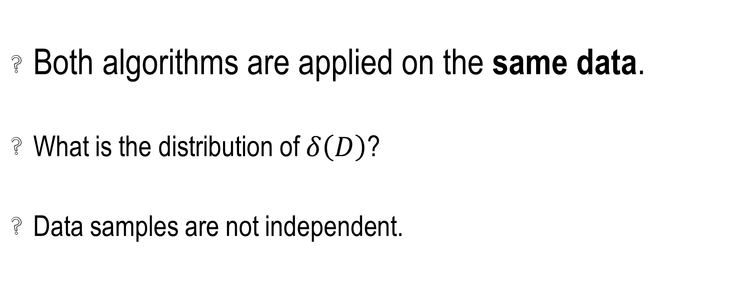
NLP & Hypothesis Testing - Problems
Both algorithms are applied on the same data.
What is the distribution of $δ\left(D\right)$?
Data samples are not independent.

Slide 11

Paired Statistical Tests
Both algorithms are applied on the same data – dependent
Paired sample: sample selected from the first population is related to the corresponding sample from the second population
Solution: apply paired-version of statistical test
Paired t-test, Wilcoxon signed-rank test, paired bootstrap…

Slide 12
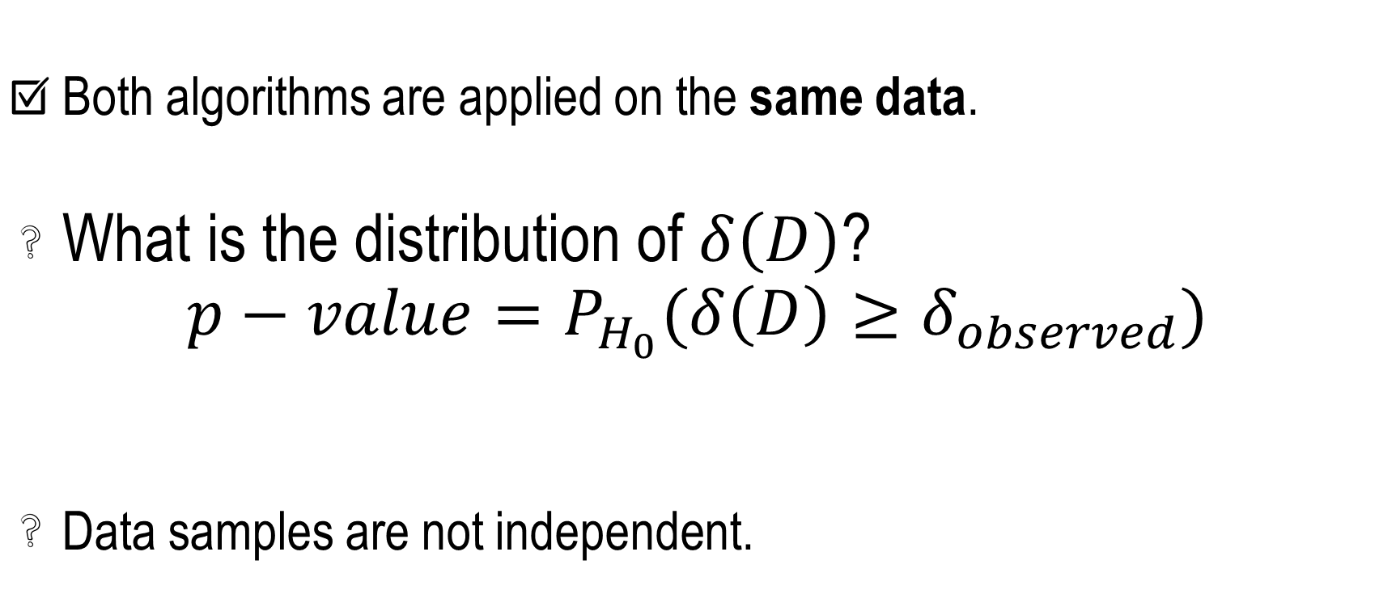
NLP & Hypothesis Testing - Problems
Both algorithms are applied on the same data.
What is the distribution of $δ\left(D\right)$?
$$p−value=P_{H_{0}}(δ\left(D\right)≥δ_{observed})$$
Data samples are not independent.

Slide 13
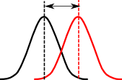
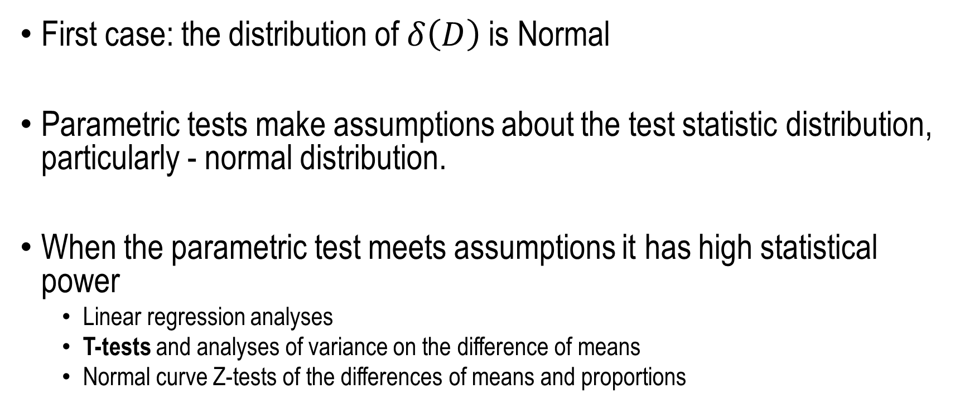
Parametric Tests
First case: the distribution of $δ\left(D\right)$ is Normal
Parametric tests make assumptions about the test statistic distribution, particularly - normal distribution.
When the parametric test meets assumptions it has high statistical power
Linear regression analyses
T-tests and analyses of variance on the difference of means
Normal curve Z-tests of the differences of means and proportions

Slide 14
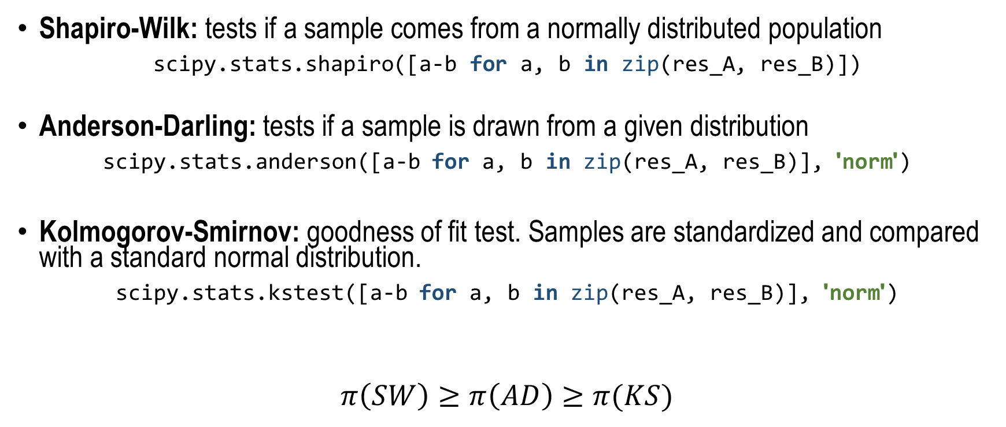
Parametric Tests – Check for Normality
Shapiro-Wilk: tests if a sample comes from a normally distributed population
scipy.stats.shapiro([a-b for a, b in zip(res_A, res_B)])
Anderson-Darling: tests if a sample is drawn from a given distribution
scipy.stats.anderson([a-b for a, b in zip(res_A, res_B)], 'norm')
Kolmogorov-Smirnov: goodness of fit test. Samples are standardized and compared with a standard normal distribution.
scipy.stats.kstest([a-b for a, b in zip(res_A, res_B)], 'norm')
$$π\left(SW\right)≥π\left(AD\right)≥π(KS)$$

Slide 15
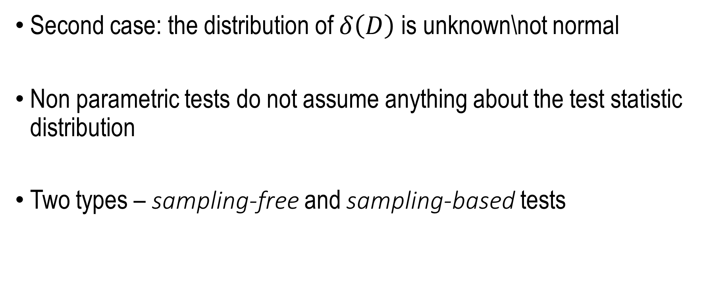
Non-Parametric Tests
Second case: the distribution of $δ\left(D\right)$ is unknown\not normal
Non parametric tests do not assume anything about the test statistic distribution
Two types – sampling-free and sampling-based tests

Slide 16



Sampling-Free Non-Parametric Tests
Binomial\ Multinomial
McNemar
Cochren’s Q
Not Normal
Sign
Wilcoxon signed-rank

Slide 17
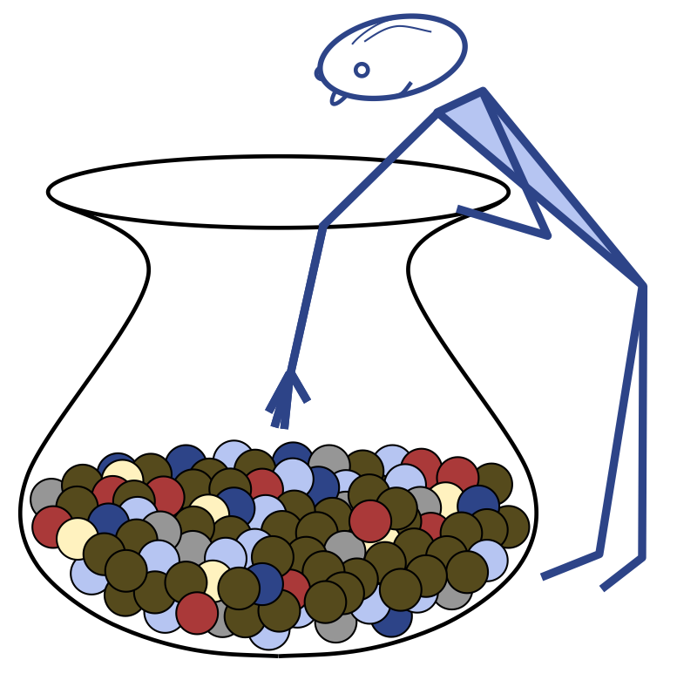
Sampling-Based Non-Parametric Tests
Permutation tests: resamples drawn at random from the original data. Without replacements.
Paired design – consider all possible choices of signs to attach to each difference.
Bootstrap: resamples drawn at random from the original data. With replacements.
Paired design – sample with repetitions from the set of all differences.

Slide 18
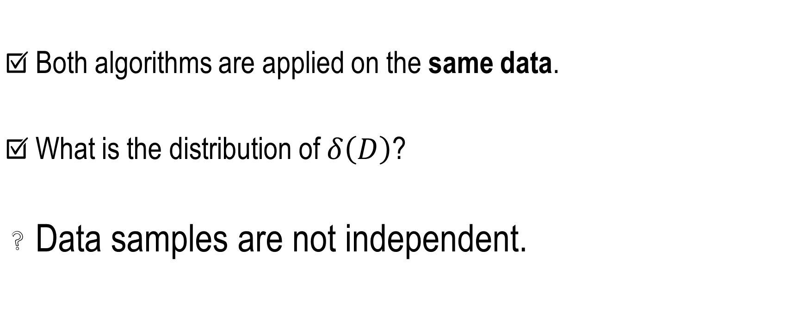
NLP & Hypothesis Testing - Problems
Both algorithms are applied on the same data.
What is the distribution of $δ\left(D\right)$?
Data samples are not independent.

Slide 19

NLP Data and I.I.D Assumption
Many NLP datasets have dependent samples
All statistical test assume independency => all tests are invalid, impact hard to quantify
Solution: come up with statistical tests that allow dependencies

Slide 20
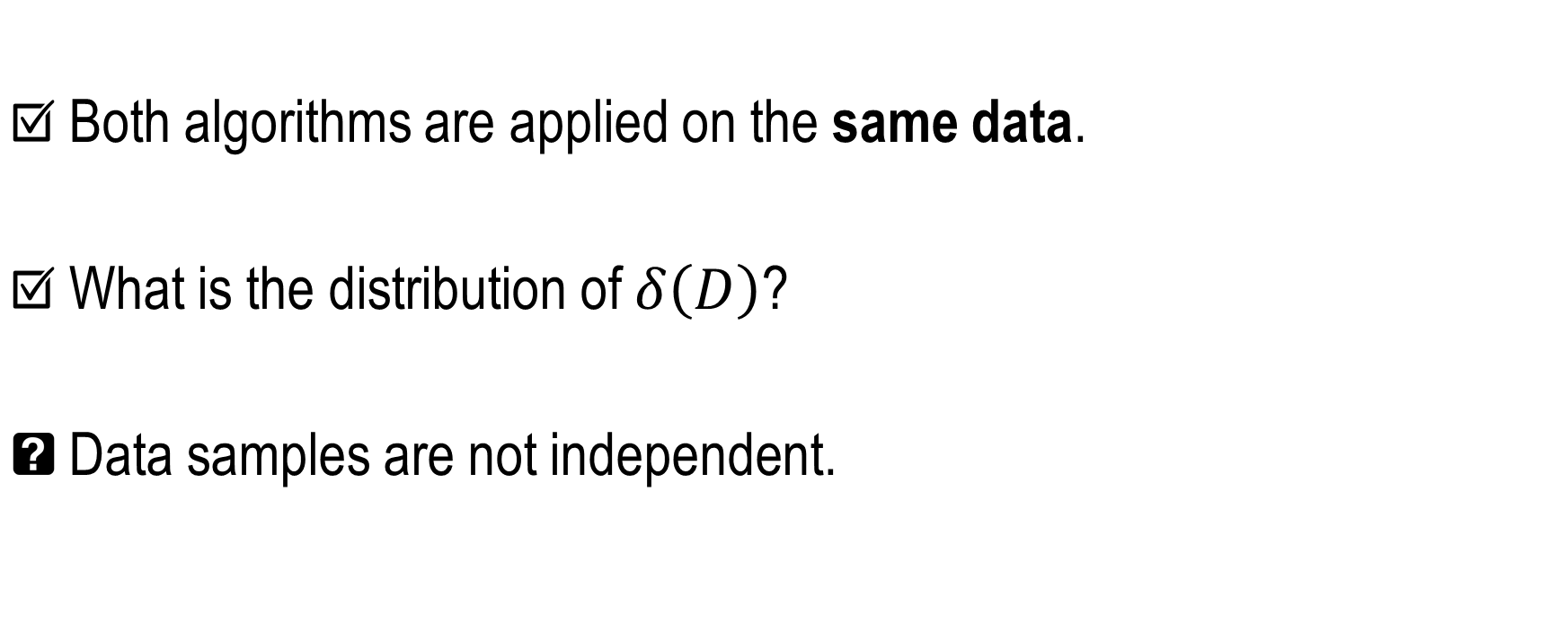

NLP & Hypothesis Testing
Both algorithms are applied on the same data.
What is the distribution of $δ\left(D\right)$?
Data samples are not independent.

Slide 21
Simple Guide

Slide 22
Thank You for Listening Questions?
https://github.com/rtmdrr/testSignificanceNLP

