Slide 1

Replicability Analysis for NLP: Testing Significance with Multiple Datasets
Rotem Dror, Gili Baumer, Marina Bogomolov, and Roi Reichart
TACL 2017
https://github.com/rtmdrr/replicability-analysis-NLP
Notes:
We have the custom of using multiplt datasets

Slide 2





Datasets in NLP

Slide 3
I want to be… state of the art
Ingredients
$A$ – my new algorithm
𝐴 – my new algorithm
$B$ – current SOTA algorithm
𝐵 – current SOTA algorithm
Data - $D_{1},D_{2},…,D_{n}$
Data - 𝐷_1,𝐷_2,…,𝐷_𝑛
Directions
Apply algorithm $A$ on $D_{i}$
Apply algorithm 𝐴 on 𝐷_𝑖
Apply algorithm $B$ on $D_{i}$
Apply algorithm 𝐵 on 𝐷_𝑖
Evaluation measure $m$
Evaluation measure 𝑚
Test if $$m\left(A,D_{i}\right)>m(B,D_{i})$$
Test if 𝑚(𝐴,𝐷_𝑖 )>𝑚(𝐵,𝐷_𝑖)

Slide 4
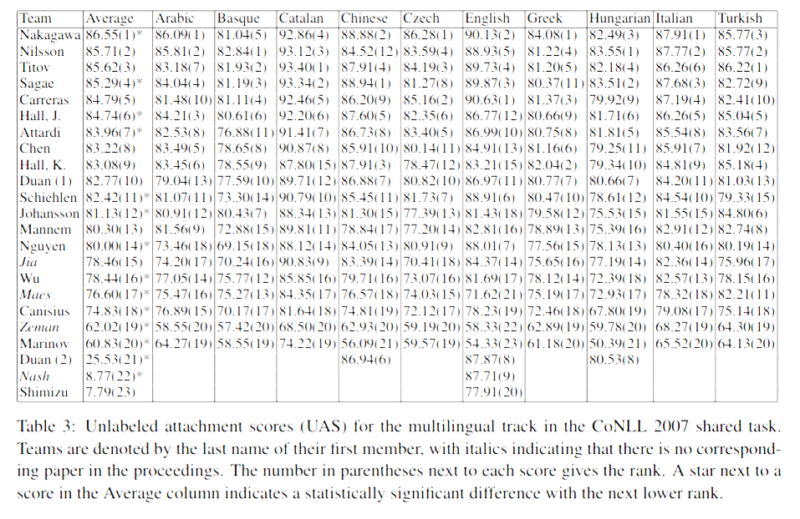
Multiple Datasets in NLP
What about these results?
Statistical significance for averaged results
The CoNLL 2007 Shared Task on Dependency Parsing
Notes:
להגיד שיכול להיות שהסיגניפיקנטיות נבעה רק מכך שהאלגוריתם טוב על איזשהי שפה אזוטרית בצורה סיגניפיקנטית ובעצם על מרבית השפות הוא לא סיגניפיקנטי, ולכן זה לא בטוח אלגוריתם שנרצה להשתמש בו

Slide 5
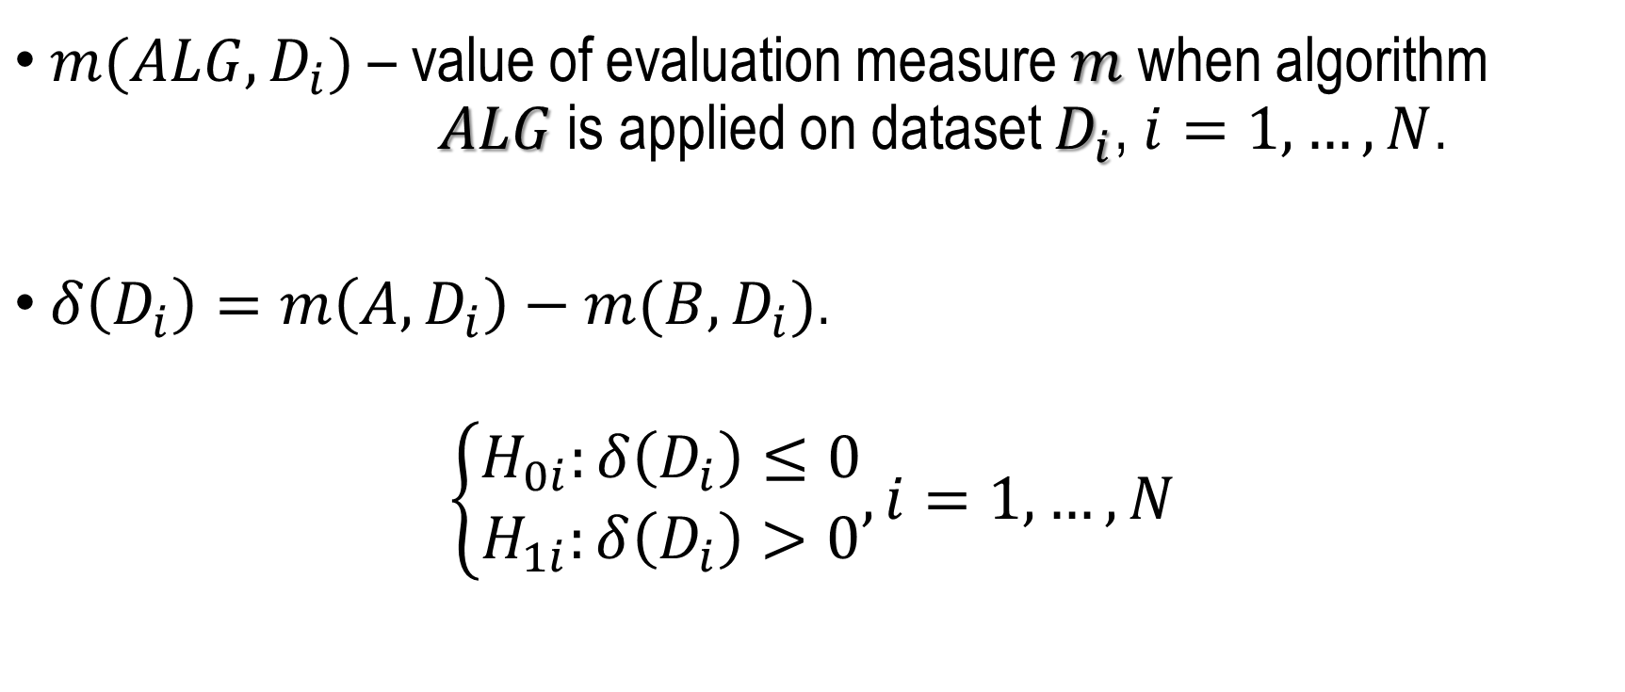
Statistical Significance: Multiple Hypothesis Testing
$m(ALG, D_{i})$– value of evaluation measure $m$ when algorithm $ALG$ is applied on dataset $D_{i}$, $i=1,…,N$.
$δ\left(D_{i}\right)=m\left(A,D_{i}\right)−m(B,D_{i})$.
$$\left\{\begin{aligned}H_{0i}:δ\left(D_{i}\right)≤0 \\ H_{1i}:δ\left(D_{i}\right)>0\end{aligned}, i=1,…,N\right.$$

Slide 6
Multiplicity - Not just in NLP
Psychology (An Open, Large-Scale, Collaborative Effort to Estimate the Reproducibility of Psychological Science (Collaboration, 2012))
Economics (Does high public debt consistently stifle economic growth? a critique of Reinhart and Rogof (Herndon et al., 2014))
Medicine (Drug development: Raise standards for preclinical cancer research (Begley and Ellis, 2012))
Genomics (GWAS – genome-wide association study (Heller et al., 2014))
and many more…
Why not us?

Slide 7
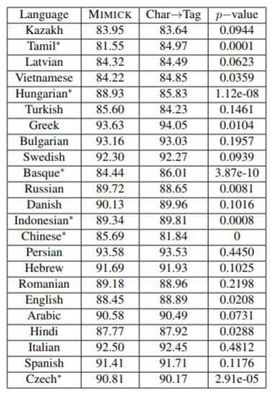
Multilingual POS Tagging
It looks like we can name 11 significant languages ☺
But - if for every data there is a small chance of 0.05 that we are wrong…

Slide 8
Multilingual POS Tagging
It looks like we can name 11 significant languages ☺
But - if for every data there is a small chance of 0.05 that we are wrong…
Then – all together there is a big chance that we are wrong!
What looks like 11 is actually… 6 ☹

Slide 9
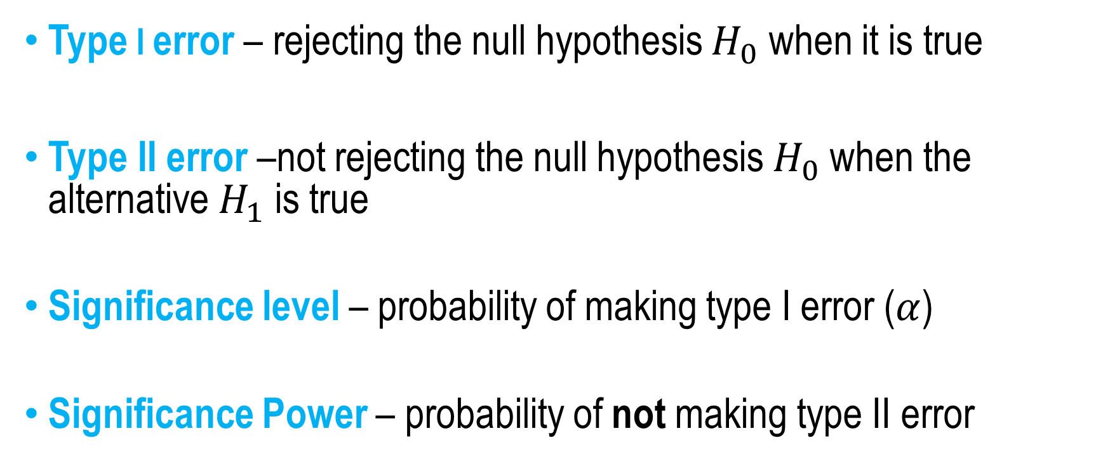
Statistical Significance Hypothesis Testing
Type I error – rejecting the null hypothesis $H_{0}$ when it is true
Type II error –not rejecting the null hypothesis $H_{0}$ when the alternative $H_{1}$ is true
Significance level – probability of making type I error ($α$)
Significance Power – probability of not making type II error
Notes:
To check why this happens let us first define the types of error we can make using statistical significance hypothesis testing

Slide 10
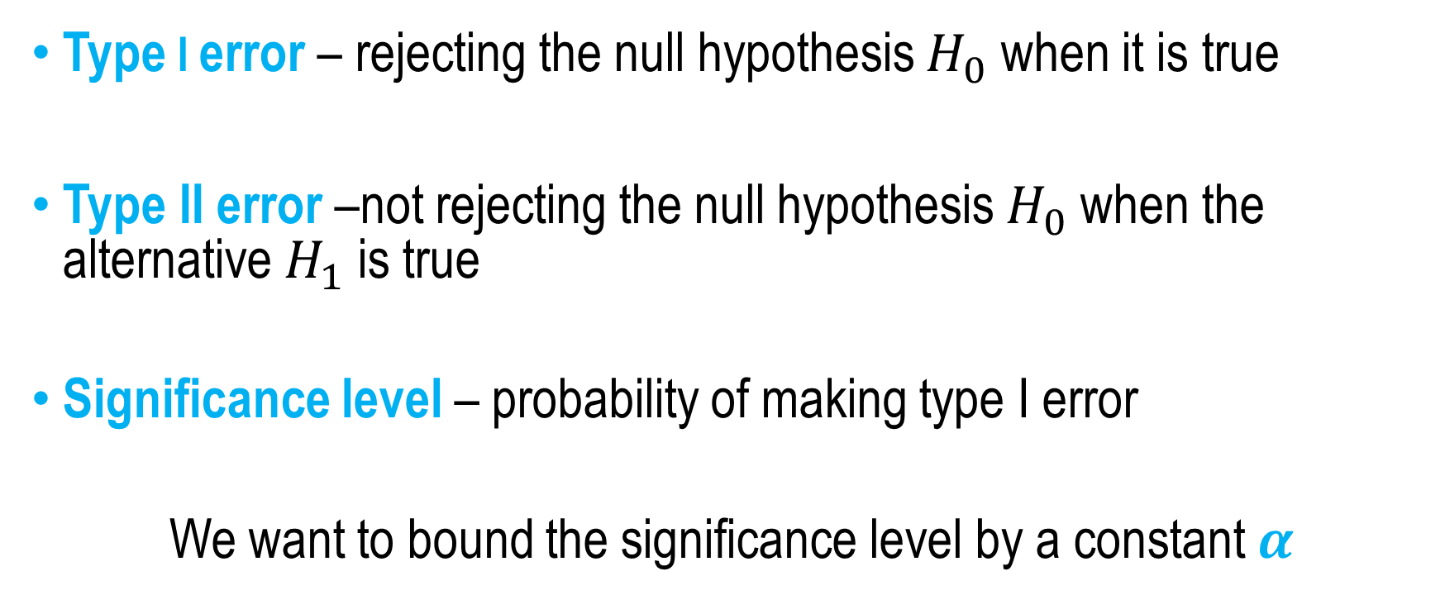
Statistical Significance Hypothesis Testing
Type I error – rejecting the null hypothesis $H_{0}$ when it is true
Type II error –not rejecting the null hypothesis $H_{0}$ when the alternative $H_{1}$ is true
Significance level – probability of making type I error
We want to bound the significance level by a constant $α$

Slide 11
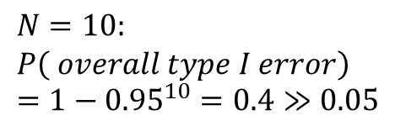
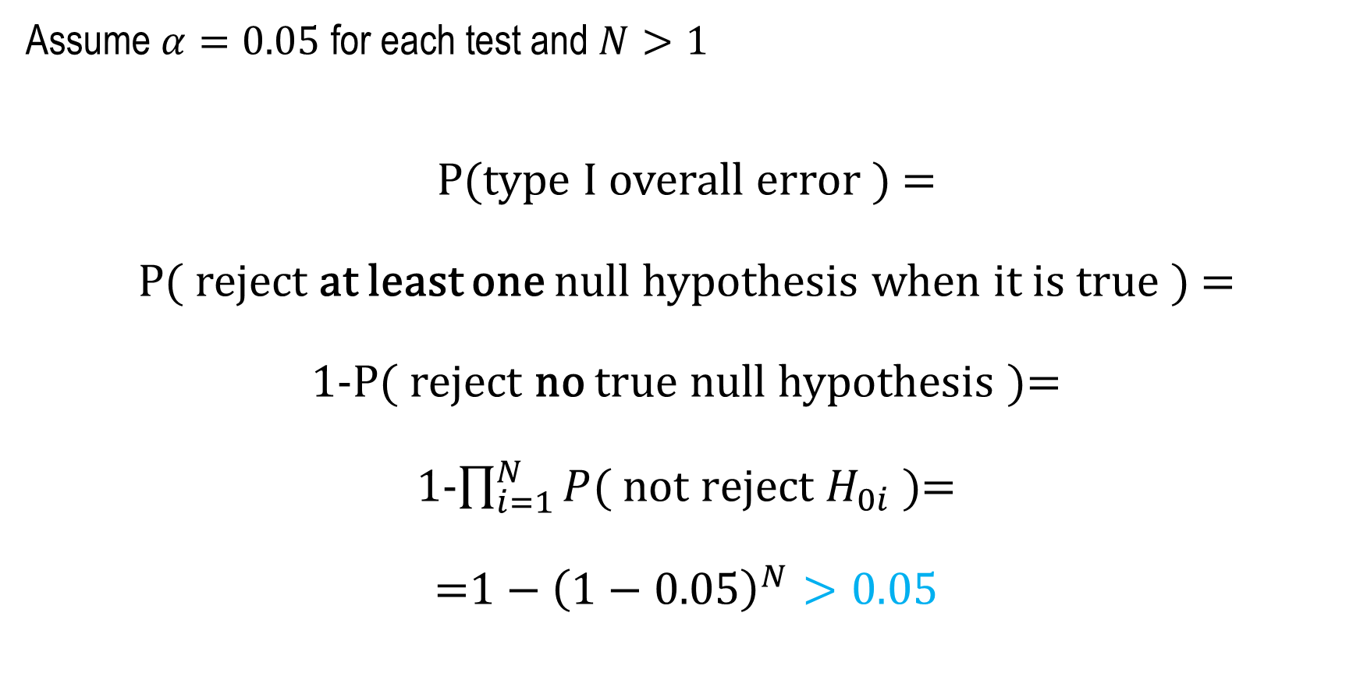
Multiplicity problem
Assume $α=0.05$ for each test and $N>1$
P(type I overall error ) =
P( reject at least one null hypothesis when it is true ) =
1-P( reject no true null hypothesis )=
1-$\prod_{i=1}^{N}{P( not reject H_{0i} )}$=
=$1−{\left(1−0.05\right)}^{N}>0.05$
$$N=10: \\ P\left( overall type I error\right)=1−{0.95}^{10}=0.4≫0.05$$

Slide 12

Two Questions – Replicability Analysis
Q1 (Counting)
For how many datasets does a given algorithm outperform another?
Q2 (Identification)
What are these datasets?

Slide 13
Q1 - Counting
For how many datasets does a given algorithm outperform another?

Slide 14
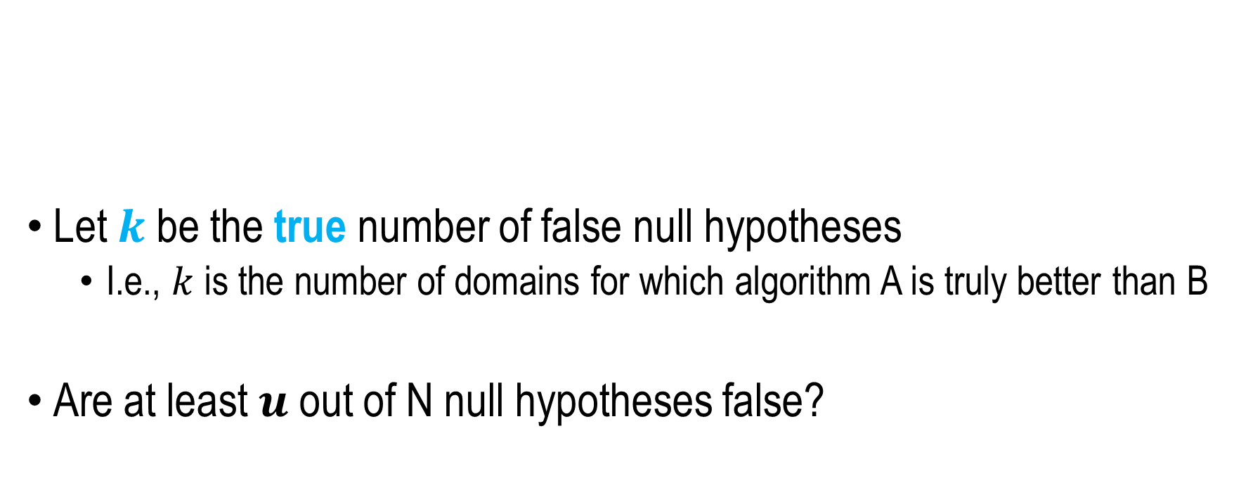

Partial Conjunction Hypothesis
$$H_{01}$$
𝐻_01
$$p_{1}$$
𝑝_1
$$H_{02}$$
𝐻_02
$$p_{2}$$
𝑝_2
…
$$p_{N}$$
𝑝_𝑁
$$H_{0N}$$
𝐻_0𝑁
Let $k$ be the true number of false null hypotheses
I.e., $k$ is the number of domains for which algorithm A is truly better than B
Are at least $u$ out of N null hypotheses false?
$$H_{0}^{u\backslash N}:k>u \\ H_{1}^{u\backslash N}:k≤u$$
Notes:
We want to predict as precisely as we can the number k
We will do so in steps, where in each step we will ask ourselves if k is upper bounded by the number u, or equivalently

Slide 15

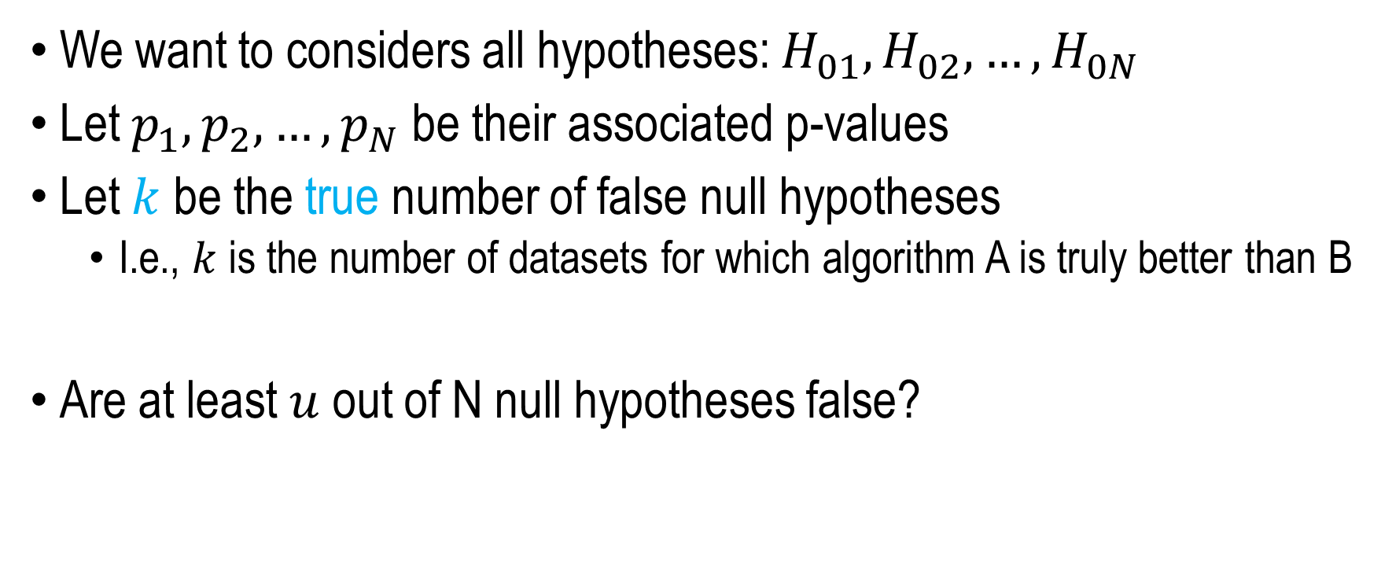
Partial Conjunction Hypothesis
$$H_{01}$$
𝐻_01
$$p_{1}$$
𝑝_1
$$H_{02}$$
𝐻_02
$$p_{2}$$
𝑝_2
…
$$p_{N}$$
𝑝_𝑁
$$H_{0N}$$
𝐻_0𝑁
We want to considers all hypotheses: $H_{01},H_{02},…,H_{0N}$
Let $p_{1},p_{2},…,p_{N}$ be their associated p-values
Let $k$ be the true number of false null hypotheses
I.e., $k$ is the number of datasets for which algorithm A is truly better than B
Are at least $u$ out of N null hypotheses false?
$$H_{0}^{u\backslash N}:u<k \\ H_{1}^{u\backslash N}:u≥k$$

Slide 16

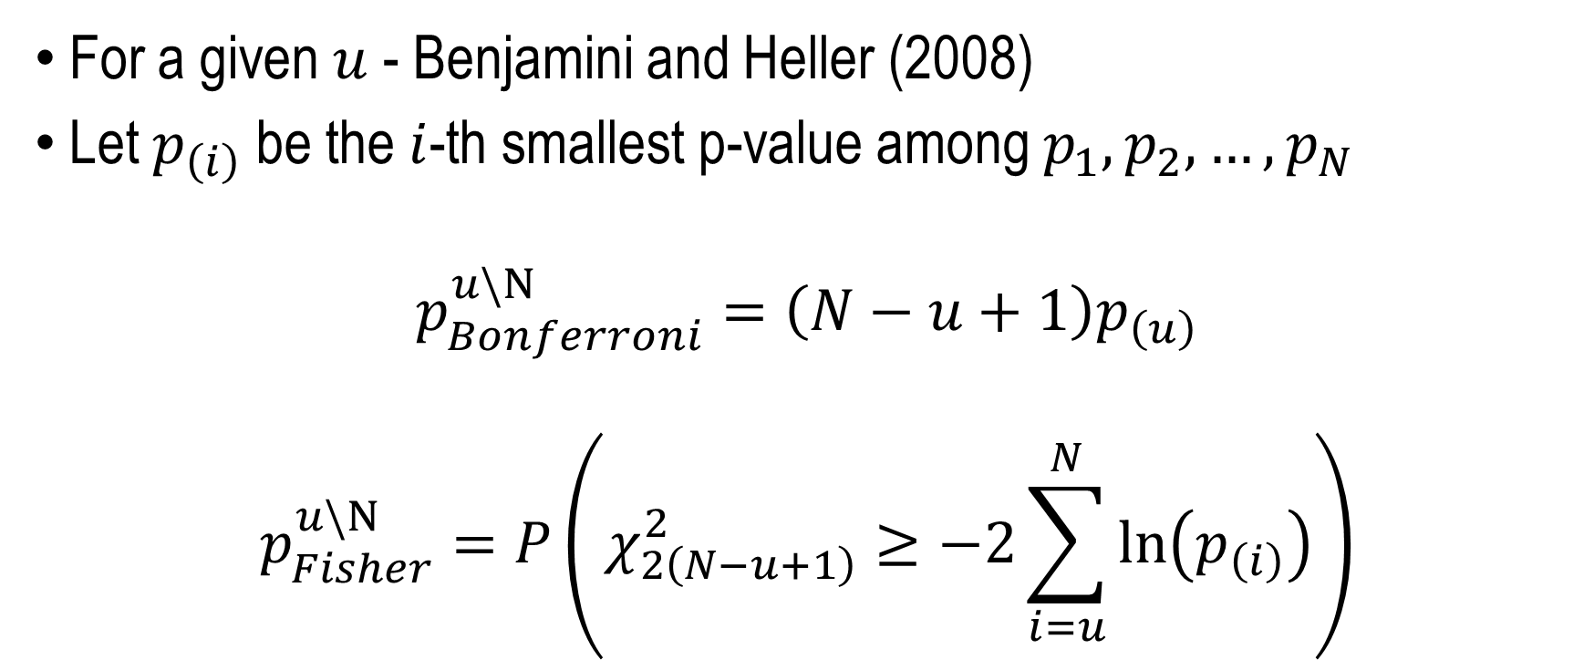
Partial Conjunction P-values
$$H_{0}^{u\backslash N}:u<k \\ H_{1}^{u\backslash N}:u≥k$$
For a given $u$ - Benjamini and Heller (2008)
Let $p_{\left(i\right)}$ be the $i$-th smallest p-value among $p_{1},p_{2},…,p_{N}$
$$p_{Bonferroni}^{u\backslash N}=\left(N−u+1\right)p_{\left(u\right)}$$
$$p_{Fisher}^{u\backslash N}=P\left(χ_{2\left(N−u+1\right)}^{2}≥−2\sum_{i=u}^{N}{\ln\left(p_{\left(i\right)}\right)}\right)$$

Slide 17

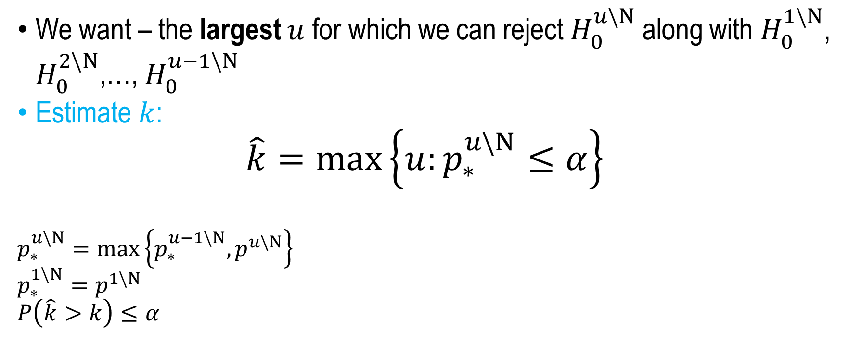
Q1 – Dataset Counting
$$H_{0}^{u\backslash N}:u<k \\ H_{1}^{u\backslash N}:u≥k$$
We want – the largest $u$ for which we can reject $H_{0}^{u\backslash N}$ along with $H_{0}^{1\backslash N}$, $H_{0}^{2\backslash N}$,…, $H_{0}^{u−1\backslash N}$
Estimate $k$:
$$\hat{k}=\max\left\{u:p_{∗}^{u\backslash N}≤α\right\}$$
$$p_{∗}^{u\backslash N}=\max\left\{p_{∗}^{u−1\backslash N},p^{u\backslash N}\right\} \\ p_{∗}^{1\backslash N}=p^{1\backslash N} \\ P\left(\hat{k}>k\right)≤α$$

Slide 18
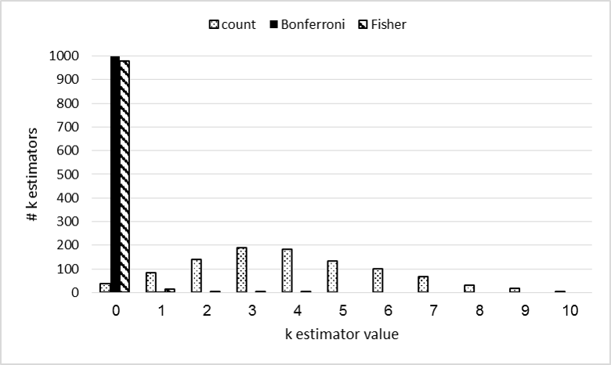
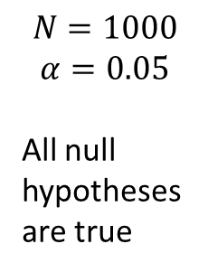
Q1 – Dataset Counting - Example
$$N=1000$$
$$α=0.05$$
All null hypotheses are true

Slide 19
Q2 - Identification
What are the datasets for which algorithm A is better than B?

Slide 20
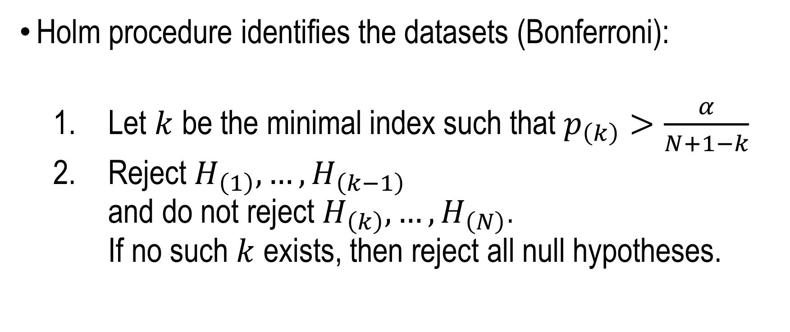
Q2 – Dataset Identification
Holm procedure identifies the datasets (Bonferroni):
Let $k$ be the minimal index such that $p_{\left(k\right)}>\frac{α}{N+1−k}$
Reject $H_{\left(1\right)},…,H_{\left(k−1\right)}$ and do not reject $H_{\left(k\right)},…,H_{\left(N\right)}$. If no such $k$ exists, then reject all null hypotheses.

Slide 21
Multilingual POS Tagging
It looks like we can name 11 significant languages
Counting – 16 significant results
Identification – 6 significant results
Notes:
(א) זה מפתיע אבל מדד נכון יכול לספור מספר גדול יותר של מקרים סיגניפיקנטיים מההשוואה הפשוטה. ו (ב) שיש הגיון בכך שספירה נותנת תוצאה גבוהה יותר מזיהוי כי זיהוי דורש יותר אינפורמציה. אלו נקודות שקשה מאד להבין בשיטות האלה וכדאי להתעכב עליהן (גם אם זה דורש עוד שקף). כדאי גם להגיד שהתמשת ב K-fisher באנליזה שבשקף.

Slide 22
Reviewer A
“I am concerned that this line of thought makes me sound very cynical, but really what I am saying is that after reading the paper, readers will be better motivated to change if their thought is "I had better adopt this method, or run the risk of looking like an idiot, like the idiots they mention in their example" than if their thought is only "I had better adopt this method because it is the scientifically correct thing to do".”
Notes:
סיכום ביניים: החלק של הסיפור לא שלם וצריך שהוא יהיה מאד ברור. זאת ההזדמנות שלך לגרום לקהילת ה ACL להשתמש בעבודה שלך ואסור לפספס את זה. אנשים לא בהכרח מבינים שיש כאן בעיה. צריך להקדיש את רוב הזמן ל High level. את הפרטים הטכניים אף אחד לא יבין במסגרת הזמן שיש לך. אבל את מציגה אותם כדי שידעו שעשית עבודה רצינית וירצו לקרוא עוד.
בשלב הזה שווה להגיד שיש במאמר את כל הפרטים הסטטיסטיים ושאת לא תוכלי לתאר את הכל במסגרת הזמן הזאת בלי לשעמם את הקהל בפרטים טכניים שהוא לא יכול להבין בפורמט של הרצאה. אז את תתני את זה ממעוף הציפור ואז תדגימי קצת מה קורה בתחום שלנו בהקשר הזה (ותזכירי כבר עכשיו את שמות האפליקציות). זה מעודד את הקהל להישאר ולצלוח את החלק הטכני שמשעמם אותו בפורמט הזה.

Slide 23
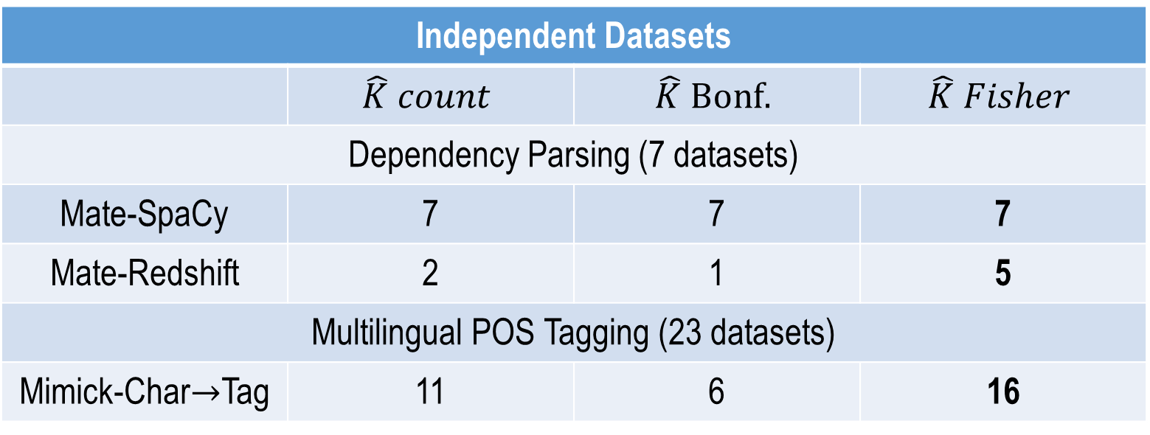
NLP Examples
Independent Datasets
 | $$\hat{K} count$$ | $$\hat{K} Bonf.$$ | $$\hat{K} Fisher$$
Dependency Parsing (7 datasets)
Mate-SpaCy | 7 | 7 | 7
Mate-Redshift | 2 | 1 | 5
Multilingual POS Tagging (23 datasets)
Mimick-Char$→$Tag | 11 | 6 | 16

Slide 24
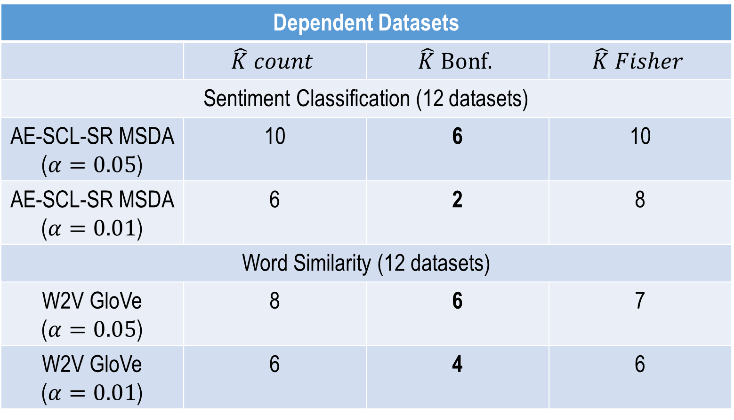
NLP Examples
Dependent Datasets
 | $$\hat{K} count$$ | $$\hat{K} Bonf.$$ | $$\hat{K} Fisher$$
Sentiment Classification (12 datasets)
AE-SCL-SR MSDA ($α=0.05$) | 10 | 6 | 10
AE-SCL-SR MSDA ($α=0.01$) | 6 | 2 | 8
Word Similarity (12 datasets)
W2V GloVe ($α=0.05$) | 8 | 6 | 7
W2V GloVe ($α=0.01$) | 6 | 4 | 6

Slide 25
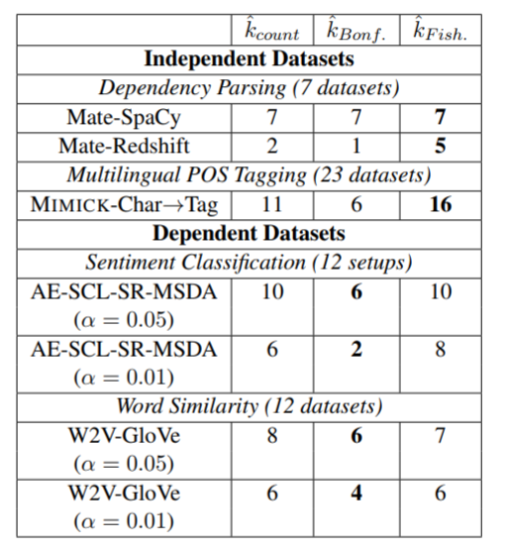
NLP Examples

Slide 26
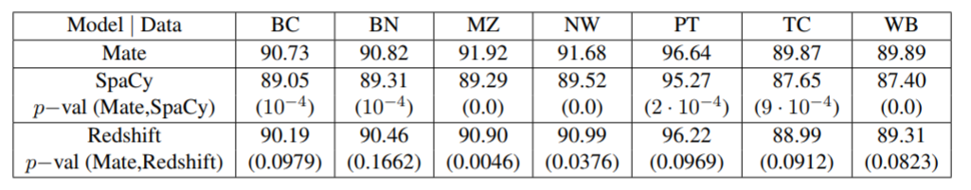
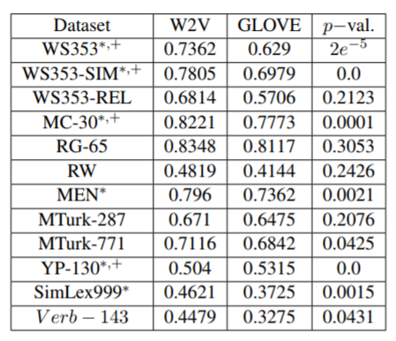
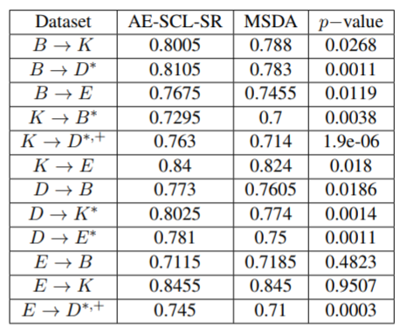
To make a long story short…
Instead of…

Slide 27

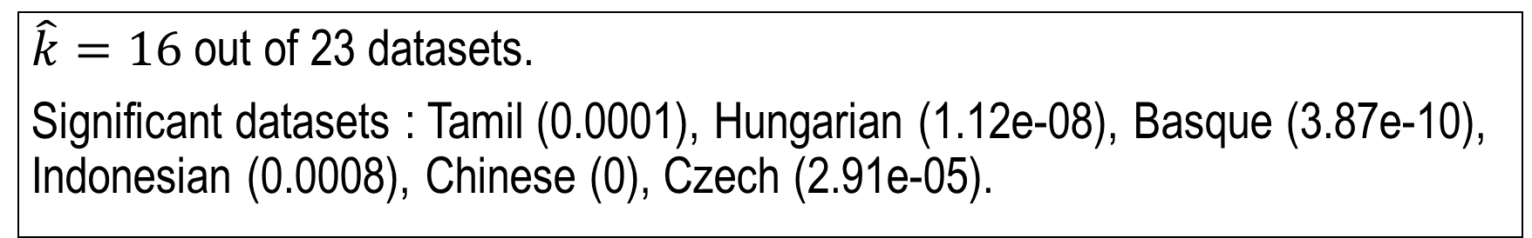
To make a long story short (and statistically valid)…
$\hat{k}=16$ out of 23 datasets.
Significant datasets : Tamil (0.0001), Hungarian (1.12e-08), Basque (3.87e-10), Indonesian (0.0008), Chinese (0), Czech (2.91e-05).

Slide 28
Thank You for Listening Questions?
https://github.com/rtmdrr/replicability-analysis-NLP

