Slide 1

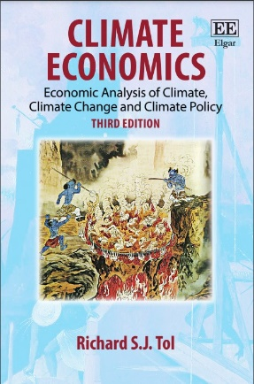




The economic impact of climate change
Richard S.J. Tol
University of Sussex
Vrije Universiteit, Amsterdam
Tinbergen Institute
CESifo
Payne Institute
Abu Dhabi University

Slide 2
Meta-analysis
… can be used to
Pool data from many, small experiments
Detect publication bias
Find regularities in estimates
Discover exhausted topics
Ensure fresh PhD candidates read the literature
Retrospectively compute statistical power
Characterize the uncertainty about
Total impact of climate change
Marginal impact of carbon dioxide emissions

Slide 3
62 estimates in 39 papers

Slide 4
62 estimates in 39 papers

Slide 6
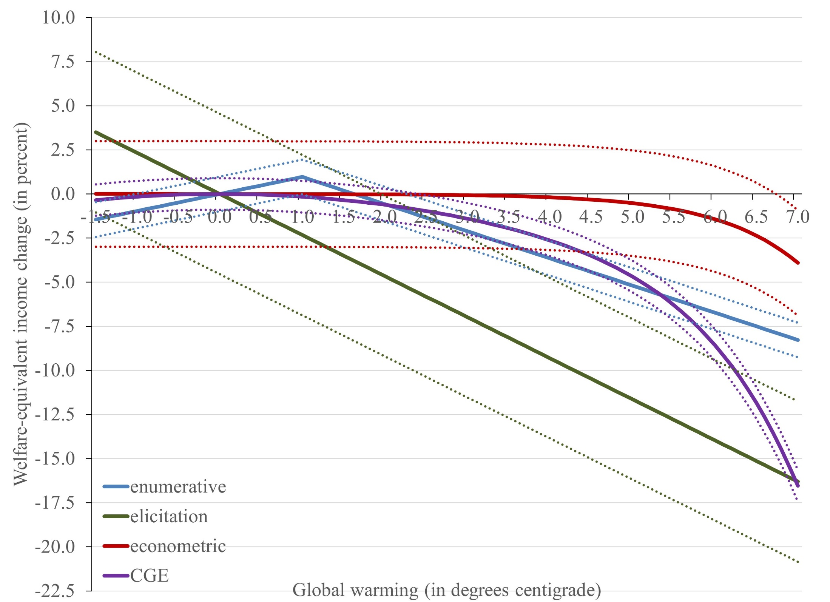

Slide 7
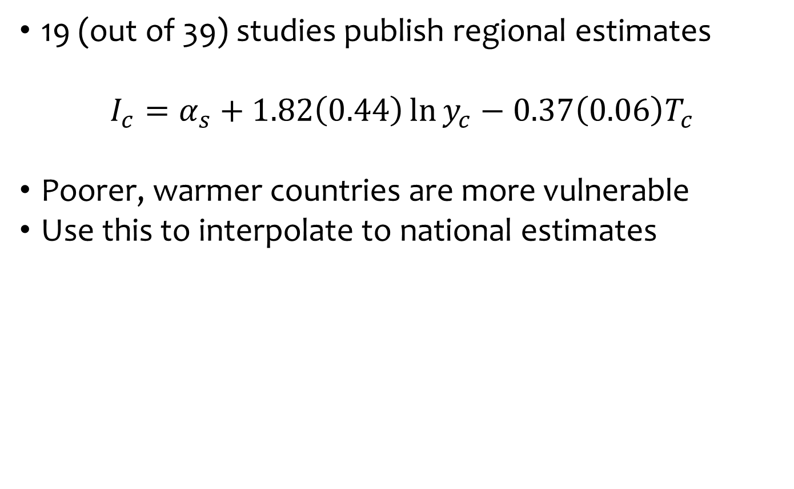
Regional distribution
19 (out of 39) studies publish regional estimates
$$I_{c}=α_{s}+1.82\left(0.44\right)\ln{y_{c}}−0.37\left(0.06\right)T_{c}$$
Poorer, warmer countries are more vulnerable
Use this to interpolate to national estimates

Slide 8
Poorer countries are more vulnerable because
Greater exposure

Slide 9
Poorer countries are more vulnerable because
Greater exposure
Hotter already

Slide 10
Poorer countries are more vulnerable because
Greater exposure
Hotter already
Low adaptive capacity
Both abatement and development reduce climate change impacts.

Slide 11
Sectoral composition
9 (out of 39) studies publish sectoral estimates
No study is complete
Using the average estimate of the sectoral impacts to impute the missing sectors, the total impact increases, on average, by 72%
Sectoral composition:

Slide 12
Dynamic effects
If climate change reduces economic output, then it also reduces savings and investment
Indeed, if output falls because of increased depreciation, reduced productivity, or a smaller labour supply, then the returns to investment fall too
Therefore, climate change also reduces capital accumulation and hence economic growth

Slide 13
In a Solow, Ramsey, or Romer model, the dynamic impact of climate change is about the same as the static impact.
That is, impacts double.
In a Mankiw model, the dynamic impacts are about twice as large.
That is, impacts triple.
(Fankhauser & Tol, 2005, REE)

Slide 14
Weather shocks
Started by Melissa Dell but popularized by Marshall Burke, a growing number of papers studies the impacts of weather shocks on economic growth
This gives the short-term elasticity but we can use the envelope theorem to derive the long-term elasticity if the market for adaptation is without
Public goods
Externalities
Lumpy capital
Market power
Distortionary taxes
(Deryugina & Hsiang, 2017, NBER; Lemoine, 2018, NBER, adds perfect foresight)

Slide 15
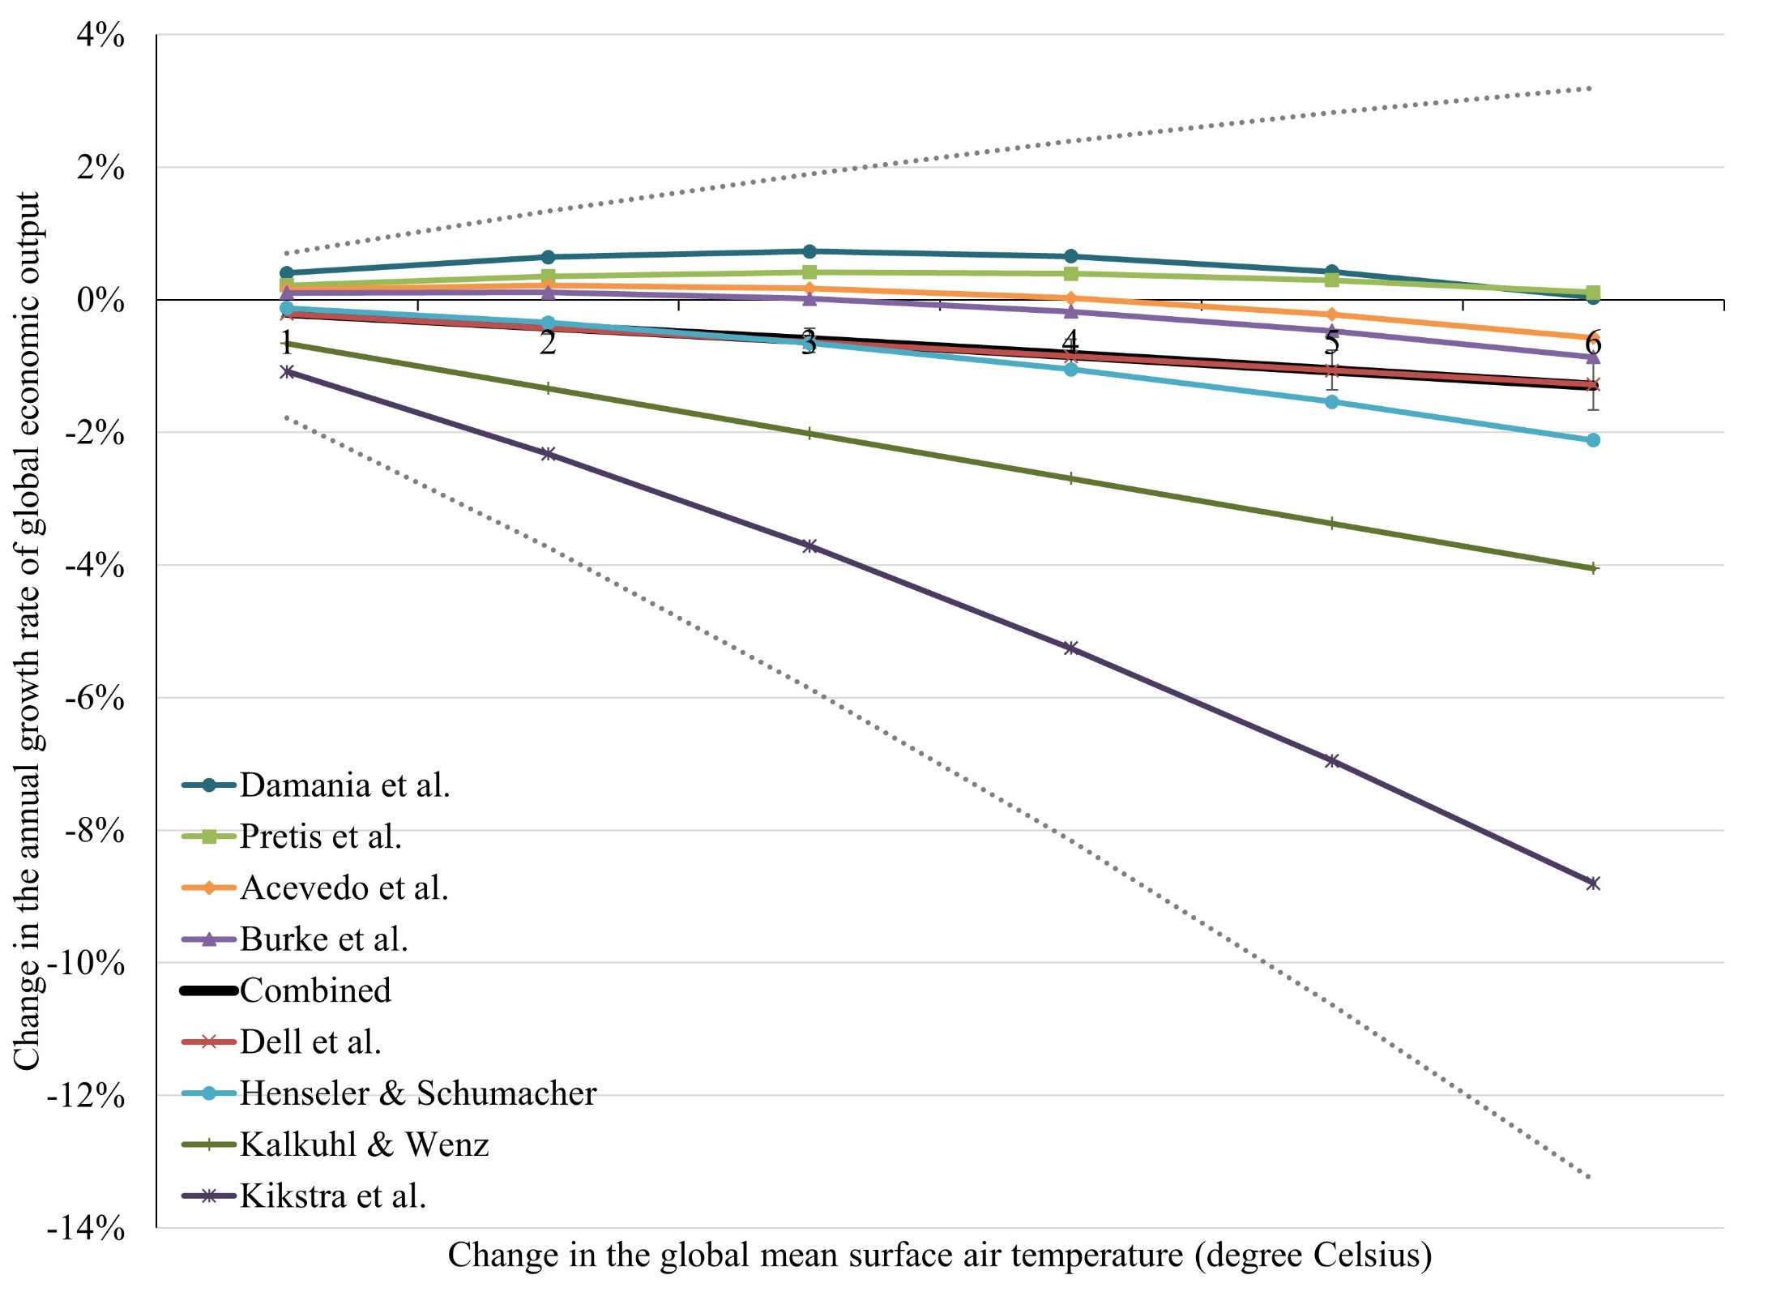

$$∆\ln{y_{t}}=f\left(T_{t}\right)$$

Slide 16
New climate determinism
In these models, the level of temperature affects economic growth
If climate stops changing, the impact persists: Growth is permanently higher or lower
Current differences in levels of development are similarly mostly due to differences in climate
The Dell-Burke models violate the economic theory of growth and development and much empirical work

Slide 17
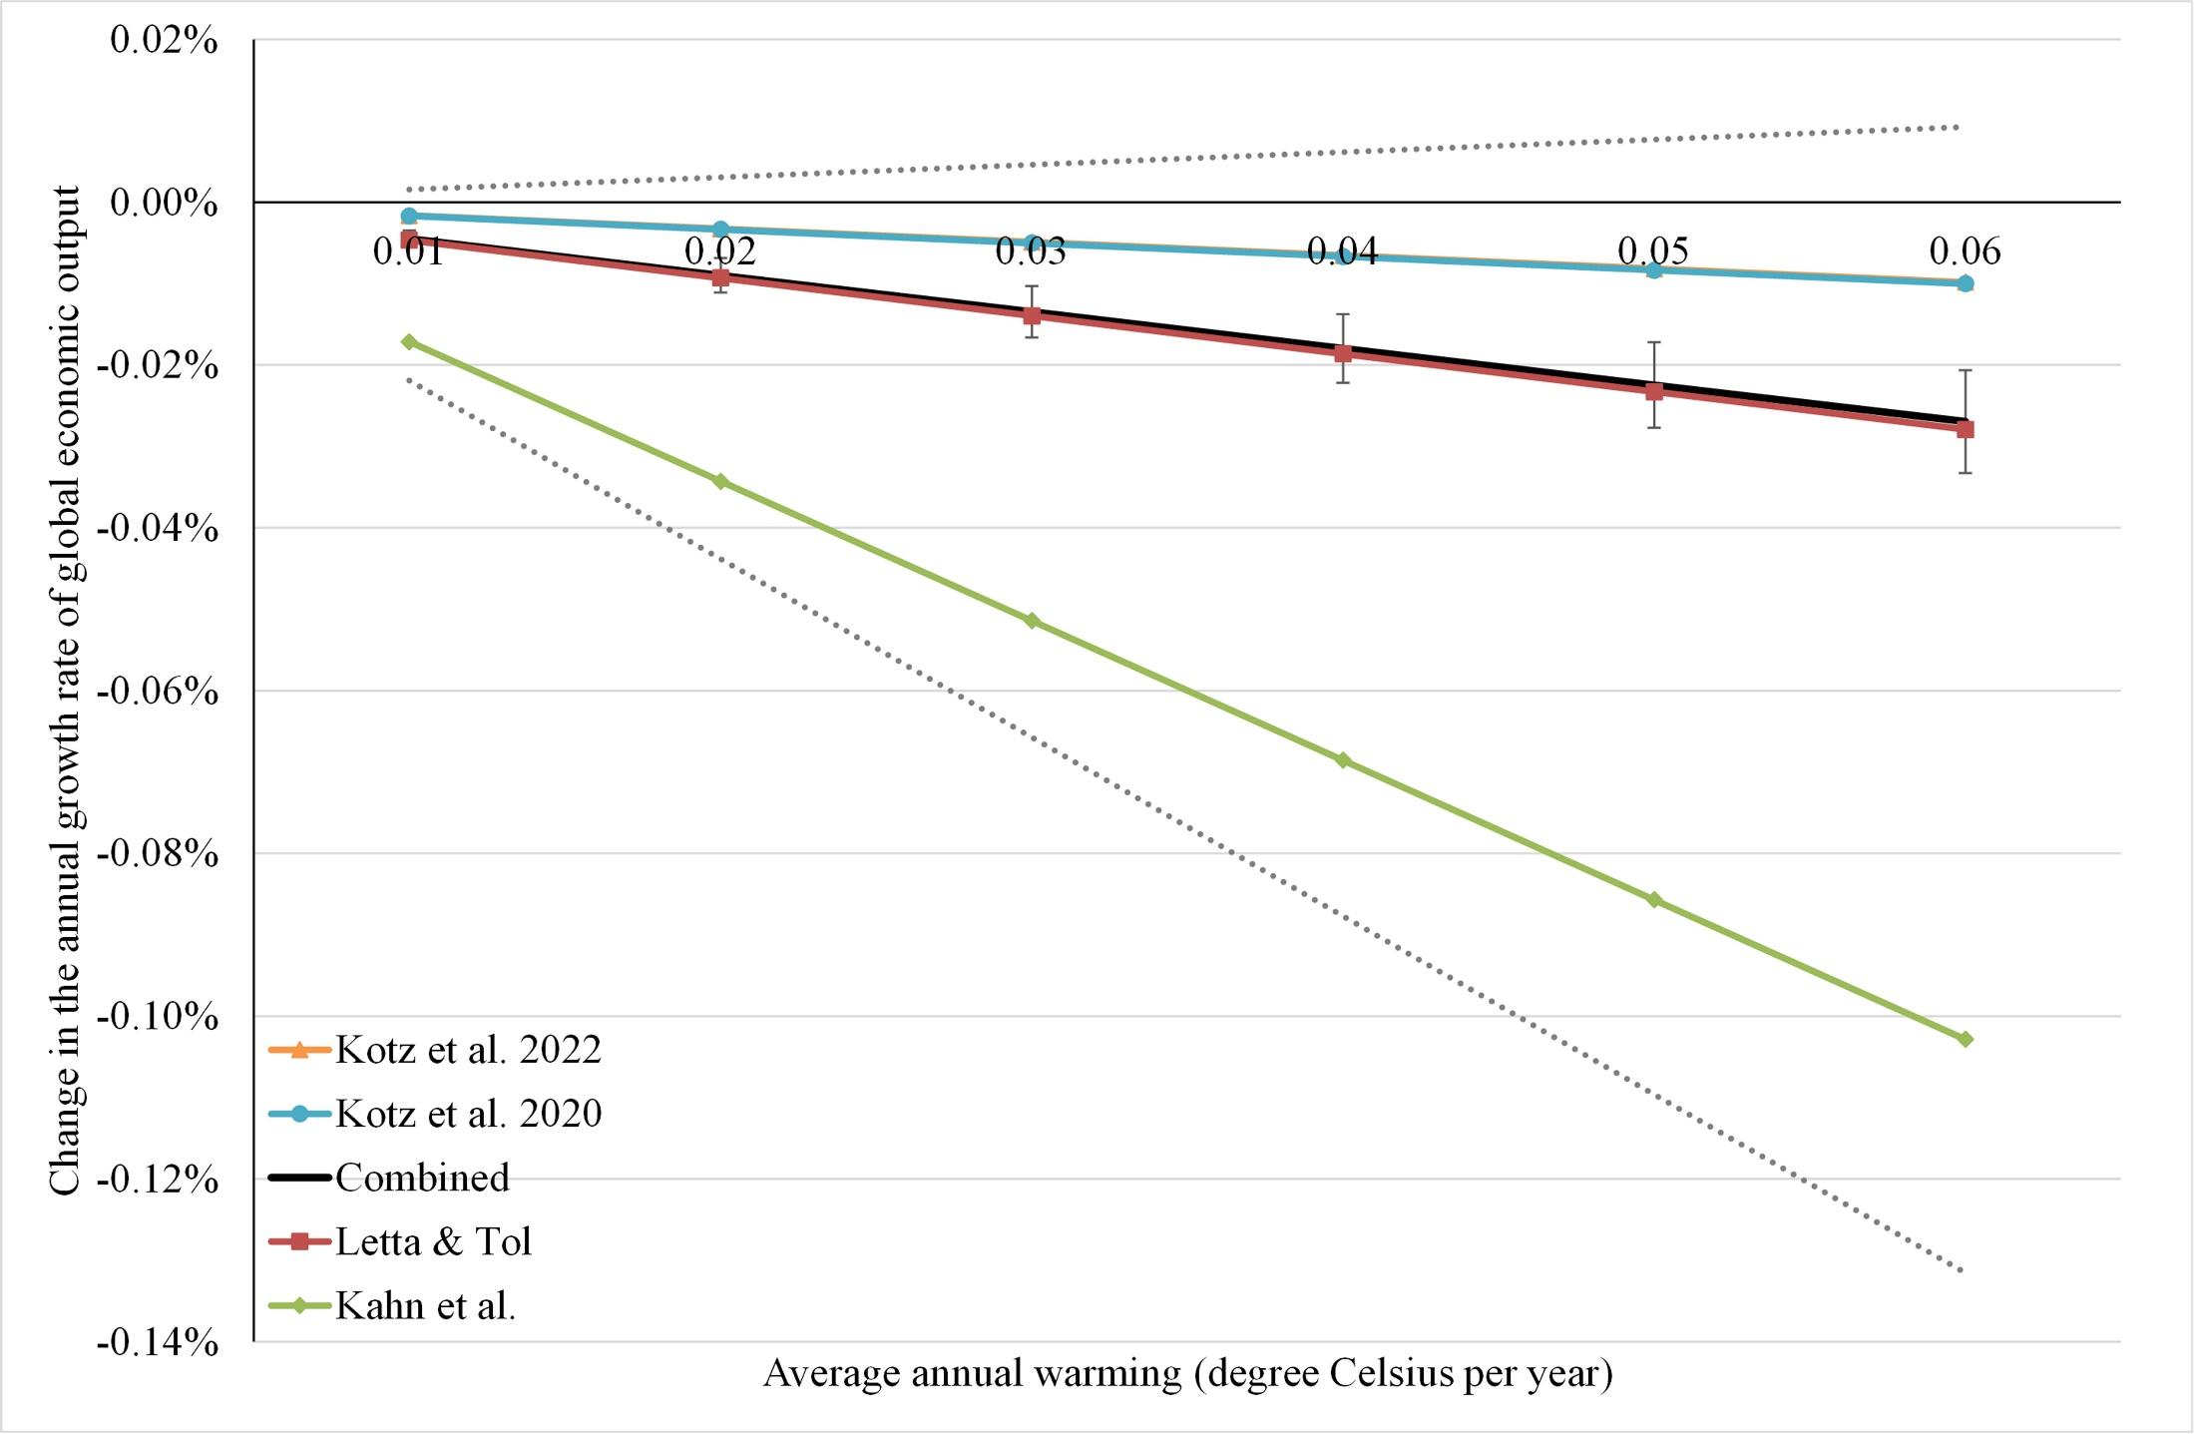

$$∆\ln{y_{t}}=f\left(∆T_{t}\right)$$

Slide 18
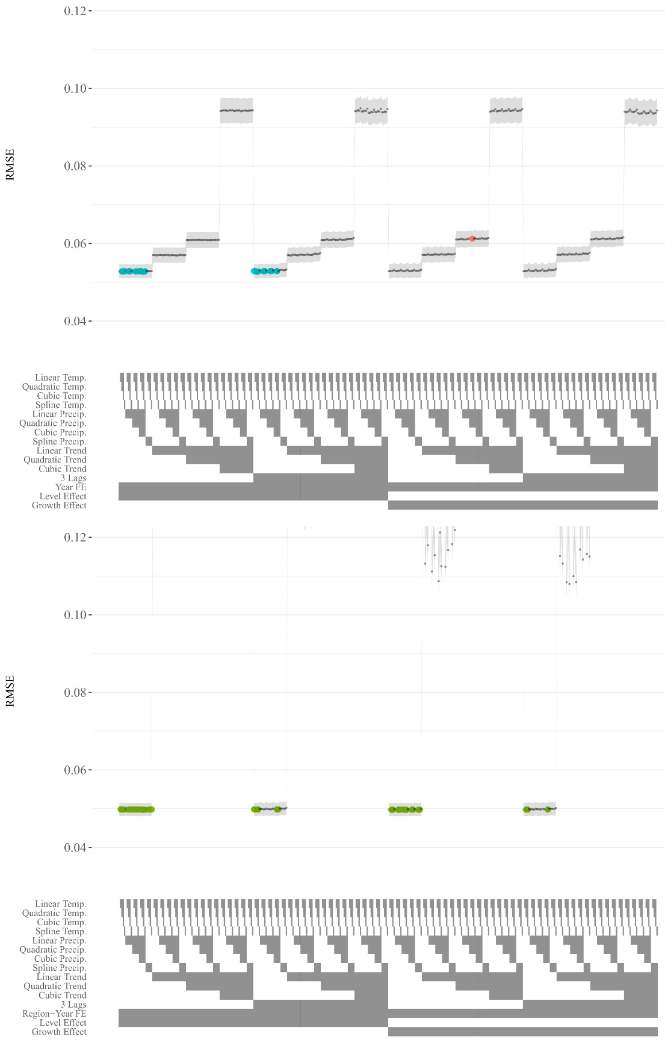
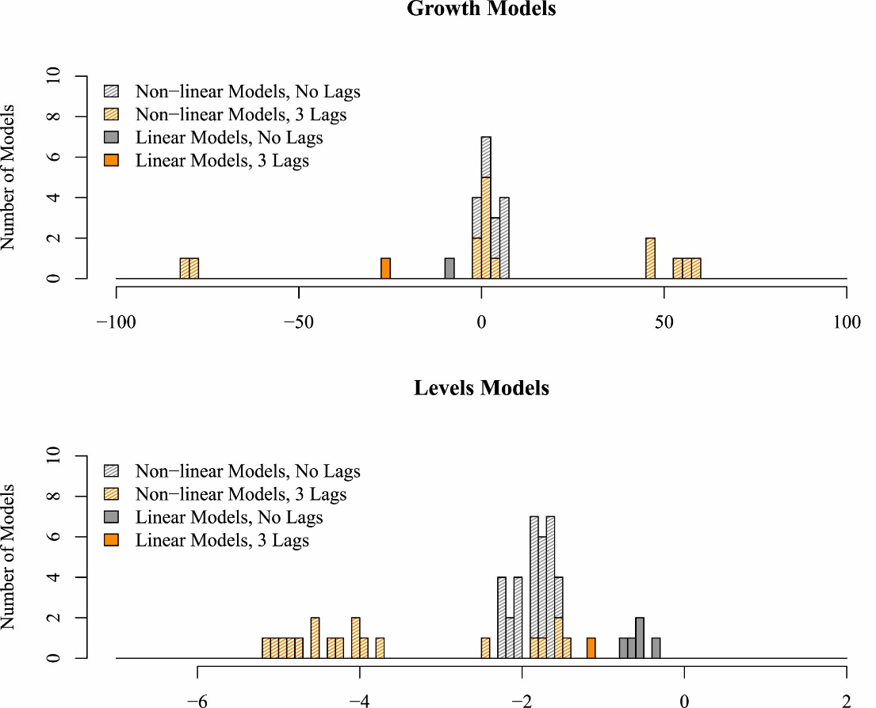
Cross-validation, 800 models
Levels models perform worse than growth models, need country-fixed effects.
Newell, Prest, Sexton (2021, JEEM)

Slide 19
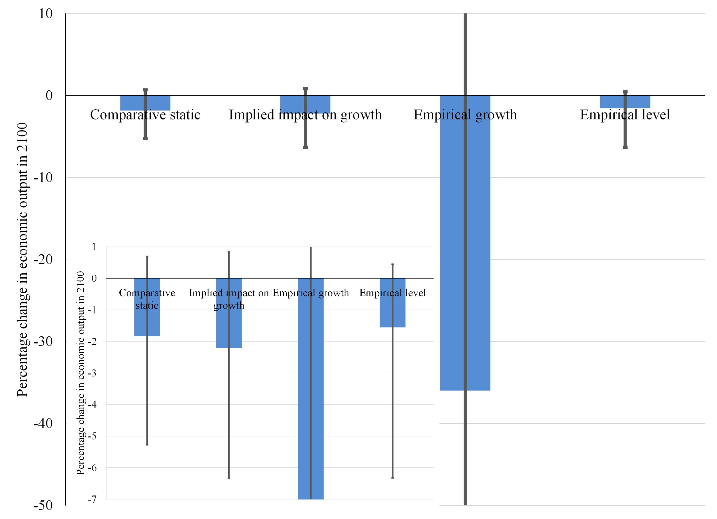

Slide 20
Social cost of carbon
Type of study | Social cost of carbon
Climate change | $28/tC
Weather shocks, growth | $217/tC
Weather shocks, level | $17/tC
SSP2; Ramsey discounting ρ=1%, η=1; Maier-Reimer/Hasselmann carbon cycle; Schneider-Thomson climate model; climate sensitivity 3°C/2xCO₂

Slide 21
Conclusion
Climate change negatively affects human welfare
Climate change reduces economic growth
Estimates not nearly as large as commonly portrayed in the media
Uncertainty is large and continues to grow
Largest impacts are symptoms of mismanagement and underdevelopment

