Slide 1
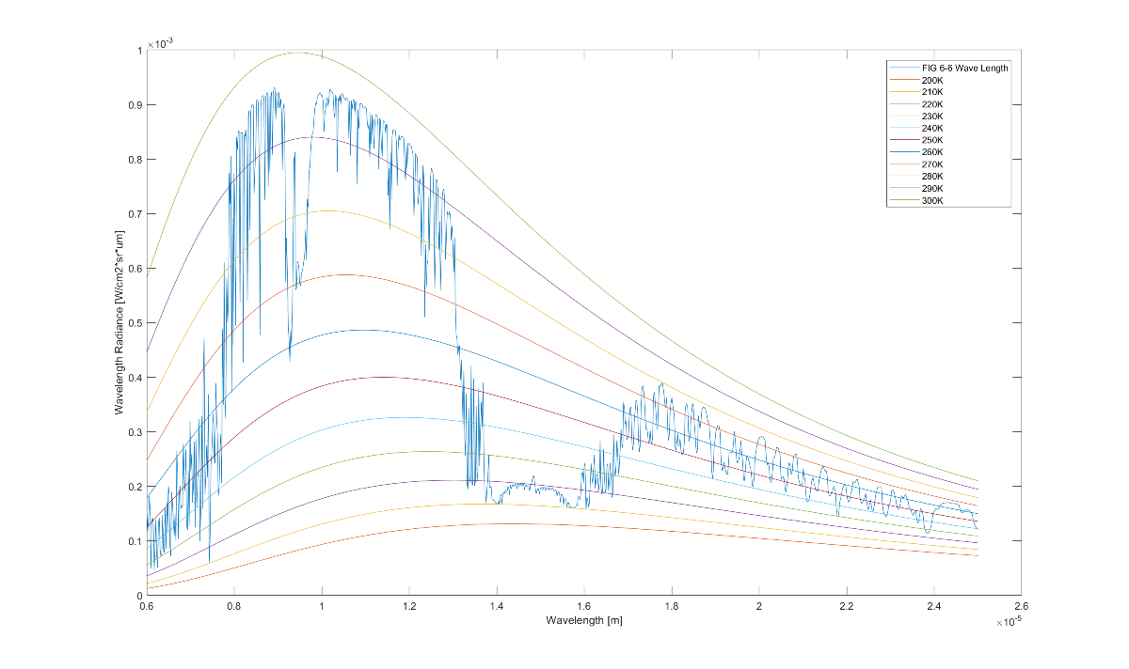
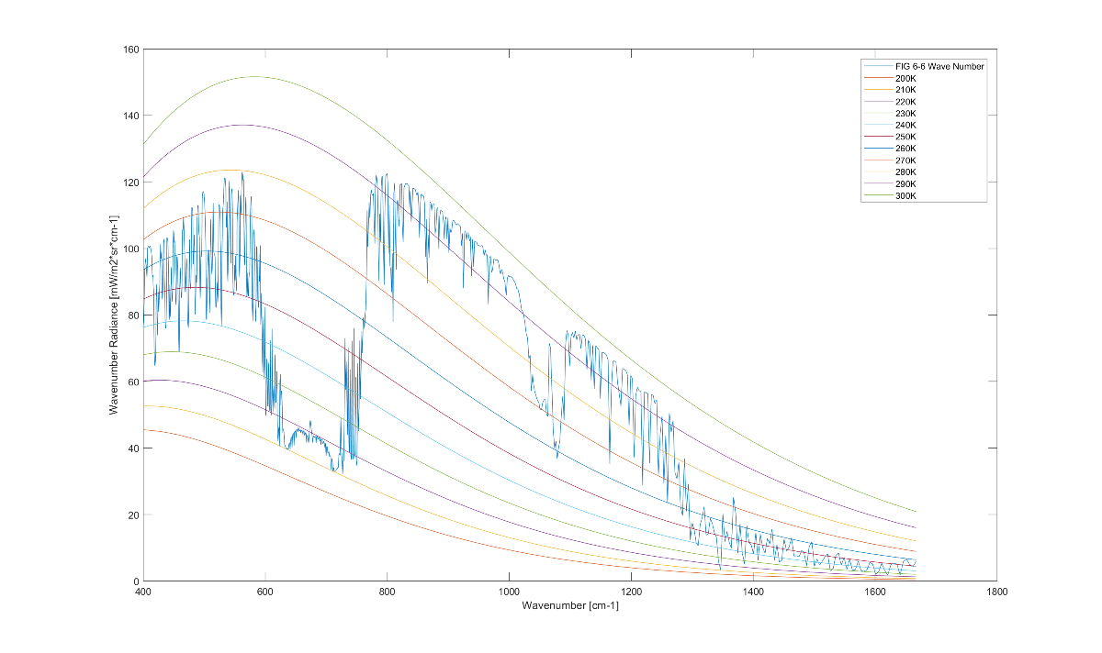
Wavenumber vs Wavelength
Fig 6-6 Radiance vs Wavelength
Fig 6-6 Radiance vs Wavelength
Notes:
Created using LEEDR
Input
Location
Atmosphere
Path Radiance
Wavelength
Path Altitude
Surface Type

Slide 2
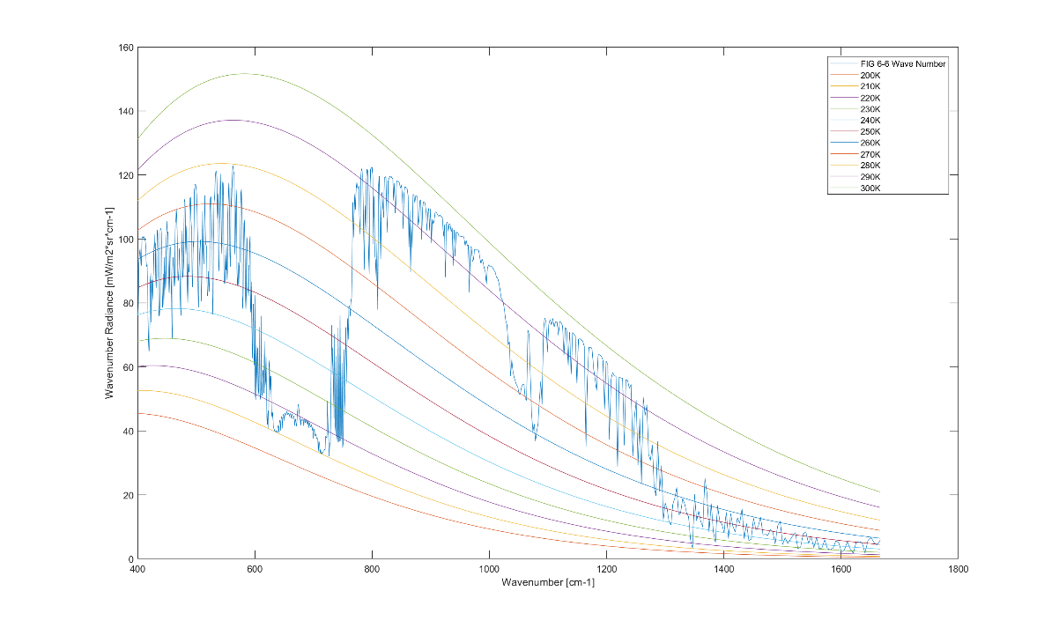
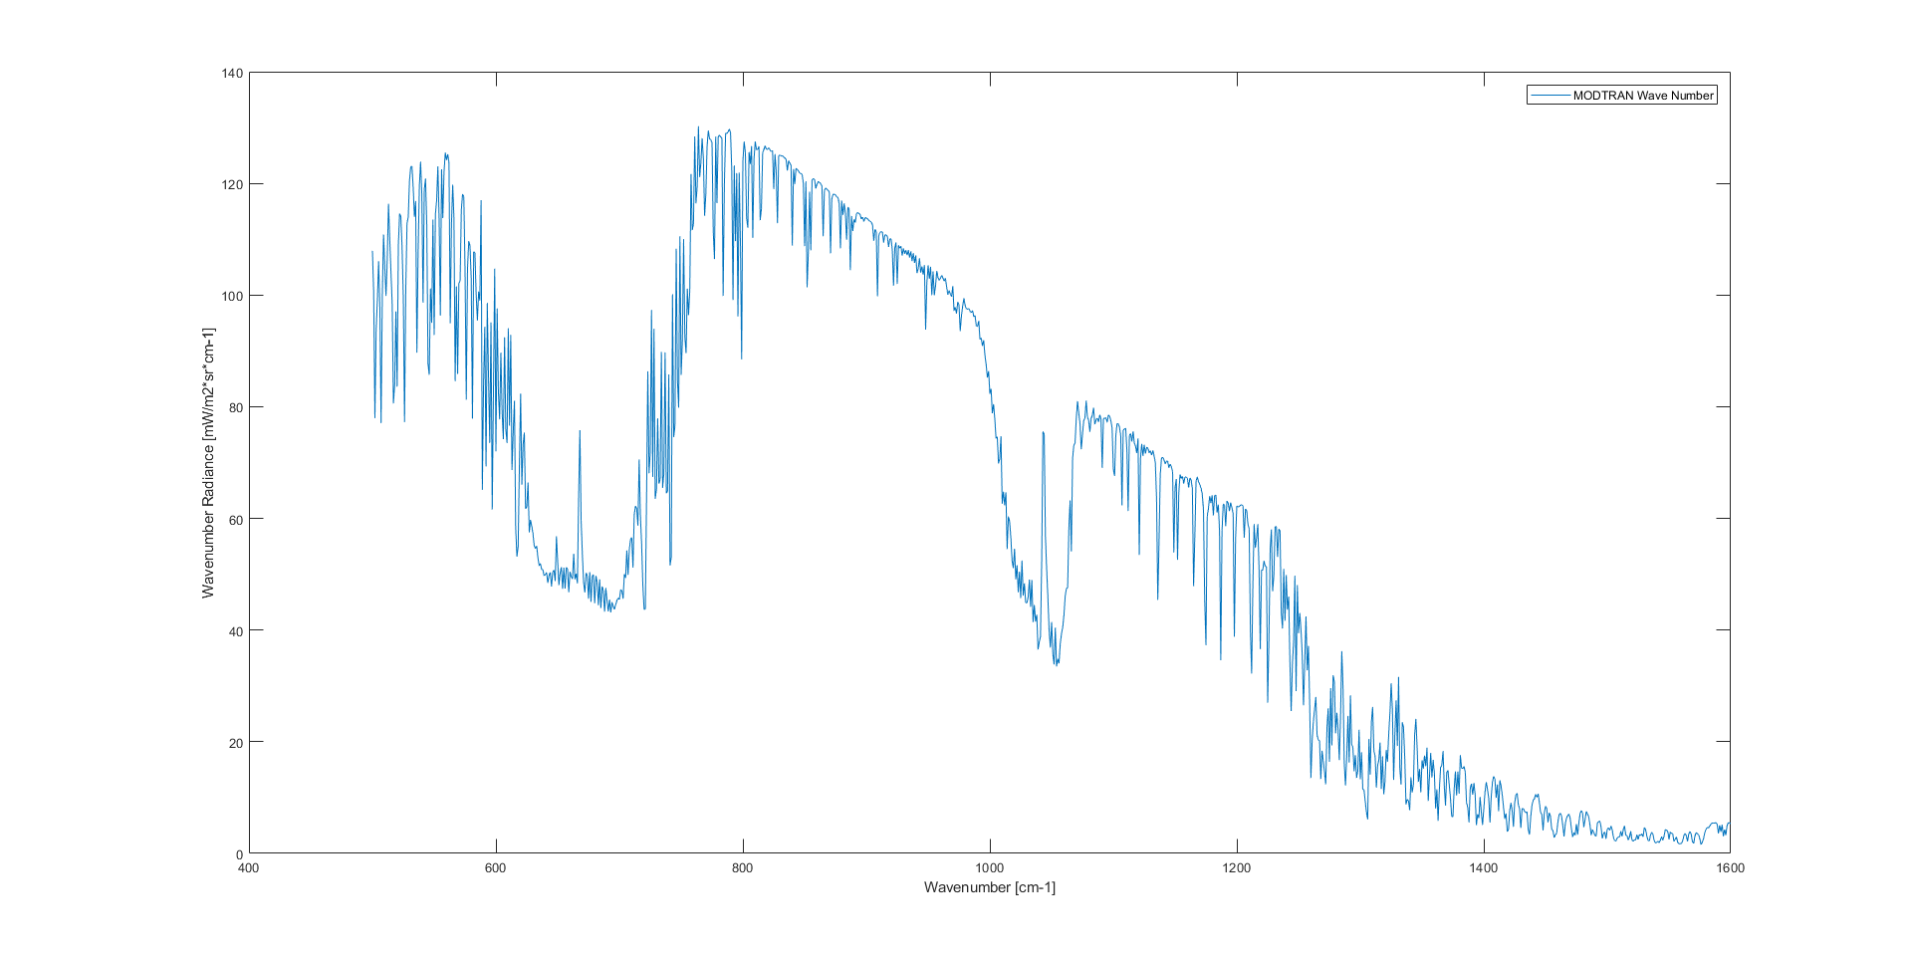
Fig 6-6 LEEDR vs MODTRAN

Slide 3
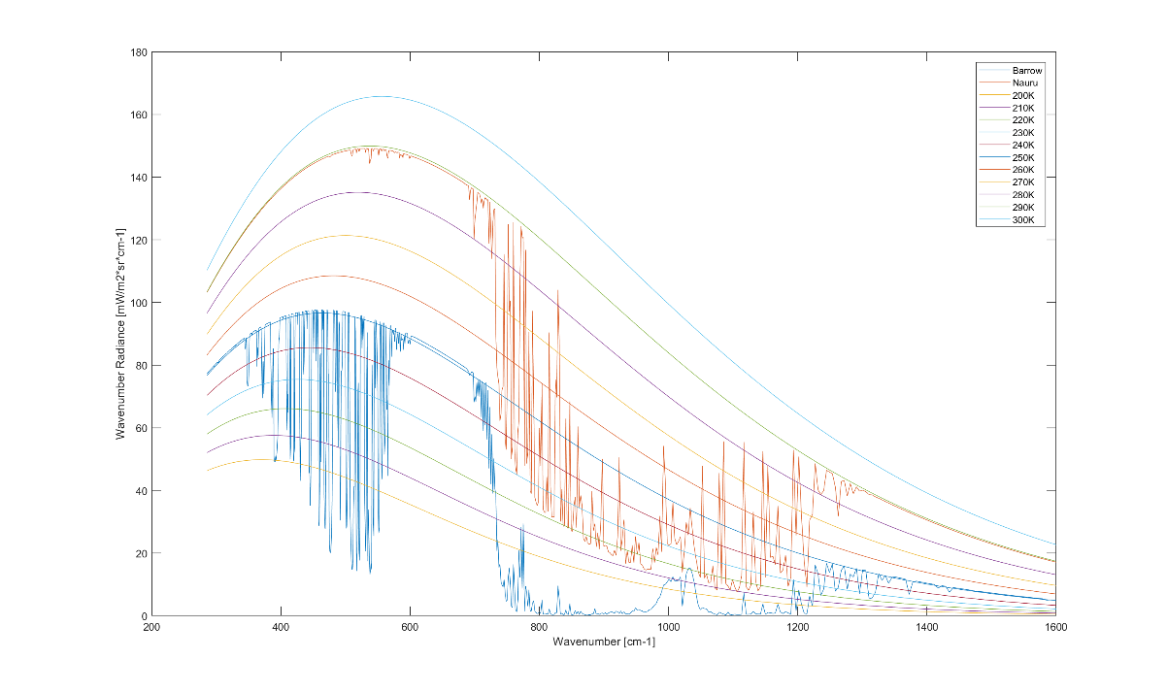
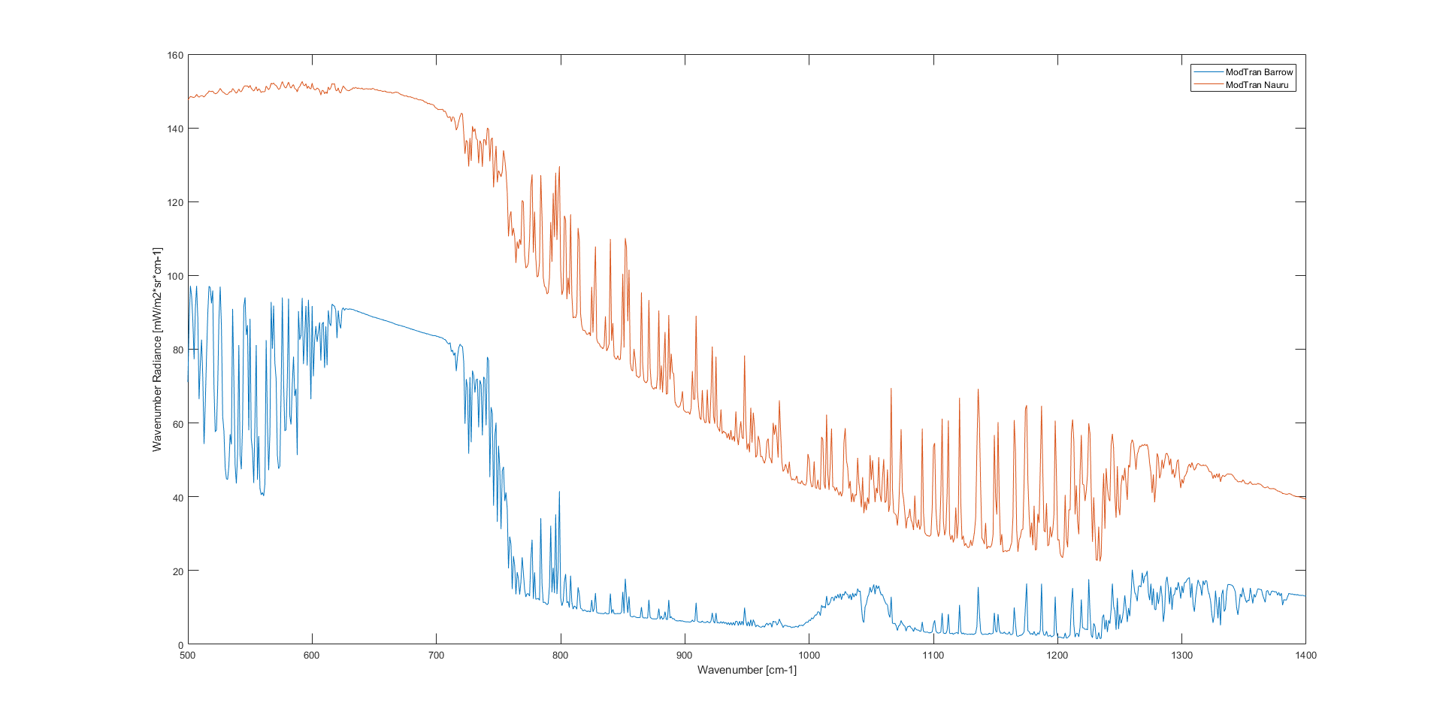
Fig 8-1 LEEDR vs MODTRAN

Slide 4
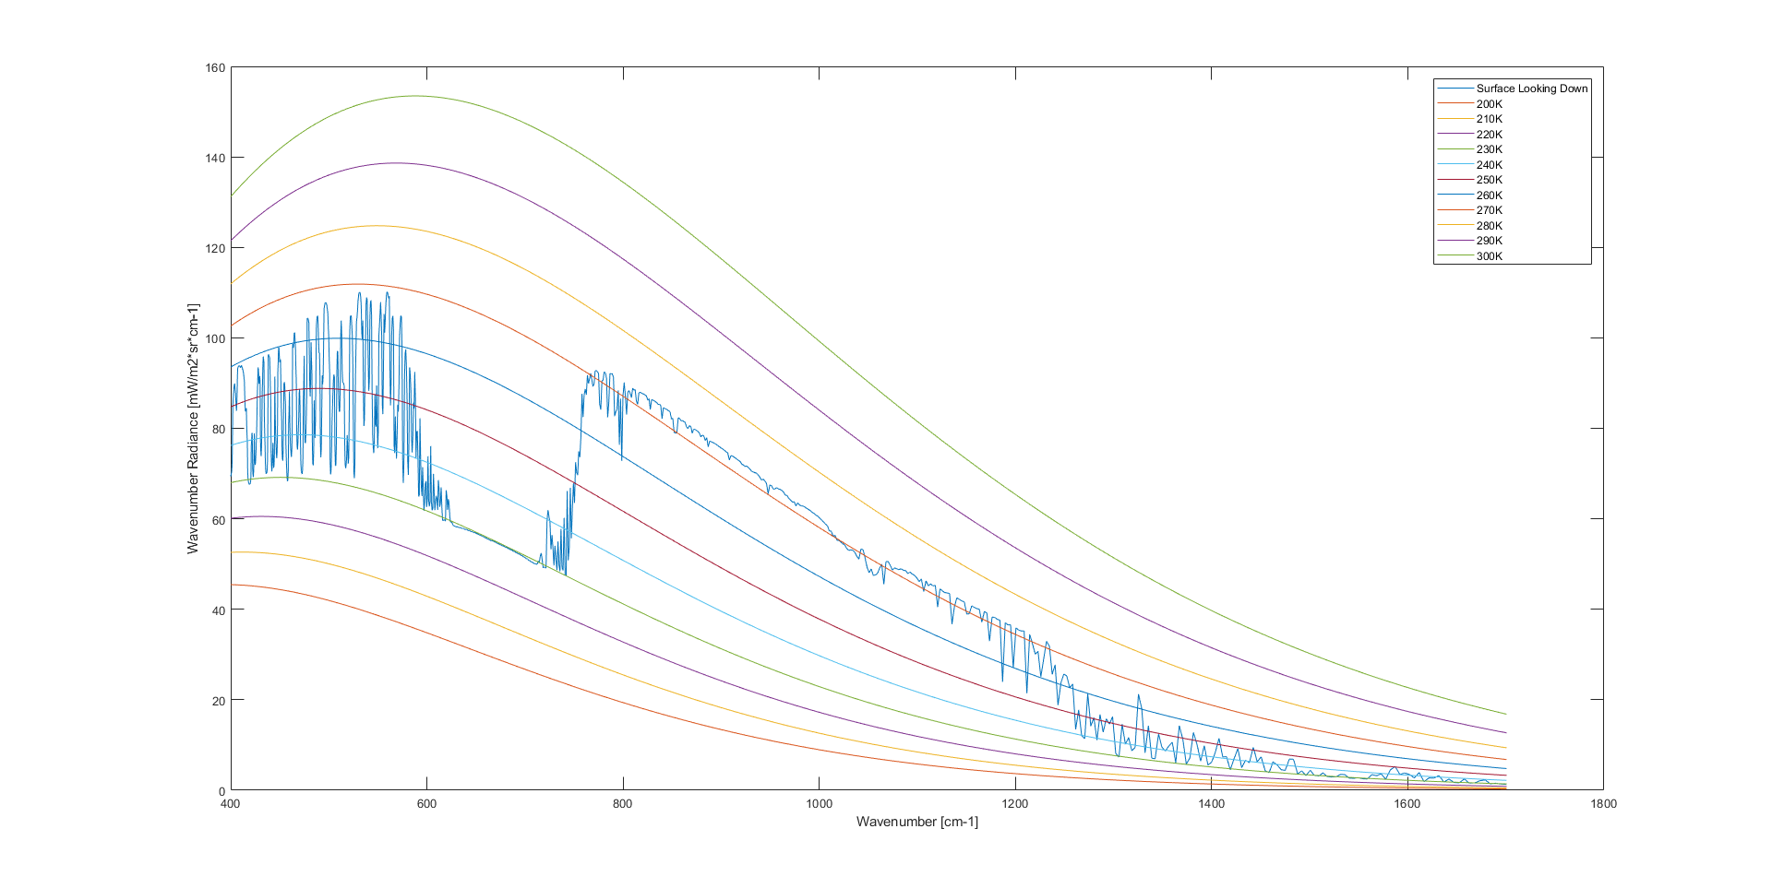
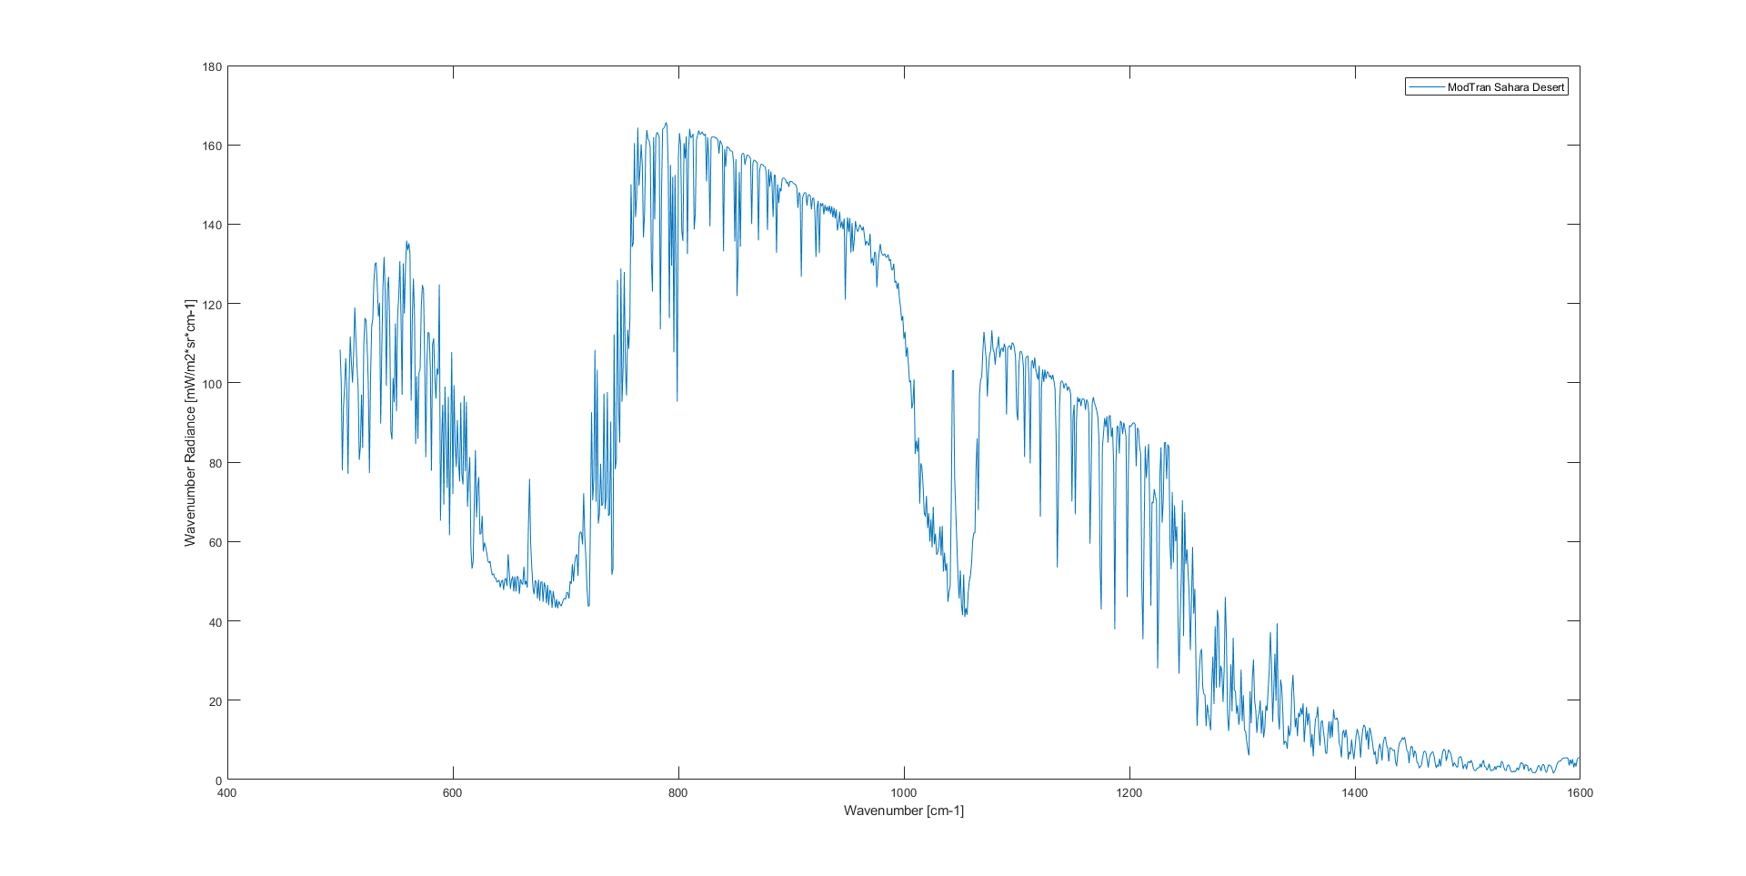
Fig 8-2A LEEDR vs MODTRAN

Slide 5
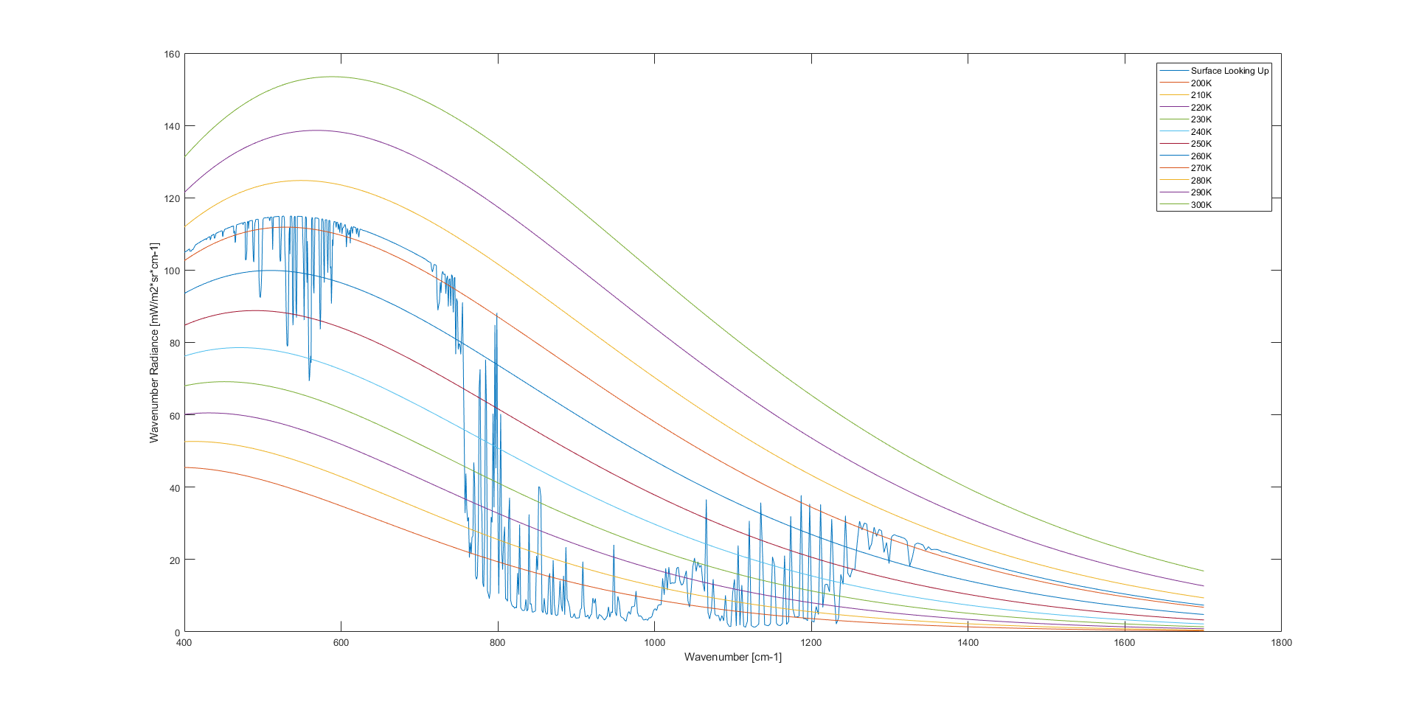
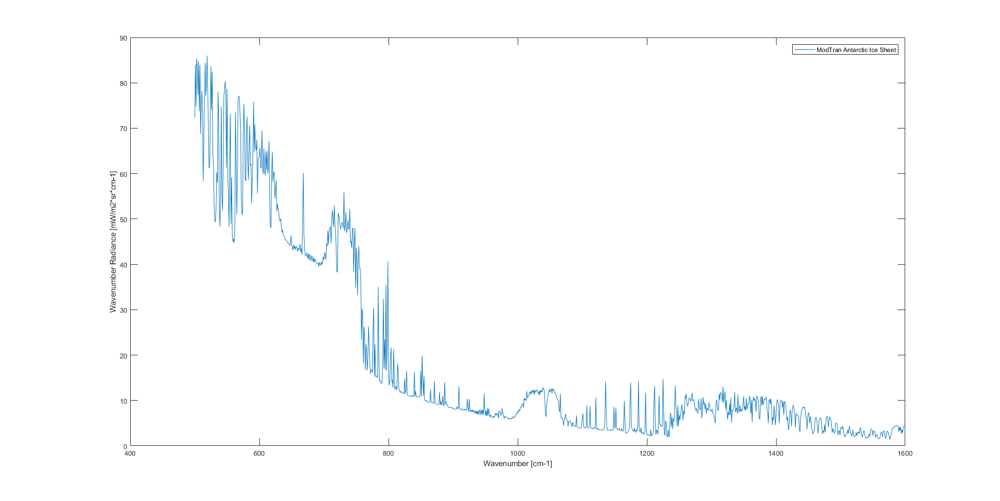
Fig 8-2B LEEDR vs MODTRAN

Slide 6
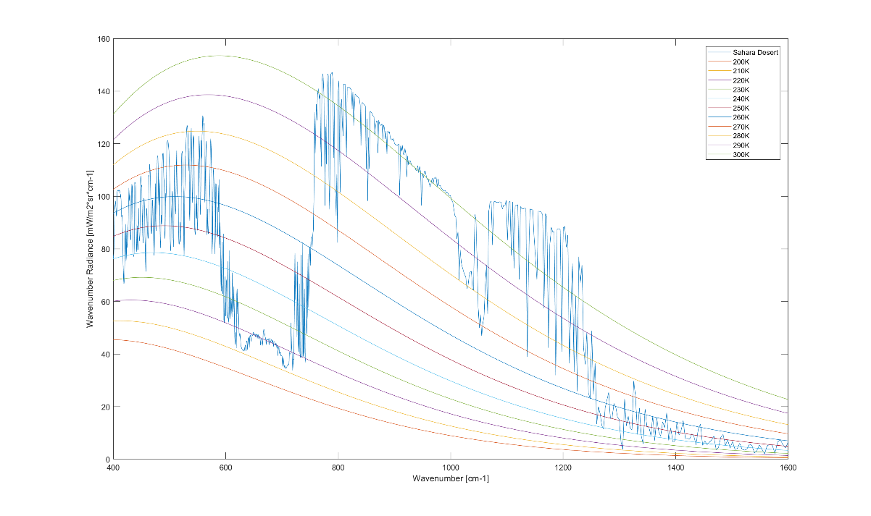
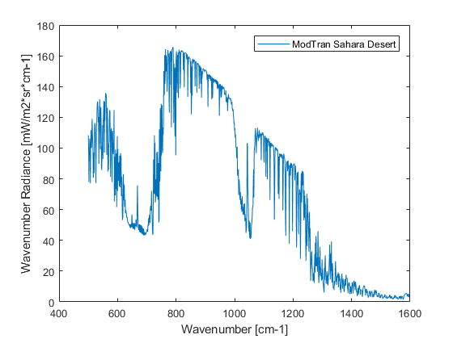
Fig 8-3A LEEDR vs MODTRAN

Slide 7
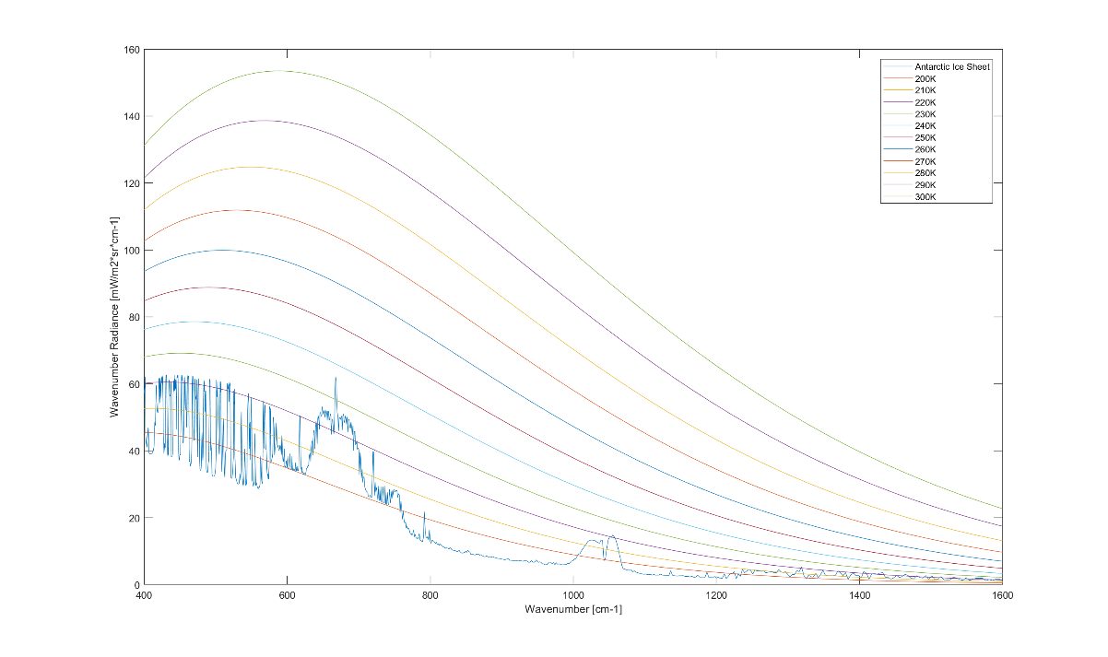
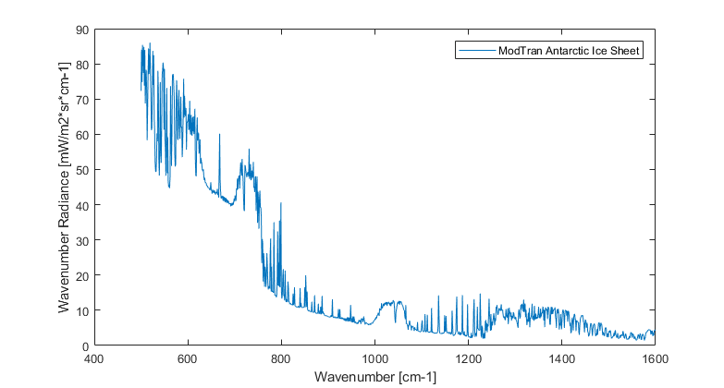
Fig 8-3B LEEDR vs MODTRAN

Slide 8
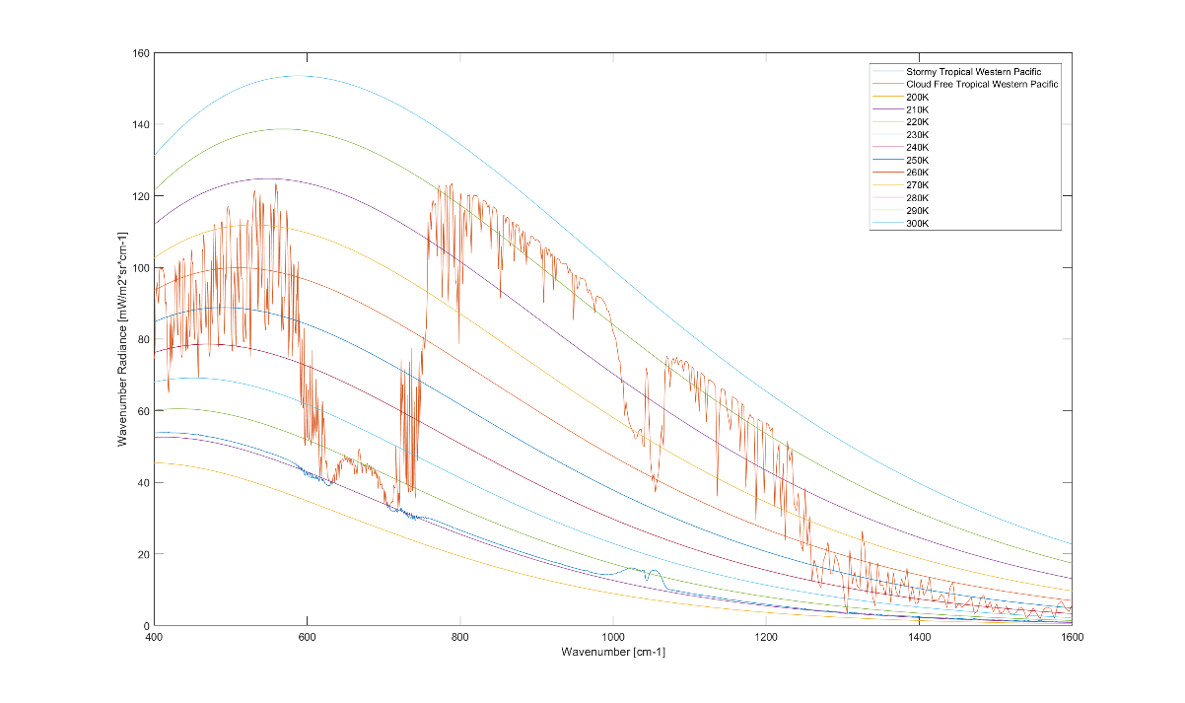
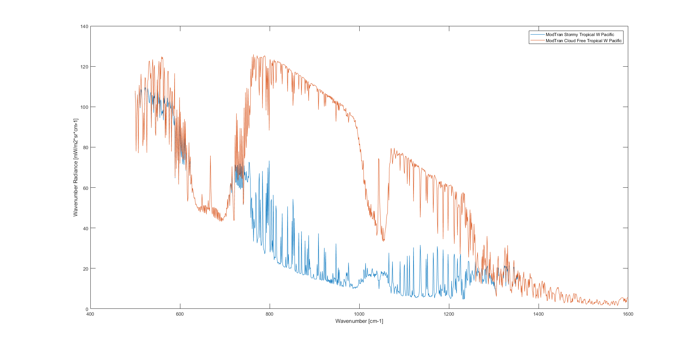
Fig 8-3C LEEDR vs MODTRAN

Slide 9
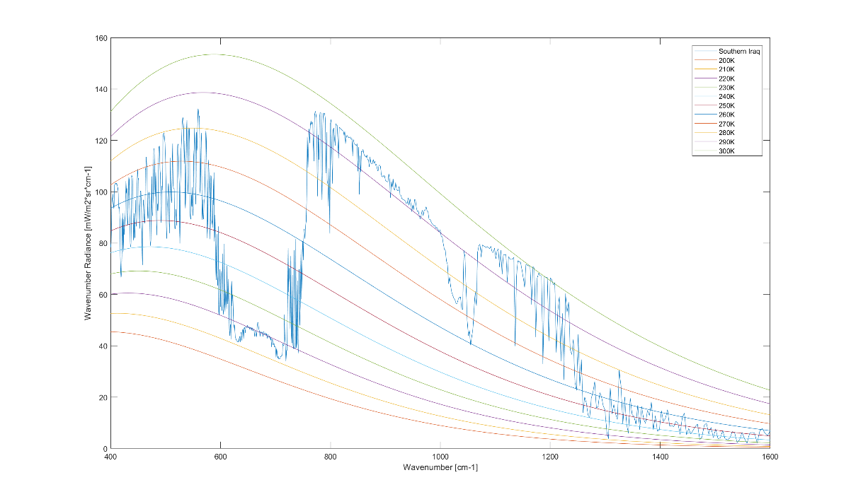
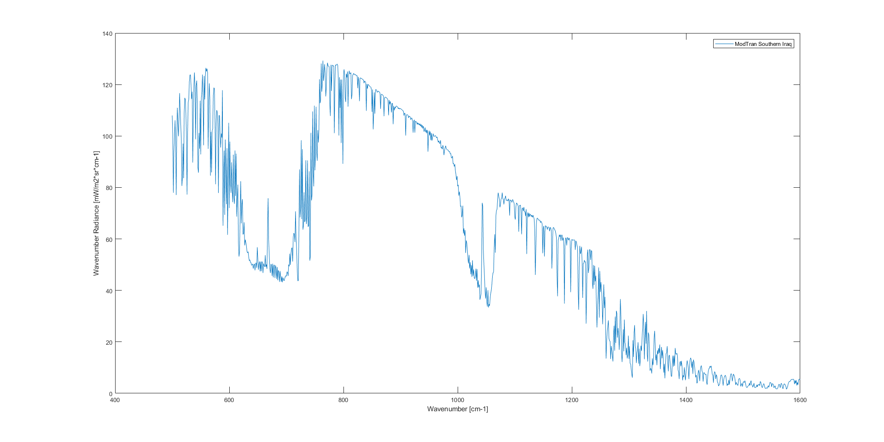
Fig 8-3D LEEDR vs MODTRAN

Slide 10
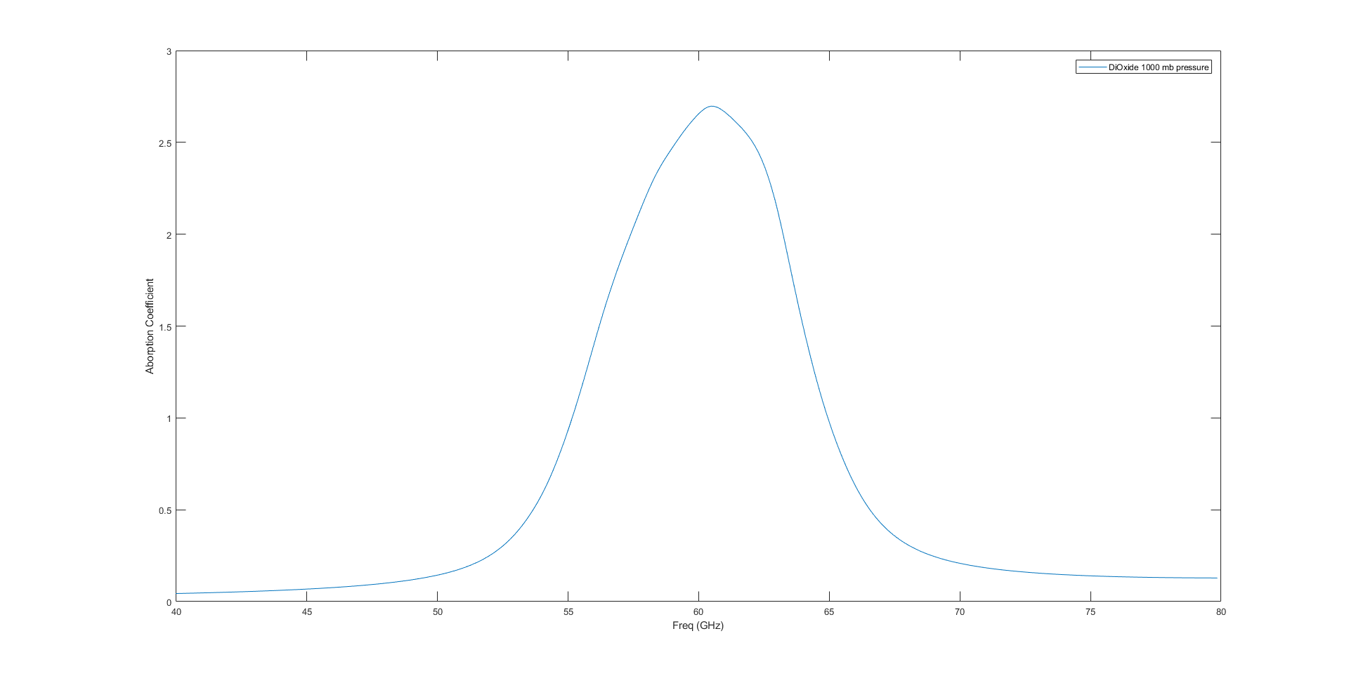
Fig 9-8

