Slide 1
Icy Bridge Project
http://aidaug.org/piday
2022.03.14
John F. Davis davisjf@gmail.com usergroup: https://rtp-aws.org git: https://github.com/rtp-aws/devpost_aws_disaster_response

Slide 2
What is this talk about?
An open source project for an entry for a DEVPOST hackathon
AWS Disaster Response Hackathon 20211201 - 20220207 SageMaker Requirement
(started 20220112)
AWS Deep Learning Challenge 20211201 - 20220207 EC2 DL1 Habana Labs (Intel) Requirement
(started 20220210)

Slide 3
Why do a hackathon?
I was out of work
Beneficial
Interest

Slide 4
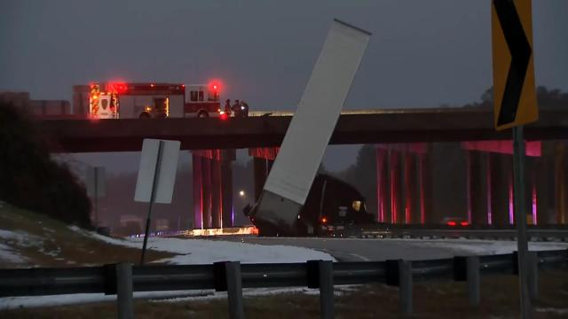
What does the project do?
Using publicly available webcams provided by the North Carolina Department of Transportation (NCDOT) automatically detect if ice is present and thus a driving hazard.

Slide 5
Does it work?
No …
But there is always next year

Slide 6
Ok, so what works/fails?
The project is well documented and ready for contributors
The frontend works
  Analysis tool to inspect the available cameras and determine which were candidates for use.
  Understanding how to use the Rekognition API for image label classification
  Ditto for custom label object identification
The backend works
  CDN, DNS, and roles for microservices
  Image uploads
  API gateway as a REST API
  Killswitch
Some knowledge of MxNet in place
It’s not 100% secure
The first prototypes for ML fail miserably and they were just intended to be prototypes

Slide 7
How is it built?
Its built as microservice architecture hosted on AWS and consists of
Frontend UI via Elastic Beanstalk Javascript/HTML/CSS/Node.js/Express/Browserfy
REST API using Lambda and API Gateway Python
Web scraping of camera images using Curl/Bash/Cron
Image Processing via MxNet
Image Labeling via SageMaker Ground Truth
Prototype Image based ML via Rekognition

Slide 8
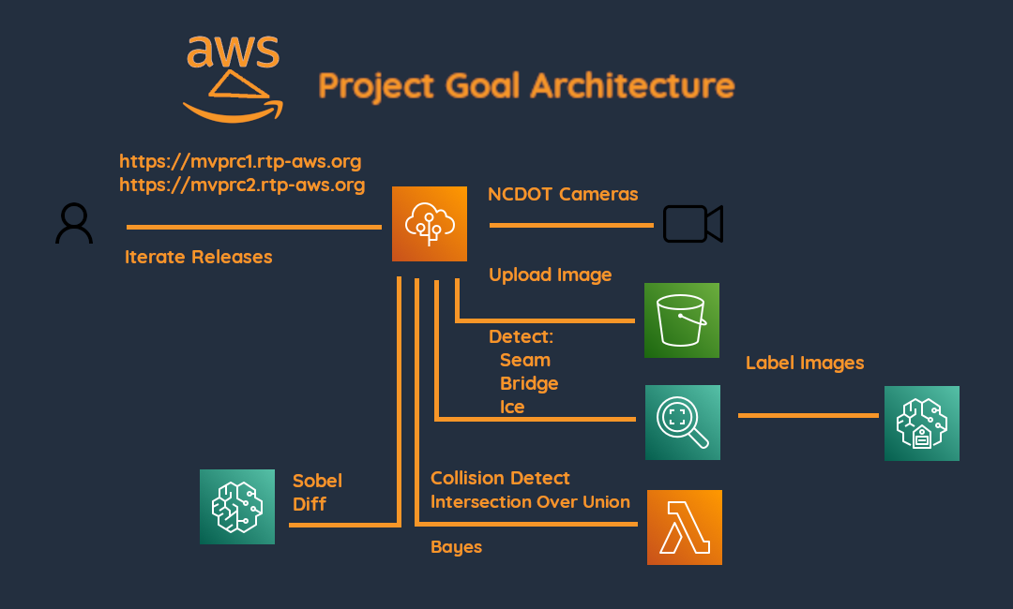
A picture is worth a 1000 words

Slide 9
Regarding the problem and the solution
Or So I am building a team …
More than one personal experience with icy roads and bridges
Familiar with the public webcams on WRAL.com
A few connections which I thought I could use
Sought assistance getting camera imagery
  Wrote connections
  Made new connections via linkedin
  Spoke to friends
  Wrote emails to NCDOT, government officials, TV stations, spoke to friends and acquaintances
While trying to find contacts found the drivenc.gov website
Daily recruitment efforts

Slide 10
What was known before starting?
I had taken some classes and done some work with ML prior to this. With that said, here is what I started with
Some DSP in School from way back when. I am familiar with 1D convolution 1990
Some classes with Image processing and 2D convolution as it pertains to ML
  AWS Computer Vision: Getting Started with GluonCV 2020
  Fundamentals of Digital Image and Video Processing 2015
  Image and Video Processing: From Mars to Hollywood with a Stop and the Hospital 2015
  Mathematics for Machine Learning: Linear Algebra 2018
  Foundations of Computer Graphics 2013
  About five Linear Algebra Classes 2015-2016
Some paid work in Matlab and some TensorFlow but not Video 2015-2020

Slide 11
What was unknown before starting?
Limited knowledge of AWS Elastic Beanstalk, Lambda, route53, Cloud Front, SageMaker, Ground Truth
Limited knowledge of DeepLens, Rekognition
Limited knowledge of HTML/CSS/Javascript/Node.js/Express
Zero knowledge of API Gateway

Slide 12
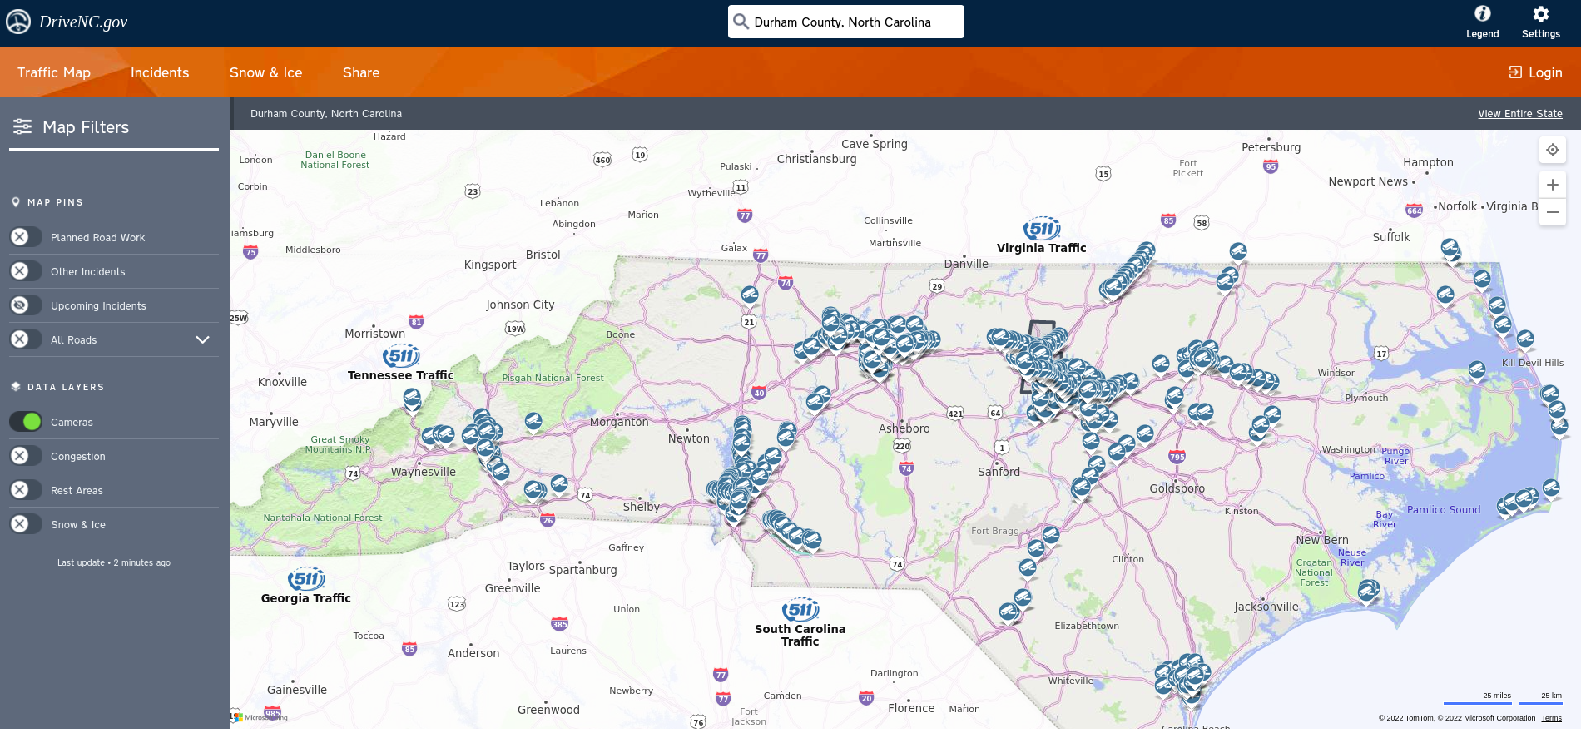
DriveNC.gov

Slide 13
Why the emphasis on the frontend?
Agile development
Hackathon requirement
Not everyone knows or have an interest in computer vision
Recruitment shiny
Interest

Slide 14
Along the way I found this
Ice is more slippery for roadways in a temperature band
Fog can create ice
Melted ice refreezes to be particularly slippery
Etc
Did not get to the point of incorporating climate into the project yet

Slide 15
Possible Architecture
Label Detection
Label Detection
Object Detection
Image
Good Visibility
Bridge
Bridge
Rotate
Grayscale
Edge Detection
Etc
Indicator
Ice Weather
Ice Image
Classification
Classification

Slide 16
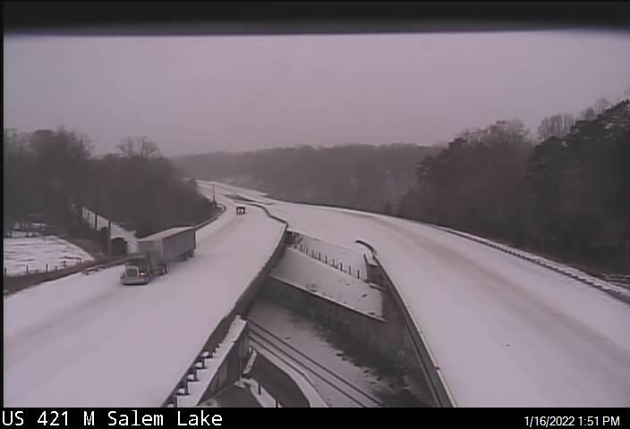
The Cameras
Chrome Developer Tools
CORS protected
Cron script
Variable update period
Variable view angle
Variable quality
Dupe removal
API changes x3
Candidate Camera
Finally made a NCDOT contact which lead to an NCDOT engineering contact

Slide 17
However, the camera angles are not fixed
Not only are the camera angles not fixed, they are subject to
Moisture
Sun glare
Image quality
Offline status
Bridge is not in view

Slide 18
How to proceed?
Options
Perform a detailed analysis and write a paper?
Build a series of models and locate the bridge and seam bounding boxes?
  Is image good or bad?
  Does image contain a bridge?
  Does image contain ice?
  Does image contain a seam?
Try and test

Slide 19
Approach 0 - Difference in edges
Assuming camera angle fixed
Determine reference image
Perform edge detection on reference and sample image
Quantify change based upon difference in pixel values
Optionally correspond with weather conditions

Slide 20
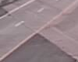
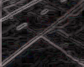
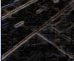

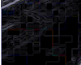
Approach 0 Example
Reference
Edge
Difference
Demo
Sample
Edge

Slide 21
Approach 1 - Bounding box comparison
Assuming camera angle fixed
Locate bridge bounding box
Locate seam bounding box
Perform IOU
If bounding box of bridge encloses seam bounding box, then no ice. Assumes ice when seam is not visible.
Optionally correspond with weather conditions

Slide 22
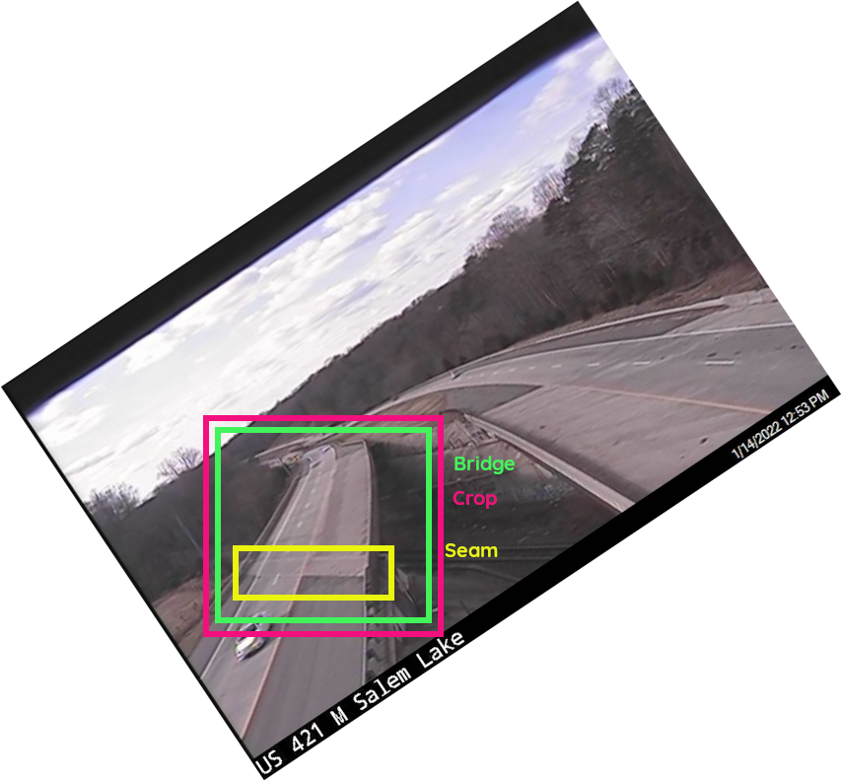
Approach 1 Example

Slide 23
Approach 2 Reflection Coefficient Difference
Kent’s suggestion
Histogram of pixel intensities
Summary statistics
Paper mentions wavelets, but perhaps based upon time of day and cloudiness can have reference for particular location
Paper
Would require weather data

Slide 24
Labeling Images with SageMaker Ground Truth
Once I had discovered Rekognition only returns bounding boxes for custom labels, I prepared for building my first object detection model.
I didn’t know Ground Truth but I set out to use it.
It is a framework for labeling images and provides an option for bounding boxes
The resulting dataset can be used as an input to Rekognition or a custom model

Slide 25
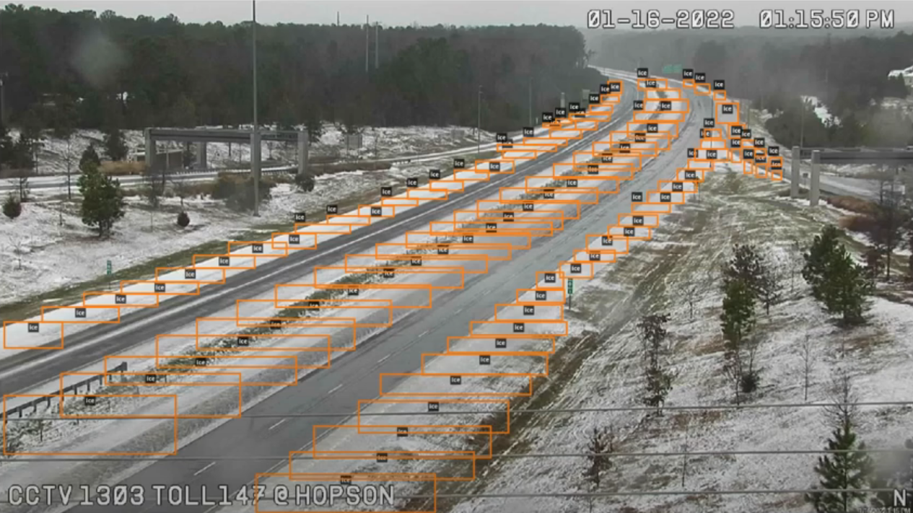
Attempt 0 - SageMaker Ground Truth / Rekognition
Use all available cameras
Labeled ice, seam, bridge
Result was terrible
This one included ice, because I thought Rekognition would be able to locate everything including the ice patches. Turns out the dotted white lines were also considered as ice.

Slide 26
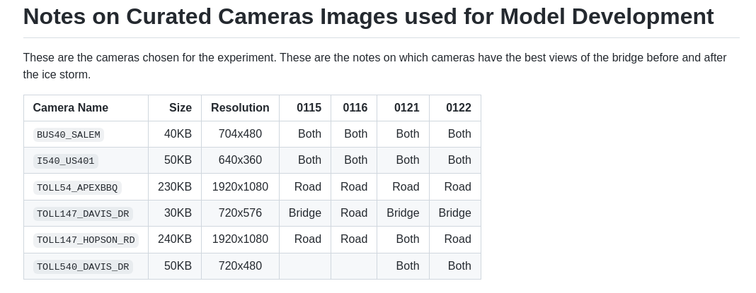
Reduced Problem
Snow Day

Slide 27
Attempt 1 - SageMaker Ground Truth / Rekognition
Reduce problem - use one camera, however include even bad images
Labeled ice, seam, bridge
Result was terrible

Slide 28
Regarding Attempt 1 - Rotate images
Enabled me to spend time with MxNet
Loading image easy - had previous work
Making images grayscale - easy enough
Online docs are tedious
Developed a rotate method. Afterwards when attempting to write the grayscale, rotate, and crop result to filesystem, I found mx.image.imrotate() /facepalm

Slide 29
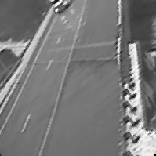
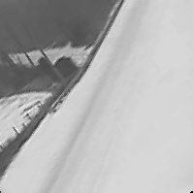
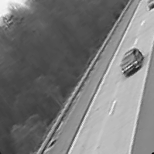
Attempt 2 - Results
Rotation varies
Not enough context
Did not attempt a model

Slide 30
Attempt 3 - MxNet Rotate - no grayscale/crop
Terrible Results
Rotating did not improve the model as shown in the demo
Demo

Slide 31
So what now?
Well that is the reason for this talk
There is more to do
You can join and assist
Probably better ways to use Rekognition
  Image segmentation?
Perhaps better results with custom models built using mxnet
More work to be done on the frontend/architecture

Slide 32
So why participate?
You learn by doing
  MxNet API
  AWS Microservices
  Javascript/HTML/CSS/Node.js
  Chrome Developer Tools
  Markdown
  Git
  Bash/Cron
  Python/Jupyter
The repo has something for everyone
  https://github.com/rtp-aws/devpost_aws_disaster_response

