Slide 1
SysEng 6196 Systems Engineering Capstone
Dr. Lou Pape
1 – Introduction to the SE Management Plan
(SEMP)

Slide 2
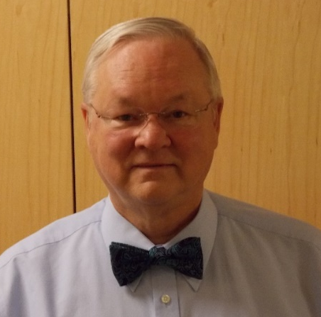
Introduction and Syllabus Review
Professor - Dr. Lou Pape
Boeing Assoc Technical Fellow, Boeing Designated Expert, Technical Lead Engineer
Expert Systems Engineering Professional (INCOSE ESEP)
See Canvas for details
Syllabus review – See Video Introduction
Note the University policy regarding plagiarism: http://www.umsystem.edu/ums/rules/collected_rules/programs/ch200/200.010_standard_of_conduct
“200.010 .B.1.b The term plagiarism includes, but is not limited to: (i) use by paraphrase or direct quotation of the published or unpublished work of another person without fully and properly crediting the author with footnotes, citations or bibliographical reference; (ii) unacknowledged use of materials prepared by another person or agency engaged in the selling of term papers or other academic materials; or (iii) unacknowledged use of original work/material that has been produced through collaboration with others without release in writing from collaborators.”
Communications via Canvas:
Course: SYS_ENG_6196: SYS ENG CAPSTONE
Videos of lectures are only available to 1DIS students (except scheduled pre-recordings are available to all students)
Introductions (HW-1): Provide your: Name, profession, professional goals, & specific goals for this class, taken prerequisites?

Slide 3
Outline: Introduction to SE Management and the SE Management Plan
Course overview
SE Management overview
What is meant by SE Management?
How does it relate to Systems Engineering?
How does it relate to Program Management?
Review of basic SE concepts
Definitions
Life-cycle concepts
SE Development Models and Standards
SEMP overview and outline
Technical planning overview: what, why, who, how, when, where
SEMP tailoring

Slide 4
Course Overview
See Syllabus for weekly details
Overall focus is the application of learning from the core curriculum
Nominal Prerequisites: Sys Eng 6105 (Project Mgt), 6104 (Architecting) (squishy)
Week 1-7: Systems Engineering Management Plan – Section by section drafts
Readings: sections of INCOSE SE Handbook (ISEH)
Homework: draft sections due each week
Midterm – Final version of SEMP incorporating comments - due Week 8
Week 8-15: Process Improvement processes
Readings: Case Studies and 6-σ textbook (C6σ GBH)
Homework – draft sections due each week
Final: Process Improvement from Case Study
Use Case Studies to Describe an Improvement Problem Solution, using the Define, Measure, Analyze, Improve, Control (DMAIC) approach

Slide 5
What is SE Management?
Systems Engineering Management defines the technical management and related activities required to conceive, develop, produce, deploy, operate, and maintain complex systems so as to satisfy user and acquirer needs
“Systems engineering management is accomplished by integrating three major activities:
Development phasing that controls the design process and provides baselines that coordinate design efforts
A systems engineering process that provides a structure for solving design problems and tracking requirements satisfaction flow through the design effort
Life cycle integration that involves customers in the design process and ensures that the system developed is viable throughout its life” (DAU, “SE Fundamentals”, p. 4)

Slide 6
SE Management in Context
Continuous Improvement
Enterprise System
“SE” the Organization
System, and the Enterprise
Organization System
“SE” the Product System
Primary Application of SE
Product System
Satisfy User
Need – the goal
Primary Application of SE Management
“Begin with the end in mind” - Covey

Slide 7
The Essence of SE Management
“If you can’t measure it, you can’t manage it.”
SE Management applies Technical Feedback Control in the application of Systems Engineering
The SE Management Plan provides a basis for measurement
SE
SE Products
Input
Process
Output
Adapted from Blanchard and Fabrycky, “Systems Engineering and Analysis”, Fourth Edition, Figure 11.1
SE Management
Action
Decision-Making
Measurement

Slide 8
Without SE Management…
FBI Virtual Case File*
$170M project cancelled because of
Poorly defined and slowly evolving design requirements
Overly ambitious schedules
Lack of a plan to guide:
Hardware purchases
Network deployments
Software development
And others
*2002 DOJ IG Report, referenced in IEEE Spectrum, September 2005, pp 25-26. http://www.spectrum.ieee.org/sep05/1455 http://spectrum.ieee.org/computing/software/who-killed-the-virtual-case-file

Slide 9
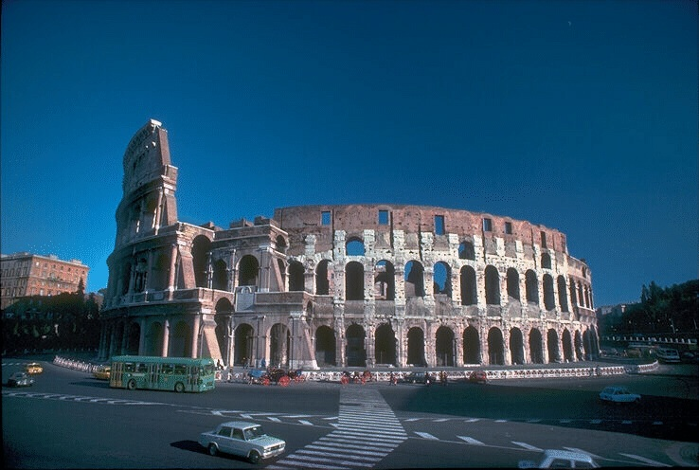
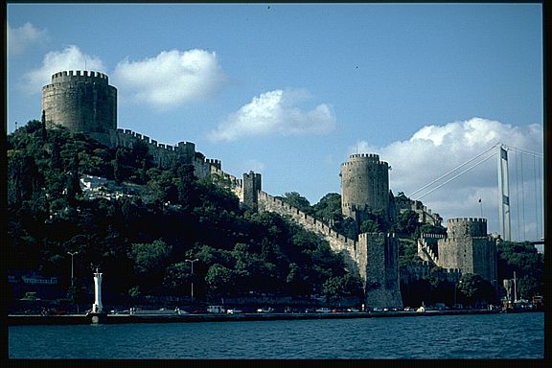

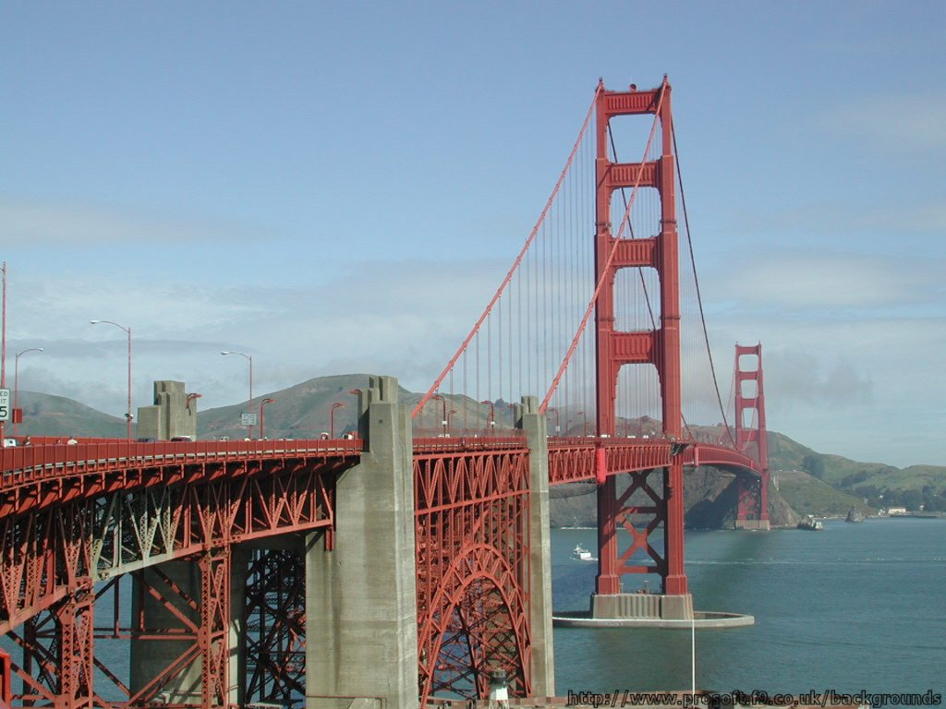
“Big” ≠ “Complex” Systems
What kinds of system development can most benefit from SE?
Technology risk
Cost/Schedule risk (limited resources)
Complex interfaces and Subsystem interactions
No iteration opportunity
Unclear problem
Coliseum, Rome
Rumeli Fortress, Istanbul
Focus of SE Management Planning should be on these considerations
Saint Peter's Basilica
Golden Gate Bridge

Slide 10
SE Standards*
ISO/IEC/IEEE 15288-2015 – Systems and Software Engineering – Life-Cycle Process
INCOSE SE Handbook v4 aligned with this standard (Our Text!)
ANSI/EIA-632, Processes for Engineering a System
Derived from draft MIL-STD-499B
IEEE 1220-2005, Standard for Application and Management of the Systems Engineering Process
Derived from draft MIL-STD-499B
Re-published as ISO/IEC 26702:2007, “Systems engineering -- Application and management of the systems engineering process”
Updated to IEEE/ISO/IEC 24748-4-2016, “International Standard for Systems and Software Engineering -- Life Cycle Management -- Part 4: Systems Engineering Planning”
INCOSE Standards List
https://www.incose.org/about-systems-engineering/se-standards
*See Syllabus for add’l Links
Notes:
https://www.acq.osd.mil/se/docs/15288-Guide-2017.pdf
https://www.sebokwiki.org/wiki/Systems_Engineering_Standards

Slide 11
SE Technical Processes
Technical Processes for the engineering of…
The Product System
The Product-Development Organization and associated processes
The Enterprise System (business reengineering and continuous improvement)
Common Systems Engineering Technical Processes (Defense Acquisition Guidebook, 4.3.10 – 4.3.17):
Requirements definition
Requirements and functional (logical) analysis
Architecture Design (solution)
Implementation (fabrication and procurement)
Integration
Verification
Validation

Slide 12
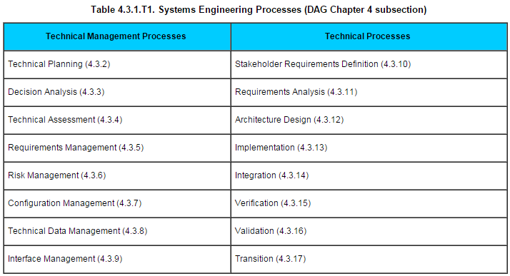
DAU DAG 4.3.1
“…As a whole, the SE processes provide a systematic approach focused on providing needed capability to the operational end user. Successful implementation of the SE processes results in an integrated capability solution that is:
Responsive to the needs of the user
Balanced among multiple requirements, design considerations, and program costs and schedules
Able to operate in complex system-of-systems (SoS) environments as required…”
Notes:
Defense Acquisition Guidebook - DAG

Slide 13
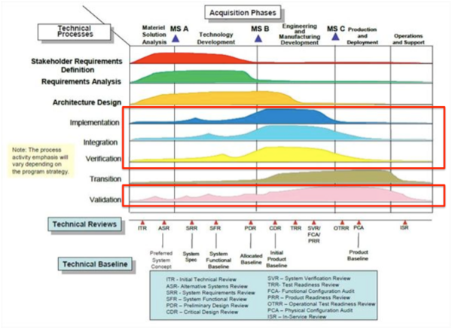
Life-cycle phasing of Technical Processes
From US DOD Defense Acquisition University
Note that MS B is PDR
http://sebokwiki.org/wiki/System_Realization Figure 3.

Slide 14
Technical Management Processes
Technical Management Processes for planning, organizing, monitoring, and controlling resources
Time
People and organizations, including suppliers
Facilities and equipment
Money
The system being developed
Common Systems Engineering Management Processes (Defense Acquisition Guidebook, 4.3.2 – 4.3.9):
Technical planning
Decision analysis (trade studies)
Technical assessment (reviews and technical measurement)
Requirements management
Risk management
Configuration management
Technical data management
Interface management

Slide 15
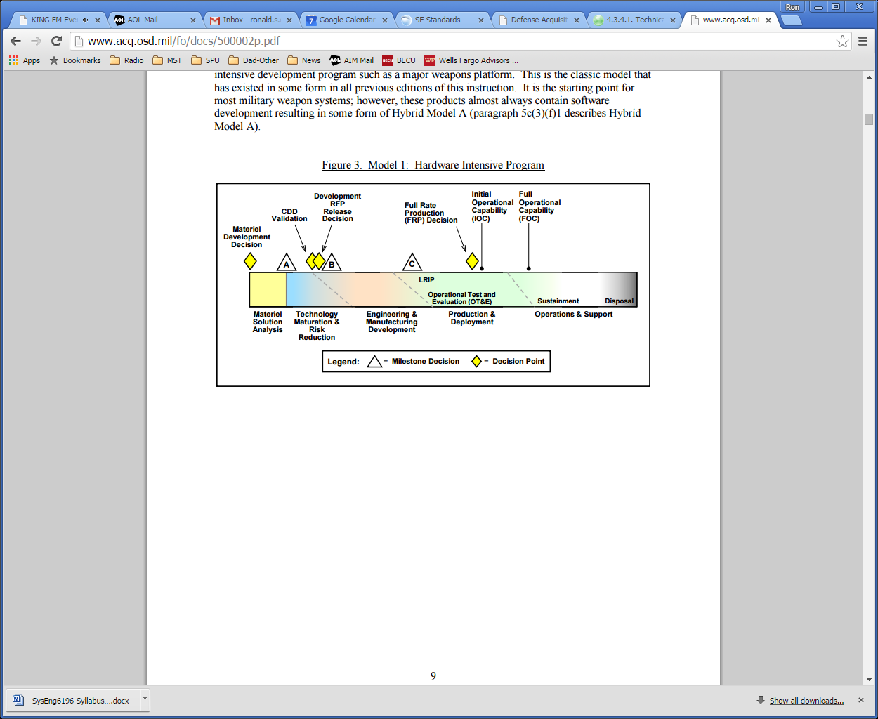
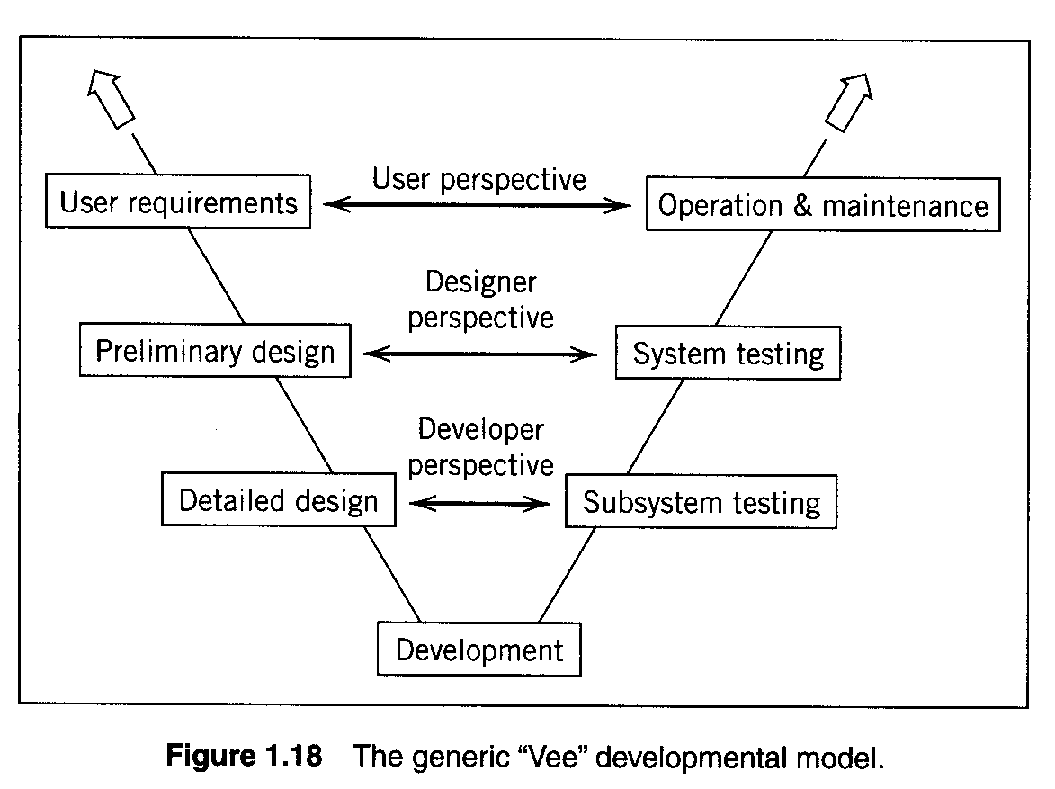
Plans in the Life-Cycle
From US DODI 5000.02, 1/2015
Figure 3, Model 1: Hardware Intensive Program http://www.acq.osd.mil/fo/docs/500002p.pdf
SEP→SEMP
SEP → SEMP
Integrated Logistics Plan
SEP: US Gov’t DoD Systems Engineering Plan
The SEMP or SEP is THE technical management plan for the program
Not limited to SEs
From Blanchard, “System Engineering Management”, 4th Edition
TEMP
Notes:
DODI 5000.02 is the biggy on how to develop systems

Slide 16
SEMP Overview
Purposes
Identify the system to be managed (“SE the SEMP”)
Use the unmanned urban vehicle or any equivalent project from 5101 [368], 6102 [468], 6104 [469]
Urban Challenge materials are available in Canvas
Identify and describe the processes, organizations, tools, and milestones necessary to be successful
The following outline roughly follows the INCOSE SE Handbook in terms of topics
Complete, annotated outline is posted in Canvas as “Midterm SEMP” at week 8
Homework each week requires you to complete the applicable sections

Slide 17
DARPA Urban Challenge SEMP
Related Links
https://www.darpa.mil/about-us/timeline/darpa-urban-challenge http://en.wikipedia.org/wiki/DARPA_Grand_Challenge
Scope
Develop and submit for testing and competition an autonomous road vehicle able to navigate and complete a defined course in a cluttered urban environment
Requirements (posted in Canvas Files, Assignments)
Evaluation criteria
California Driver Handbook http://www.dmv.ca.gov/pubs/pubs.htm
Note also “E-stop” Guidelines
The SEMP defines the technical management plan for achieving the program objectives of a competing team

Slide 18
DARPA Urban Challenge
Life cycle and Key Milestones: see “Urban Challenge Event Guidelines”
Development
Site visits (DARPA required)
National Qualifying Event (DARPA required)
Treat as formal “Verification”
Final Event (DARPA required)
Treat as “Validation”
Extension options (business decision)
Treat as Operations and Maintenance
Disposal (required in all cases)
Life cycle creates the need for specific tasks and processes

Slide 19
Alternates to DARPA Urban Challenge
You may develop a SEMP for another project used in other courses (5101, 6102, 6104)
But - You must submit all project-specific compliance documents with HW2 , including any equivalent:
Acquirer specifications
Statement of work
Integrated management plan or schedule
You should assume that I will be relatively ignorant of any alternate project, and you will have to educate me – extensively!

Slide 20
Plan vs. Report
You are here↓
Retrospective: Apply Lessons Learned
Plan the Work
SysEng 6105 [412]
SysEng 6196
Work the Plan
SysEng 5101 [368] and others
Report on the Work
SysEng 5101 [368] and others
Plan the work that you already know must be done (Future tense)
Processes will be contemporaneous with development (Present tense)
Apply lessons learned from similar
Don’t “report” (past tense) in SEMP

Slide 21
DAU/DAG 4.1.2 Systems Engineering Plan
“The purpose of the Systems Engineering Plan (SEP) is to help Program Managers develop, communicate, and manage the overall systems engineering (SE) approach that guides all technical activities of the program. The SEP documents key technical risks, processes, resources, metrics, SE products, and completed and scheduled SE activities…(from customer’s perspective)
“The SEP describes the integration of SE activities with other program management and control efforts, including the Integrated Master Plan (IMP), Work Breakdown Structure (WBS), Integrated Master Schedule (IMS), Risk Management Plan (RMP), Technical Performance Measures (TPMs), and other documentation fundamental to successful program execution. The SEP also describes the program’s technical requirements, engineering resources and management, and technical activities and products as well as the planning, timing, conduct, and success criteria of event-driven SE technical reviews throughout the acquisition life cycle….
As the program’s blueprint for the conduct, management, and control of all technical activities, the SEP captures decisions made during the technical planning process and communicates objectives and guidance to program personnel and other stakeholders. The SEP should define the “who, what, when, why, and how” of the SE approach, for example:
The program organization with roles and responsibilities, authority, accountability, and staffing resources. This includes the coordination of the program’s integrated product teams (IPTs) and their products, resources, staffing, management metrics, and integration mechanisms….
https://www.dau.mil/community-hub#All||title_asc

Slide 22
SEMP Outline – 1
Week 1
Week 2
Notes:
These two pages are the key to the first half of the semester.

Slide 23
SEMP Outline – 2
4. Technical Processes
4.1. Business/Mission Analysis
4.2. Stakeholder Needs and Requirements Definition
4.3. Requirements Definition, Validation, Traceability
4.4. Architecture Definition and Traceability
4.5. Design Definition and Traceability
4.6. System Analysis
4.7. Implementation
4.8. Integration
4.9. Verification and Traceability
4.10. Transition
4.11. Validation
4.12. Operations
4.13. Maintenance
4.14. Disposal
Week 4, 5, 6
5. Technical Management Processes
5.1. Project Technical Plan
5.1.1. Major Events: Integrated Master Plan
5.1.2. Work Packages
5.2. Technical Management and Assessment
5.2.1. Technical Performance Management
5.2.2. Continuous Assessment
5.2.3. Other Technical Measurements
5.3. Integration with Cost and Schedule Management
5.4. Decision-Making
5.5. Issue Identification and Resolution
5.6. Risk and Opportunity Management
5.7. Configuration Management
5.7.1. Baseline Definition and Management
5.7.1.1. Configuration Identification
5.7.1.2. Configuration Status Accounting
5.7.2. Change Management
5.7.3. Requirements Management
5.7.4. Interface Management
5.8. Information Management
Week 3
6. Organizational Investment
6.1. Environment Management
6.1.1. Program Policies and Procedures
6.1.2. Program Measurement and Assessment
6.1.3. Continuous Improvement
6.2. Investment Management
6.2.1. Product Line Investment
6.2.2. Supply
6.2.3. Acquisition
6.3. Resource Management
6.3.1. Personnel
6.3.2. Infrastructure
6.4. Quality Management
Week 7

Slide 24
SEMP Tailoring
The challenge of standards is a “one size fits all” mentality for the most generalized case
Most standards provide for customizing (“tailoring”) for the specific application
Users must decide what to keep, modify, delete
See ISEH section 8*
*All ISEH references are to ver. 4

Slide 25
SEMP Tailoring
Standardized templates enable more consistent products and are expected for mature organizations
The negative side is that complex programs can seldom tolerate “one size fits all” planning and execution
Tailoring
“Tailoring is the process by which specific requirements of a standard, specification or similar document are selected and used to meet the needs of a project.”
“Tailoring should only be undertaken when it is necessary to make or adapt an existing standard to fit user requirements, taking account of time, cost and performance.” http://web.archive.org/web/20070609192145/http://www.dstan.mod.uk/tailor_stan.pdf
“Tailoring” is a method of customizing that
Acknowledges the standard
Addresses the intent of the standard
Adapts the standard to the specifics of a program to improve the technical and business performance of the program

Slide 26
SEMP Tailoring
For this course
Use the outline as provided
For any section that you believe is unnecessary for your project, write your rationale for exclusion in the applicable section instead of what the plan content would be
Feedback will be provided
Cogency and quality are preferred over length
Rationale must be consistent with your project description in section 1
On a real program, deviations from established templates would be managed by policy (“reserved”, “not applicable”, or simply, not there)
Some value to preserving standard numbering

Slide 27
Technical Planning Overview - 1
What – Project Goals; Deliverables – Must establish a common vision
When – Development Phasing, Milestones
Who – Organization
How – Processes, tools,
Where – Facilities, Location(s)
NOTE: a “Plan” is not a compliance document (e.g., SOW/Rqmt). Do not use “shall”
SEMP
1. Introduction
1.1 Document Purpose
Why is this document being written? How is it intended to be used?
1.2 Document Scope
What does it cover? What general subjects are not included?
1.3 Document Update
Method and Frequency – How, and how often? Why then?

Slide 28
Example 1.1
“The Systems Engineering Management Plan (SEMP) identifies and documents the approved technical management processes to be used throughout the life of the program. It is meant to be used as a guideline and reference, for new and existing managers and engineers to ensure they execute these processes consistently as documented”
1.1 Document Purpose
Why is this document being written? How is it intended to be used?
Example Problems
How will the intent be measured or enforced?
Process execution
A Reference by new/ existing managers and engineers
Are processes clear enough?

Slide 29
Example 1.2
1.2 Document Scope
What does it cover? What general subjects are not included?
Example Problems
Technical processes listed – what about the others?
What processes are handled elsewhere, and how might someone find them?
Identify single source of any specific program information
“This SEMP guides personnel as they execute Systems Engineering and Integration functions such as: requirements analysis, requirements validation, functional analysis, functional verification, synthesis, verification/ validation, system analysis, and systems integration and control. Figure 1.2-1 depicts the systems engineering (SE) process”

Slide 30
Example 1.3
1.3 Document Update
Method and Frequency – How, and how often?
Example Problems
Event-based or calendar based updates?
Periodic or on-condition?
Assess need for change before committing to change (potential program cost savings)
Does the nature of what is being managed change character at life cycle stage transitions?
“The Systems Engineering Management Plan (SEMP) will be reviewed and updated in conjunction with each technical review identified in the Integrated Master Plan (IMP). Necessary changes will be made and reviewed at the technical review to ensure that the plan is always consistent with program needs. Organizations involved in SEMP updates are identified in section 3”
Notes:
Ahead of each technical review might be too often, and it’s the busiest time – getting ready for a review; why not soon after the review?

Slide 31
Technical Planning Overview - 2
What – Project Goals, Deliverables
When – Development Phasing, Milestones
Who – Organization (section 3)
How – Approach, processes, tools
Where – Facilities, Location (as needed; can be addressed in “organization” and verification/validation)
1.4 Program Summary
1.4.1 Program Objectives and Scope
What are the primary objectives (programmatic and technical)? How will you determine “success”? Are there any limitations or key assumptions? Information in this section will be used to evaluate adequacy of this plan
1.4.2 Project Summary and Deliverables
Describe major stages of the project, key milestones and deliverables in each stage. These can be more than hardware and software
1.4.3 Technical Description
Describe the system and the strategy or approach to achieving the technical objectives

Slide 32
Example 1.4.1
1.4.1 Program Objectives and Scope
What are the primary objectives (programmatic and technical)? How will you determine “success”? Are there any limitations or key assumptions? Information in this section will be used to evaluate adequacy of this plan
Issues and Discussion
This discussion is critical for everything that follows – don’t treat it as mere “boilerplate”
Keep the end in mind (Covey)
“The purpose of this program is to develop, verify, and deliver ABC product for evaluation [or deployment] to the XYZ Corporation, the acquirer
The success of these product deliverables depends on improving the technical maturity of the obershammer technology from the current TRL 5 to TRL 8.
Key measures of technical success include improvement in the five program KPPs as follows: …
Key measures of programmatic success include delivering prototypes per the Integrated Master Schedule on xx December 20yy, …
Program constraints include…
Programmatic risks being managed include…

Slide 33
Example 1.4.2
1.4.2 Project Summary and Deliverables
Describe major phases of the project, key milestones and deliverables in each phase. These can be more than hardware and software
Issues and Discussion
This section sets up the rationale for the plan – why and how certain things are done to meet intermediate and final deliverables
“This program is divided into three major development stages: (1) technology demonstration, (2) engineering development, and (3) integration and demonstration. Within each stage are a number of milestones…
Key deliverables for these respective stages are”…

Slide 34
Example 1.4.3
1.4.3 Technical Description
Describe the system and the strategy or approach to achieving the technical objectives
Describe how requirements for all life-cycle phases will be developed and incorporated
Issues and Discussion
The technical plan must reflect the strategy
The approach must plausibly lead to satisfying the objectives. Various development models are possible (next slides)
“The ABC system is ...
“To achieve the technical objectives the program will use a spiral development model as indicated in figure 1.4.3-1. This approach is appropriate because the end state requirements are uncertain. In each spiral there will be a phase for requirements identification and development, prototyping, verification and validation. Simulation will be used to ensure that the overall program is making progress …”

Slide 35
System Concepts Review
Now moving to the ‘Mission Concept Review’
If you already had this proposed new system
How would you be using it?
What would it do for you?
Would it replace anything that exists now?
Who would use it?
How would that be better?
What would improve about mission performance?
Would maintenance, or initial costs be better?
What could go wrong?
Could it be turned against us?
Etc.

Slide 36
“Systems Engineering” Definitions
ISO 15288 – 2015, “Systems and Software Engineering – System Life Cycle Process”, http://www.15288.com/
“4.31 System…
“Combination of interacting elements organized to achieve one or more stated purposes
“NOTE 1 – A system may be considered as a product or as the services it provides”
No explicit definition of “systems engineering” in the standard

Slide 37
System vs. Environment
A key job is to discern (or define) the scope and boundary of the system: What’s in? What’s out?
Environment or “context”
System Boundary
System
Outputs
Inputs &
Influences

Slide 38
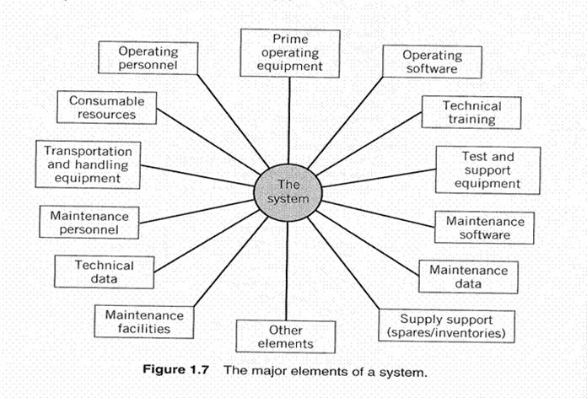
Elements of a “System”
Product
Support
Training
Data
Facilities
Much more than the “product”
From Blanchard, “System Engineering Management”, 3rd Edition

Slide 39
Systems, Subsystems, Components
Common usage organizes a hierarchy of system components
System
Segment
Subsystem
Component
Parts
One’s “system” is someone else’s “component” or “subsystem” – no absolutely correct label
A “system” is based on your scope of responsibility
Top-down

Slide 40
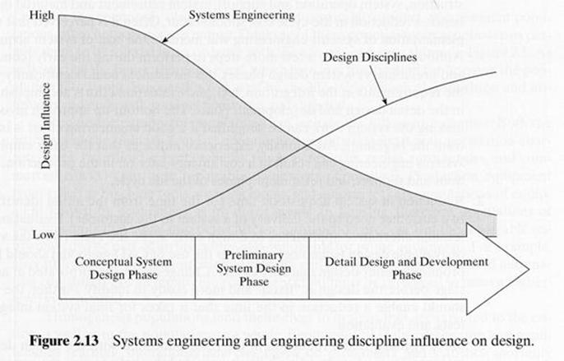
Design Influence Over Time
From Blanchard and Fabrycky, “Systems Engineering and Analysis”, 4th Edition
Transition from conceptual design (strong SE influence) to detailed design (weaker SE influence)
SE Management emphasis changes

Slide 41
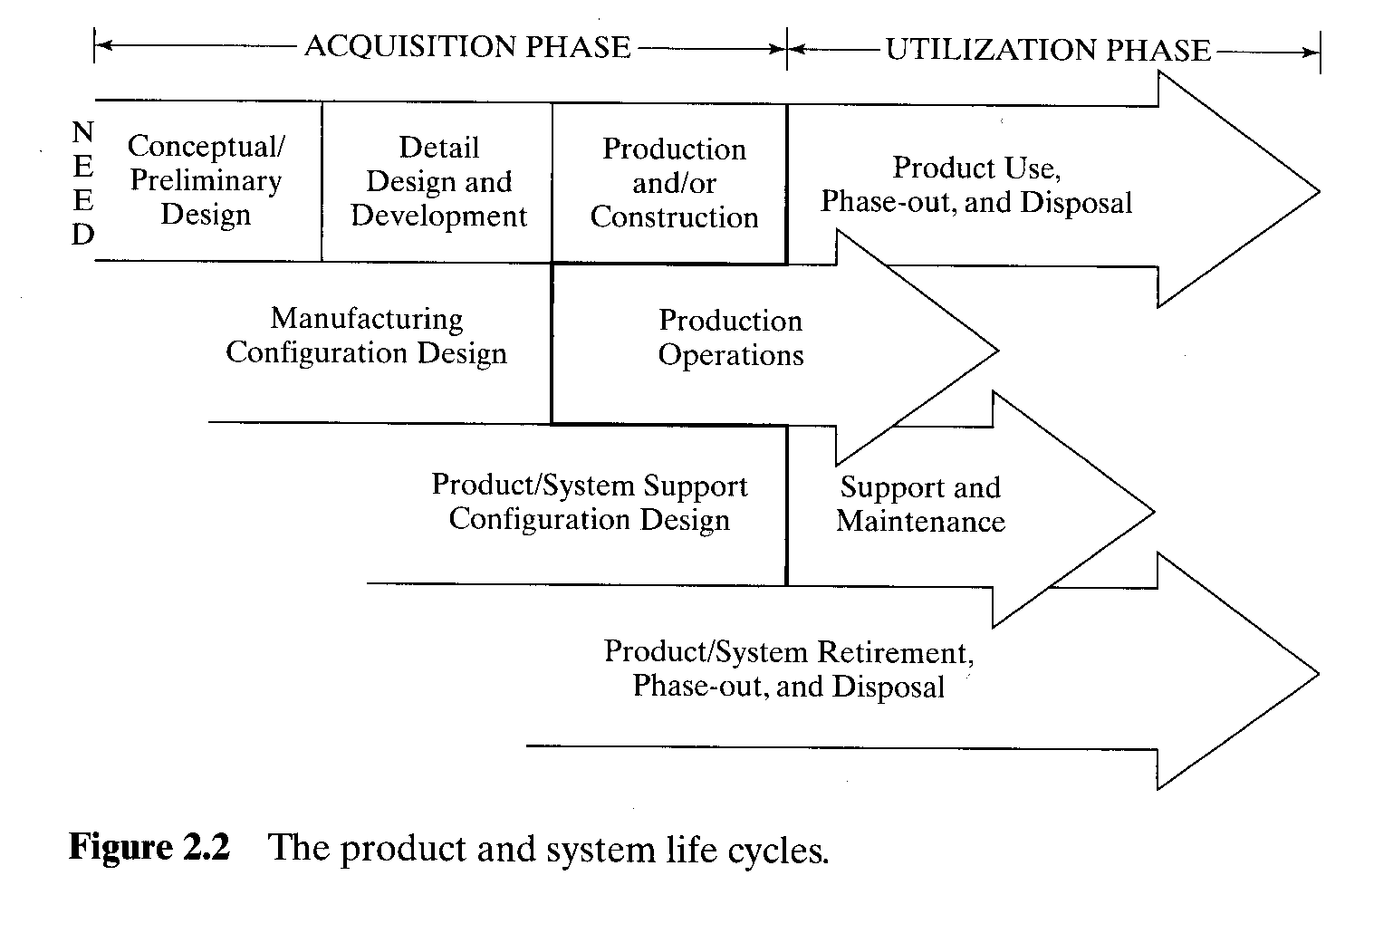
System Life-Cycle Engineering
Need to address all life-cycle stages during early design
Acquisition
Development, Verification, Production (Implementation), Deployment (Transition)
Utilization (also called, “sustainment”)
Operations, Maintenance (and Training), Disposal
The essence of Concurrent Engineering (Blanchard 2.2.1)
From Blanchard and Fabrycky, “Systems Engineering and Analysis”, 4th Edition

Slide 42
Concurrent Engineering
“A systematic approach to the integrated, concurrent design of products and their related processes, including manufacture and support. This approach is intended to cause the developers, from the outset, to consider all elements of the product life cycle from conception through disposal, including quality, cost, schedule, and user requirements”
A Concurrent Engineering strategy needs to be reflected in the plan: organization, processes, review milestones
“Concurrent Engineering” does NOT mean, “everybody start engineering now”
From Blanchard, “System Engineering Management”, 4th Edition, 34, note 24, Winner et al.

Slide 43
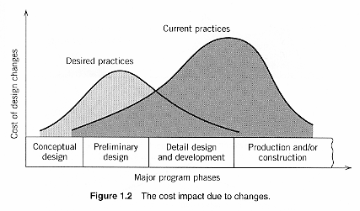
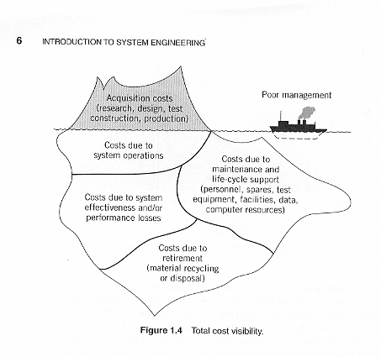
Minimizing Lifecycle Cost (LCC)
Development costs
Design once (minimize iteration)
Identified Need
Design and Development
Production and/or construction
Operational use and
Maintenance support
Retirement and
material disposal
Design for operations and support
Biggest % of life-cycle costs (LCC)
From Blanchard, “System Engineering Management”, 3rd Edition

Slide 44
Development Models – Acquisition Environment
Traditional process development models
Linear with limited feedback
Waterfall model
V model today, Digital Twin
Evolutionary acquisition strategies integrate advanced, mature technologies into producible systems that can be deployed to the user as quickly as possible.
An evolutionary acquisition strategy matches available technology and resources to approved, time-phased, capability needs.
Development and lifecycle models that support systems engineering with an evolutionary acquisition strategy
Incremental (phased waterfalls) (PrePlanned Product Improvement)
Spiral model deleted in latest US Department of Defense Acquisition Policy (DOD Instruction 5000.02, December 2008)

Slide 45
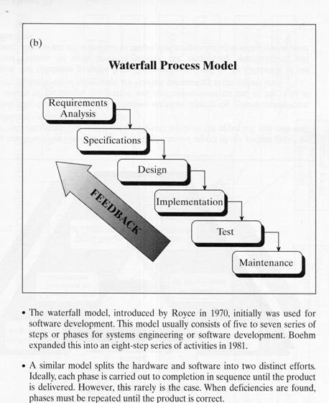
System Development Models - 1
Waterfall – finish each activity before proceeding to next
“Ideal” approach; supported by TOC (don’t start next activity until completing the prior activity)
Seldom enough time allocated
“Need” often outpaces schedule
From Blanchard and Fabrycky, “Systems Engineering and Analysis”, 4th Edition

Slide 46
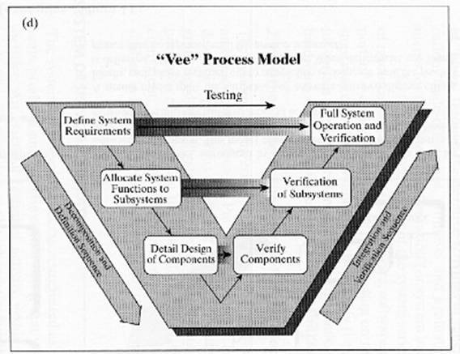
System Development Models - 2
‘Vee’ – Organizes Waterfall model into two comple-mentary parts
Associates verification with associated requirements at each level of hierarchy
From Blanchard and Fabrycky, “Systems Engineering and Analysis”, 4th Edition

Slide 47
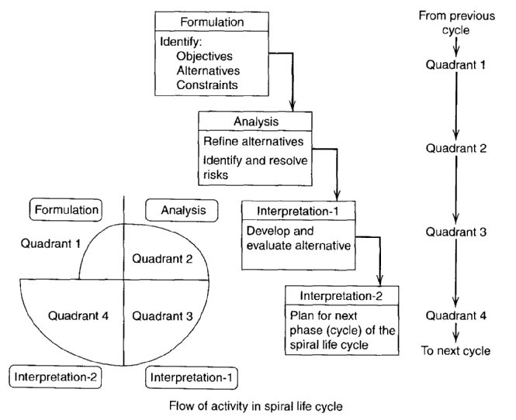
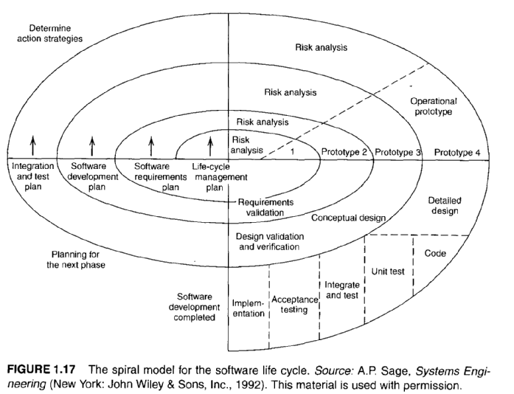
System Development Models - 3
Spiral – incorporates prototyping to reduce development risk (define, build, test, refine, test, refine….)
No longer in US DODI 5000.02 Acquisition Policy (but deeply embedded in people’s consciousness)
From Blanchard, “System Engineering Management”, 4th Edition

Slide 48
System Development Models - 4
Agile Development*
Emphasizes continuous validation
Combines “incremental” with “spiral” when desired end state is unknown but individual increments can be defined
“Finish-to-finish” requirements, design, and integrate
Requirements
Design
Build
Integrate
Verify
Validate
Carson, Ronald S., “Can Systems Engineering be Agile? Development Lifecycles for Systems, Hardware, and Software”, Proceedings of INCOSE 2013.
See also Dove et al., Proceedings of INCOSE 2015
Time
after Carson 2013

Slide 49
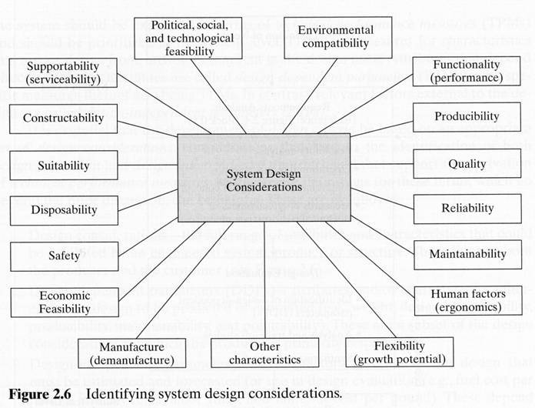
System Design Considerations
Drawn from all stages of system life-cycle
From Blanchard and Fabrycky, “Systems Engineering and Analysis”, 4th Edition

Slide 50
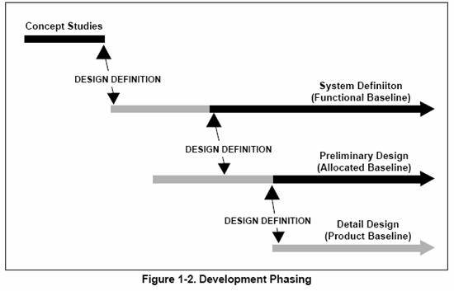
Development Phasing
Development usually progresses through distinct levels or stages:
From DAU SE Fundamentals
Concept level, which produces a system concept description
System level, which produces a system description in terms of system characteristics and constraints
Subsystem/component level, which produces first set of subsystem and component product performance descriptions, then a set of corresponding detailed descriptions of the products’ characteristics essential for the production

Slide 51
2.0 Reference Documents – 1
2.0 Identify references on which you are depending and which are cited in the text. How are these references tailored, prioritized, and applied?
2.1 Industry References
Standards, industry handbooks, other references. Identify which are “guidance” (provide useful information) and which are “compliance” (must be adhered to). For “Compliance”, the referencing section of the plan must address how compliance will be shown. List in a tabular form
Document Number | Document Title, Version, Date | “Guidance” or “Compliance”?
ISO/IEC15288 | Systems and Software Engineering – System Life-Cycle Processes, 2nd Edition, 2008-02-01. | Guidance

Slide 52
2.0 Reference Documents – 2
2.2 Acquirer References (tabular format)
Acquirer-specific references. Might not be applicable for supplier-funded development
2.3 Enterprise References (tabular format)
Your company items that apply to more than just your program – You need to hypothesize a larger organizational context for this project
2.4 Program References (tabular format)
Project-specific references controlled by the performing organization. May include, for example, program management plans or plans subordinate to the SEMP (e.g., risk management, requirements management, etc.)

Slide 53
Questions for Tonight?
HW1 – do it if not done
Next week:
Week 2 Readings in Syllabus - be prepared to discuss in class
ISEH 3, 6.1, 6.2, 9.7, 10.1-10.13
HW2 – Due
Canvas Discussion Board
Is ONLY to be used when
Class is not held (e.g., Snow day), or
You have arranged in advance to miss class
If used, posts are due at beginning of class time for credit
Lecture 2: Program Organization
End – Good night!

Slide 54
Program Completed
Missouri University of Science and Technology
© 2006-2020 Curators of University of Missouri

