Slide 1
SysEng6196 Systems Engineering Capstone
Dr. Lou Pape
2 – Program Organization

Slide 2
Organizing for the Work
The project organization is a system
The organization system must be designed to accomplish the work identified (see SEMP section 1)

Slide 3
Allocating the Work
Responsibility Assignment Matrix
The Work Breakdown Structure (WBS) organizes & allocates the work
The Organizational Breakdown Structure (OBS) provides the design solution for allocating the work to organizational elements
The allocation is the Responsibility Assignment Matrix (RAM)
This is SE applied to organizations

Slide 4
SOW, WBS, Organization
§3
What to do: SOW with Deliverables
§1
Who will do it: Organization
Responsibility Assignment Matrix
Detailed task
Allocation
How to organize the work: WBS
How to do the work:
SEMP §4 & §5
Detailed task
Definition

Slide 5
3.0 Program Organization
3.1 Work Allocation: WBS
Provide a summary work breakdown structure that accomplishes the work identified in section 1, and define tasks to the tier 3 level.
Organization (≠ WBS)
RRAA
Organizational Integration

Slide 6
WBS and Organization
Why describe WBS as part of “Organization” in SEMP?
Program deliverables need to be clearly defined and organized to ensure they are accomplished
Defining top levels of WBS is necessary to establish roles and responsibilities for organizational elements
WBS is not an organizational chart (WBS ≠ Organization) – but a Task and Deliverable organization
Detailed WBS defines organization of work packages prepared for the purposes of program planning, budgeting, contracting and reporting (more under §5.1, Technical Planning)
Responsibility assignment matrix (RAM) allocates WBS elements to organizational elements
Notes:
Deliverables: plans, hardware, software, reports, manuals, training, status, reviews,

Slide 7
Work Breakdown Structure (WBS)
The WBS is a product- or task-oriented tree that leads to the identification of the activities, tasks, subtasks, and work packages that must be performed for the completion of a given program
Product-oriented: deliverable is product per specification or drawing
Task-oriented: deliverables are typically reports (information)

Slide 8
WBS
WBS must include at least three levels of activity:
Level 1: Identifies the total program scope of work, and the system to be developed and delivered to the acquirer
Level 2: Identifies the various sub-projects and activities that must be completed in response to program requirements
Level 3 and lower: Identifies the activities and tasks that are directly subordinate to the next-higher-level items
Task decomposition is similar to functional decomposition

Slide 9
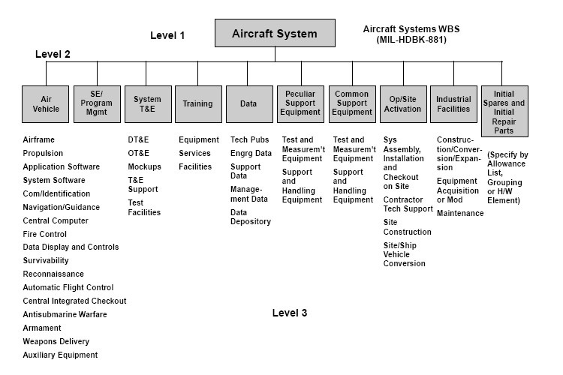
Example WBS to Level 3
Level 3
Appropriate for SEMP §3 – but needs task completion criteria in the text
More detail is required in SEMP §5.1

Slide 10
WBS Development
Key elements of WBS
Describe all work necessary to deliver contractual obligations (focus of 3.1)
Describe how work packages will be defined for cost/schedule control purposes (focus of 5.1, but introduced here)
Clearly describe work products (outputs)
Clearly describe inputs to tasks
Eliminate duplicate work effort (supported by clarity of task descriptions, inputs, and deliverables)

Slide 11
SEMP §3
3.1 Work Allocation: WBS
Provide a summary work breakdown structure that accomplishes the work identified in section 1, and define example tasks to the tier 3 level
3.2 Organization Structure (OBS) and Responsibility Assignment Matrix (RAM)
3.3 RRAA (Role, Responsibility, Authority, Accountability)
3.4 Organizational Integration
Notes:
Role Responsibility Authority Accountability

Slide 12
Organization
Organizational Breakdown Structure (OBS) needs to support achieving program objectives
Similar to product architecture (functional decomposition)
Organizational structures are tailored to most effectively accomplish the required functions
The goal is to achieve the most effective utilization of resources to accomplish the program objectives
There are things outside the program that influence it
Apply Systems Engineering – to define, build, control, and maintain the organization
We usually think in terms of the product, but this is for your people and your organization structure

Slide 13
Organization for SE
Many different ways to organize projects, programs, people
No “perfect” organization structure
Always need to identify and integrate across interfaces
Functional
Project
Technical specialty
Need clear alignment of authority and responsibility
Organization structure and allocated budget are big influencers on program SE success
Discussion question: Why? (this is where YOU talk)

Slide 14
Anarchy vs. Organization
Must we have “organization”?
“If all are responsible, then no one is responsible”
Example: Public parks
Some structure is necessary to ensure results
Trend toward “flattened” hierarchies to reduce layers/levels of management (recently)
Requires
High-coordination by a few people, or
High-responsibility by all people (“see a need and satisfy it” culture)
Notes:
Flattened organization is “Lean”

Slide 15
3.2 Organization Overview
Provide a graphical organization chart
Provide a summary description of how the relationships among organizational members help achieve Program Mission and Objectives [see §1]
Explain any differences compared with the WBS and how the program will ensure all work can be efficiently accomplished
Include a responsibility assignment matrix (RAM) that links the organizational structure to the WBS using ‘RACI’
Notes:
Responsible, Accountable, Coordinate, Inform

Slide 16
Review of Alternative Organizational Structures
Alternatives
Functional
Project
Matrix
Integrated Product Teams
How to select? Do a Trade Study!
Criteria include
All work allocated to capable organizations (feasibility of organization)
Manage risks of partitioning organization and work
Enterprise organization support, and resource contention – how do you handle that?

Slide 17
Functional Organization Structure
Sometimes referred to as the “classical” or “traditional” approach
Involves the grouping of specialties or disciplines into separately identifiable entities
The depth of the individual elements of the organization will vary with the type of project and level of emphasis required
Is well suited for a single project operation
May not be as appropriate for large multi-product firms or agencies

Slide 18
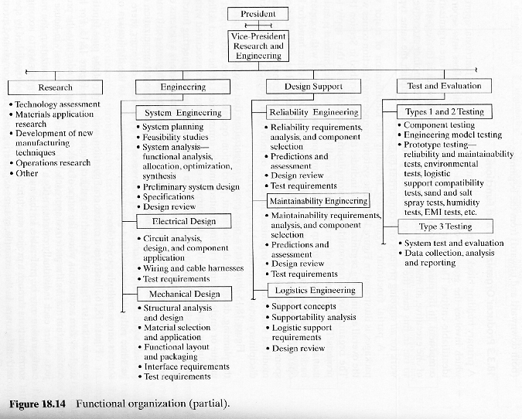
Functional – In Parallel with a “Project” Organization
Projects “borrow” expertise from “central” engineering (or mfg, finance, etc.)
Retain capability in central org
Less project control of resources
From Blanchard and Fabrycky, “Systems Engineering and Analysis”, Fourth Edition

Slide 19
Functional Organization Structure -Pros and Cons
Advantages:
Enables the development of a better technical capability for the organization
The organization can respond more quickly to a specific requirement
Budgeting and cost control are easier
The channels of communication are well established
Disadvantages:
Difficult to maintain an identity with a specific project
Concepts and techniques tend to be functionally oriented with little regard for project requirements
Reduced acquirer/customer orientation

Slide 20
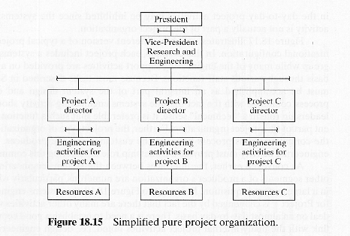
Project Organization
Employees assigned to projects
Enhanced project control
Diminished central organiz-ational capability
From Blanchard and Fabrycky, “Systems Engineering and Analysis”, Fourth Edition

Slide 21
Product-Line/Project Organization Structure –Pros and Cons
Advantages
The lines of authority and responsibility for a given project are clearly defined
Strong acquirer (customer) orientation
High degree of personnel loyalty, motivation, and morale
Personnel expertise can be assigned and retained exclusively on the project
Greater visibility relative to all project activities
Disadvantages
The application of new technologies tends to suffer without strong functional groups and the opportunities for technical interchange between projects
A duplication of effort, personnel, and the use of facilities and equipment
Difficult to effectively utilize personnel in the transfer from one project to another
The continuity of an individual’s career, growth potential, and opportunities for promotion are often not as good when he or she is assigned to a project for an extended period of time

Slide 22
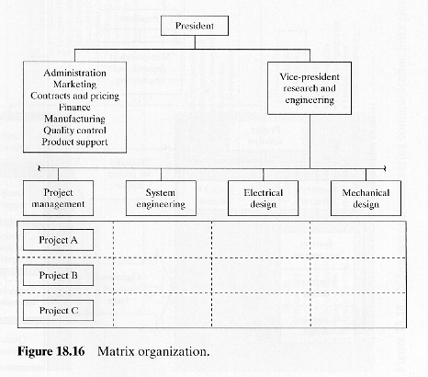
Matrix
Employees retained in central organization
Projects assign tasks to an organizational element, not a person
From Blanchard and Fabrycky, “Systems Engineering and Analysis”, Fourth Edition

Slide 23
Matrix Organization Structure
An attempt to combine the advantages of the pure functional organization and the pure project organization
Enables staffing the project with project - specific personnel
Functional departments are responsible for maintaining technical excellence and exchange of technical information between projects
May form a two- or multi- dimensional structure
Projects representing potential profit centers
Functional departments identified as cost centers

Slide 24
Matrix Organization Structure Pros & Cons
Advantages
1. The project manager can provide the necessary strong controls for the project while having ready access to the resources from many different function-oriented departments
2. The functional organizations exist primarily as support for the projects
3. Technical expertise can be exchanged between projects with a minimum of conflict
4. Authority and responsibility for project task accomplishment are shared.
5. Key personnel can be shared and assigned to work on a variety of problems
Disadvantages
1. Each project organization operates independently. Duplication of efforts is possible/likely
2. May be more costly in terms of administrative requirements
3. The balance of power between the project and the functional organizations must be clearly defined initially and closely monitored thereafter
4. From the perspective of the individual worker, there is often a split in the chain of command for reporting purposes

Slide 25
Integrated Product Teams (IPTs)
Goal: align organization to product structure to ensure an integrated product
Product element integration (architecture)
Life-cycle integration
Identifying, defining and managing interfaces is very critical in Integrated Systems Development
The objective is to create a team of qualified individuals that can effectively work together to solve a problem in response to a given requirement
They are established to concentrate on those activities that significantly impact selected performance factors, cost of ownership, and configuration management

Slide 26
Integrated Product and Process Development (IPPD)
The Department of Defense defines IPPD as a “Management technique that simultaneously integrates all program activities throughout the life cycle, include systems management, development, manufacturing, testing, deployment, operations, support, training, and eventual disposal. Using IPPD, multi-disciplined Integrated Product/Process Teams (IPTs) shall simultaneously optimize the product, product manufacturing, and supportability to meet system cost and performance objectives” [emphasis added]
From Blanchard, “System Engineering Management”, 4th Edition , 370, note 4, DODR5002.R

Slide 27
Key Characteristics
IPTs are established to produce a specific product or service – all team members/functions work together toward the common goal
It is multidisciplinary – includes various disciplines and domains
Members usually have mutual, as well as individual, accountability
Integrated, concurrent decision making – empowered to make decisions within specific product or service goal (but within the interfaces)
Needed: Planned integration among teams towards system goal (a challenge!)

Slide 28
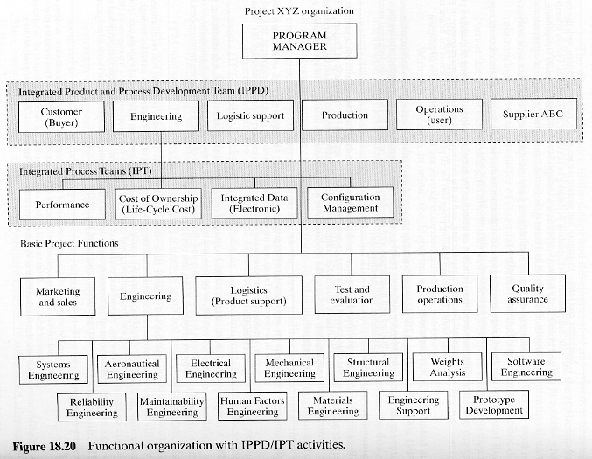
Functional Organization with IPTs
Life-cycle focus
From Blanchard and Fabrycky, “Systems Engineering and Analysis”, Fourth Edition

Slide 29
IPT Charter
IPTs are established by designated high-level authority in the organization
The representative team members must
Be well qualified in their respective areas of expertise
Empowered to make on-the-spot decisions
Proactive relative to team participation
Success-oriented
Resolved to addressing the problem assigned

Slide 30
IPT Planning
In addition to organizing itself, the PDT/IPT needs to have a thorough knowledge of the task at hand
They need to understand the project objectives, the specifications/acquirer requirements, design targets, cost, and schedule
This information needs to be given to the team(s) by the program manager or management team
The requirements should be thoroughly reviewed
A team charter and execution plan need to be established with clear responsibility, accountability, and authority
Notes:
Product Development Team/Integrated Product Team

Slide 31
IPTs and Functions – Example 1
Mix of “products” and traditional “functions” at top level
Unambiguous elemental product responsibility
Ambiguous system product responsibility
Can lead to
Diffusion of system product responsibility and authority
Challenges to integrate system elements

Slide 32
IPTs and Functions – Example 2
Combined IPT/Function organization
Improved product integration

Slide 33
System Engineering Organization
What’s the role of SE management in IPPD?
Help design the organization to achieve program objectives during program planning
Help define:
Schedule (tasks and deliverables)
Budget (budget for tasks)
Technical performance and compliance
Help ensure organizational integration during execution
Integrated Master Schedule (IMS) integration
Facilitate Product/deliverable handoffs

Slide 34
Alternate SE Deployment
SE isolated from product development
Role limited
SE integrated into product development
Either retain SEs at top level or deploy to each subordinate team

Slide 35
Responsibility Assignment Matrix (RAM)
Connects SEMP§3.2 Organization to§3.1 WBS
Introduces §3.3 – RRAA
http://www.mindtools.com/pages/article/newPPM_RAM.htm
Define the deliverables (WBS)
Identify the people (organizational breakdown structure – OBS)
Map Deliverables to people/organization as (RACI)
R = Responsible (People who do the work)
[If multiple organizations are Responsible, designate exactly one as R*: People who do the work AND are responsible to ensure that it gets done]
A = Accountable (People legally responsible that the work gets done correctly)
C = Consulted (People who provide input before and during the work – who coordinate on the work)
I = Informed (People who are kept informed of progress)
Copyright © Mind Tools Ltd, 1995-2010, All Rights Reserved. Reproduced with permission
Notes:
Role, Responsibility, Authority, Accountability

Slide 36
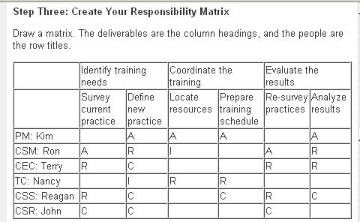
Example RAM
Be careful of >1 “R” in any column; it may lead to conflicts or gaps
WBS →
Org. ↓
http://www.mindtools.com/pages/article/newPPM_RAM.htm
Copyright © Mind Tools Ltd, 1995-2010, All Rights Reserved. Reproduced with permission.

Slide 37
Systems Engineering a RAM
Work (WBS)
 | WBS | WBS | WBS | WBS | WBS
Org
Org
Org
Org
Organization (OBS)
Allocating work from WBS to elements of organization is a standard SE task:
Allocate requirements (work from WBS) to…
Elements of the organization architecture (the OBS)

Slide 38
Roles, Responsibility, Accountability and Authority
3.1 WBS
3.2 Organization and Responsibility Assignment Matrix
3.3 RRAA
3.4 Organizational Integration

Slide 39
SEMP Section 3.3
3.3 Role, Responsibility, Authority, Accountability
Describe each role (summary of what they do), specific responsibilities, specific authority, to whom they are accountable, and responsibilities for specific program results or deliverables. This collection of information can be described as a “charter”. These descriptions should be consistent with the allocation of tasks in the following sections and the WBS

Slide 40
Responsibilities and Authority
Responsibilities must be clear: what is the expectation (organizational requirement)?
WBS elements are allocated to elements of the organization
Deliverables need to be clear
Bad role/responsibility definition and unclear team interfaces will result in duplication of effort, conflict, or gaps
Authority and Accountability
Team leaders and managers must verify that teams are exercising their authority appropriately and that they are accountable for their assigned responsibilities
Authority must align with responsibility
Delegate authority to execute the responsibility
Budget; people; other resources (see notes below)
Notes:
Other resources: tools, factory space, test equipment, storage, office space, computer time…

Slide 41
Roles
3.3.1. Program Leadership
Program Management, acquirer engagement, cost and schedule, etc.
3.3.2. Technical Leadership
Chief Engineer or Chief Architect, Chief Systems Engineer, other function or product team leaders
3.3.3. Teams and Functions
Integrated product and process development (IPPD) and/or function-based organization
3.3.4. Key Suppliers and Supplier Integration (who buys stuff for you)
“Acquisition” per the Handbook. Identify suppliers who are critical for program success and how they are integrated into the program SE execution
3.3.5. Associate organizations
If applicable, identify partners or other suppliers who deliver to a common acquirer on a specific project
3.3.6. Acquirer (your customer)
Describe any execution-level involvement of acquirer organizations, such as working groups, integrated product or process teams
3.3.7. User
If different from acquirer identify their specific involvement in working groups, integrated product or process teams, evaluation (validation), etc.

Slide 42
Acquirer, Supplier, and Other Supplier Relationships
The system engineering function may appear at several levels, evolving from the acquirer and down to the supplier and lower-tier suppliers
System engineering tasks are implemented across multiple organizations
The acquirer may establish a system engineering organization
These tasks may be allocated to the supplier
The responsibility along with the authority must be clearly defined from the beginning
Formal and informal channels of communication must exist between various entities involved

Slide 43
Supplier Organization and Functions
“Supplier” is anyone that provides materials, products, and/or services to an acquirer
System engineering requirements must be traceable from the acquirer to all “key” suppliers (any doing SE)
Suppliers
Design or Manufacturing/Production development
Need product definition for design or build
Standard or “Commercial off-the-shelf” (COTS) components
“You get what they’ve got”
“Modified off the shelf” is an oxymoron (see “development”)
Products vs. services
Tiered suppliers

Slide 44
Acquirer Organization and Functions
The acquirer and user organizations may be different
The user vs. your acquirer
The requirements associated with the latter should support the objectives specified for the former
Why might this not work in practice?
The acquirer must clarify system objectives and program functions and provide managerial backing when delegating responsibilities
The system engineering functions can be accomplished within either the acquirer’s or the supplier’s organizational structure, or the combination
Acquirer ($)
Dynamic Tension
Users
Supplier

Slide 45
Organization RRAA
Clearly identify
Role – Why are they included in the discussion? What over-arching function or purpose do they serve?
Responsibility – Identify major deliverables. What would be missing from program success if they were omitted?
Authority – Summarize the authority given to the organization role. Often this is in the form of control of resources (money, people, facilities, schedule). What decisions can be made autonomously?
Accountability – To whom are they responsible? Who will be affected if there are problems (late, over budget, inadequate performance, etc.)? What are the key measures of success for the organization?
Be consistent with Responsibility Assignment Matrix (RAM)

Slide 46
3.4 Organizational Integration
3.1 WBS
3.2 Organization and Responsibility Assignment Matrix
3.3 RRAA
3.4 Organizational Integration

Slide 47
Organizational Integration
Organizational integration is necessary because of partitioning
Similar to product or system integration
Ensures that
Diffuse responsibilities are coordinated
Effort is performed consistently
Suppliers
Acquirer
Technical approach

Slide 48
3.4.1 Working Groups and Boards
Working groups and boards may have different scope
Integrate across inter-organizational boundaries
Example: Interface Control Working Group – includes acquirer, suppliers, and project
Integrate across intra-organizational boundaries
Example: Configuration Control Board – IPTs, various engineering or non-engineering functions
Consider
Boundaries between organizations that create the need for focused integration based on risk
Do NOT create boards and working groups to
Diffuse responsibility and decision-making – leads to the “paralysis of analysis” and lack of leadership
Duplicate responsibilities of existing organizations
DO
Identify clear charter, scope: what unique service or function is provided by board or working group that cannot be provided by any single organization? Describe the RRAA

Slide 49
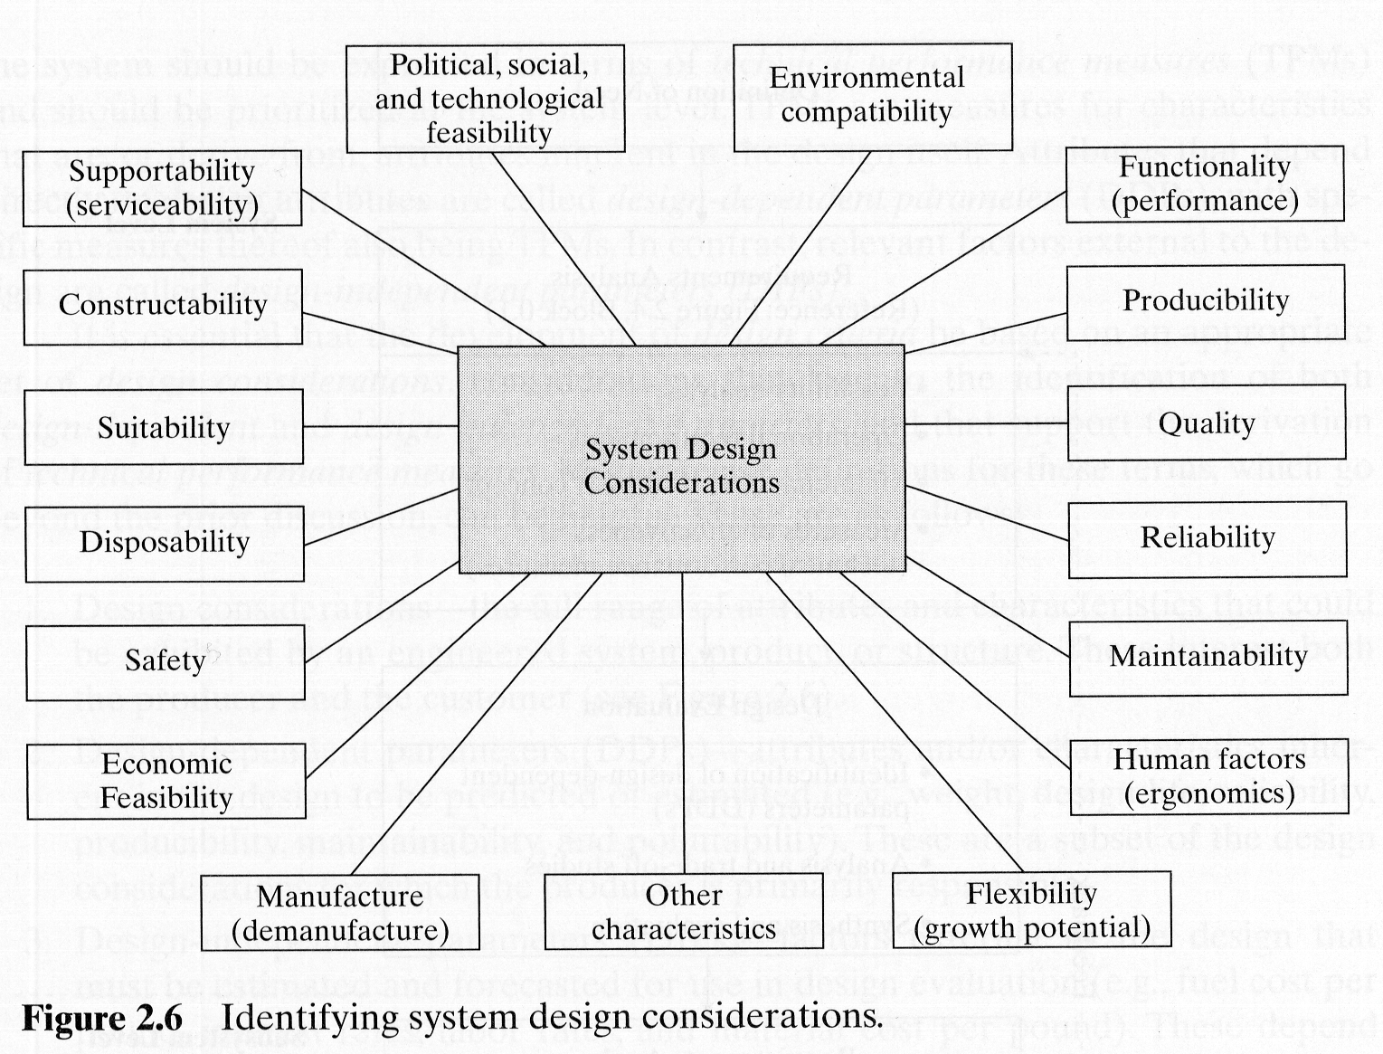
3.4.2 Technical Specialty Integration
Identification of expertise
Software
Human Factors
Safety
Security
Manufacturing
Disposability
Quality
Environment
Reliability
Maintainability
Logistics/ Supportability
Affordability
Interoperability
Electromagnetics
Mass properties
Program Tasks
From Blanchard and Fabrycky, “Systems Engineering and Analysis”, Fourth Edition

Slide 50
Why “Specialties”?
Sophisticated technology demands narrow specialization to apply the state-of-the art
Large, complex systems benefit from overarching and consistent design approach to handling specialized disciplines
How can the project best deploy specialty engineers to their product development/mfg/etc.?

Slide 51
Common Tasks for Specialties
Describe common approaches across all specialties
Identify any unique efforts for each applicable specialty area
Consider program planning
Application of specialty areas’ standards
Requirements development
Design guidance and design analysis
Developmental testing
Verification (both test and analysis)
Required operations, maintenance, or disposal support
This section is about the strategic approach to deploying specialties, not a process description section
The intent is not to duplicate information in sections 3.3 or 4, but to identify the roles of specialists being identified
This is especially important in a product-based organization structure

Slide 52
Software
Software is not usually classified as a “specialty” but as another engineering discipline (e.g., electrical, mechanical…)
Treatment is needed at the system level because of the strong influence of software architecture on system design and performance
This can create tension in the management of the system development

Slide 53
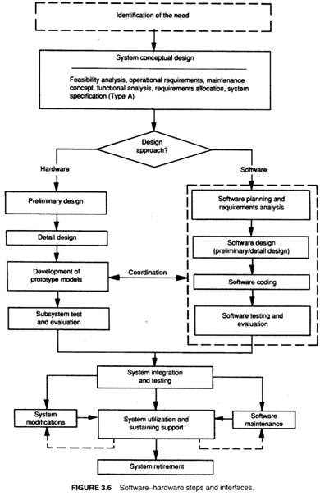
SW Engineering
Parallels Systems Engineering Life-Cycle
Planning
Requirements
Architecture
Design
Code (Element Fabrication)
Assembly, Test & Fix (Verification & Correction)
Production
Maintenance
Correction
Improvement
Some degree of concurrence and iteration
From Blanchard, “System Engineering Management”, 4th Edition

Slide 54
Reliability
Reliability is the probability that a system or component will perform its required functions under stated conditions for a specified period of time
Elements of
Probability
Duration
Conditions
Input/environments
Output/performance

Slide 55
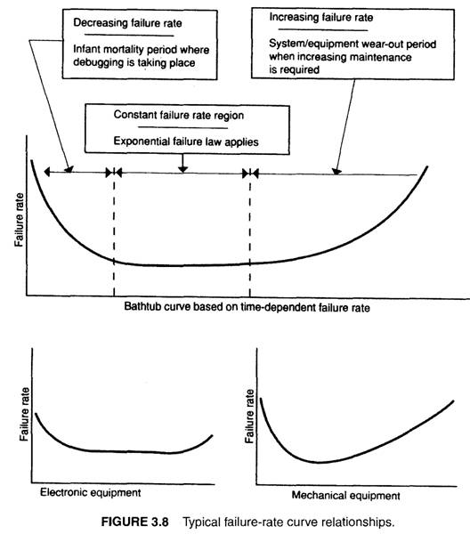
Failure Rate Over Time
“Infant morality”
Constant λ
Random failure
Electronic parts
Wear-out
λ increasing
Mechanical parts
From Blanchard, “System Engineering Management”, 4th Edition

Slide 56
Reliability Summary
Strongest influences on reliability are temperature and temperature fluctuations
Large thermal design margins give higher reliability systems
Life-cycle activity
Analysis: very little “reliability testing” to failure of modern avionics with MTBFs > 1,000 hours
Overstress testing applied to components and subsystems during development to ensure design margin, instead
Environmental stress testing applied on manufacture to find weaknesses
System integration level DT&E & IOT&E is a late (but far too frequent) time to find reliability weaknesses
O&S data gathering for design improvements

Slide 57
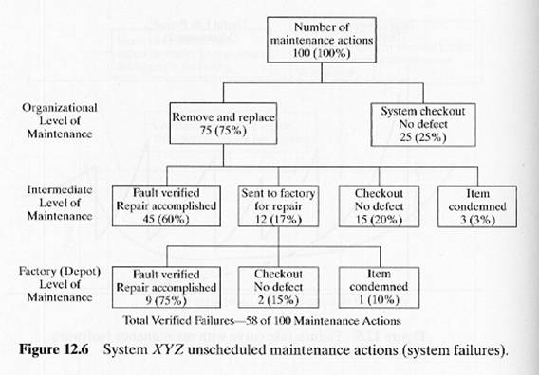
Maintenance Restores Functionality after failure
3 levels of maintenance –
“Org” (organ-ization), “Intermediate”, “Depot”
Analogous to “Home”, “Shop”, “Manufacturer”
Failures are not always con-firmed after removal (“no fault found”)
From Blanchard and Fabrycky, “Systems Engineering and Analysis”, Fourth Edition
Notes:
Original Equipment Manufacturer - OEM

Slide 58
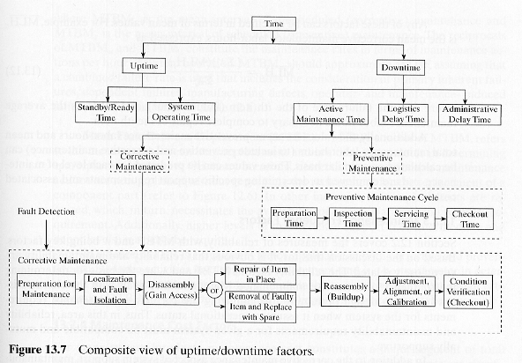
Maintenance Cycle Times
From Blanchard and Fabrycky, “Systems Engineering and Analysis”, Fourth Edition
MDT
M
LDT
ADT
System-controlled
System-dependent
Delays for personnel – related issues (assignment, strikes, other organization issues)
Waiting for spare part, test equipment, facility, transportation
Unit dependent

Slide 59
Availability
Inherent Availability A₀
Probability that system will satisfy requirements at any point in time, under stated conditions
A_{i} = MTBF/(MTBF + Mct) [Mct = mean correction time]
Characteristic only of the equipment
Suppresses preventive maintenance, administrative and logistics delays
Enables trades between MTBF and Mct
For some operations with no allowed maintenance, A_{i} = Reliability
For DARPA Urban Challenge, there’s no maintenance during the Final Event, so A_{i} = Reliability

Slide 60
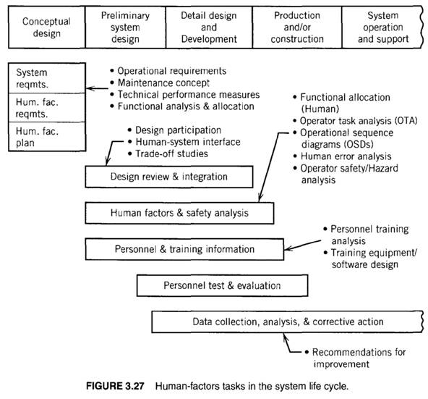
Human Factors
Job/duty/tasks
Anthropometrics
Vision
Environment
Reach/motion
Cognition and psychology
Complexity
“Non-machine” behaviors
Non-Mil; ADA accommodations
From Blanchard, “System Engineering Management”, 4th Edition
Notes:
Americans with Disability Act

Slide 61
Safety and Hazard Analysis
Goal: ensure safety of personnel involved with system
Operators, maintainers, and “casual” passers-by
Tasks
Planning and Reviews
Fault tree analysis (FTA)
Hazard identification
Causes
Effects
Classification
Rate of occurrence
Corrective/preventive measures
Similar to (and uses) FMECA
Risk analysis
Data collection and analysis
Safety Training
Safety Test and Evaluation
Notes:
Failure Modes/EffEcts Criticality Analysis

Slide 62
Security
Design for intended operators, balanced with…
Design against unauthorized users and threats
Physical security – access control
Anti-tampering – passive
Detection and annunciation
Some similarities regarding protection against electronic/ information attacks (viruses, denial of service)
Define and protect system boundaries (points of entry)
Information Assurance / Security
Balance Confidentiality, Integrity, Availability (CIA)
Certified Information Systems Security Professional (CISSP) (Cf. http://en.wikipedia.org/wiki/CISSP )

Slide 63
Producibility / Manufacturability
Considerations
Can it be made? – Technical feasibility
With acceptable costs? – Economic feasibility
With what impacts? – Sustainability feasibility
On workers
On environment
During manufacturing

Slide 64
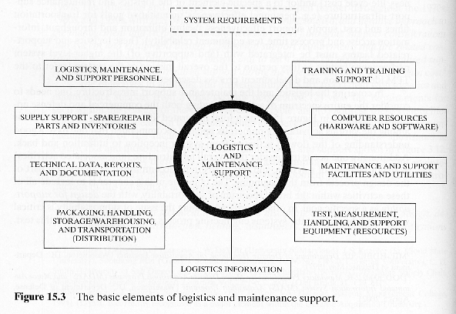
Elements of Logistics and Supportability
Much more than the “system” being supported
People
People
Spares and Consumables
Information Infrastructure
Technical Data
Plans
Physical Infrastructure
Transportation and Handling
Repair Infrastructure
From Blanchard and Fabrycky, “Systems Engineering and Analysis”, Fourth Edition
Experience Data and Communications

Slide 65
Quality
Old: “Inspect quality in” – Big feedback loops
Current: “Total Quality Management” and equivalents
TQM is a total integrated management approach that addresses system/product quality during all phases of the life cycle and at each level in the overall system hierarchical structure.
Elements
User satisfaction (not just meet requirements)
Continuous improvement
Minimize variation
Enterprise activity
Much more in lecture 8 ff…
See also “CMMI”

Slide 66
Environmental Engineering: Green Production – Closing the Cycle
Reduce waste by aligning costs and benefits
Raw Materials –
Profit to producer
Finished
Product –
Profit to producer
Manufacturing “waste”
Tailings
Disposal, Reuse, or Recycle? Profit? Costs?
Operations “waste”
Operations and Support Materials – Profit to user and suppliers

Slide 67
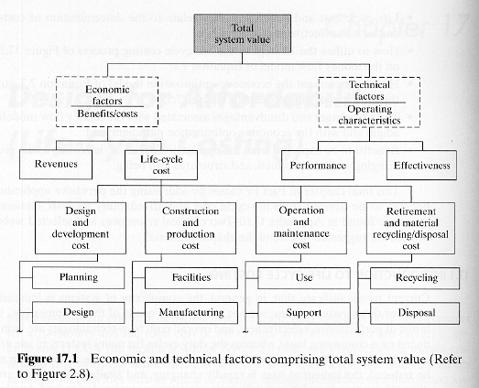
Affordability & Life-Cycle Costing
Why do we care about life-cycle cost?
Operations and support vs. acquisition
Time value of money
Disposal vs. manufacturing
From Blanchard and Fabrycky, “Systems Engineering and Analysis”, Fourth Edition

Slide 68
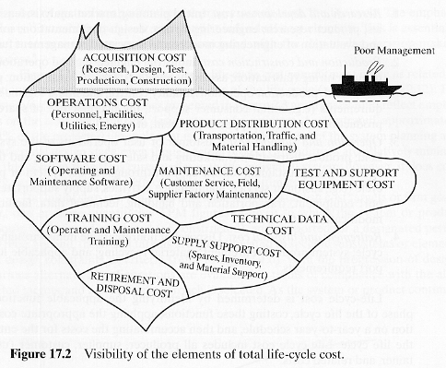
Hidden Future Costs
Tendency to ignore future O&S costs – Why?
Out-years are “not my problem”
Limitations on acquisition funds may force known acceptance of higher LCC
From Blanchard and Fabrycky, “Systems Engineering and Analysis”, Fourth Edition

Slide 69
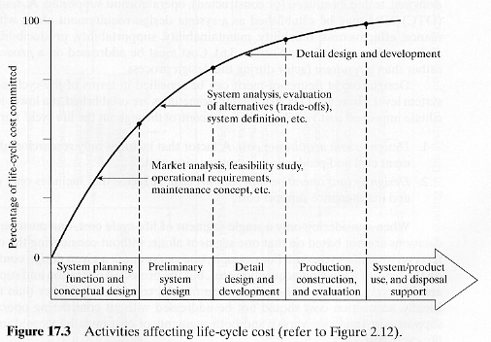
Cost Considerations in the System Life Cycle
Future LCC fixed early in product develop-ment cycle
From Blanchard and Fabrycky, “Systems Engineering and Analysis”, Fourth Edition

Slide 70
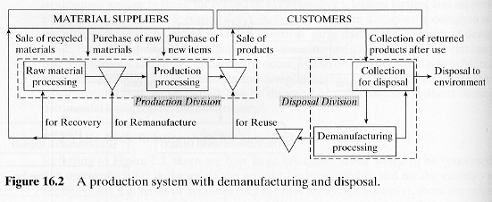
Demanufacturing & Disposal
Enable “disassembly” and
Reuse
Recycle / remanufacturing
Recovery of materials and components
Example: Grinding vs. burning stumps
Disposal is a last resort
From Blanchard and Fabrycky, “Systems Engineering and Analysis”, Fourth Edition

Slide 71
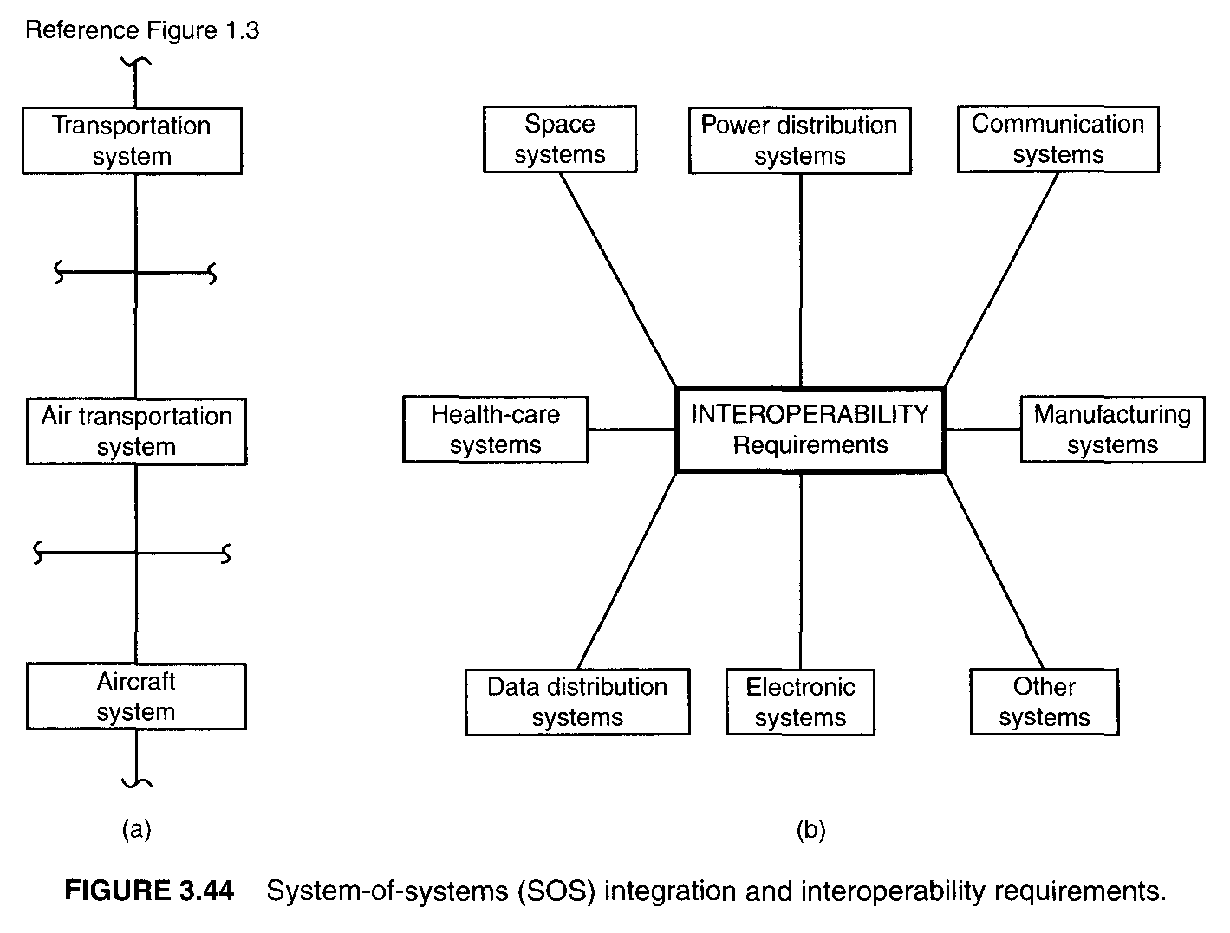
Interoperability
System element life-cycles have different time-lines
Technology upgrades
Support infrastructure
Associated systems
Need to “expose” and control internal interfaces to enable “system-of-system” behavior and interoperability
From Blanchard, “System Engineering Management”, 4th Edition

Slide 72
Electromagnetics (E³)
Electromagnetic effects are based on the combination of radiated and conducted electrical signals
Operations of most electronic devices both affect and are affected by the local electromagnetic fields
Standards affect consumer products
Systems composed of hundreds and thousands of electronic components and wiring must ensure
EM compatibility (no self-jamming)
Acceptable EM susceptibility – ability to operate in local environment
Acceptable EM emissions – limits on what is produced
Affects physical placement of electronics and wiring
Some group must keep track of all of this; verify & provide guidance
Might be important for Urban Challenge, including E-stop
Notes:
Electromagnetic Environment Effects

Slide 73
Mass Properties
System level needs to account for total weight and distribution of weight
Each element will be allocated weight as part of requirements
Location of element (determined by system design) determines distribution of weight
Some group must keep track of all of this
Total weight = sum(weights)
Center-of-mass= sum(weight x distance)
sum(weight)

Slide 74
3.4.2.3 Integrating Specialties
Describe how the specialists are organized and deployed, their specific roles, responsibilities, authority, accountability, and how they are integrated across the organization (vertically – a single specialty throughout the whole organization, or horizontally – all the specialties at a given level)

Slide 75
Example SEMP – GLAST / LAT
Gamma-ray Large Area Space Telescope / Large-Area Telescope
Review / discuss TOC, 4.1, 4.2, 4.2.3, 4.2.6, 5.1 regarding “Organization”
What is provided?
What appears to be missing? What risks are generated?
Note roles of ISE and other teams

Slide 76
Questions for Tonight?
Next week
Reading as Assigned in Syllabus – ISEH 4
Homework 3 - SEMP Section 3
Read Lecture 3: Technical Processes
Following week: Lecture 4 Technical Planning and Assessment
Reading: ISEH 5.1, 5.2, 5.7
Homework 4 - SEMP Section 4
End – Good night!

Slide 77
Program Completed
Missouri University of Science and Technology
© 2011-2020 Curators of University of Missouri

