Slide 1
SysEng 6542 MBSE Technical Paper Review
Ryan Patton
A Case Study on NASA MBSE Practices

Slide 2
FUELEAP/Pathfinder Cases
FUELEAP – aims to cultivate new concepts and capabilities that can lead to innovative design concepts and breakthrough technologies that will transform the aviation industry
Heavy-fuel SOFC-powered aircraft
2017 – Present (Ongoing)
Pathfinder – aims to develop and advance MBSE capability across NASA, apply MBSE to real NASA issues, and capture issues and opportunities surrounding MBSE
Implemented in FY16 as the first of its kind by the NASA Engineering Safety Center (NESC) SE TDT
Used to develop modeling products for a campaign (Program) of crew and cargo mission (Projects) to establish a human presence on Mars utilizing In-Situ Resource Utilization (ISRU).

Slide 3
FUELEAP Objectives
Clearer Identification of the Project Needs, Goals, and Observations (NGOs)
Improved Communication Through the Use of Formal System Models
Better Preparation for Life-Cycle Reviews
Easier Identification of the Interdependencies Between Project Elements (i.e., The Relationship of Requirements to Physical Aircraft Subsystems, The Interfaces Between Subsystems, etc.)

Slide 4
Pathfinder Goals
Goal 1: Demonstrate system modeling for mission architecture use and reuse for a human to Mars campaign of missions
Objective 1: Model Organization
Objective 2: Parametric Analysis
Objective 6: Model Libraries
Goal 2: Mature the “Extensive ISRU” campaign from the architecture/mission design analysis toward a Program SRR by producing systems engineering products in a model-based way.
Objective 5: Reviews
Goal 3: Understand, Demonstrate, and Apply Concepts of Model Re-Use
Objective 7: Design Patterns
Goal 4: Learn configuration management and collaboration best practices with respect to modeling and assess export capabilities of tools.
Objective 3: Collaborative Modeling and Configuration Management
Objective 4: Model Export Capability

Slide 5
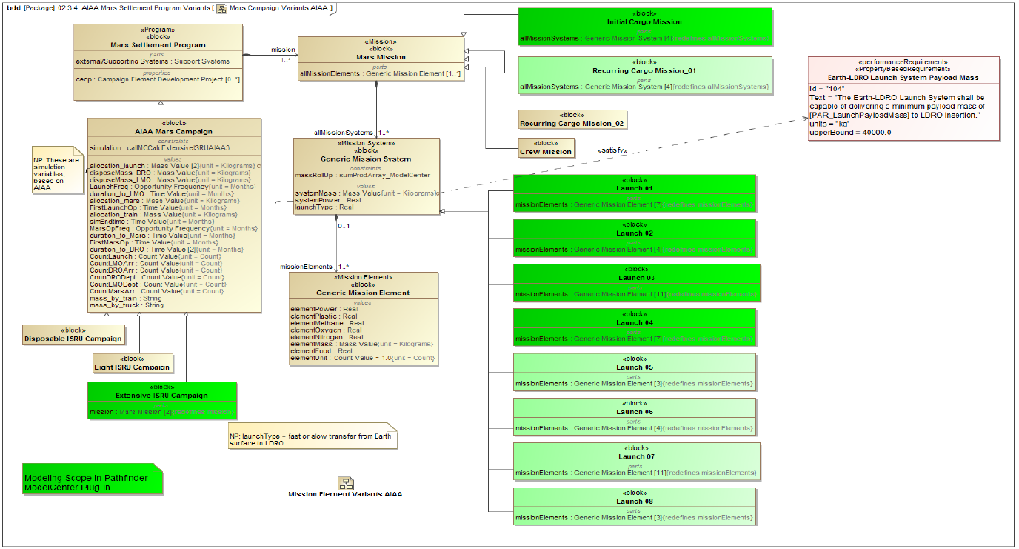
Modeling Efforts Example
Mars Campaign Model for Parametric Analysis

Slide 6
Results/Lessons Learned
FUELEAP SE Team: modeling requirements in SysML can quickly become cumbersome, capturing formal requirements and tracking them at a high-level only worth it – makes more sense for aeronautics than astronautics systems
Pathfinder Team:
Accomplishments by Goals
Goal | Goal Text | Accomplishments
1 | Demonstrate system modeling for mission architecture use and reuse for a human to Mars campaign of missions. The system modeling would be done at the campaign and mission level | The team demonstrated system modeling by developing numerous models for a Mars Campaign and Missions to take ISRU cargo to the Mars surface Some of the developed models can be reused by other teams and are in a model library, as part of final deliverables. The team acquired knowledge of, as well as developed some lessons learned and observations regarding model organization for a (Program) Campaign of Missions. The team performed sensitivity analyses at the campaign level for two factors (mass limits for a particular launch, slips/delays in launch dates).
2 | Mature the Extensive ISRU campaign from the architecture/mission design analysis toward a Progam SRR by producing systems engineering products in a model based way. | The team developed 11 model based systems engineering products for the Extensive ISRU Mars Campaign. The model based systems engineering products generated represent a subset of lifecycle review products for a Program SRR, Program SDR, Mission level CMR, and Mission level SRR.
3 | Understand, demonstrate, and apply concepts of model reuse | The team acquired knowledge of and, to some extent, applied model reuse as we developed our model based systems engineering products at the Campaign and Mission levels. The team demonstrated model reuse by developing a model library that contains several reusable modeling assets.
4 | Learn configuration management and collaboration best practices with respect to modeling and assess capabilities and tools. | The team acquired knowledge of, as well as developed numerous lessons learned and observations regarding configuration management and collaborative modeling. The team assessed the Document Modeling plugin and utilized it in the generation of the final report.

Slide 7
Future
FUELEAP – hopes to add on to existing models
System safety analysis, including FMEA and FTA, for the integrated SOFC power system
Complete aircraft FHA
Feasibility analysis of the integrated heavy fuel hybrid-electric SOFC power system as a transformational source of airborne power, using research-defined objective performance criteria as threshold values for feasibility
Pathfinder
Continue to mature and advance the demonstrated parametric capability associated with performing trade analysis for a Mars Campaign
Creating an Agency wide collaboration space for MBSE
Developing common and reusable assets
Further refining model governance principles
Establishing a MBSE “boot camp”
Ascertaining the concepts of model Verification and Validation

Slide 8
Questions?

