Slide 1
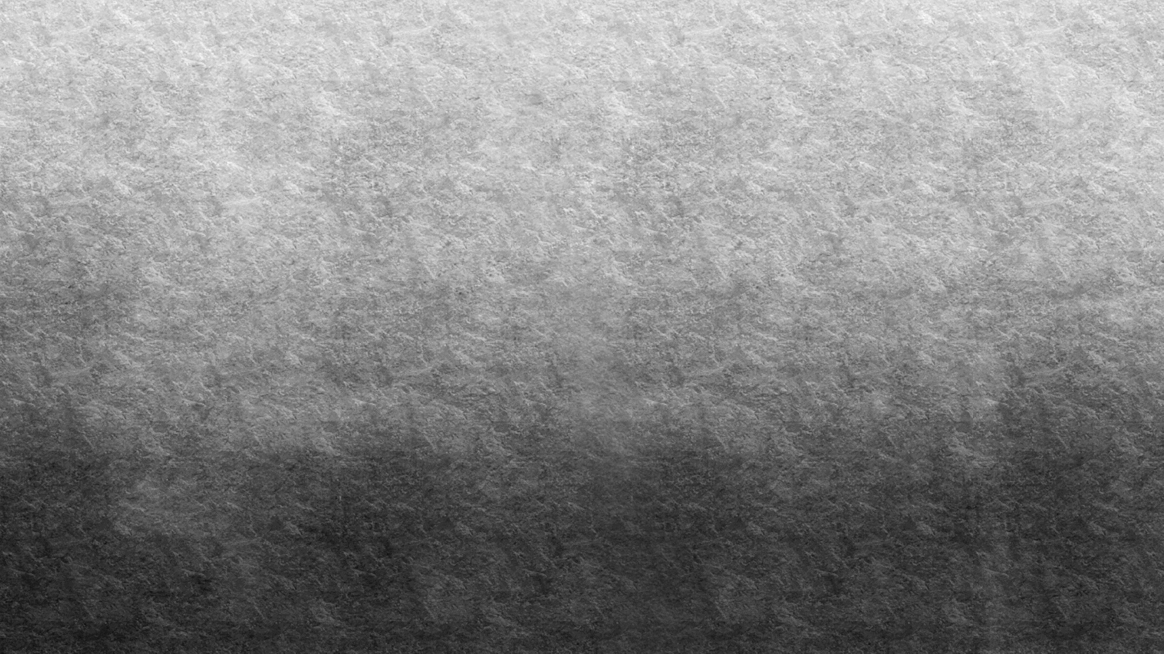
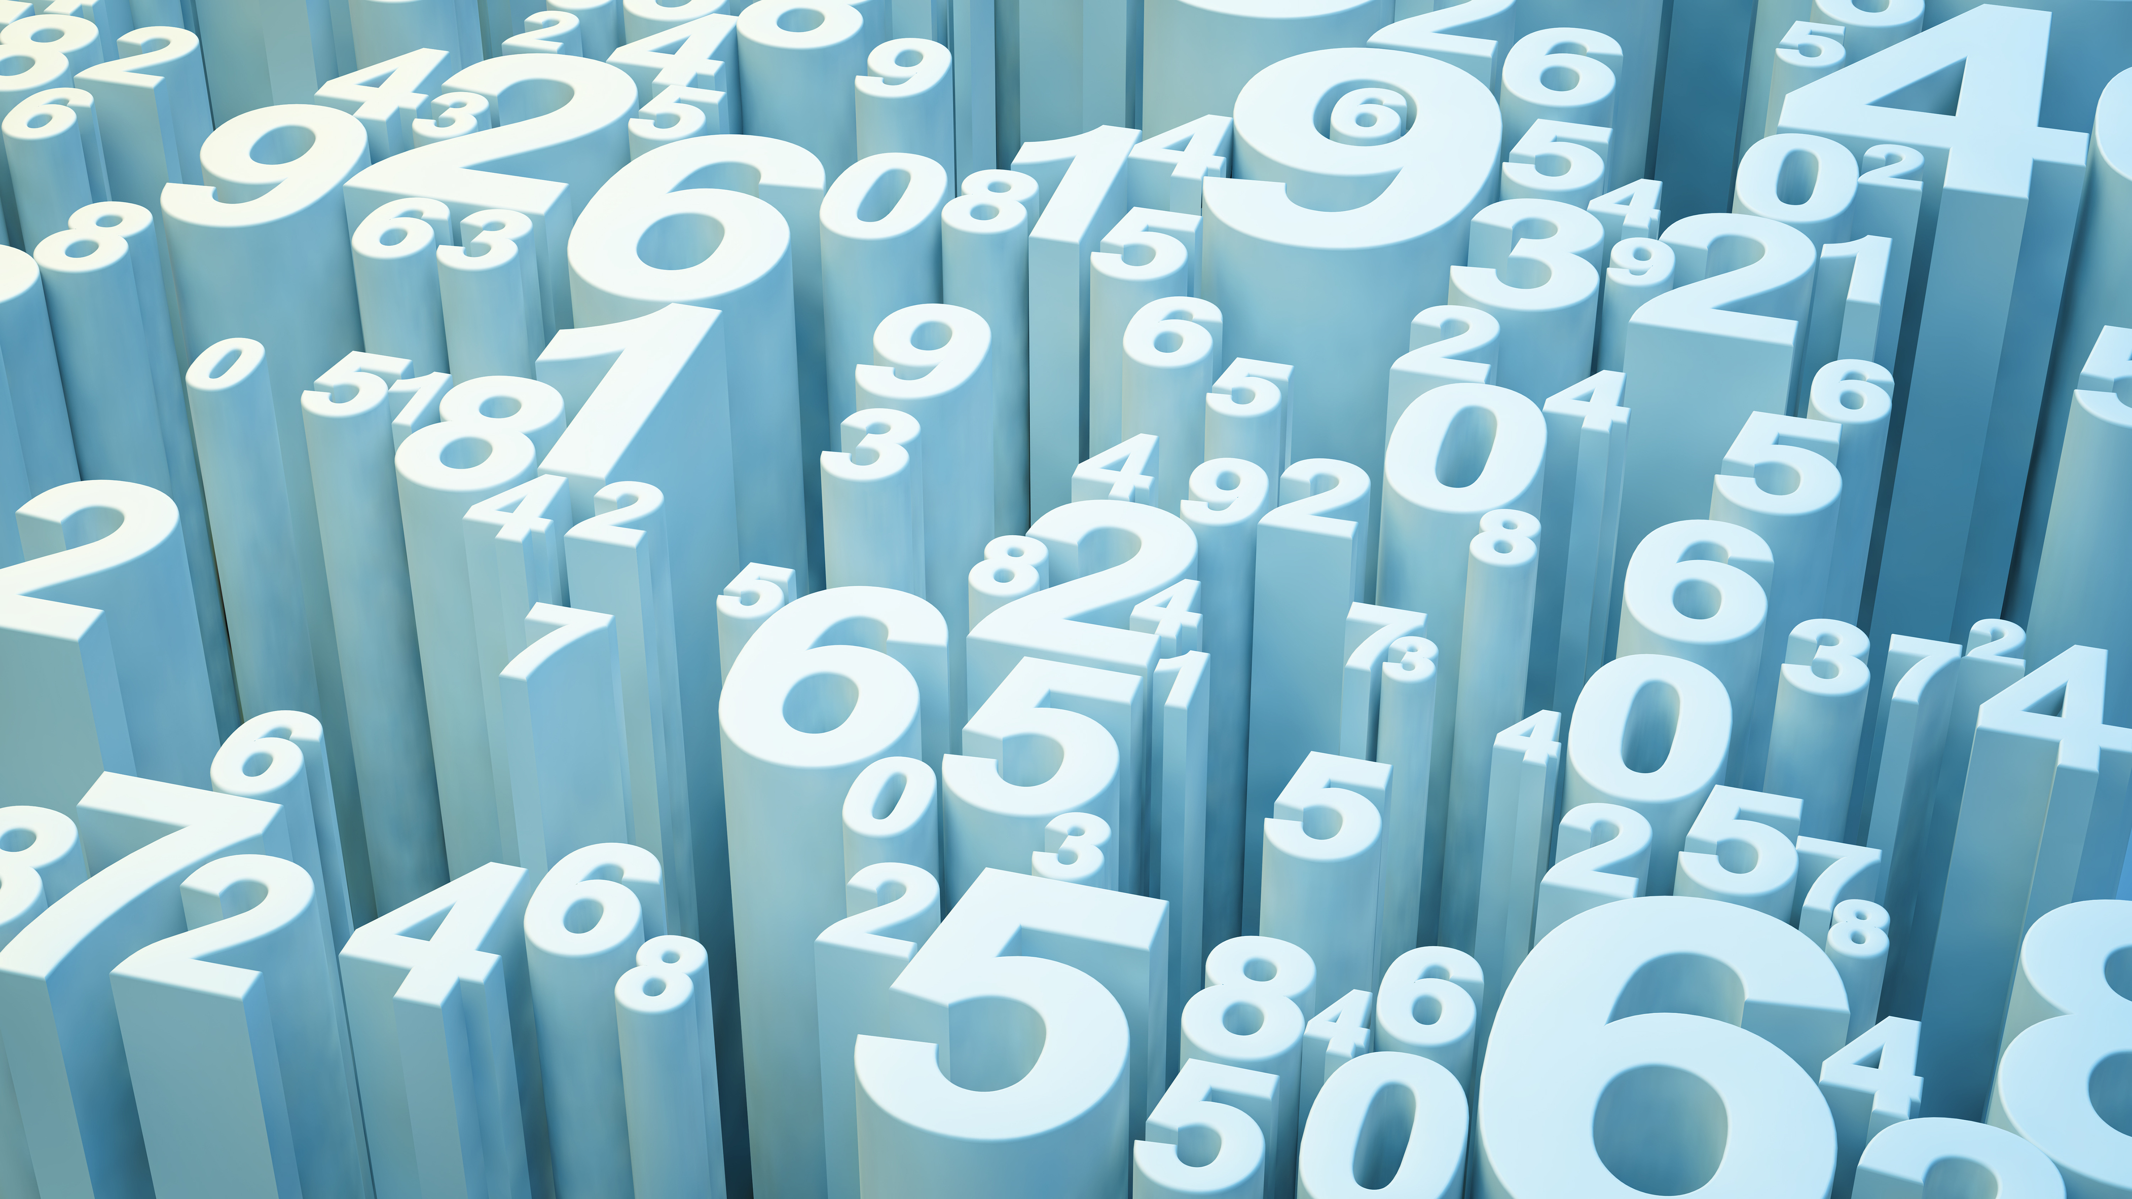
HOUSE PRICING
RATAN TEJA PUNATI

Slide 2
DATA SUMMARY

Slide 3
DATA PARTITION

Slide 4
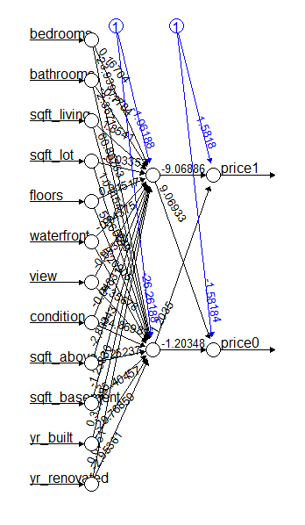
FULL NEURAL NETWORK MODEL

Slide 5
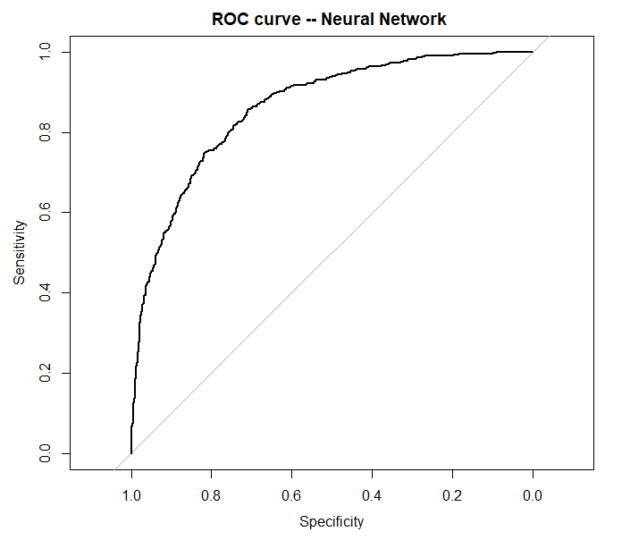
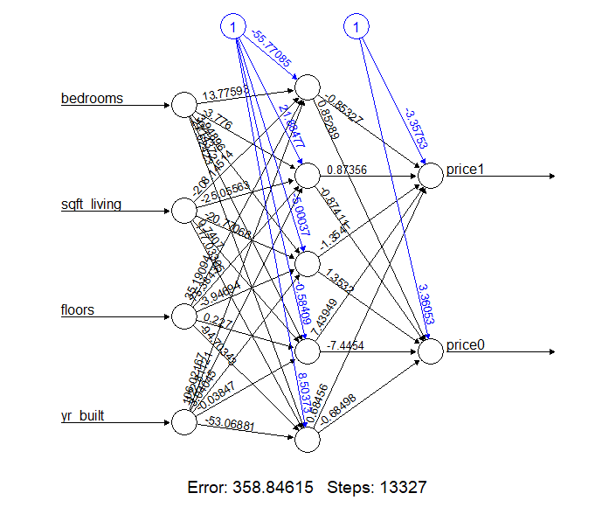
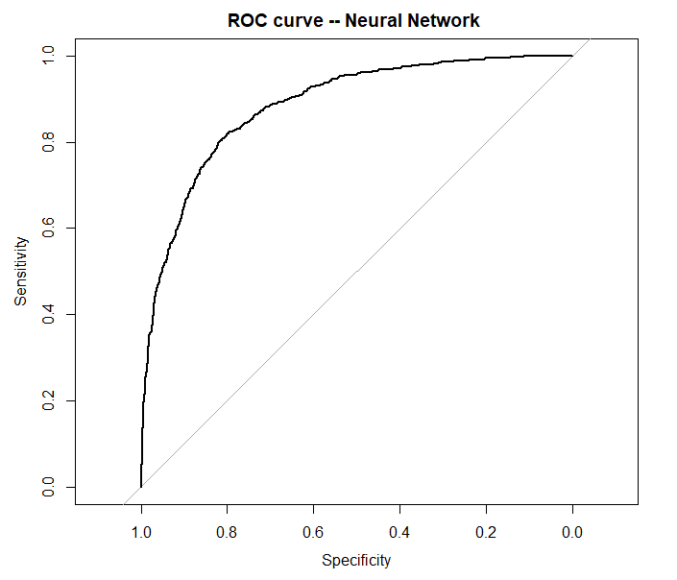
BEST MODEL

Slide 6
CONCLUSION
The best neural network model has 4 features. This best model can be used to estimate the Price of houses depending on various features, such as bedrooms, sqft_living, floors, year built with 1 hidden layer of 5 neurons.

