Slide 1

House Pricing
Ratan Teja Punati

Slide 2
Data Summary

Slide 3
Data Partition

Slide 4
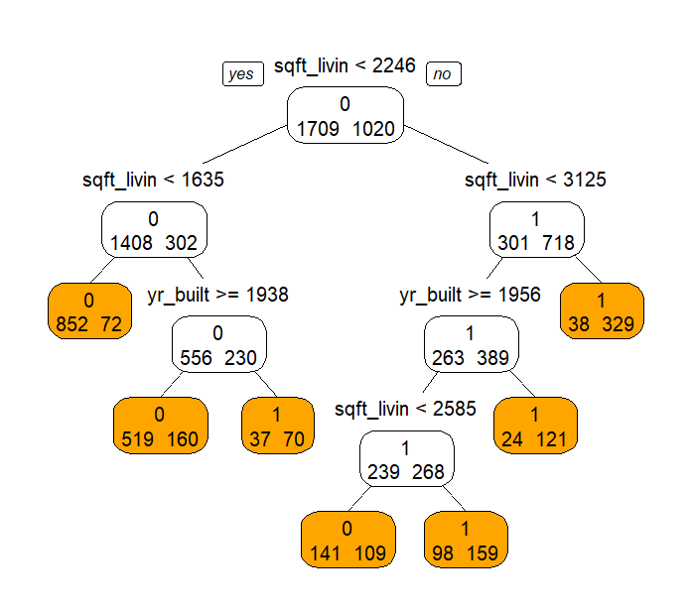
SINGLE CLASSIFICATION TREE

Slide 5
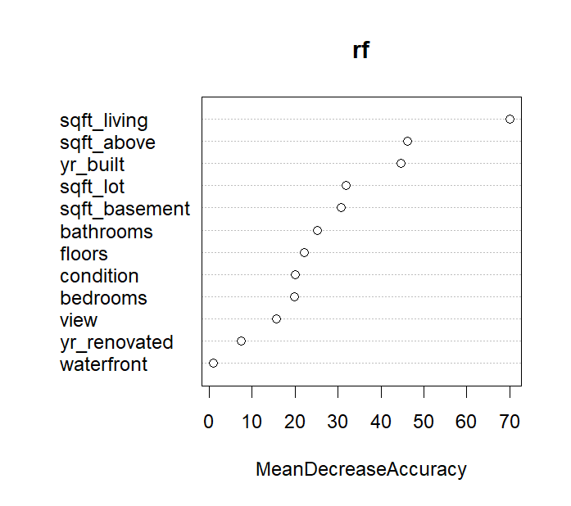
RANDOM FOREST

Slide 6
BAGGING MODEL

Slide 7
Comparison of LR, NN and Tree
Model | Training Accuracy | Training Sensitivity | Training Specificity | Validation Accuracy | Validation Sensitivity | Validation Specificity
Logistic Regression | 78.20% | 63.09% | 86.78% | 77.09% | 59.73% | 87.27%
Neural Network | 81.57% | 73.63% | 86.31% | 78.85% | 71.68% | 83.17%
Decision Tree | 80.29% | 66.57% | 88.47% | 79.18% | 66.42% | 86.87%
Random Forest | 97.11% | 93.53% | 99.24% | 80.11% | 69.64% | 86.43%
Bagging Model | 99.60% | 99.41% | 99.71% | 78.79% | 69.93% | 84.14%

